Slide 1
Web Traffic Time Series Forecasting
Kaggle Use Case

Slide 2
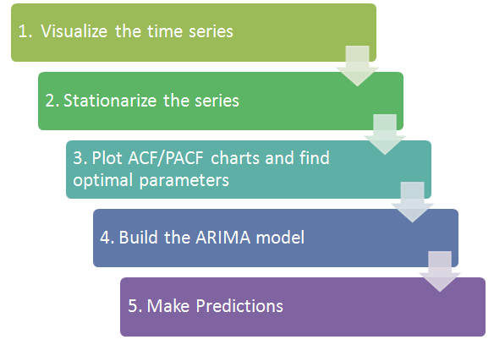
The process:

Slide 3
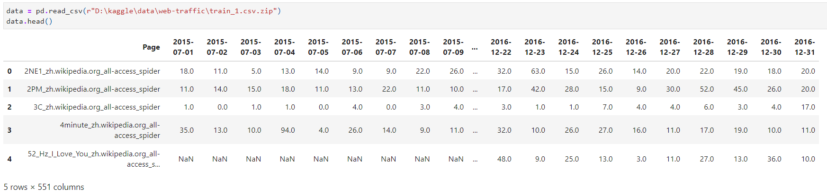
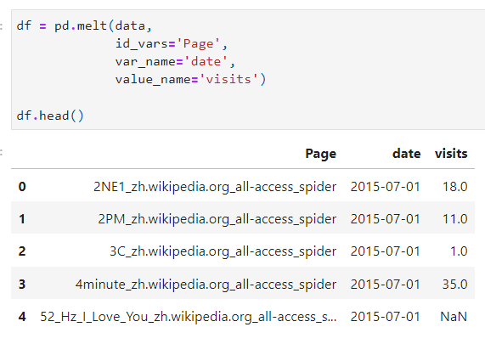
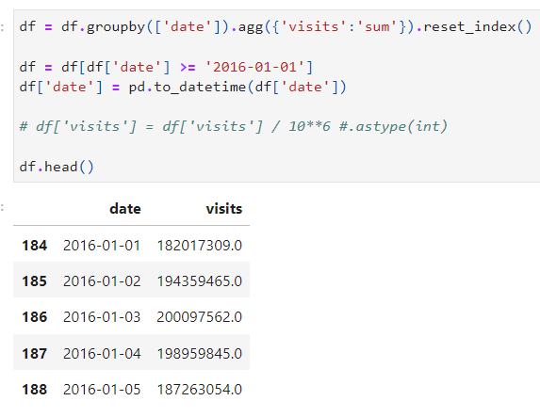
The Data:

Slide 4
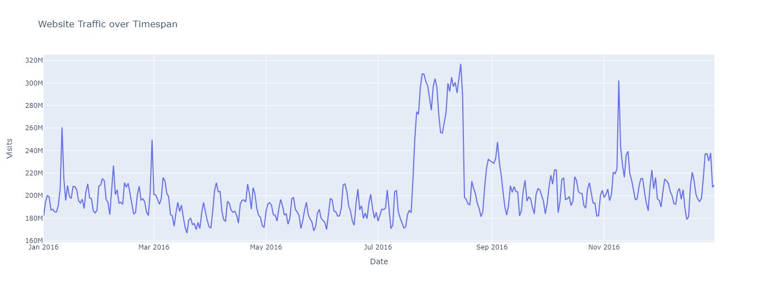
Visualize the data:

Slide 5
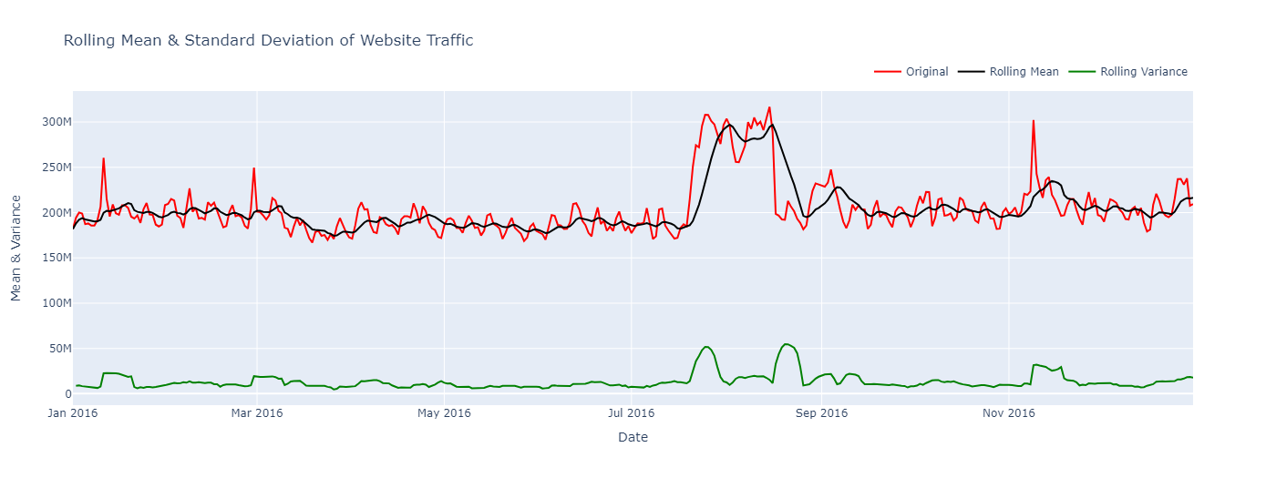
Check for Trend

Slide 6
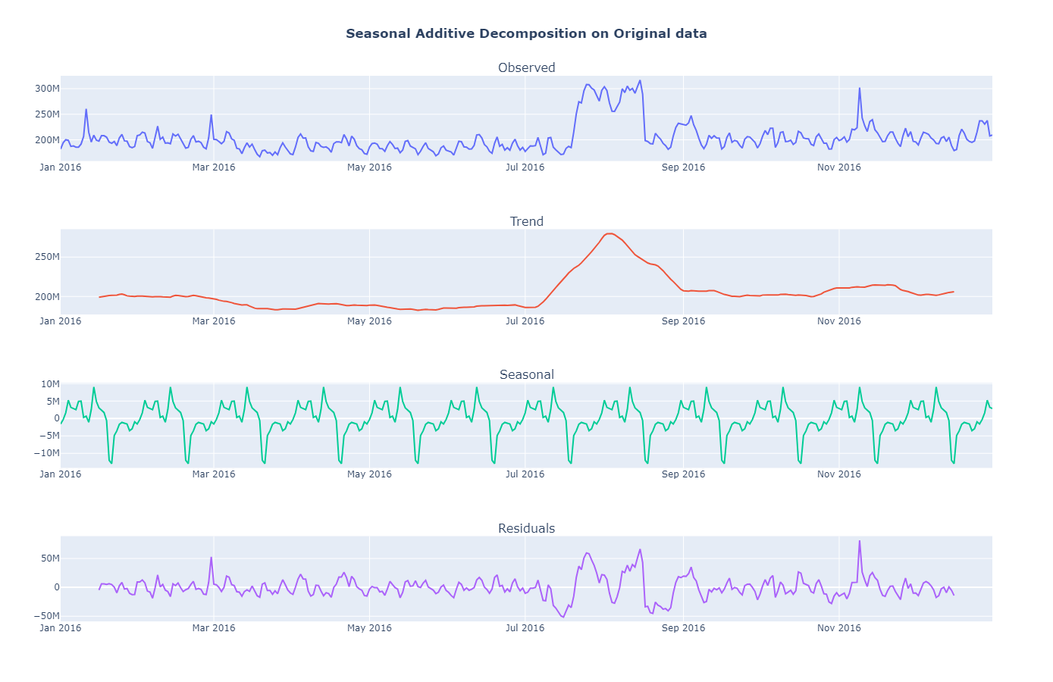
Check for Seasonality :

Slide 7
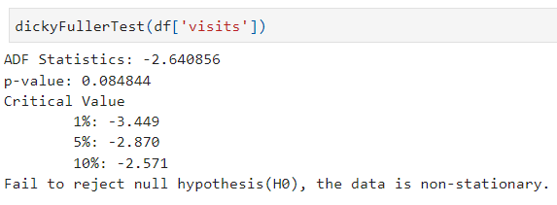
Augmented Dickey-Fuller (ADF) Test:

Slide 8
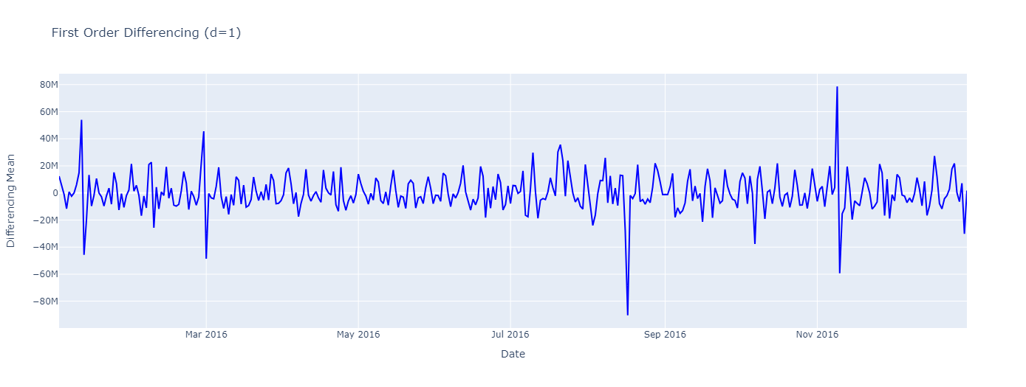
Differencing Method :

Slide 9
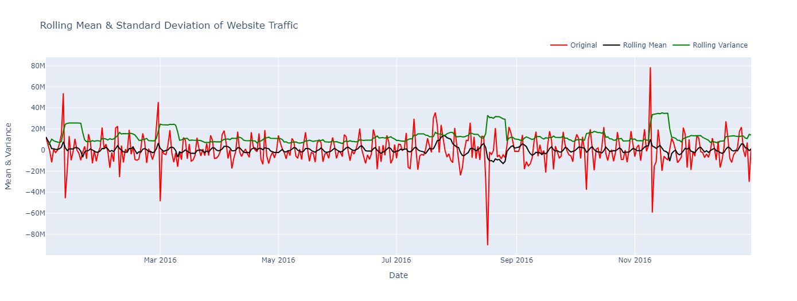

Slide 10
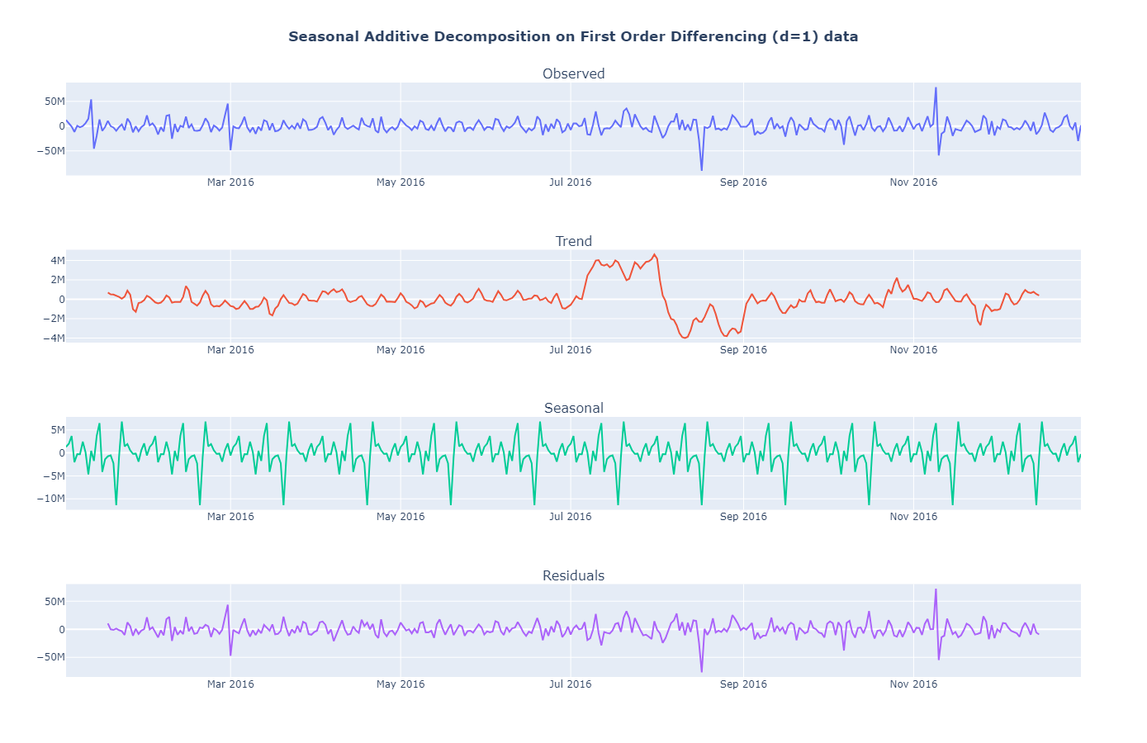
The seasonal frequency (m) identified is 12, indicating a monthly-wise series.

Slide 11
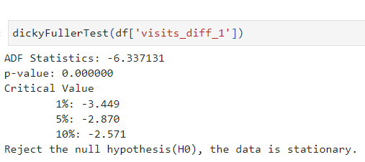
Augmented Dickey-Fuller (ADF) Test:

Slide 12
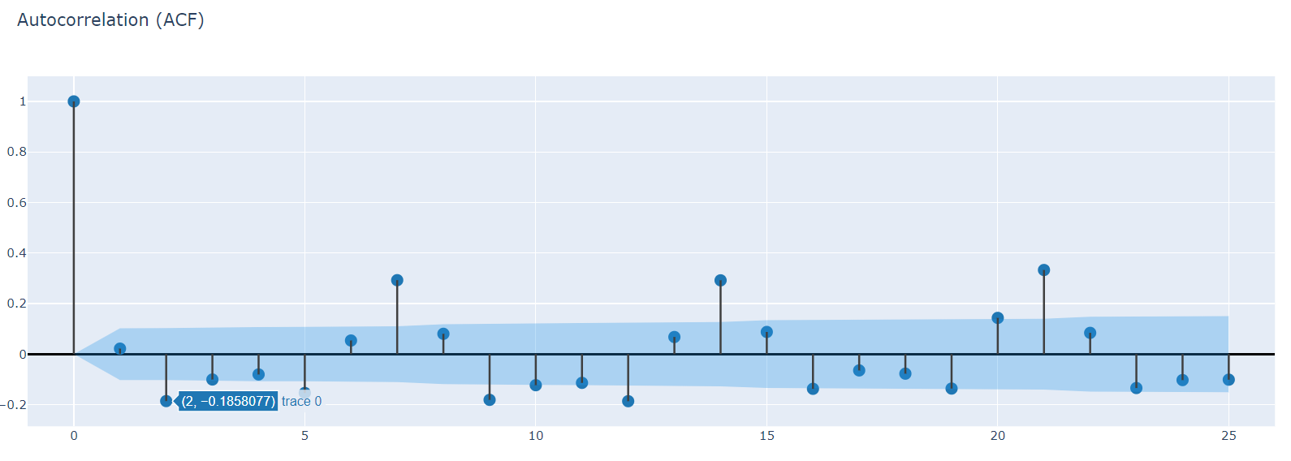
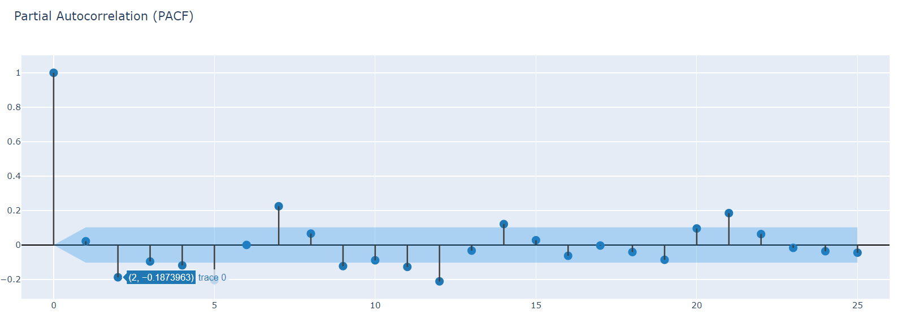
Autocorrelation Analysis
q=2
p=2

Slide 13
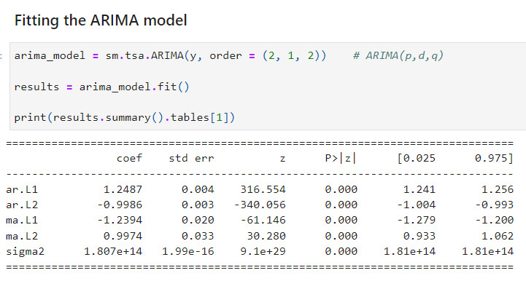
Time Series Forecasting – ARIMA (p, d ,q)
Fitting the ARIMA(p, d, q) model with order ARIMA(2, 1, 2) from above analysis.

Slide 14
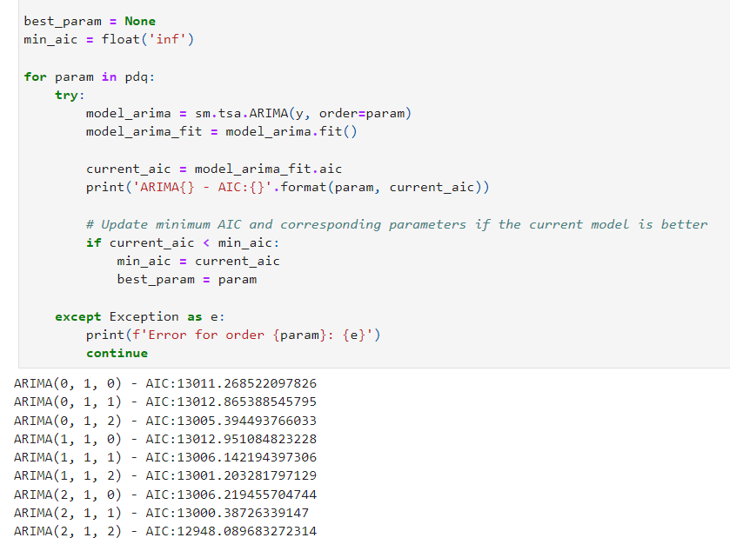
Also, finding the best order for ARIMA(p, d , q)

Slide 15
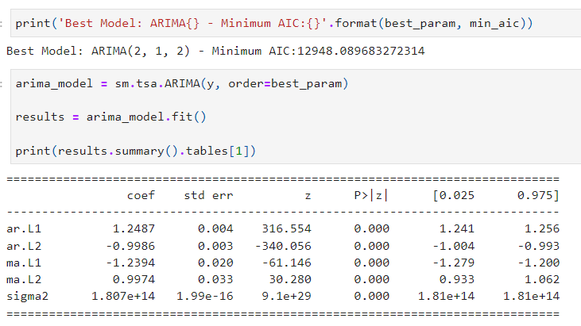
best order found out to be
p=2, d=1, q=2

Slide 16
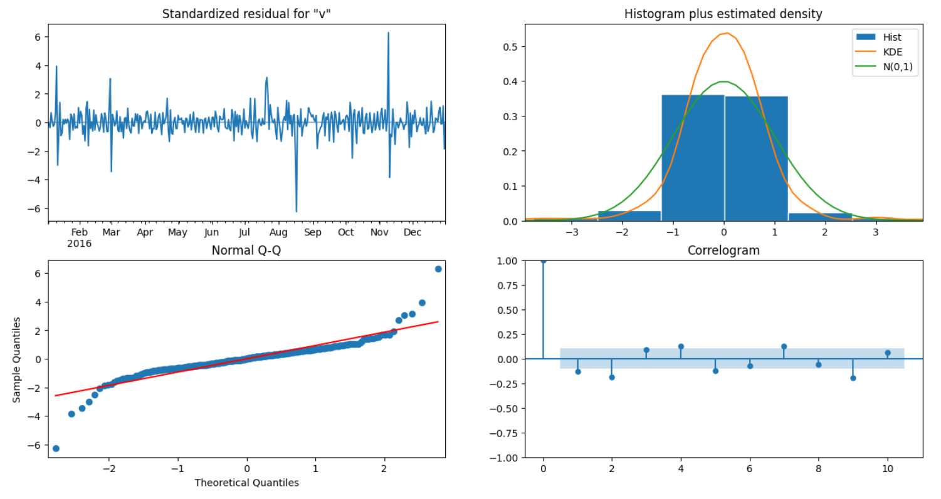
Interpret the Plot Diagnostics ?

Slide 17
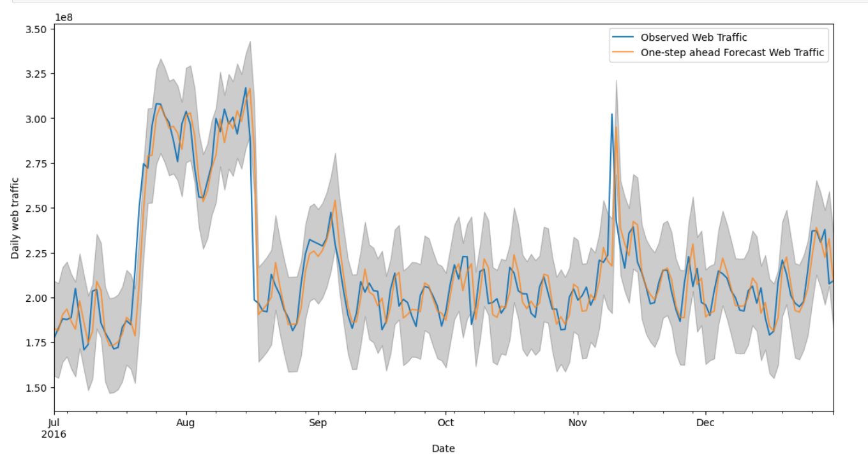
Validating Forecast (Interpolation)
The Mean Squared Error of our forecasts is 261592157080111.44
The Root Mean Squared Error of our forecasts is 16173810.84

Slide 18
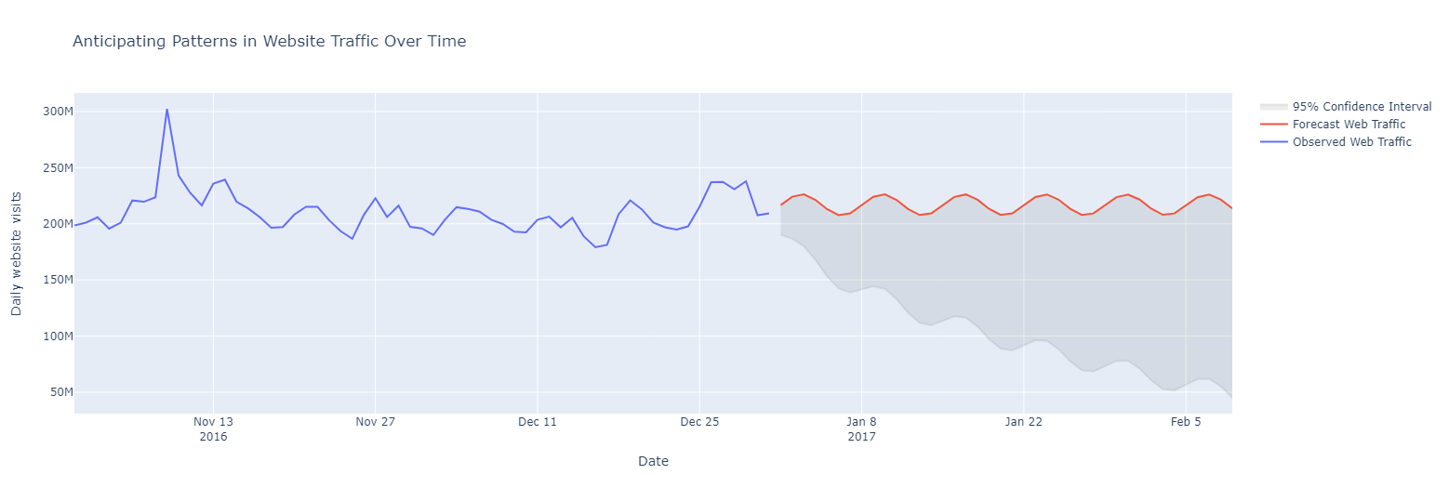
Producing & Visualizing Forecasts (Extrapolation)

Slide 19
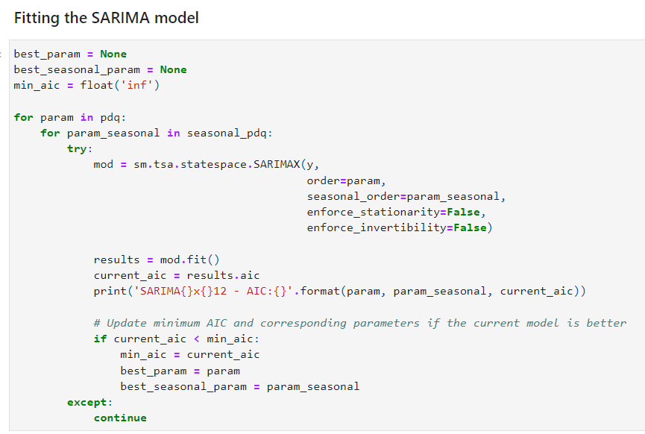
Time Series Forecasting – SARIMA (p, d, q, m)

Slide 20
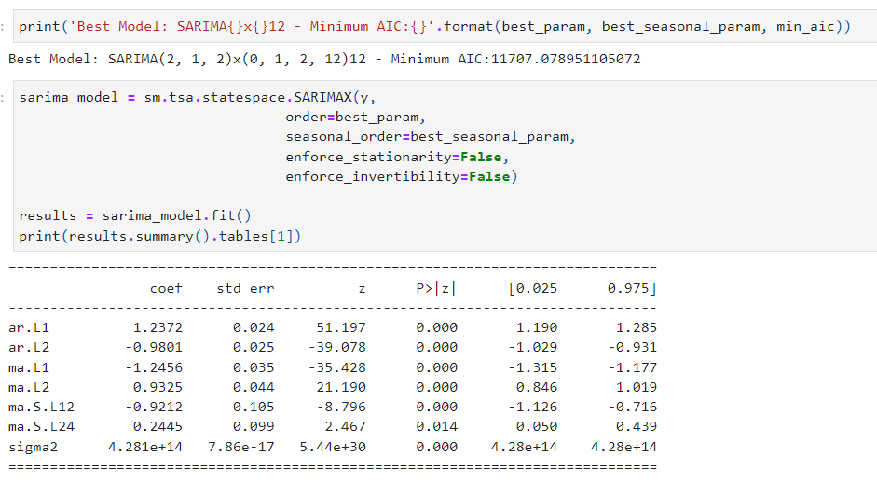
Finding the best order for SARIMA(p, d , q, m)
best order
p=2, d=1, q=2
& m=12

Slide 21
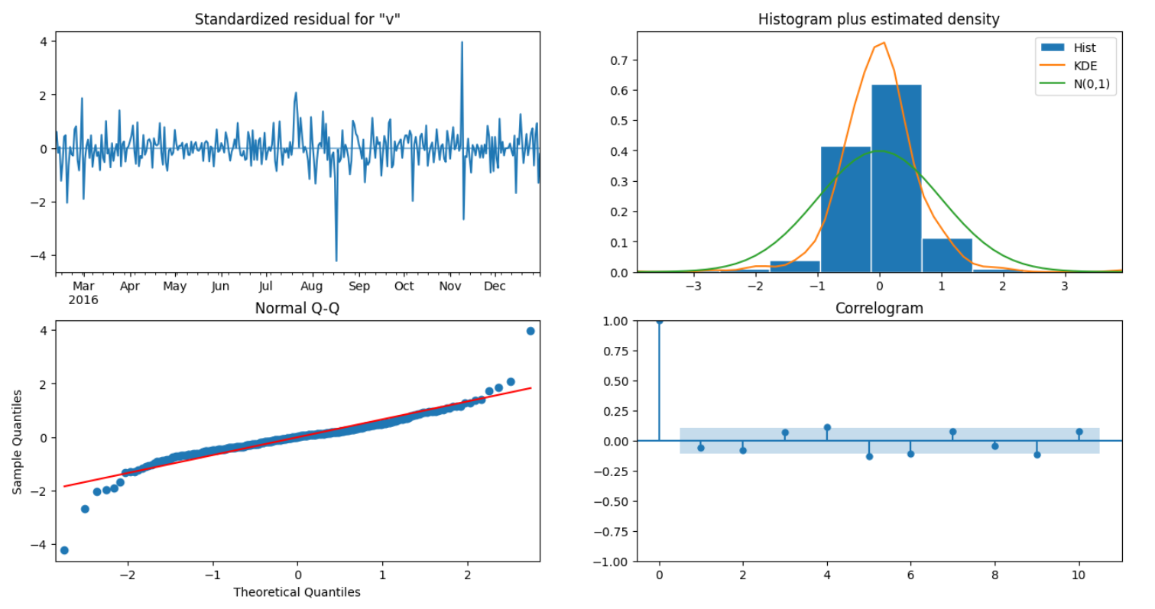
Interpret the Plot Diagnostics ?

Slide 22
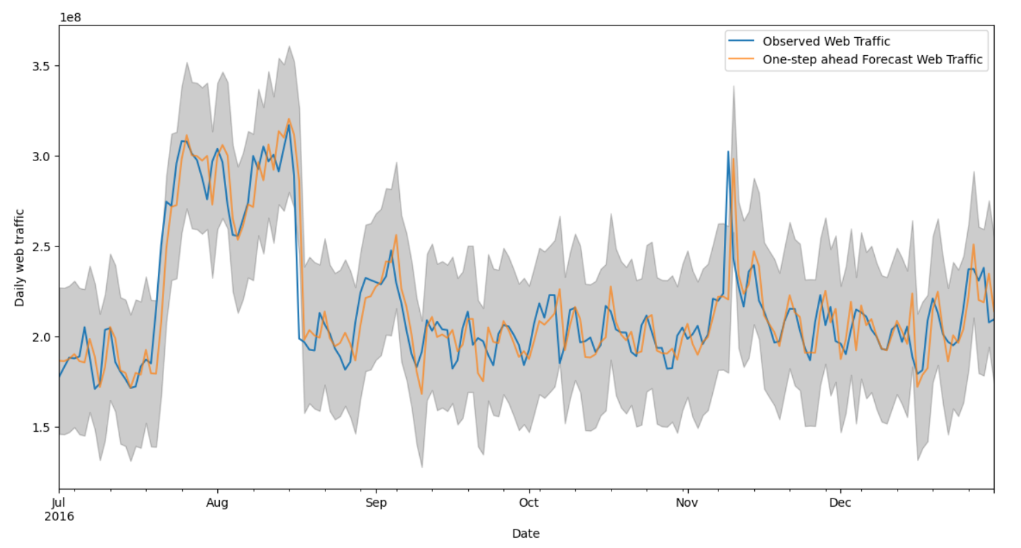
Validating Forecast (Interpolation)
The Mean Squared Error of our forecasts is 460239255099706.6
The Root Mean Squared Error of our forecasts is 21453187.53

Slide 23
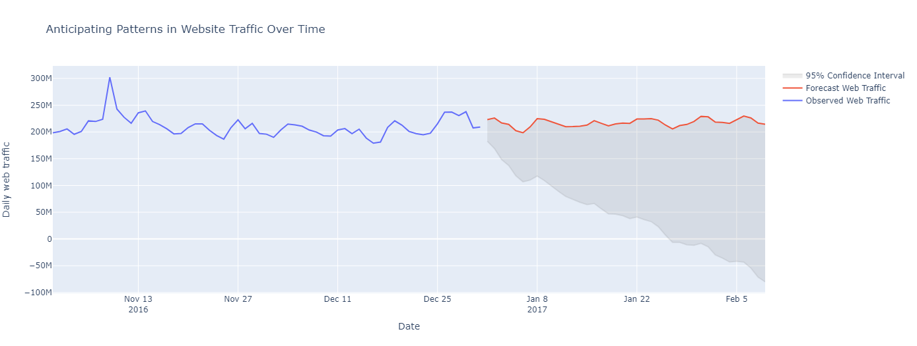
Producing & Visualizing Forecasts (Extrapolation)

Slide 24
Thank you !

