Slide 1
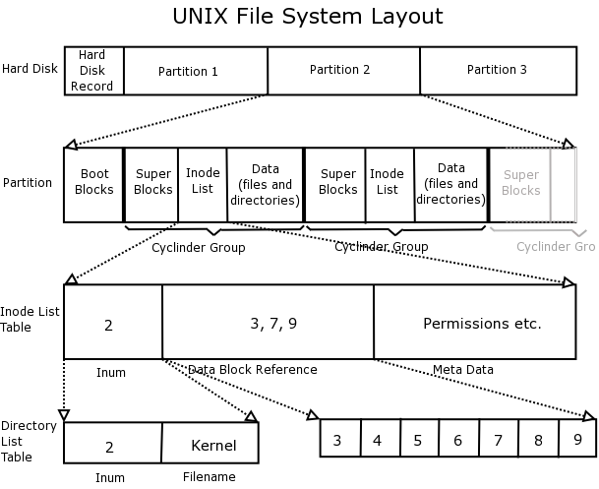

SLASH2
File system for Wide-Area Storage Management
Pittsburgh Supercomputing Center
Paul Nowoczynski, Jared Yanovich, Zhihui Zhang

Slide 2
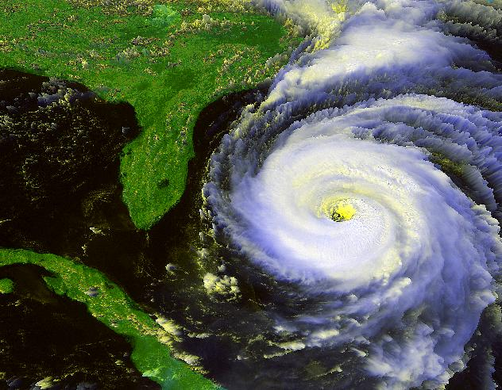
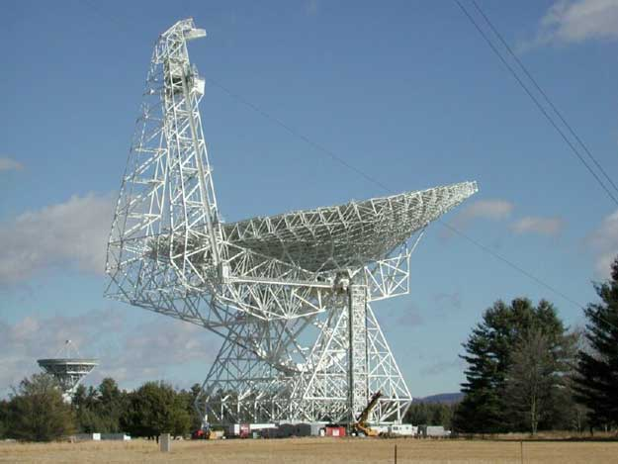
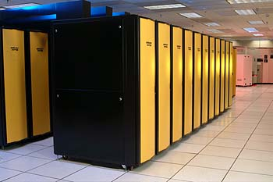
Need for Wide Area Storage Mgmt
Geographic replication for valuable data (when one site isn't enough!)
Data generation and analysis often occur at different sites: (LHC, LSST, Green Bank, etc.)

Slide 3


Need for Wide Area Storage Mgmt
Cloud Computing
  Maintaining storage environment for applications regardless of run-time locale
  Intelligent staging and shipping of input and output data
Distributed Research Collaboration
Presenting a common work environment regardless of location

Slide 4
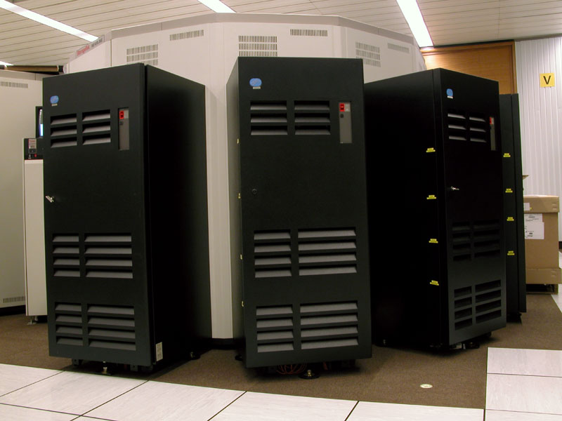
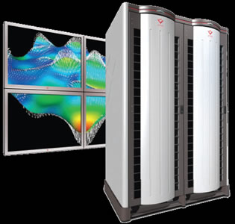
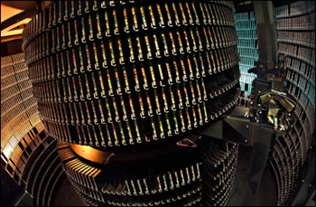
Wide Area Storage Mgmt within HPC
Data Set Migration
Archival storage local or remote
Post-processing systems visualization, data analysis
A supercomputer with available cycles
Site 'A'
Compute and Archival Storage
Site 'B' Visualization
Site 'C'
Mass Storage

Slide 5
Issues with the current HPC model
Majority of the effort is forced upon the user:
  Dealing with environmental inconsistencies
  Managing data transfers
  Replica management
System-managed operations exist in limited capacity
  iRODS is an exception
Limited availability of transparent file operations
  No “global filesystem” which binds storage resources
  Files must be staged in from remote sites

Slide 6
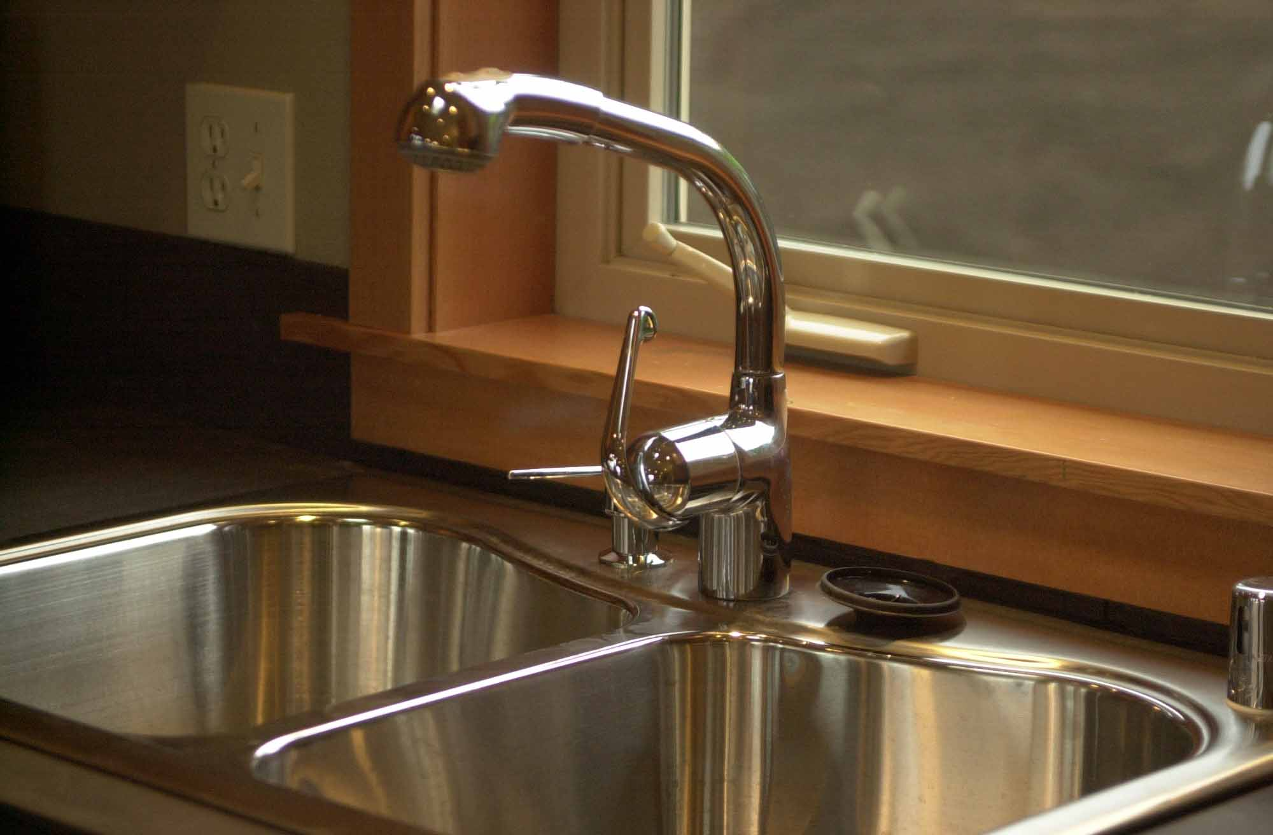
Objectively speaking..
What do (HPC) users / applications want?
Universal namespace
Global data access through standard APIs
  POSIX
Local performance (when necessary)
  Implies tight integration with relevant storage resources
System-managed data transfers
  Fully utilize storage and network bandwidth
  No babysitting!

Slide 7

The reality
Providing system level uniformity across disparate storage resources is a tall order.
Many dimensions of heterogeneity exist
  Varying from the technical to the political

Slide 8
Today's Tools and Methods
Either too much or not enough..
High-level data mgmt interfaces
  Data movers (i.e. gridftp, scp)
  External replica management
Low-level interfaces
  Adapting parallel filesystem technologies to the WAN (MC-GPFS, Lustre)

Slide 9
High-level Storage Mgmt Tools
Much of the hard work is placed onto the user:
  Managing data transfers
  Monitoring for failed transfers and issuing retries
  Verification of file integrity
  Adapting to the tools required for data transfer
    Forced to learn new APIs

Slide 10
High-level Storage Mgmt Tools
Difficult to achieve good performance
  When transferring multi-terabyte data sets, good performance is critical.
  Parallelization or striping across multiple endpoint nodes is necessary, this drastically complicates matters for the typical user.
  Detailed knowledge of the network paths and storage architectures at the source and destination is usually required.
The result is that users are forced to become systems experts OR system experts are needed to aid large data users.

Slide 11
WAN Parallel FS (low-level)
Possibility for system-managed operations exist
  Parallel data migration between sets of OSD's
  Namespace no longer an issue
However, a range of problems exist
  Vendor lock-in
  Licensing
  Requires strict systems administration procedures between sites
  Increased possibility of cascading outages
  Cannot be integrated with all types of compute or archival resources (portability)

Slide 12
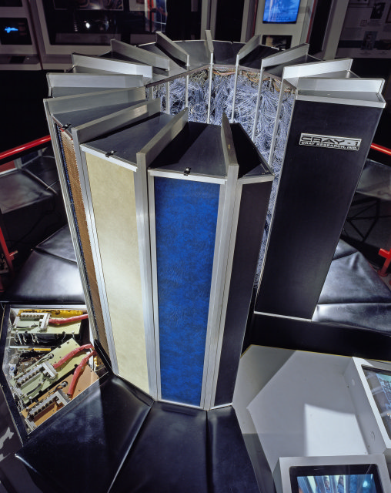
WAN Parallel FS (low-level)
In practice..
Deployed as smaller, auxiliary storage systems to provide a global filesystem for home directories.
    Does not replace or integrate with the existing HPC storage resources
HPC
Site 'B'
HPC
Site 'A'
WAN Parallel
Filesystem

Slide 13
WAN Parallel FS (low-level)
Can filesystem uniformity be mandated across institutions? Perhaps, but not likely..
  Could negatively impact the procurement process for individual institutions
  Stifle competition in the filesystem space
HPC
Site 'B'
HPC
Site 'A'
Parallel
Filesystem
(Local / WAN)

Slide 14
What is SLASH2?
“Portable filesystem layer designed to enable the inclusion of seemingly disparate storage systems into a common domain to provide system managed storage tasks.”
.. or more simply put ...
Data management system designed to aid users who frequently deal with large datasets in grid environments.
Key characteristics
  Highly portable – allow many types of storage systems to be integrated
  POSIX filesystem interface
  Object-based

Slide 15
SLASH2: Background
Designed implementation by researchers at the Pittsburgh Supercomputing Center
Inspired by distributed archival caching system developed at PSC in 2004
  MSST '05 paper on Slash1.
Funding provided by National Archives and National Science Foundation

Slide 16
How does SLASH2 Contribute to WAN Storage Mgmt?
Data management activities are performed by the system
  Monitored by administrators
  Avoid mistakes made by users
Provides a common storage protocol which may be ported to a large array of systems
  Regardless of vendor or storage system class
  Minimizes dependence on proprietary solutions
  Aid in integration of new storage and retirement of old
System stored data checksums
  Essential for detection of corrupt data
  May be used for proactive scrubbing of data

Slide 17
How does SLASH2 Contribute to WAN Storage Mgmt?
Incorporates essential features into the system
Move complexity away from the user and into filesystem
    File replication
    Integrated replica tracking
    Inline data verification and rectification
    Detection of faulty storage endpoints
Provides a single namespace

Slide 18
SLASH2 Architecture Example
SLASH2
Metadata
Server
PanFS
Backend
Lustre
Backend
SLASH2
client
PanFS Clients /
SLASH2 I/O Nodes
Lustre Clients /
SLASH2 I/O Nodes
Stand-alone FS /
SLASH2 I/O Node

Slide 19
SLASH2 Architecture
Metadata Server
  Maintains name → object ID mapping
  Data residency information
  Sliver checksums (64bit CRC per 1MB / data)
  Userspace ZFS under the hood
  Fully journaled
  Stateful storage of pending replication requests

Slide 20
SLASH2 Architecture
SLASH2 I/O service runs atop an existing filesystem
  SLASH2 objects stored in local filesystem
  SLASH2 I/O nodes which mount the same backend filesystem may be used in parallel
      File I/O
      Data Replication

Slide 21
SLASH2 Architecture
SLASH2 client is FUSE-based
Features of interest
  Page cache, dnode cache
  Asynchronous, coalesced writes
  Readdir+
  Location aware data retrieval

Slide 22
SLASH2 Architecture:
Logical Integration of Storage Systems
SLASH2
Metadata
Server
Archival Storage
SLASH2 Backend
Site 'A'
Archival
Namespace exports
System-managed replications
Parallel FS
SLASH2 Backend
Compute
Parallel FS
SLASH2 Backend
Site 'B'
Compute &
Archival
Site 'C'
Compute

Slide 23
SLASH2: System-Managed File Replication
Ease of use
  Users specify target files and destination system in a single request - “copy file set 'D' to Site C's archiver”
  If a non-recoverable failure occurs, a system administrator is notified – user intervention is not required.
Performance
  When possible, initiates parallel data transfer between data source and destination
  Uses an effective load-balancing scheme to ensure that a single slow endpoint does not dis-proportionally affect performance.
  Tuning parameters are held in the system, users are not required to know them

Slide 24
SLASH2: Integrated Replica Management
Data replicas are systematically maintained
  Completed replication update a file's residency state
  Upon overwrite of file data, old replicas are automatically invalidated by the system.
Replication occurs at block or chunk level, not file level.
  Partial file overwrites will not invalidate entire file replicas, only the affected block(s).
Intelligent data retrieval (should data replicas exist)‏
  Data retrieval requests are sent to most appropriate storage system
  Corrupt or missing data may be retrieved from alternate replicas transparently to the application.

Slide 25
SLASH2: BMAP Data Structure
Central metadata structure, serves to represent a file chunk
Contains data structures for replica management & data checksums
Acts as a logical work unit for replication purposes
Generation numbering for maintaining coherency (invalidating replicas)
Slash2 Bmap (ondisk)
struct slash_bmap_ondisk {
sl_blkgen_t bh_gen;
sl_gcrc_t bh_crcs[NC];
u8 bh_repls[NR];
psc_crc_t bh_bhcrc;
};
Slash2 file data
Data Block
Size=bmap_size (~10^8bytes)
Offset=bmap_no * bmap_size
Slash2 Bmap Crc
Array
Size=(10^3 bytes)
Data Block Subunits
Size=SL_CRC_SIZE (1024^2)

Slide 26
Current State of Affairs
Read() / Write(): stable in most cases
Replication engine: very close, but bugs persist
Namespace operations have been thoroughly tested
  Coherency model similar to NFS – no leased locks
Security
  UID / GID based
  MDS has NFSv4 ACL support through ZFS
  RPC validity is determined through a shared-key mechanism

Slide 27
Development for 2010 - 2011
Test and evaluation of a distributed metadata system prototype using Eventual Consistency
  Aimed at providing reliable but asynchronous namespace mirroring between metadata servers.
  Implements a new algorithm where the metadata servers may modify a single namespace simultaneously without creating conflicts.
    Modification logs are passed amongst the metadata servers and applied in a deterministic fashion
    Ensures that metadata servers are always 'approaching synchronization, though they may not be in sync at any given moment.

Slide 28
Development for 2010 - 2011
Secure Authentication
  Design and approach are still being discussed
  Node and user authentication
  Kerberos?
  Borrow concepts from the IU / Data Capacitor model?
  What are the opinions of the TeraGrid community?
More Debugging!!
  Deployment of automated test system (tsuite)

Slide 29
Demo Configuration
Single Metadata server
2 Clients
2 I/O Systems (bessemer@PSC, lime@PSC)
  Bessemer@PSC - 2 I/O nodes

Slide 30
Demo Configuration
SLASH2
Metadata
Server
CITRON
IO SYSTEM:
LIME@PSC
(stand alone server)
IO SYSTEM
BESSEMER@PSC
(Lustre)
I/O Node 0
I/O Node 0
I/O Node 1
Namespace exports
SLASH2
Client
LEMON
SLASH2
Client
ORANGE
Preferred I/O Path

Slide 31
Demo Configuration
site @PSC {
site_desc = "Pittsburgh Supercomputing Center";
site_id = 2;
resource bessemer {
desc = "DDN9550 Lustre Parallel Fs";
type = parallel_fs;
id = 0;
ifs = 128.182.99.124,
128.182.99.123;
fsroot = /bessemer/pauln/s2io/;
}
resource lime {
desc = "Stand-alone I/O server";
type = standalone_fs;
id = 1;
ifs = 128.182.99.27;
fsroot = /s2io;
}
resource citron {
desc = "WVU Testbed MDS";
type = mds;
id = 99;
ifs = 128.182.99.29;
jrnldev = /dev/md1;
}
}
Only one site at the moment (@PSC)
Would love to add more!

Slide 32
Demo Items
Replication test
Create test
Stat test
Build test

Slide 33
Slash2 Website
http://quipu.psc.edu/slash2
Under heavy construction.. Will have development resources soon!
  Source code download
  Access to svn repository
  Bug tracking and submission
  Mailing list

