Slide 1
Team Number: 6 Distance Based Application Trigger
Mehdi Yosofie & Philipp Schlieker, 21.12.2018
Notes:
<Foliennummer>

Slide 2
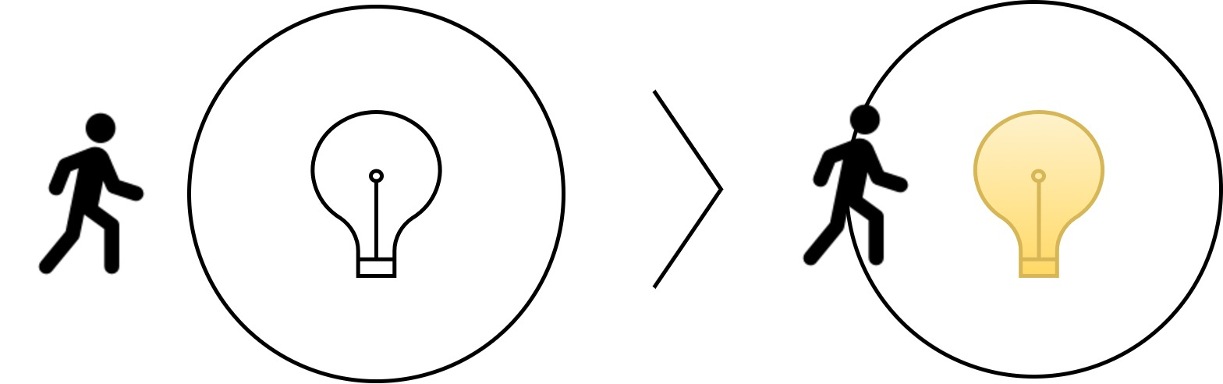
Distance Based Application Trigger
Distance Based Application Trigger
Software- and Systems Engineering Research Group
<Foliennummer>
Notes:
<Foliennummer>

Slide 3

Distance Based Application Trigger
Distance Based Application Trigger
Software- and Systems Engineering Research Group
<Foliennummer>
Notes:
<Foliennummer>

Slide 4
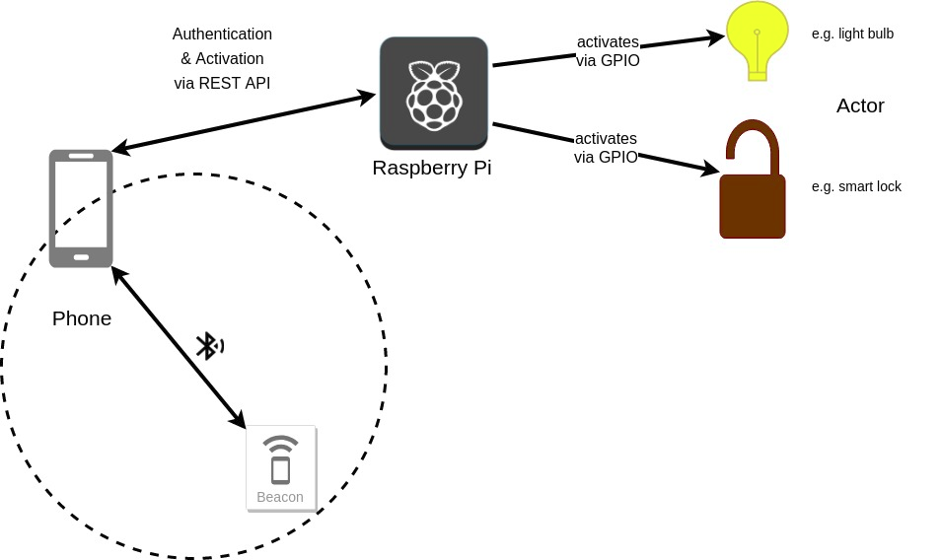
Project Architecture

Slide 5
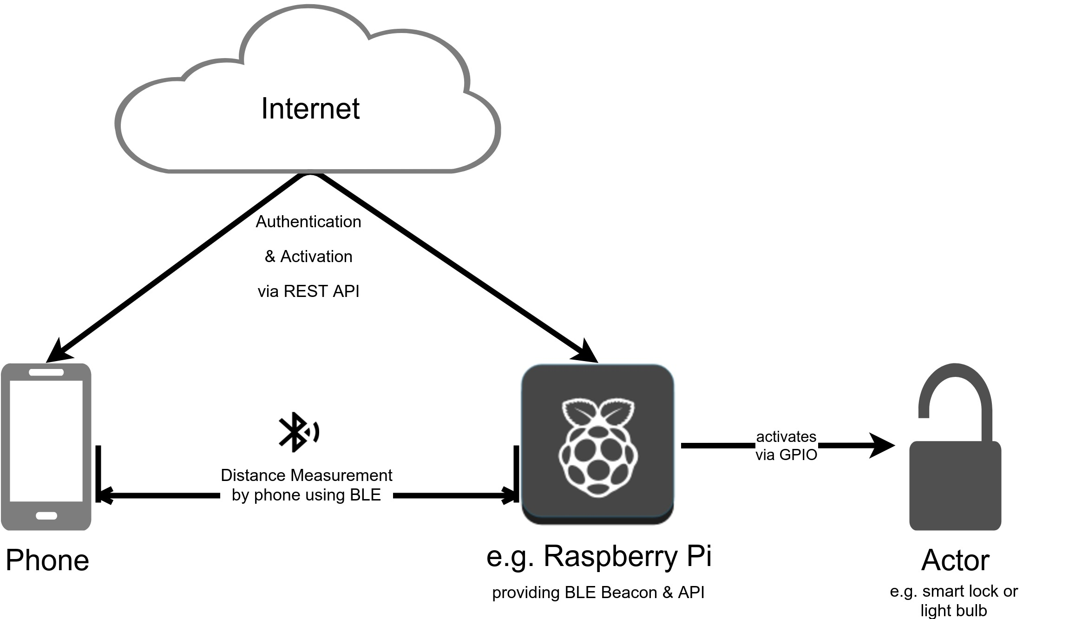
Conceptual approach
Distance Based Application Trigger
Software- and Systems Engineering Research Group
<Foliennummer>
Notes:
<Foliennummer>

Slide 6
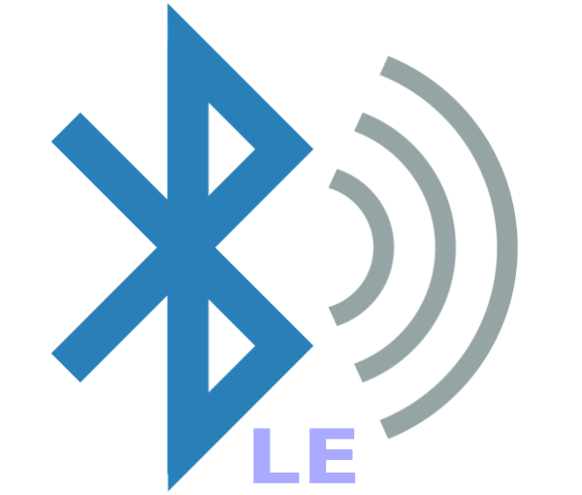
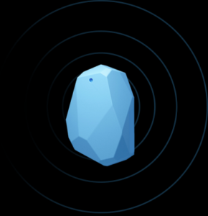
Sensors used
Bluetooth Low Energy (BLE)
Beacons
Distance Based Application Trigger
Software- and Systems Engineering Research Group
6
Notes:
<Foliennummer>

Slide 7
Potential Problems
Accuracy of position estimates
Response time for detection of beacons in the background
Compatibility of different beacons
Compatibility of BLE libraries between Android versions
Distance Based Application Trigger
Software- and Systems Engineering Research Group
7
Notes:
<Foliennummer>

Slide 8


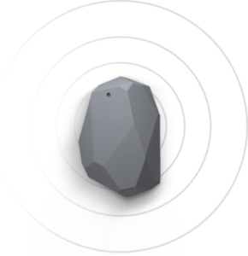
How would the prototype function?
Android App
using AltBeacon Framework
API
using Raspberry Pi or Sonoff Smart Switch
Beacon
using Raspberry Pi,
Laptop or dedicated Beacon
Distance Based Application Trigger
Software- and Systems Engineering Research Group
<Foliennummer>
Notes:
<Foliennummer>

