Slide 1
Team Number: 6 Distance Based Application Trigger
Mehdi Yosofie & Philipp Schlieker, 21.12.2018

Slide 2
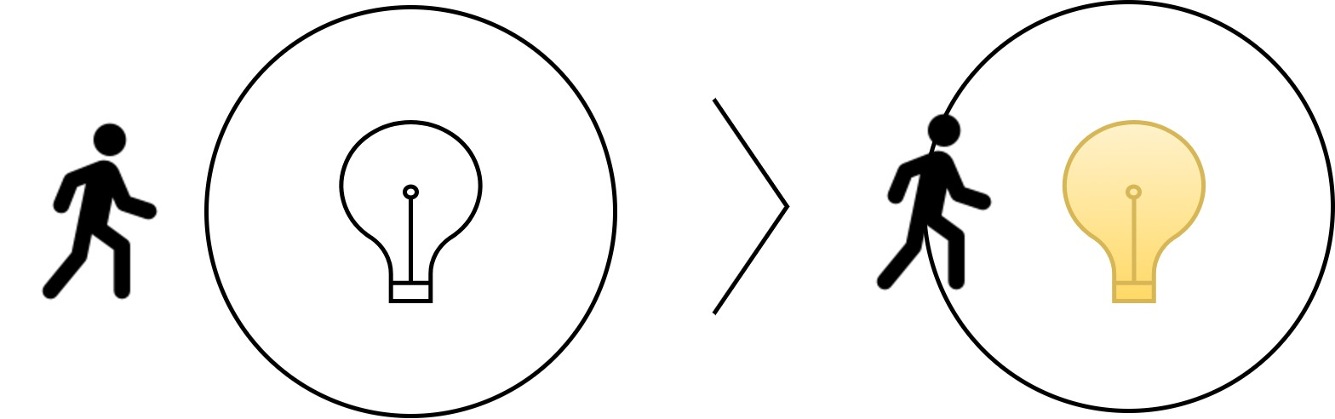
Distance Based Application Trigger

Slide 3

Distance Based Application Trigger

Slide 4
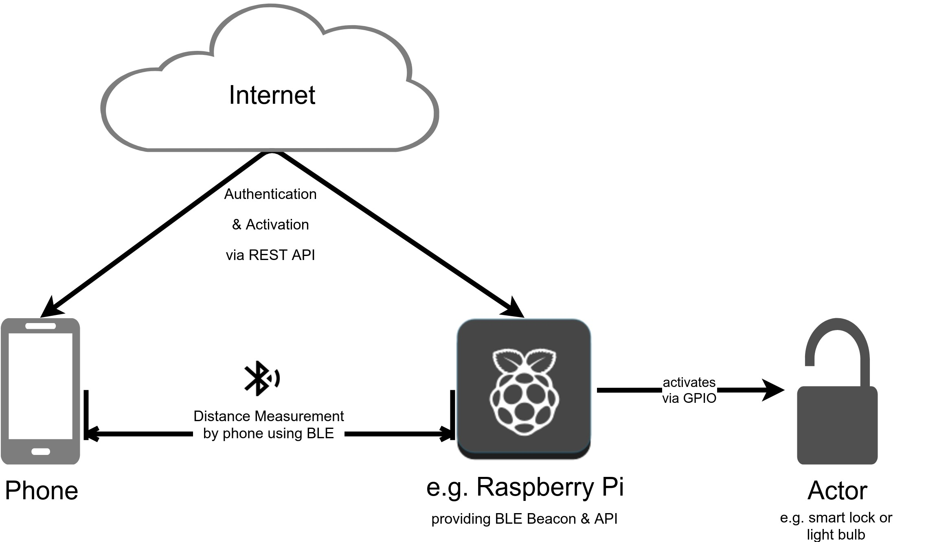
Conceptual approach

Slide 5
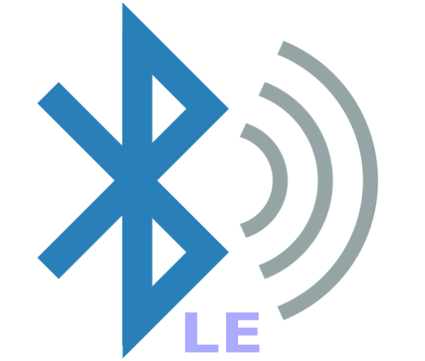
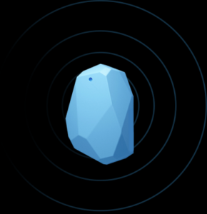
Sensors used
Bluetooth Low Energy (BLE)
Beacons

Slide 6
Potential Problems
Accuracy of position estimates
Response time for detection of beacons in the background
Compatibility of different beacons
Compatibility of BLE libraries between Android versions

Slide 7
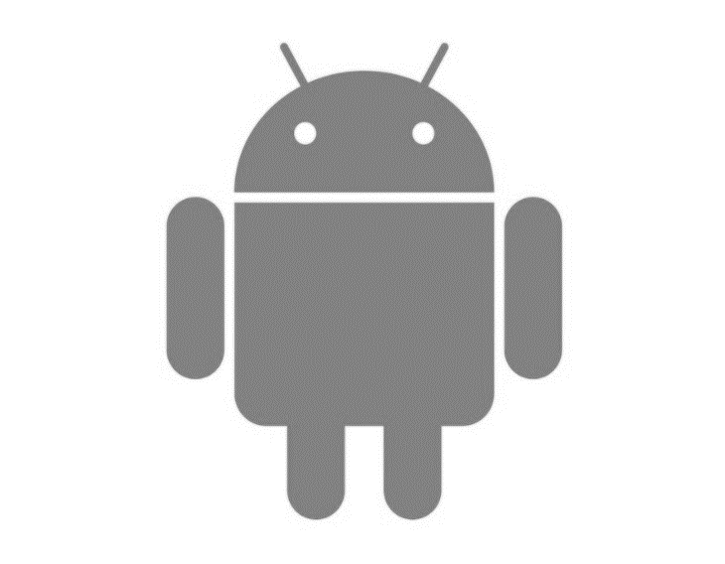

How would the prototype function?
Android App
using AltBeacon Framework
API
using Raspberry Pi or Sonoff Smart Switch
Beacon
using Raspberry Pi,
Laptop or dedicated Beacon

