Slide 1

Simulating materials properties from first principles
Genetic Algorithm

Slide 2
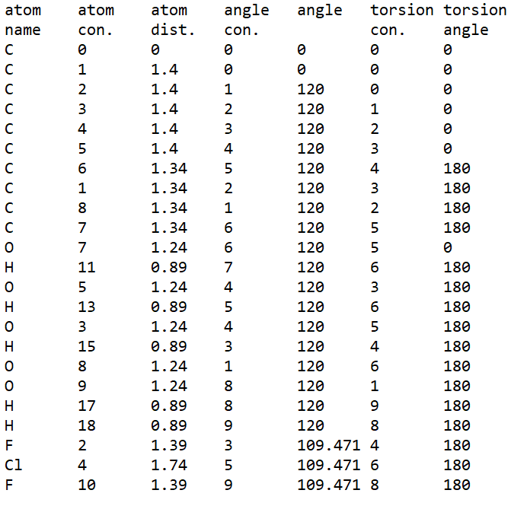
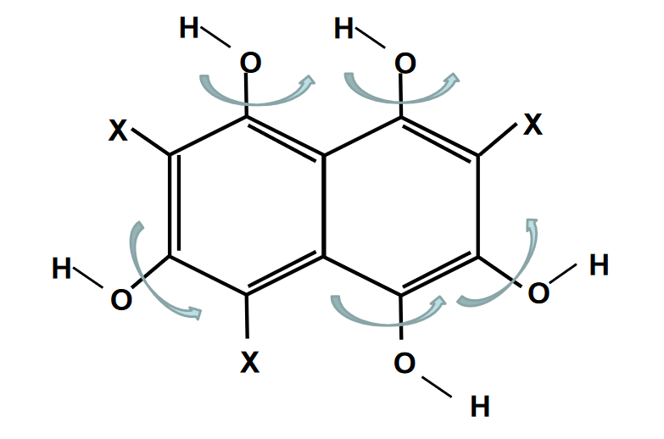
Task
Change C-C-O-H torsion angles to find the best energy
6-fold discretization: 0, 60, 120, 180, 240 and 300 °
6⁵ possibilities, 2s per calculation: ~4 ½ hours runtime

Slide 3
Genetic algorithm
[120, 180, 0, 60, 180] [0, 120, 120, 300, 60]
E3 E2
4 3
[0, 0, 180, 300, 0] [0, 120, 120, 300, 60] [120, 180, 0, 60, 180] [60, 0, 120, 0, 60]
E1 E2 E3 E4
[120, 180, 0, 60, 180] [0, 120, 120, 300, 60] [0, 0, 180, 300, 0] [60, 0, 120, 0, 60]
E3 E2 E1 E4
4 3 2 1
[0, 120, 120, 300, 60] [0, 0, 180, 300, 0]
[0, 120, 180, 300, 0] [0, 0, 120, 180, 60]
[0, 120, 180, 300, 0] [0, 0, 120, 300, 60]
Random initial population
Calculate energies (PySCF, method: RHF, basis set: sto-3g)
Sort by lowest energy and assign weights: ranked pair selection
Single point crossing-over and mutation
2 best genomes stay in population

Slide 4
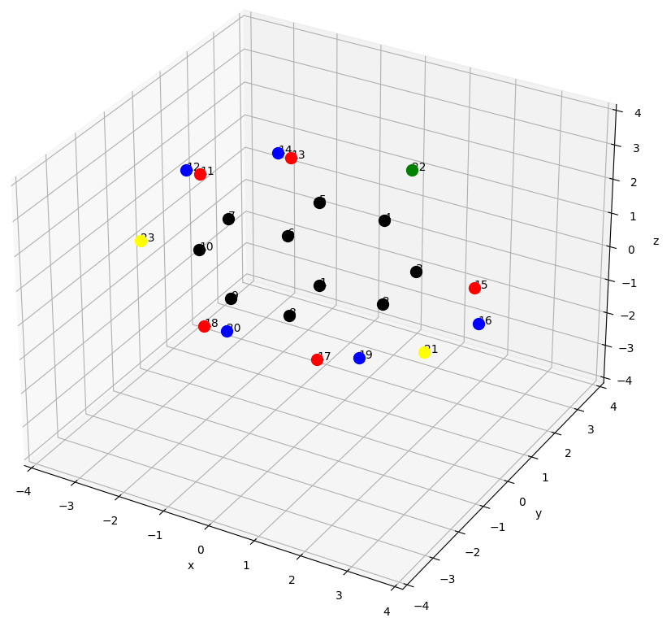
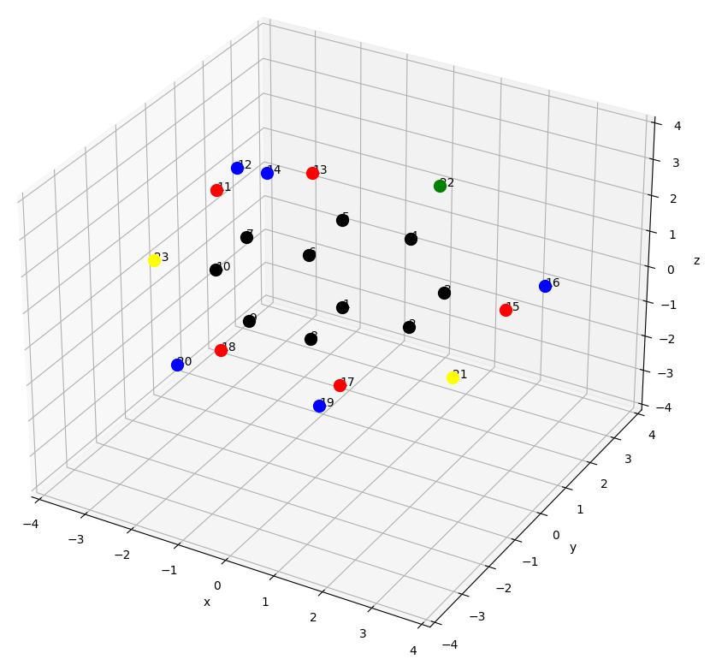
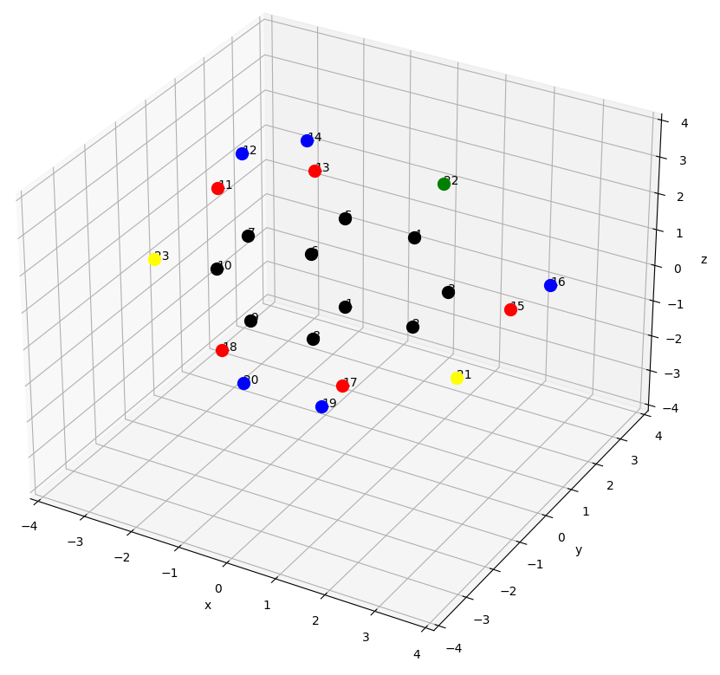
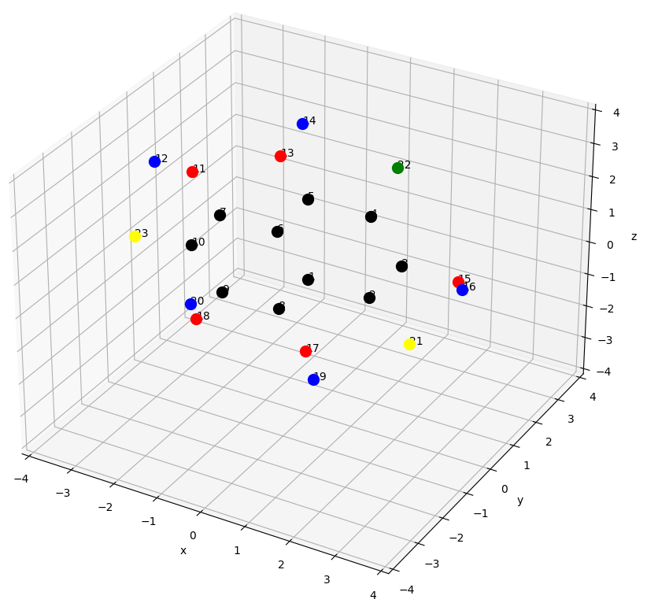
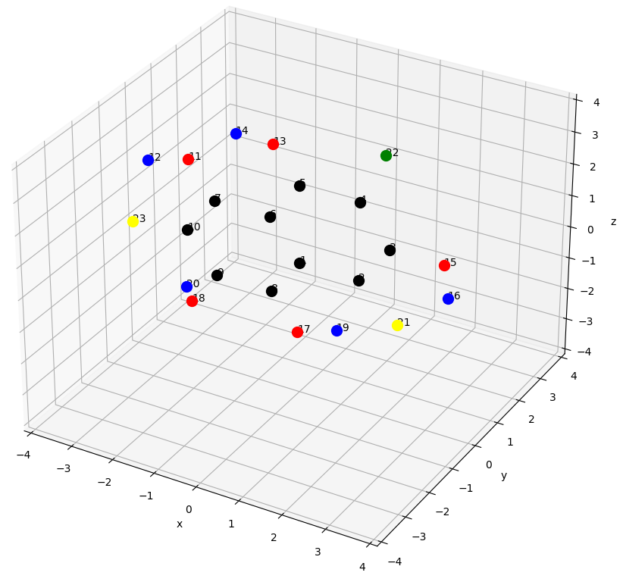
Results
9 combinations in total - population sizes: 5, 10, 20
mutation rates: 0.25, 0.5, 0.75
Number of generations: 30
Initial population for pop. size 5:
C: black, H: blue, O: red', F: yellow, Cl: green

Slide 5
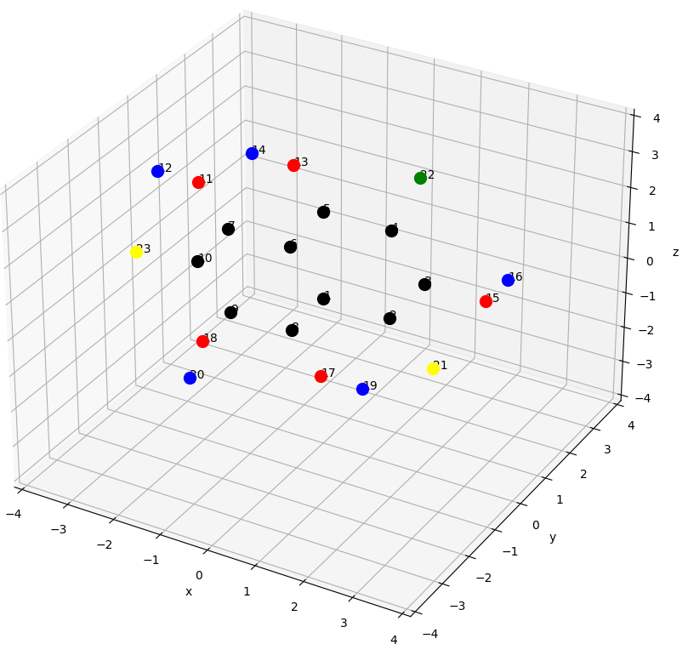
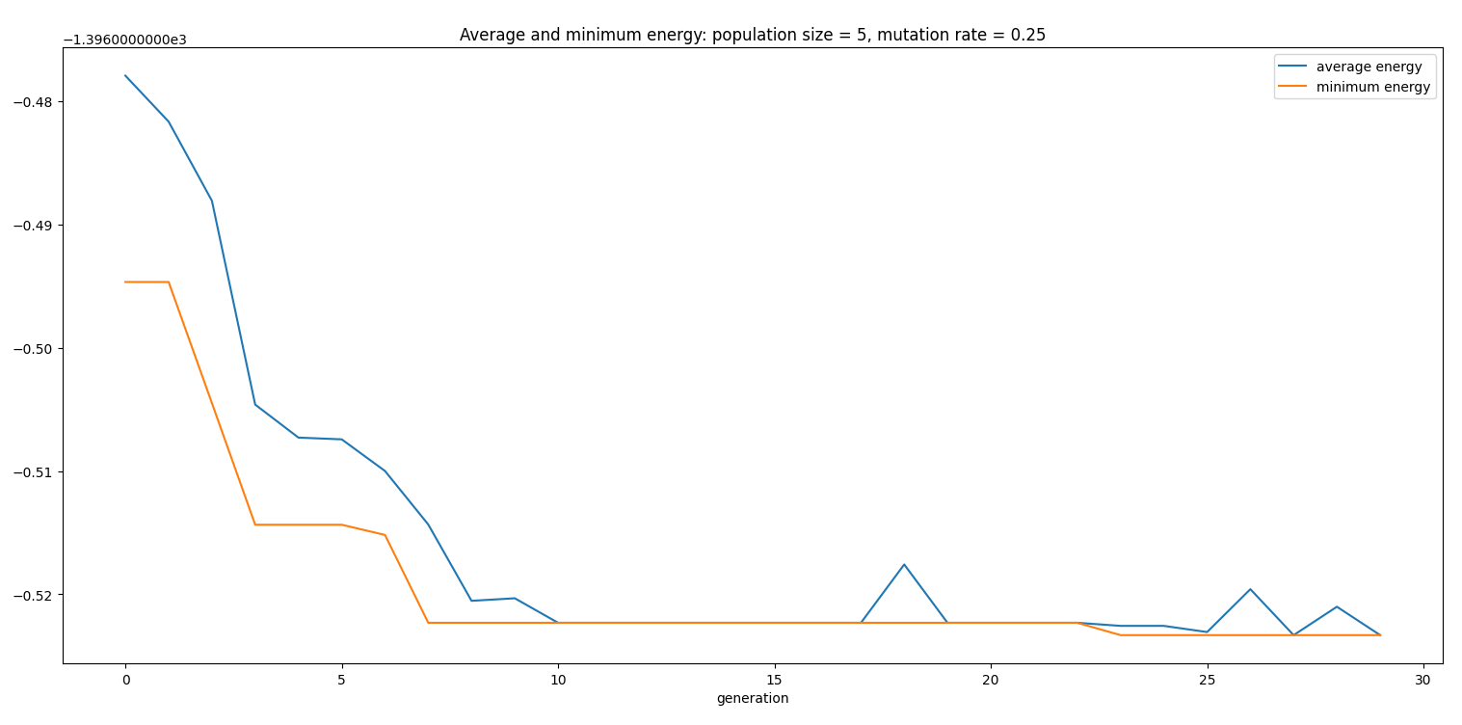
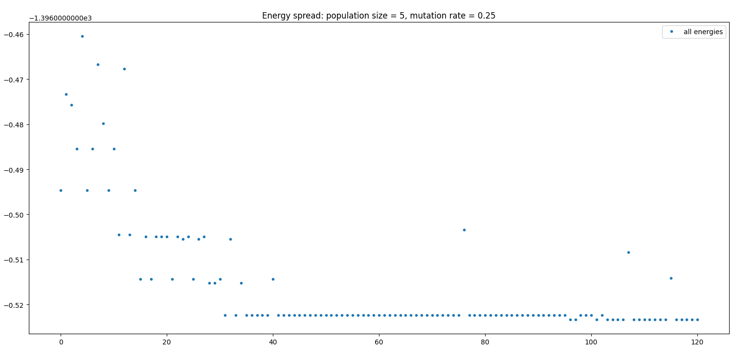
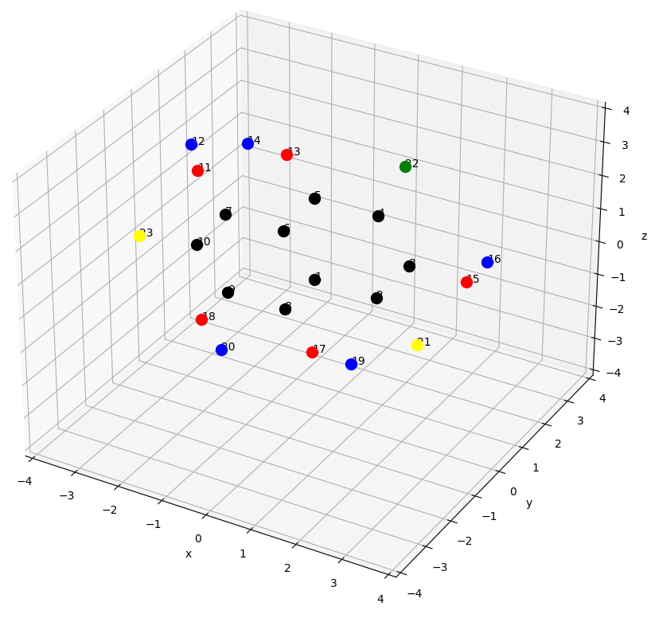
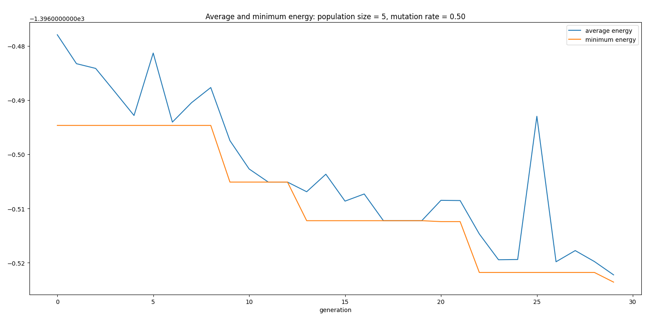
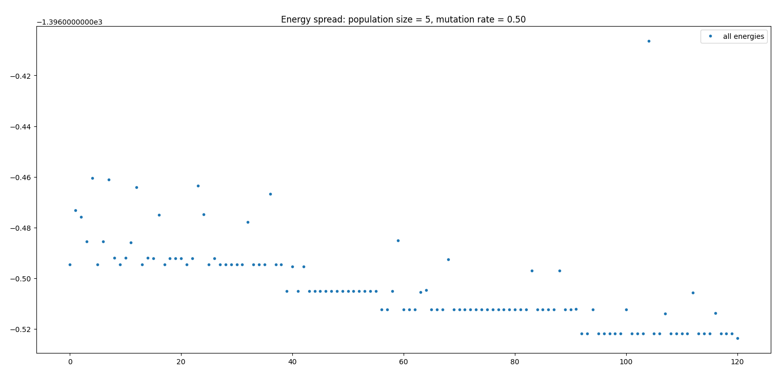
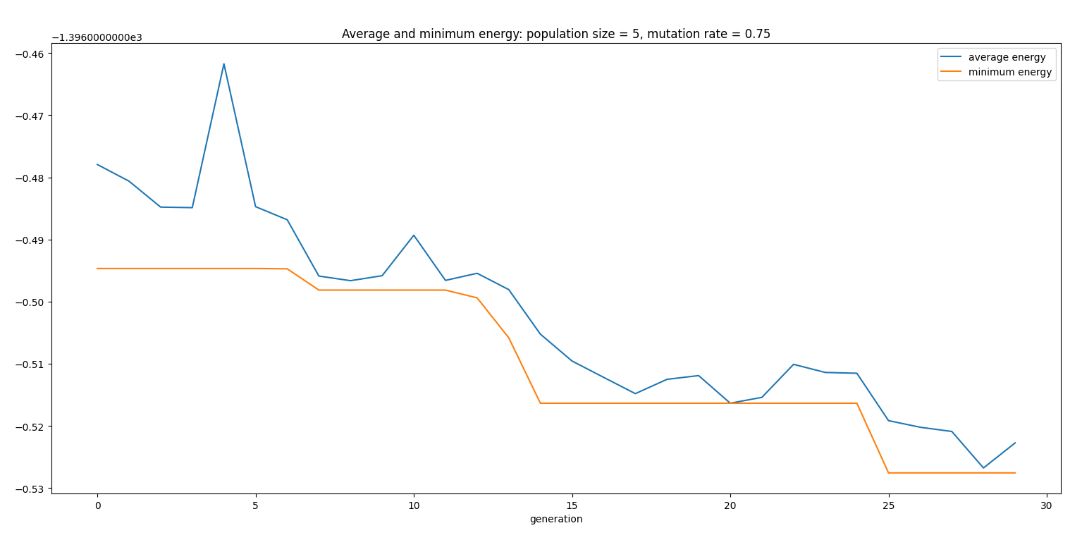
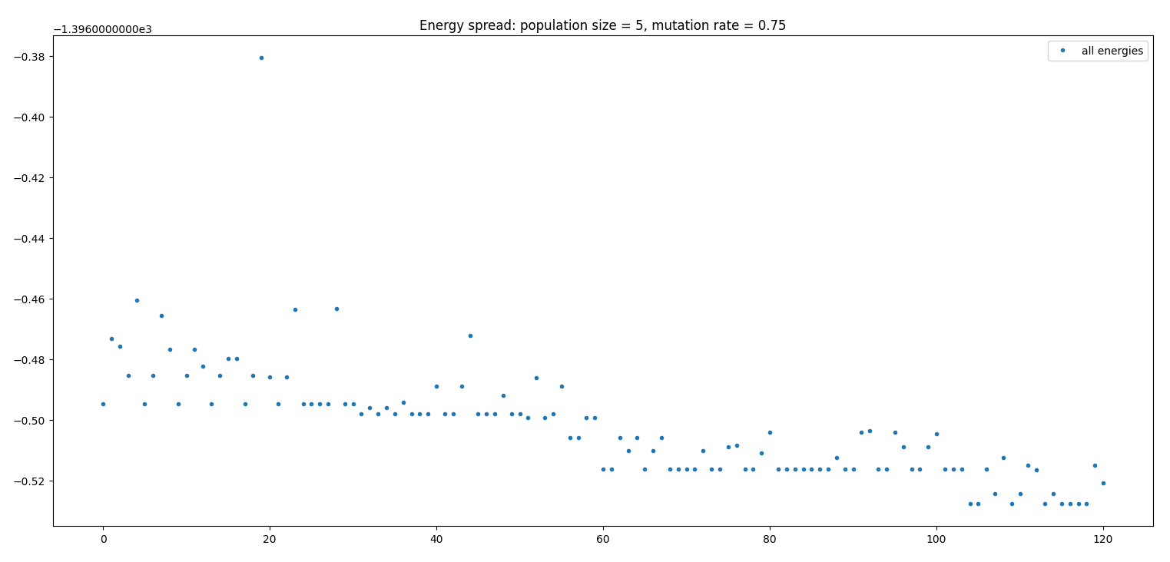
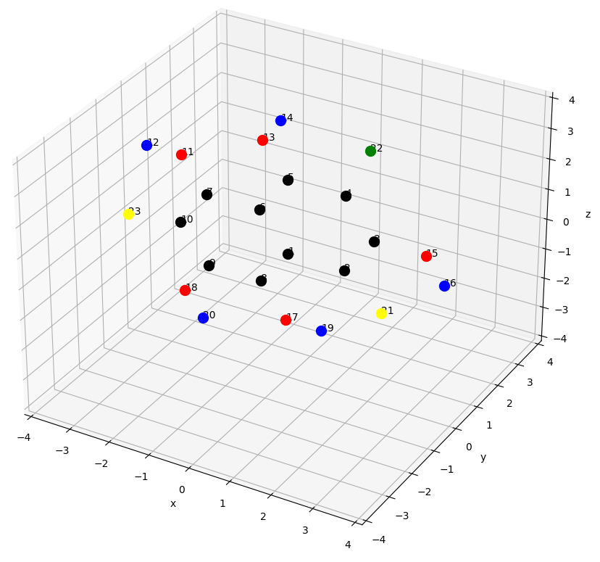
Results
[180, 0, 0, 180, 60]
Population size 5
Runtime:
10.65 min
[120, 0, 0, 180, 0]
7.90 min
[180, 180, 180, 180, 0]
7.93 min

Slide 6
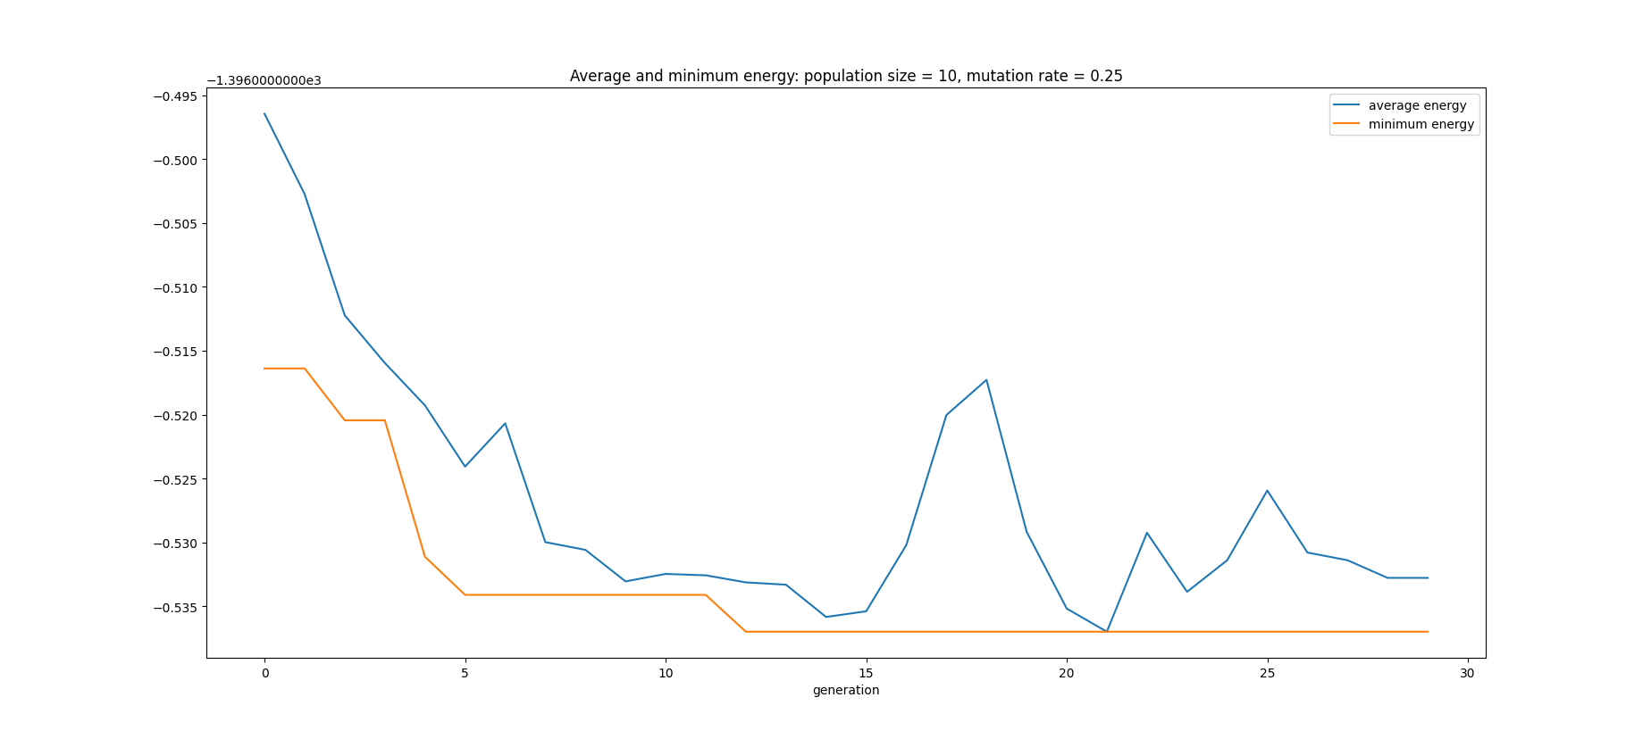
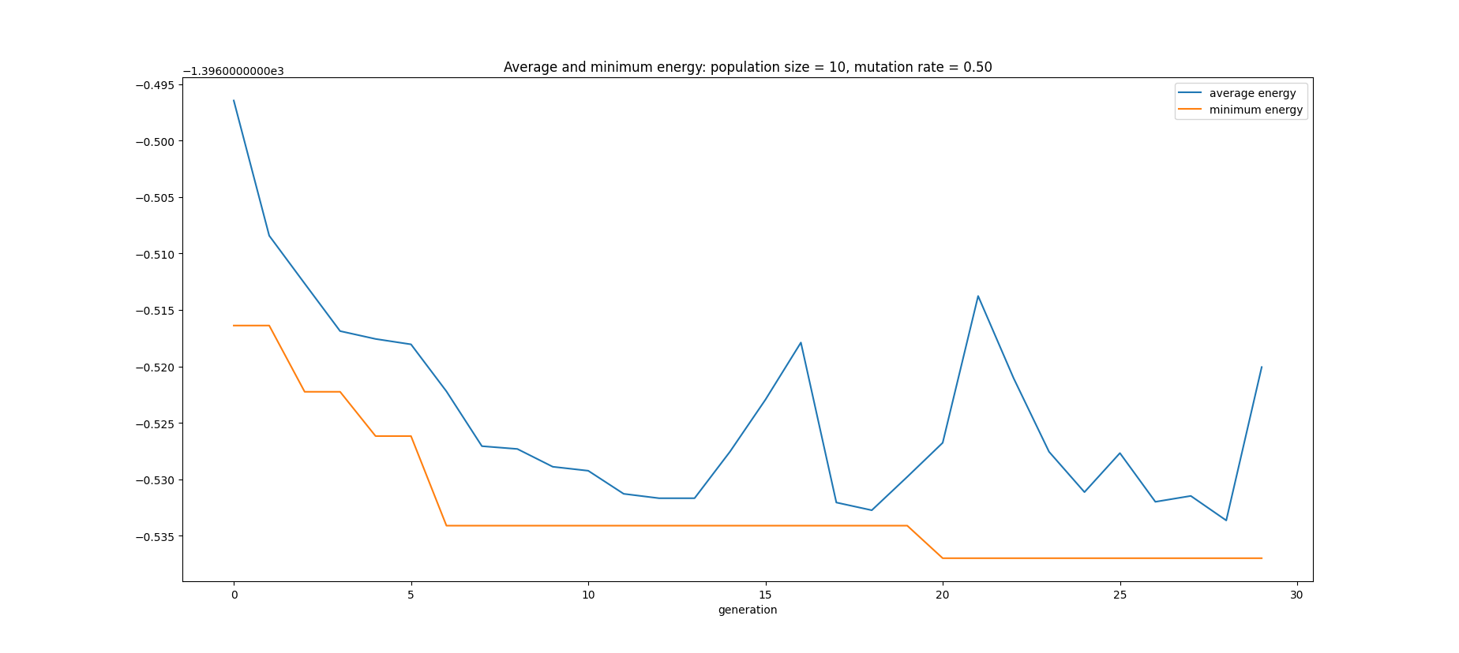
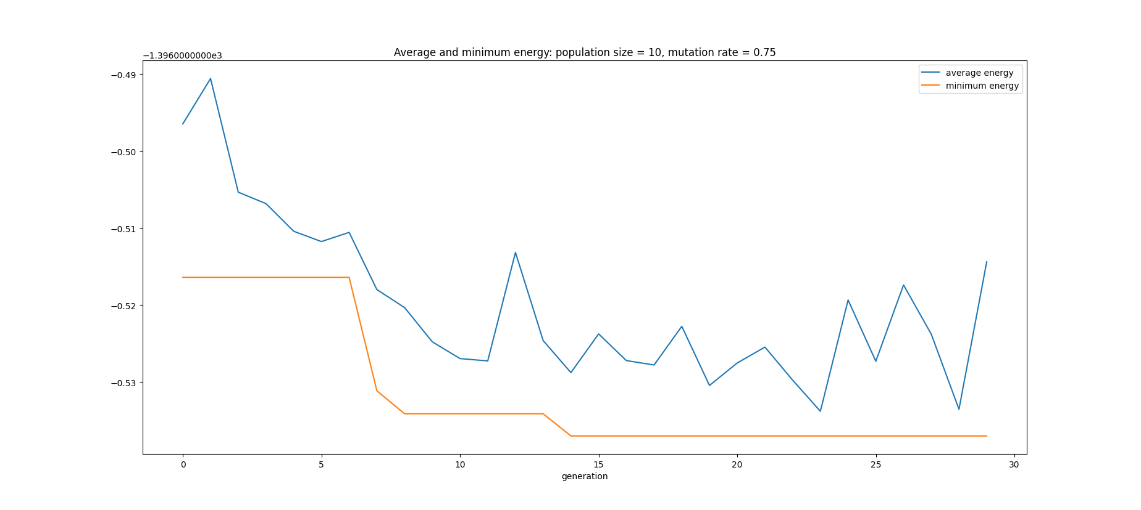
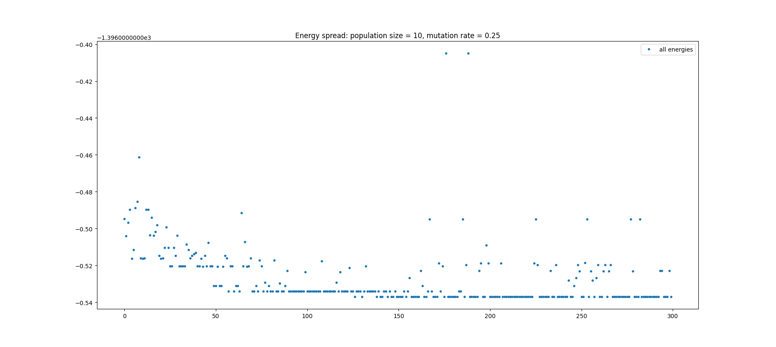
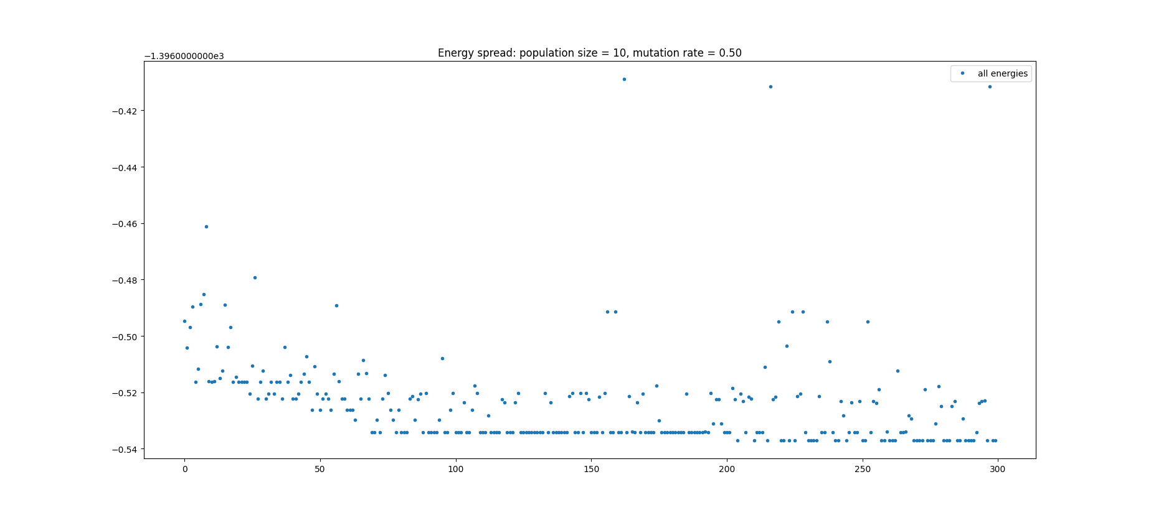
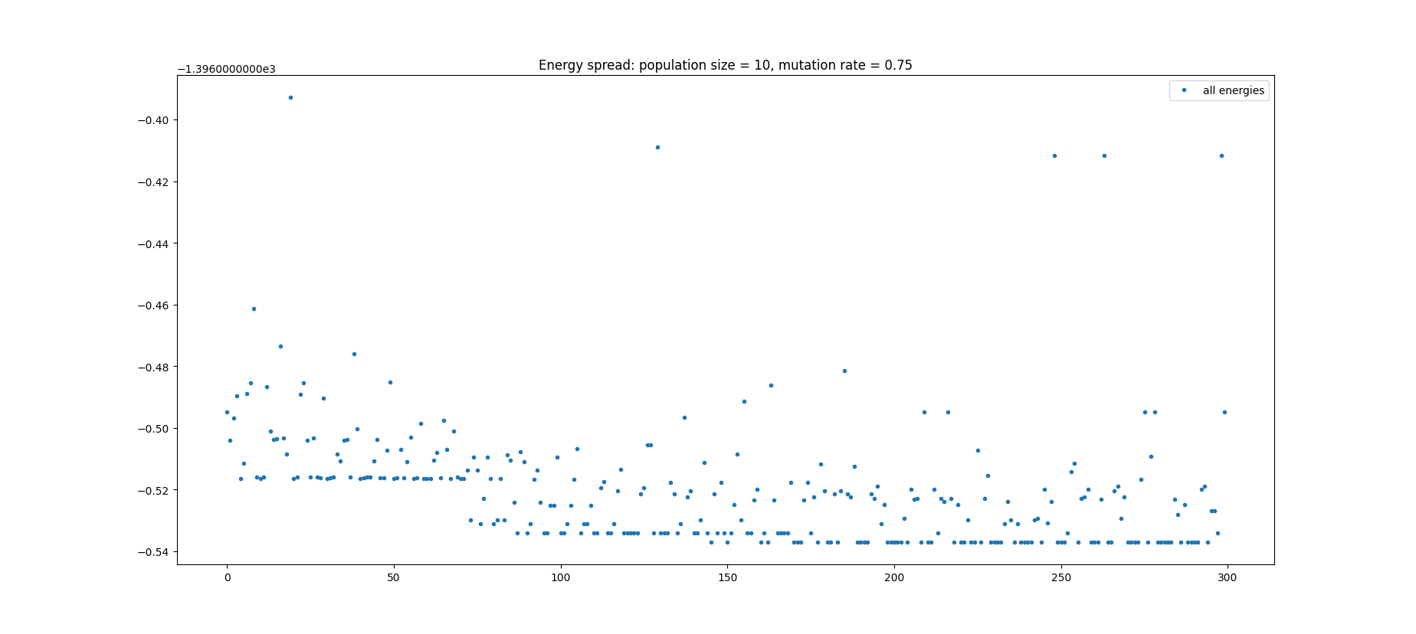
Results
Population size 10
19.47 min
18.78 min
20.04 min

Slide 7
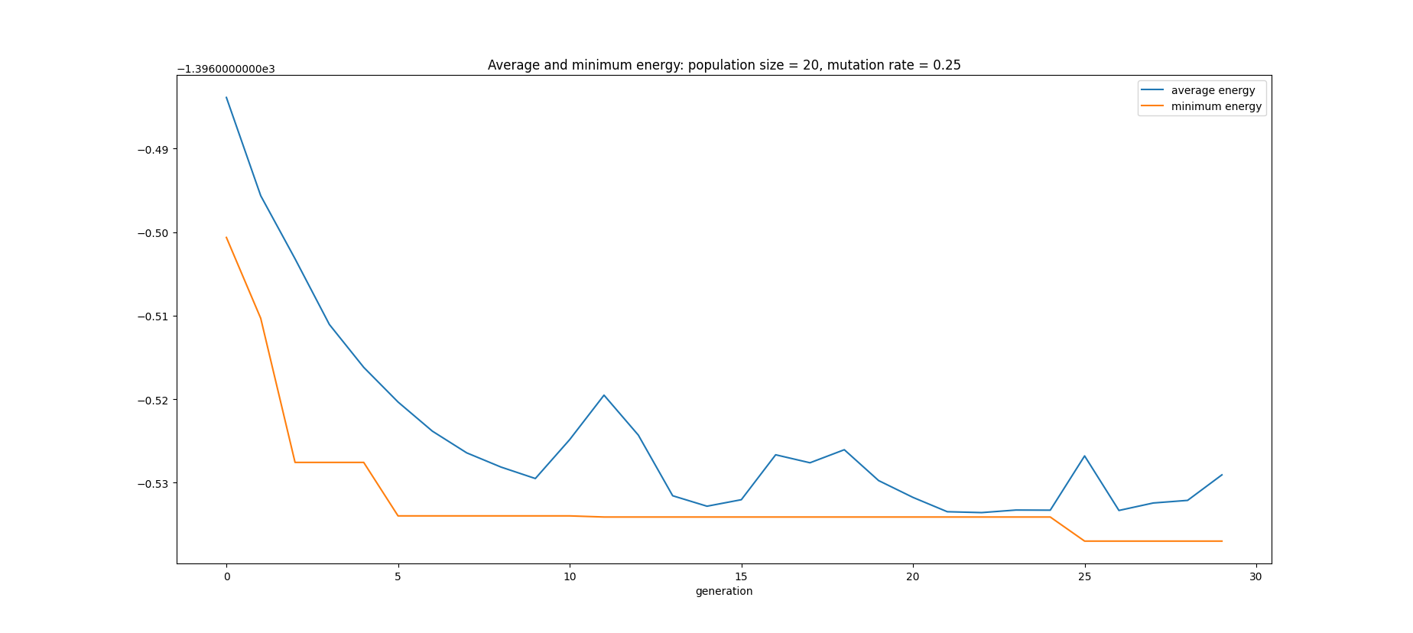
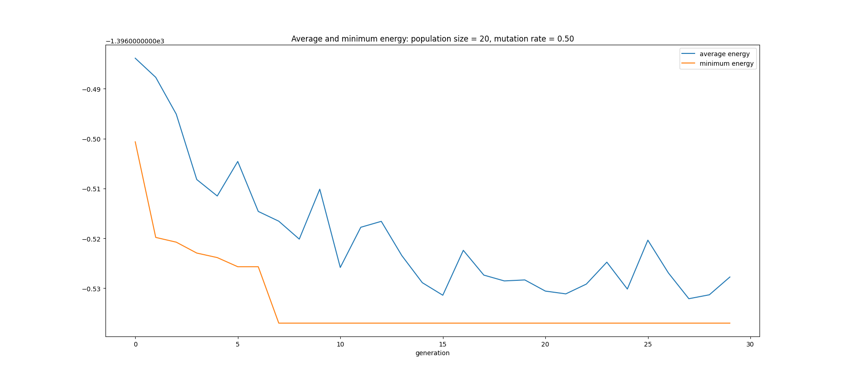
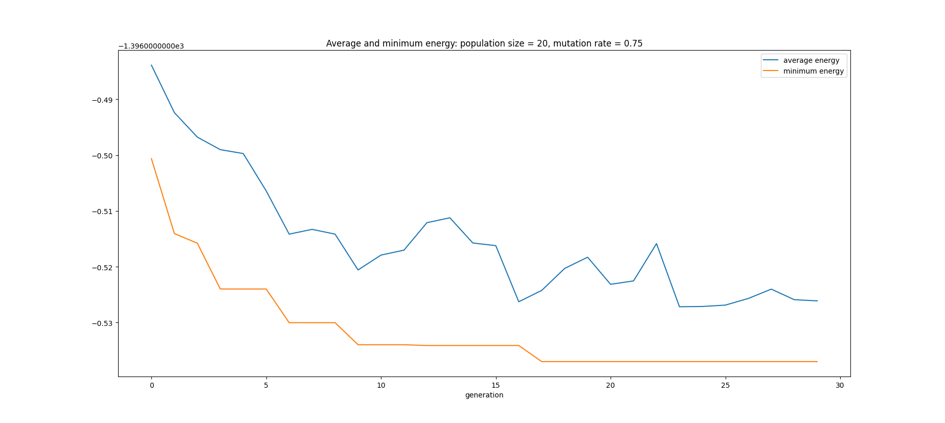
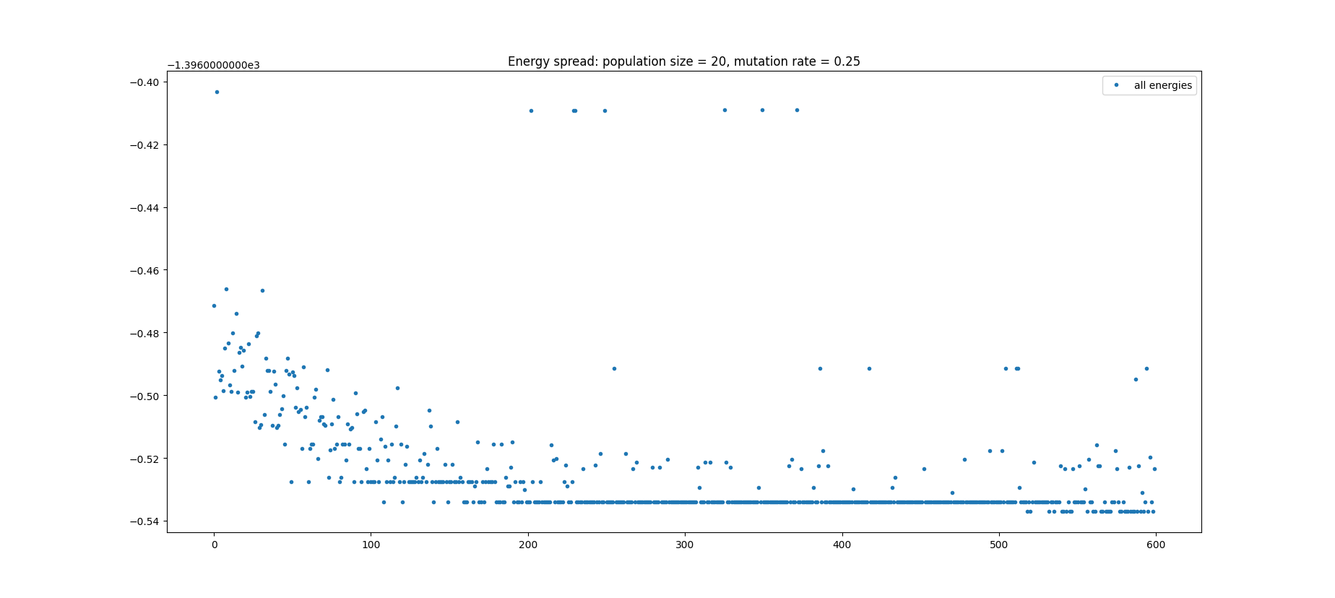
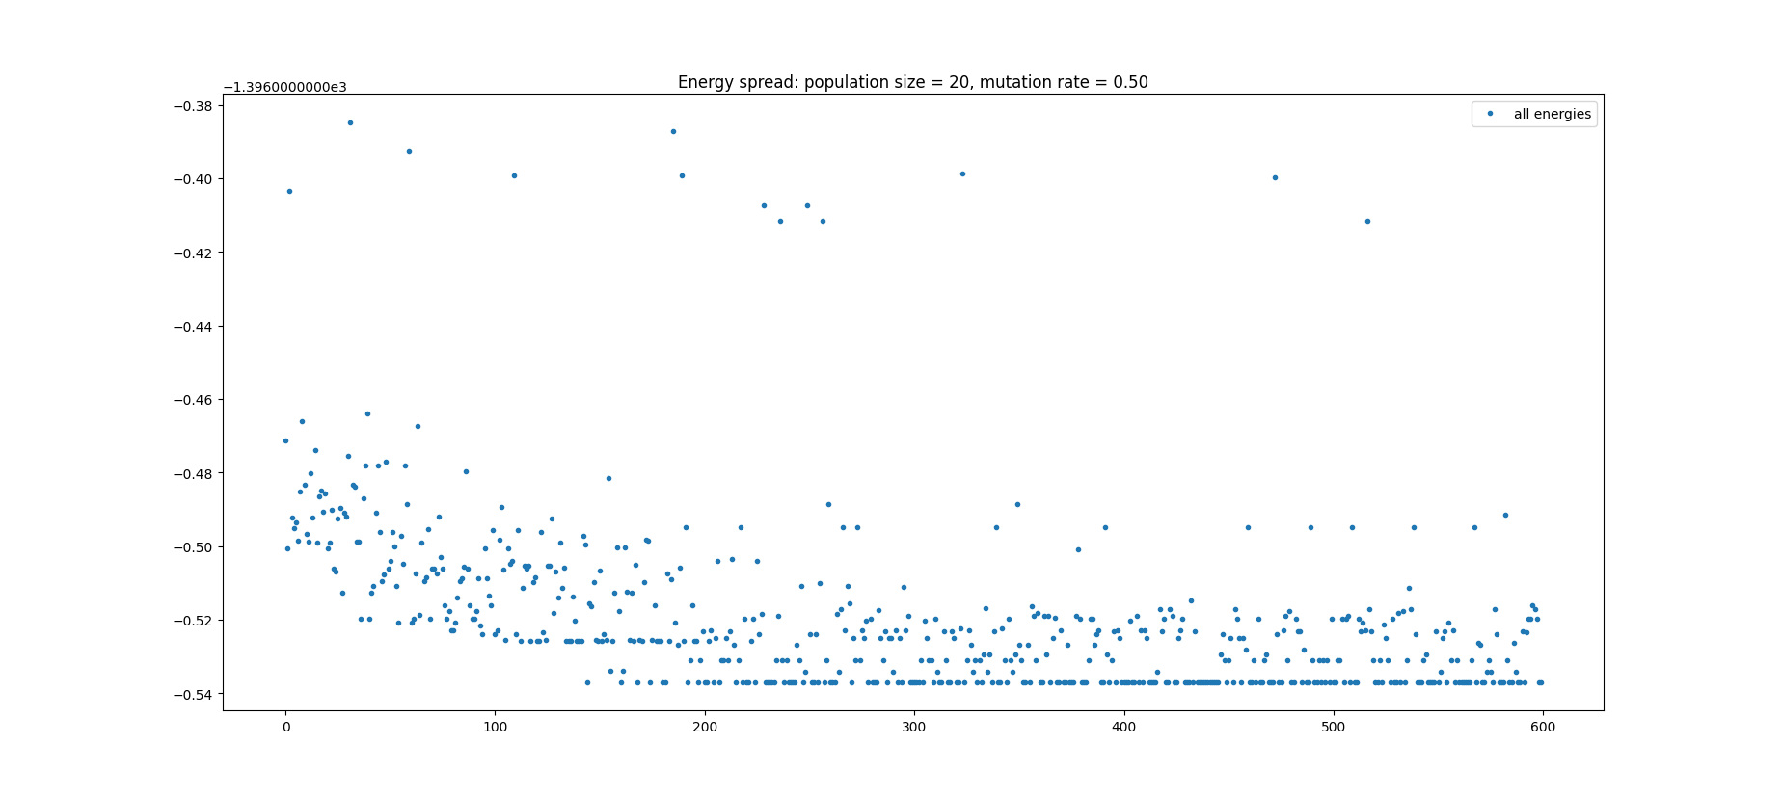
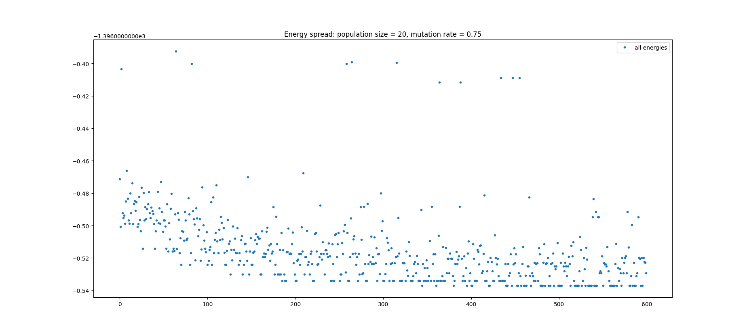
Results
Population size 20
37.51 min
37.88 min
38.31 min

Slide 8
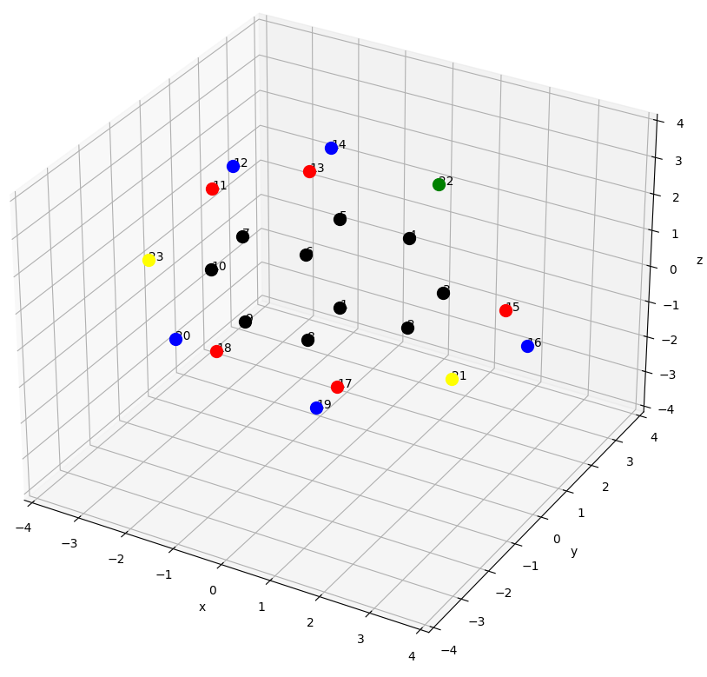
Conclusion
Population size 5 only recommendable with larger number of generations
Population size 10 should be sufficient with a number of gens ~25, especially regarding runtime
Rather large mutation rate preferable to ensure diversity in the population
[0, 180, 180, 0, 180]

Slide 9
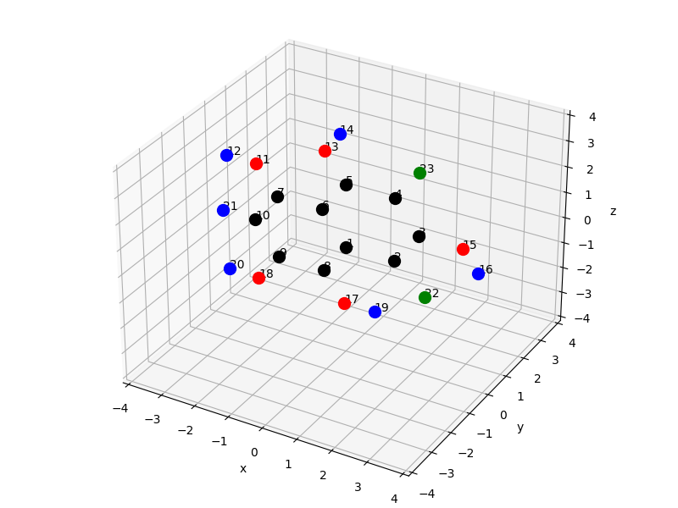
Reproducability
Resulting Genome: [180, 0, 180, 180, 0]
Verification of the results reproducibility with a slightly different initial molecule:
C: black, H: blue, O: red, F: green

Slide 10
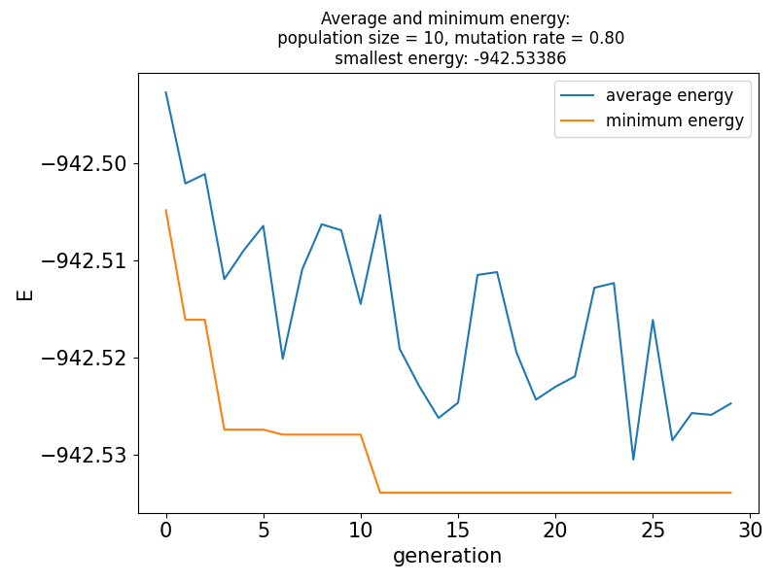
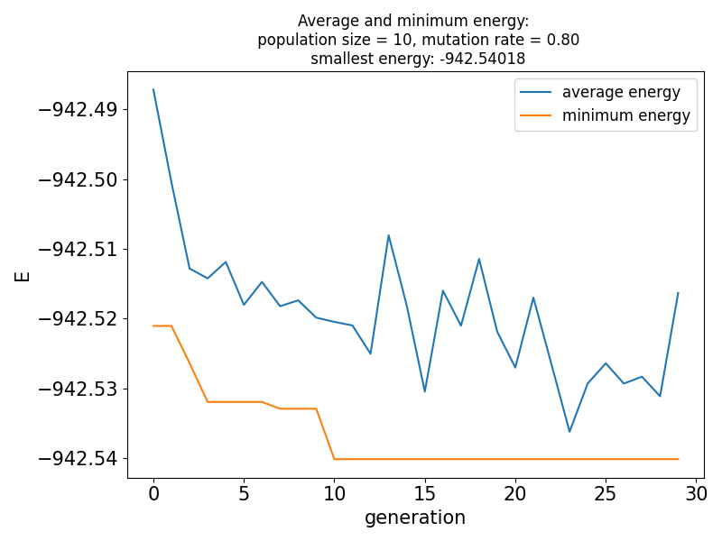
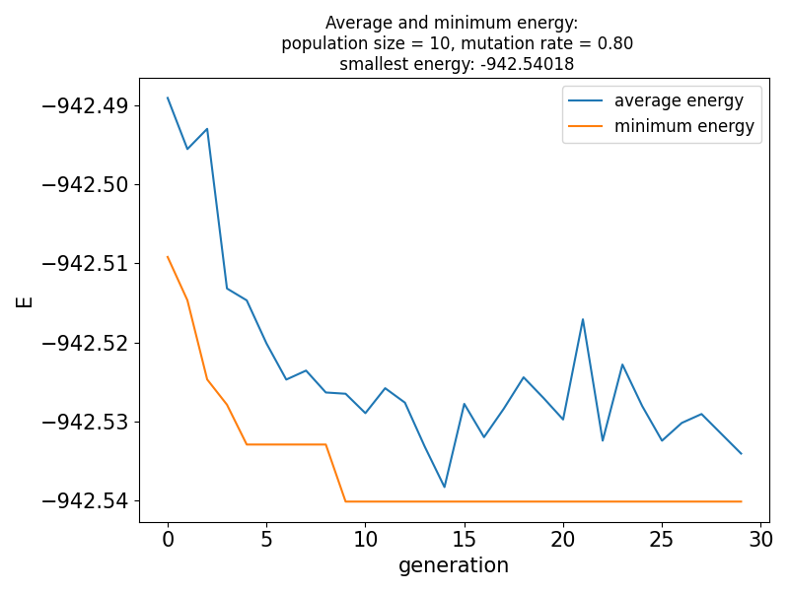
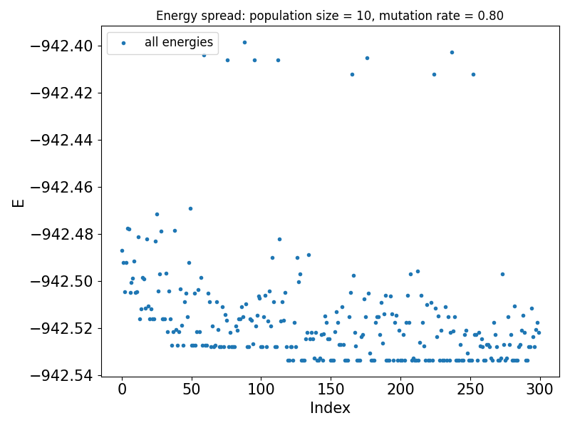
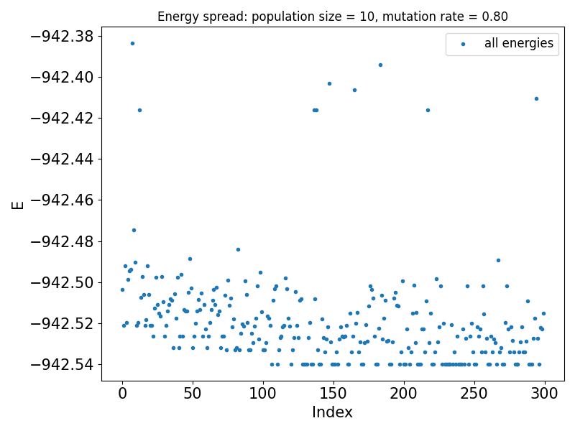
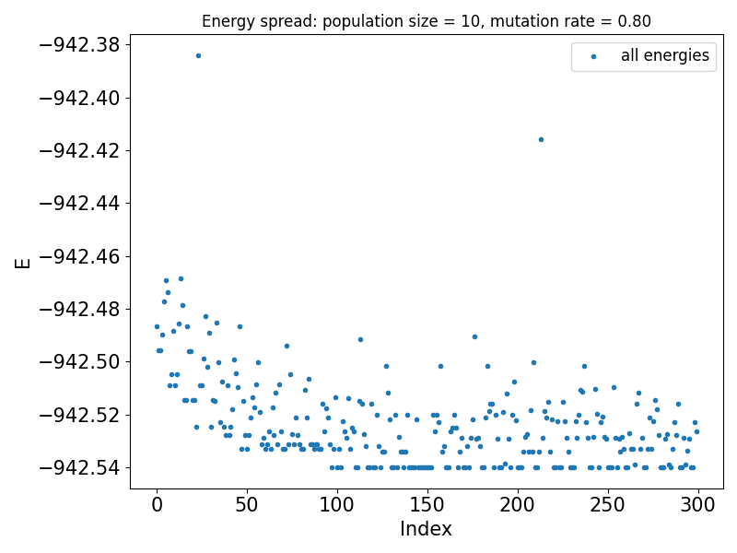
Reproducability
Resulting Genome: [180, 0, 180, 180, 0]
Population size 10, mutation rate 0.8
Resulting Genome: [180, 0, 180, 0, 180]
10.39 min
10.38 min
9.47 min

Slide 11
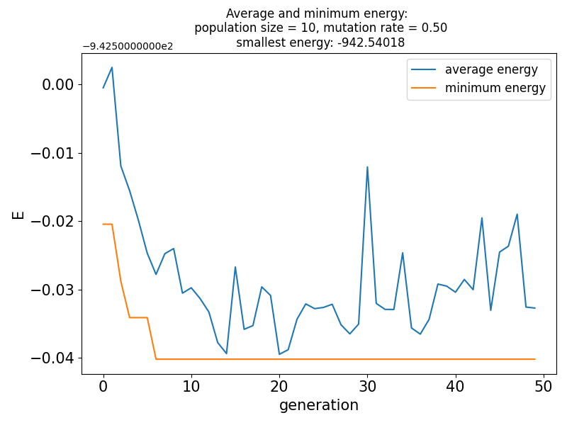
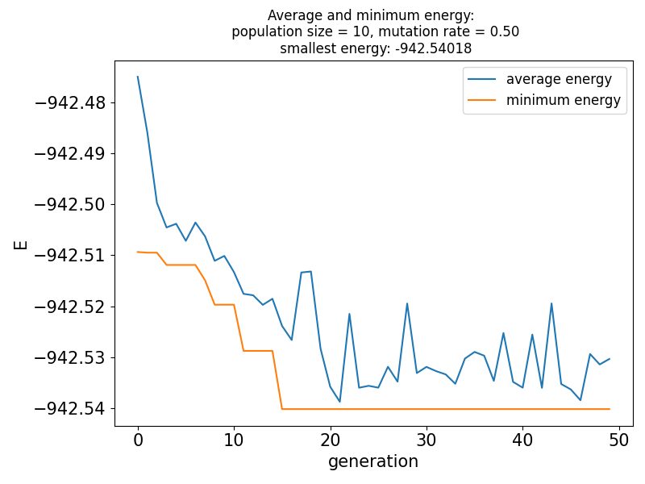
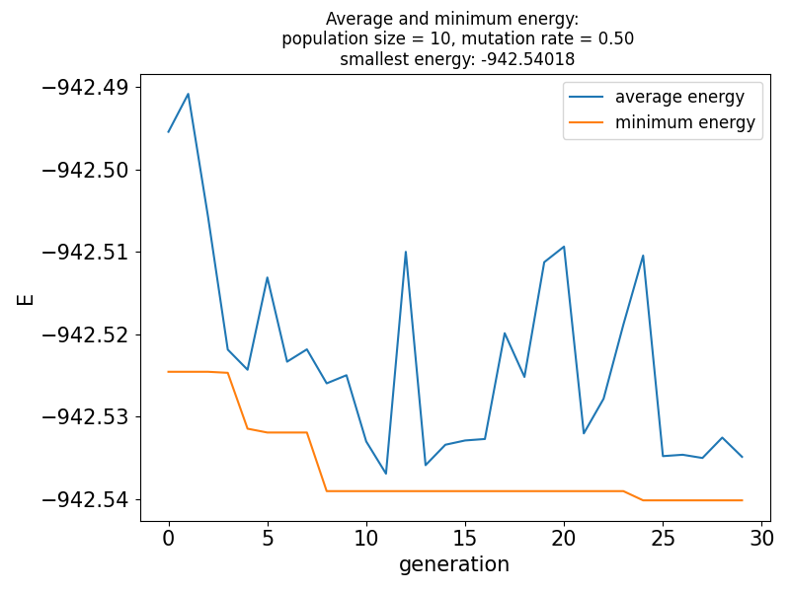
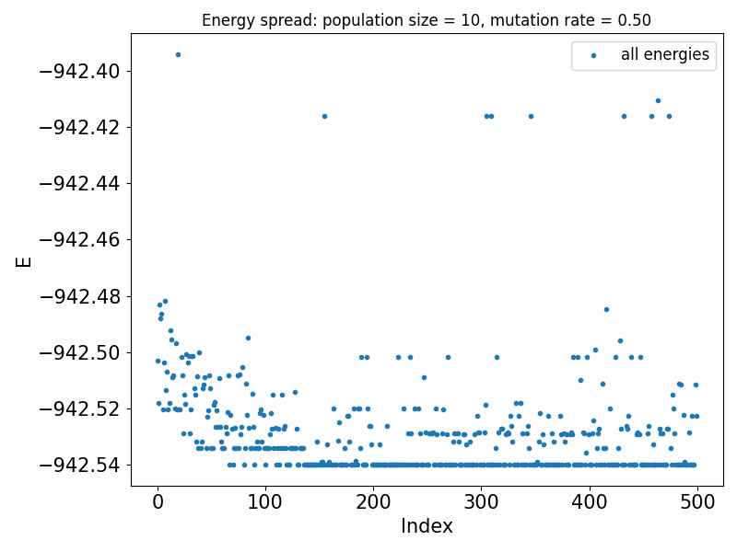
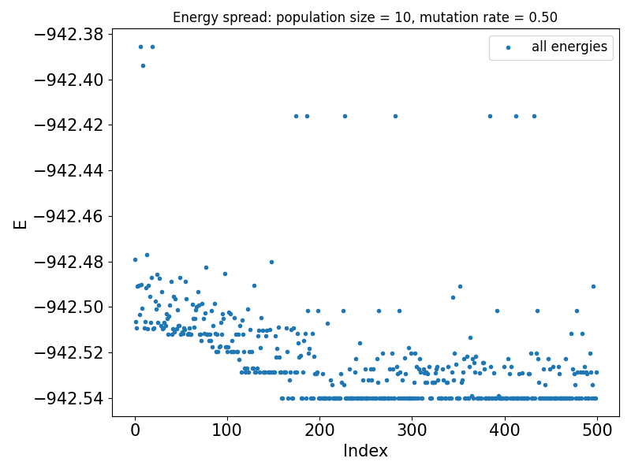
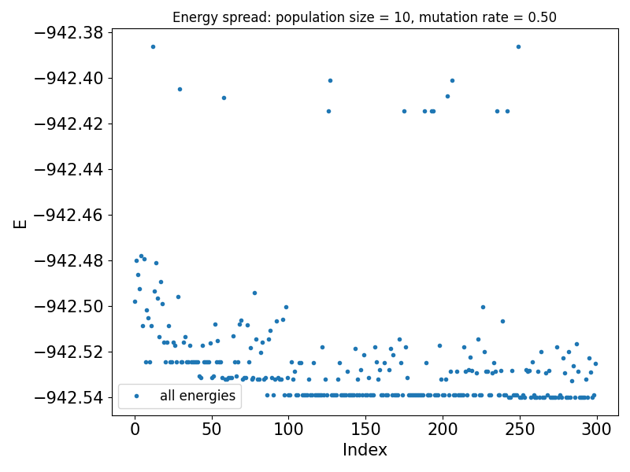
Reproducability
Resulting Genome: [180, 0, 180, 180, 0]
Population size 10, mutation rate 0.5
17.50 min
17.54 min
10.52 min

Slide 12
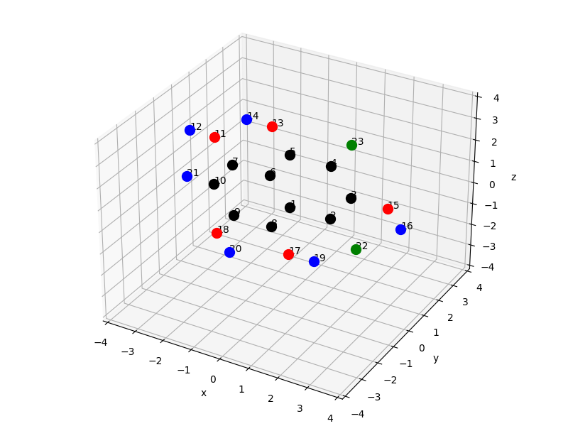
Conclusion
Results are reproduceable also for a slightly different molecule
Population size of 10 sufficiently large
Initial Molecule: [180, 180, 180, 180, 180]
Resulting Molecule: [180, 0, 180, 180, 0]
C: black, H: blue, O: red, F: green

