Slide 9
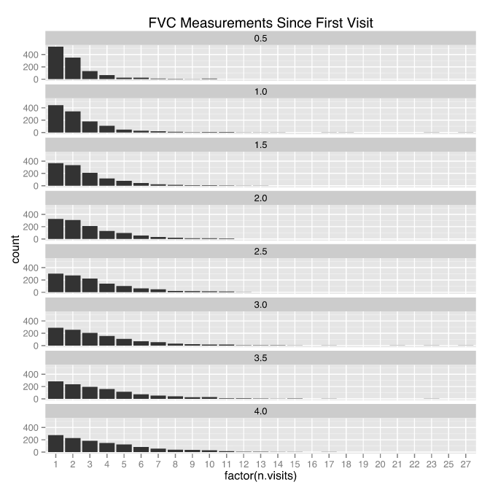

Slide 10
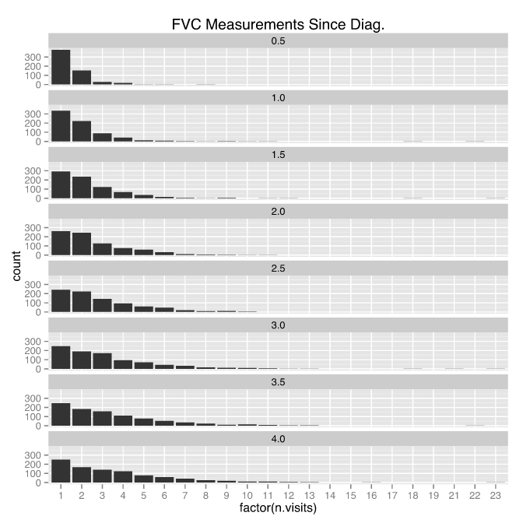

Slide 11
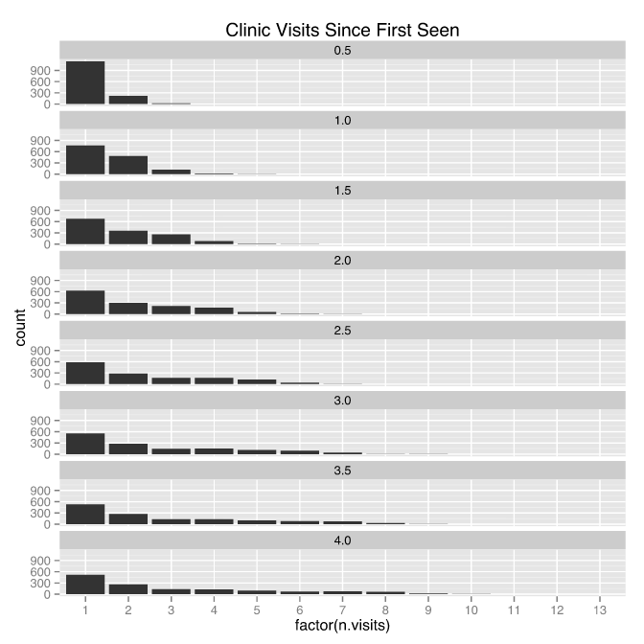

Slide 12
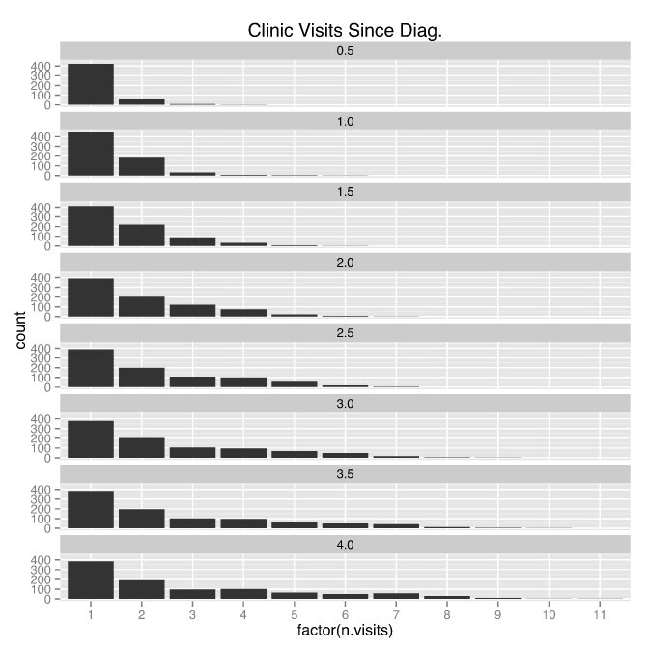

Slide 15
Linear Models of Trajectories
Train on visits prior to 2 years since diagnosis
Test on visits after 3 years since diagnosis
Errors reported as per-patient root mean squared error
Normalized by population FVC standard deviation (0.86)

Slide 18
Notes:
Best 16 predictions constrained to error within 0.5 to 1 standard deviation (0.86)

