Slide 1
Master-Worker System
Paweł Ściegienny
Marcin Pabian
Tomasz Romaniuk

Slide 2
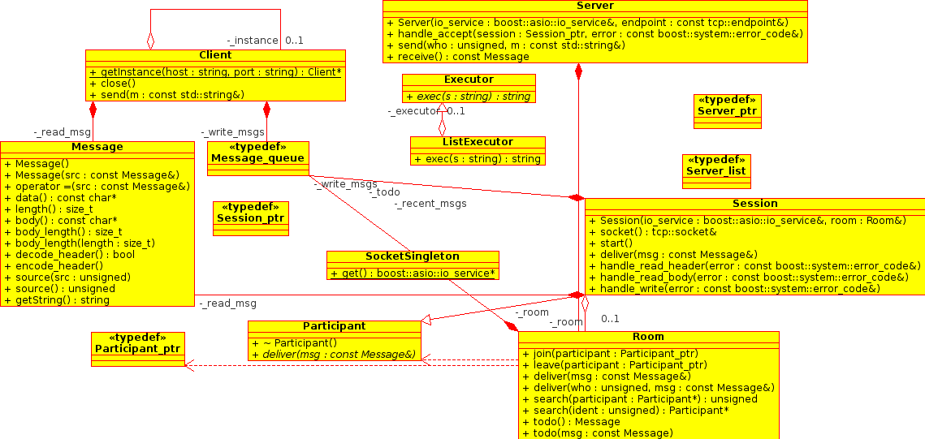
How does it work?

Slide 3
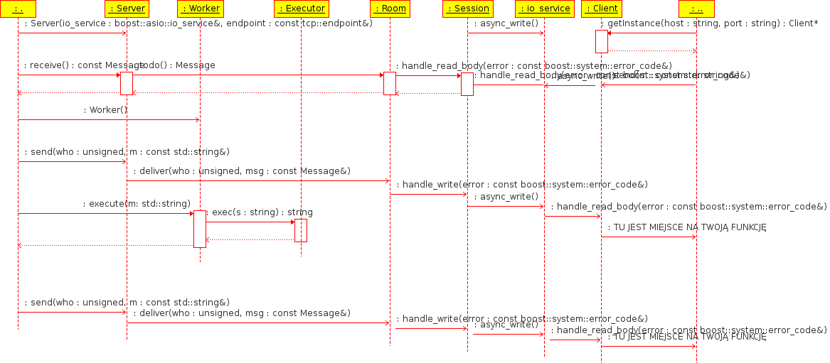
It's easy

Slide 4
Credits & License
Content by R3IS23
License: LGPL
Boost FileSystem Library
OpenOffice.org template by Raphaël Hertzog
http://raphaelhertzog.com/go/ooo-template
License: GPL-2+
Background image by Alexis Younes “ayo”
http://www.73lab.com
License: GPL-2+

