Slide 1
PowerShell for a Kubernetes Admin
Fabien Dibot

Slide 2
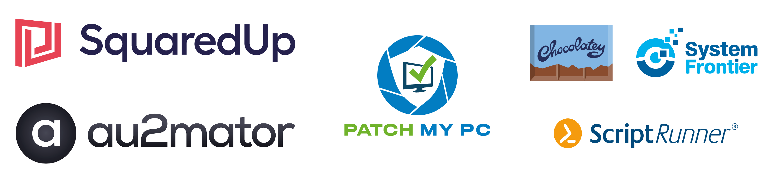
Many thanks to our sponsors:

Slide 3


Fabien Dibot
Cloud Solution Architect @ Microsoft
Huge fan of cloud computing and automation
Father of 2 boys
Really happy to present physically this year

Slide 4
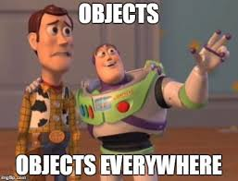
Goal of this session
Use powershell, create objects and manage your kubernetes applications

Slide 5
K8s overview
Internet
Kubernetes control
Worker node
kubelet
kube-proxy
Master node
Docker
Prod
Prod
API server
Containers
Containers
kubectl
-controller-manager
-scheduler
Worker node
kubelet
kube-proxy
replication, namespace, serviceaccounts, etc.
etcd
Docker
Prod
Prod
Containers
Containers

Slide 6
Why ?
Administrate cluster objects at scale
Automate admin tasks
App troubleshooting in k8s is mostly done through kubectl
But… kubectl.exe returns text
… and can be in Json/Yaml text format

Slide 7
Demos
Kubectl.exe

Slide 8
Demos
Kubectl.exe parser

Slide 9
Good, but not enough
Not modern approach
Relies too much on a binary
And Crescendo module appears

Slide 10
Demos
Crescendo

Slide 11
Let’s make it faster
Use official C# k8s client - https://github.com/kubernetes-client/csharp
No kubectl.exe dependency
Still a lot to do/improve
Still needs kubeconfig because no external IDP supported
Fork/download/test : https://github.com/fabiendibot/posh-k8s

Slide 12
Demos
KubernetesClient

Slide 13
Lessons learned
Use SDK and APIs when possible:
Faster
But can be tricky to use (async)
C# SDK has limitations
OIDC authentication not (yet?) supported
Switching between contexts not supported
Kubectl has more commands than you can imagine

Slide 14
Q&A
15 minutes

