Slide 1
Next Up:
Jordan Borean

Slide 2
3
3

Slide 3
2

Slide 4
1

Slide 5
Writing your own Ansible PowerShell Module
Jordan Borean

Slide 6

Many thanks to our sponsors:

Slide 7

Jordan Borean
Software Engineer for Red Hat
Works on Ansible, specializes in Windows integrations
Enjoys working with Python, PowerShell, and C#
Loves a bike ride and just learning new things
Dislikes aliases in scripts
You can download your shield here:
Speakers shields
If any problem with you shield, please contact us at contact@psconf.eu

Slide 8
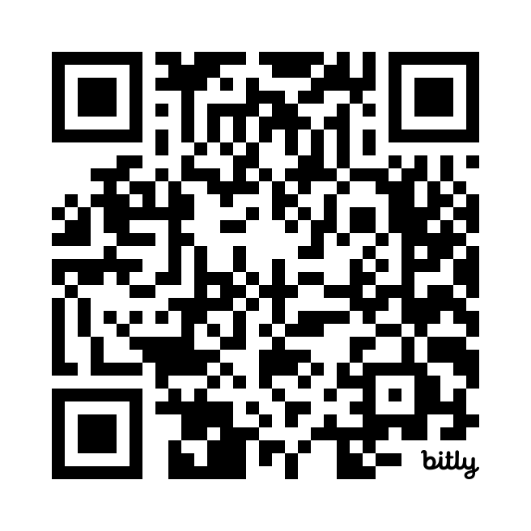
Signup
https://bit.ly/PSConfEU

Slide 9
What is Ansible
“Ansible is an open source IT automation engine that automates provisioning, configuration management, application deployment, orchestration, and many other IT processes. It is free to use, and the project benefits from the experience and intelligence of its thousands of contributors.”
https://ansible.com

Slide 10
Plugin System
A way to extend the functionality of Ansible
Comes in many different types
Except for modules, plugins must be written in Python
Ansible has some builtin plugins but is moving towards a distributed set of collections

Slide 11
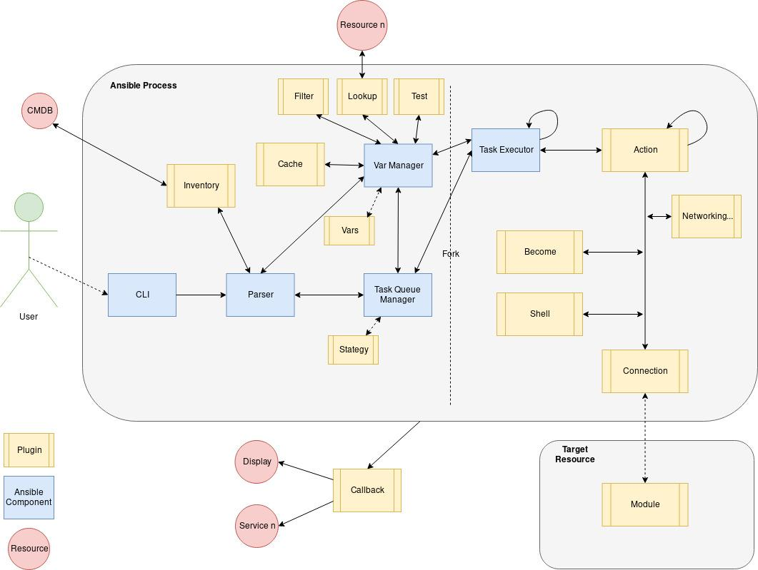

Slide 12
Roles and Collections
Roles are the old way of packaging Ansible content
Collections introduced in Ansible 2.9
Better support for packaging all Ansible plugins
Managed by the ansible-galaxy command

Slide 13
Modules
Executed on the target host
Typically Python for *nix and PowerShell for Windows
Can be in any language, even binaries
Typically manage 1 resource idempotently

Slide 14
Demo
Writing a module

Slide 15
Check Mode and Diff Output
Check Mode == -WhatIf
Diff Output returns more details for what has changed
Check mode is important to support
Diff is typically a nice to have

Slide 16
Demo
Adding Check Mode Support

Slide 17
Documentation
Very important to implement properly
Written as YAML
Contains documentation, examples, and return info
There are tests to check your docs and module spec match

Slide 18
Demo
Adding Documentation

Slide 19
Testing
All provided through ansible-test
For Windows we can do sanity and integration tests
Sanity covers simple linting, doc checks, and more
Integration tests are written as Ansible tasks to run

Slide 20
Demo
Writing tests

Slide 21

Action Plugins
A step higher than modules
Executed on the Ansible host
Can execute 0..many modules
Written in Python

Slide 22
Demo
Writing an Action Plugin

Slide 23
Module Utils
Share code between modules
Only supported for Python and PowerShell modules
PowerShell can use both PowerShell and C# utils

Slide 24
Demo
Module Utils

Slide 25

Q&A
15 minutes

