Slide 1


PSCopilot.Help

Slide 2

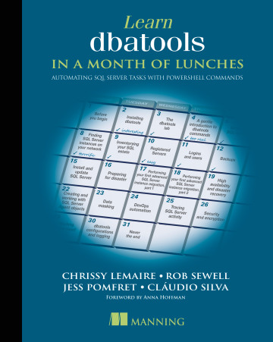
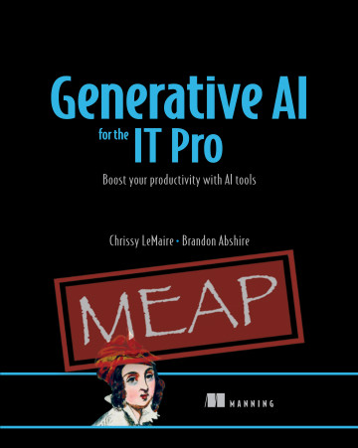

anning author
45% off
lemaire3pseu
AI at Work
Notes:
I’m also an author and these are my two books.

Slide 3

privacy.openai.com
PSCopilot.Help
Notes:
For those of you who value privacy and the GDPR, I recommend going to opt-out of everything at privacy.openai.com

Slide 4

Just use
Azure OpenAI
Services
PSCopilot.Help
Notes:
For those of you who value privacy and the GDPR, I recommend going to opt-out of everything at privacy.openai.com

Slide 5
PSHelp.Copilot
PSCopilot.Help

Slide 6
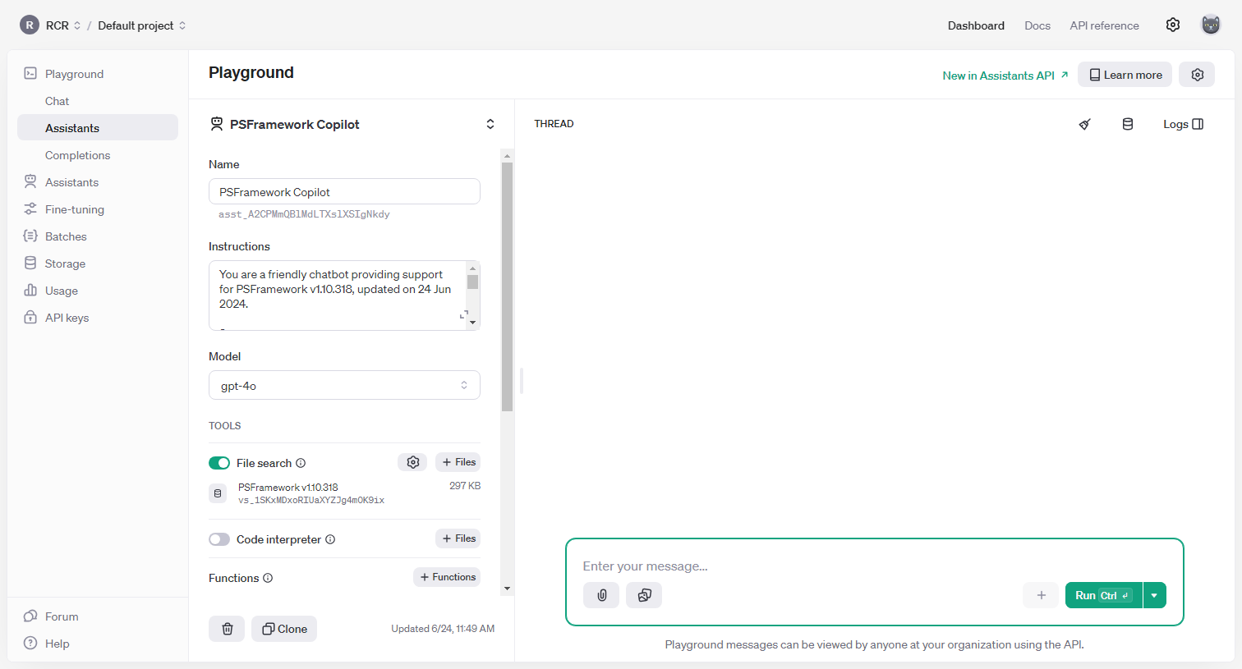
OpenAI API Assistants
AI at Work
Notes:
This is how *I* use it at work.
Custom GPTs are little task assistants that come with a $20/mo subscription to ChatGPT. They are also called Assistants in the API (sorta).

Slide 7
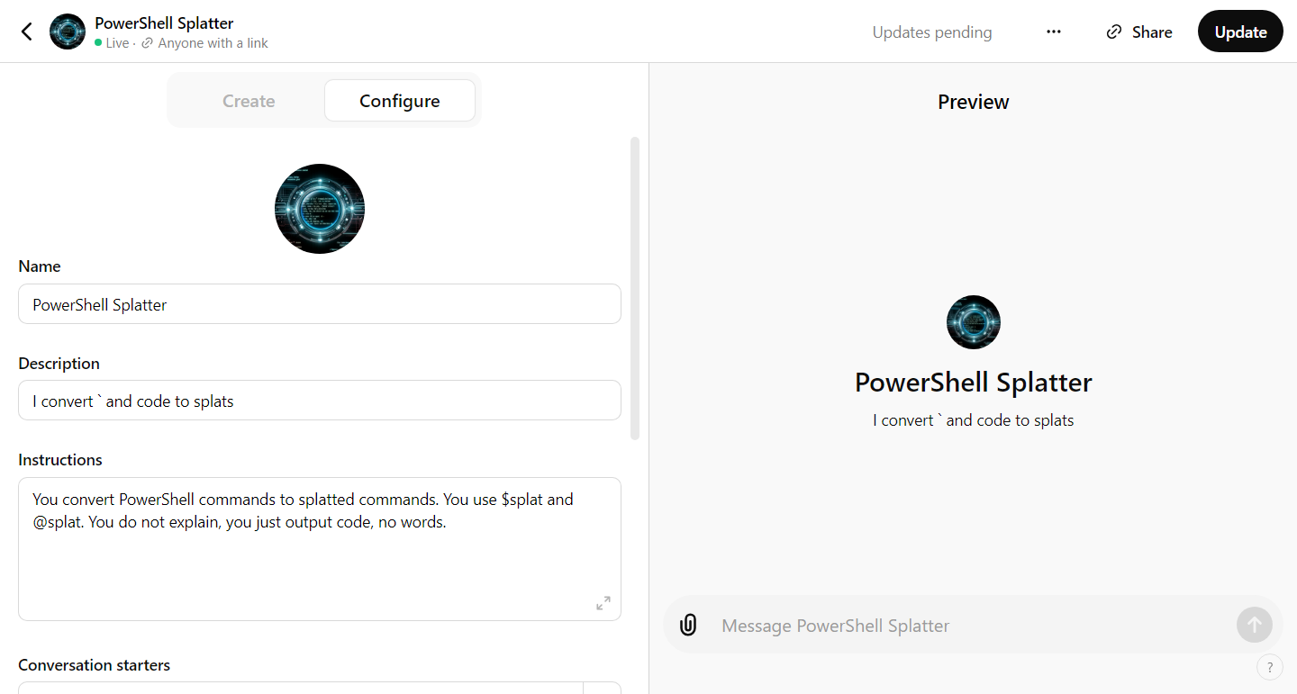
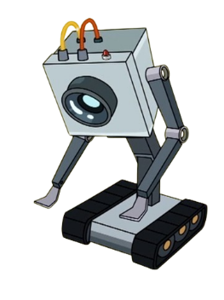
Custom GPTs
AI at Work
Notes:
This is how *I* use it at work.
Custom GPTs are little task assistants that come with a $20/mo subscription to ChatGPT. They are also called Assistants in the API (sorta).

Slide 8
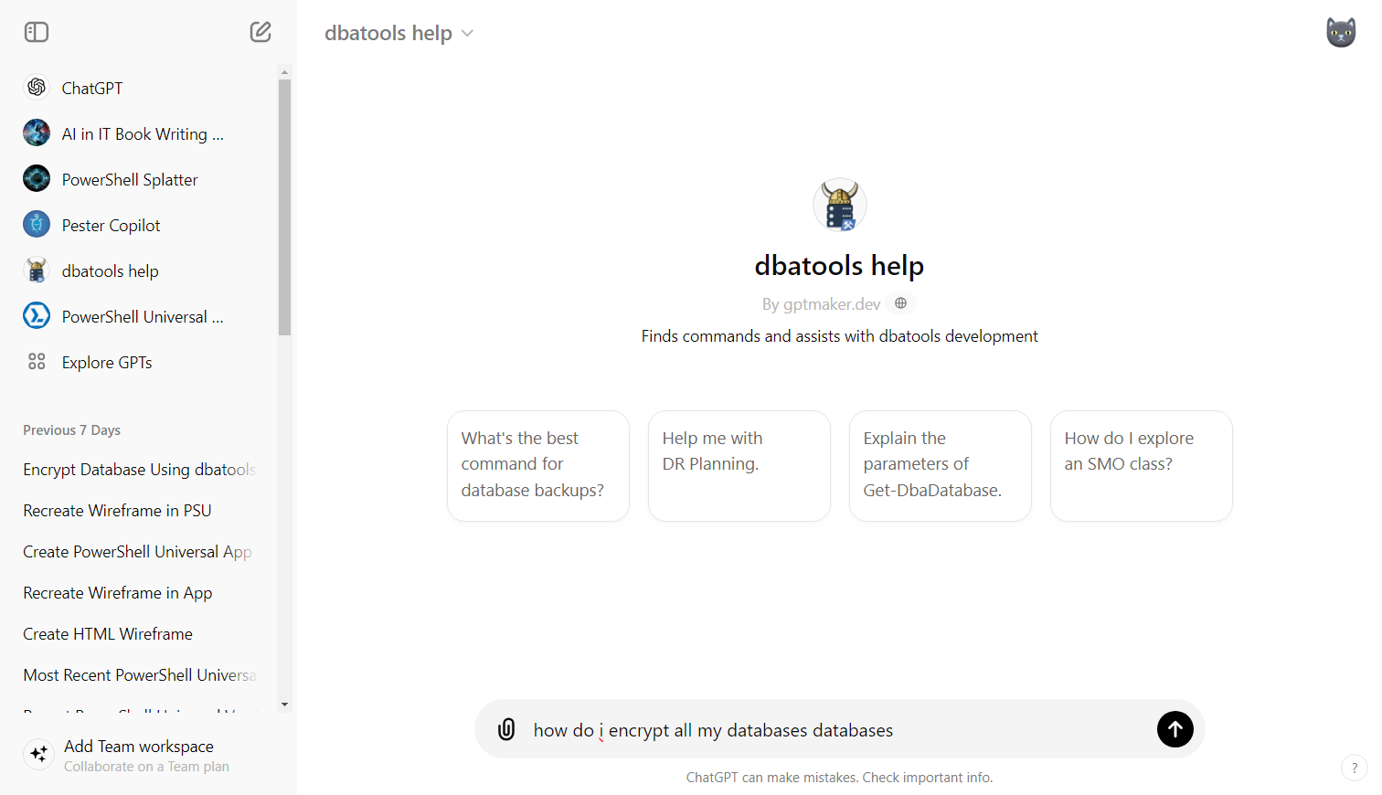
Custom GPTs
AI at Work
Notes:
This is how *I* use it at work.
Custom GPTs are little task assistants that come with a $20/mo subscription to ChatGPT. They are also called Assistants in the API (sorta).

Slide 9
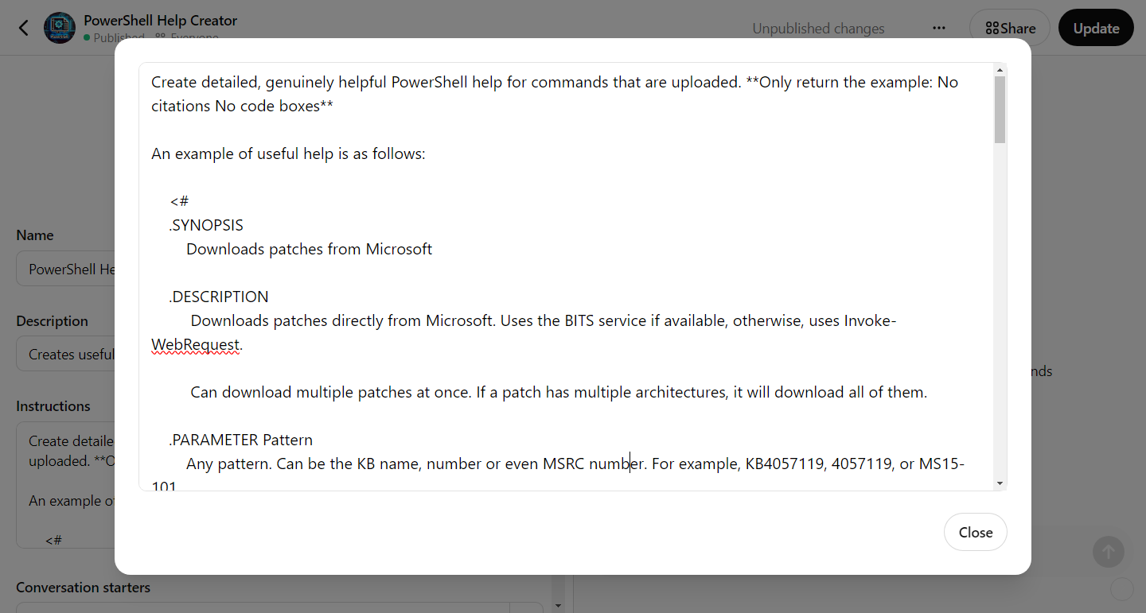
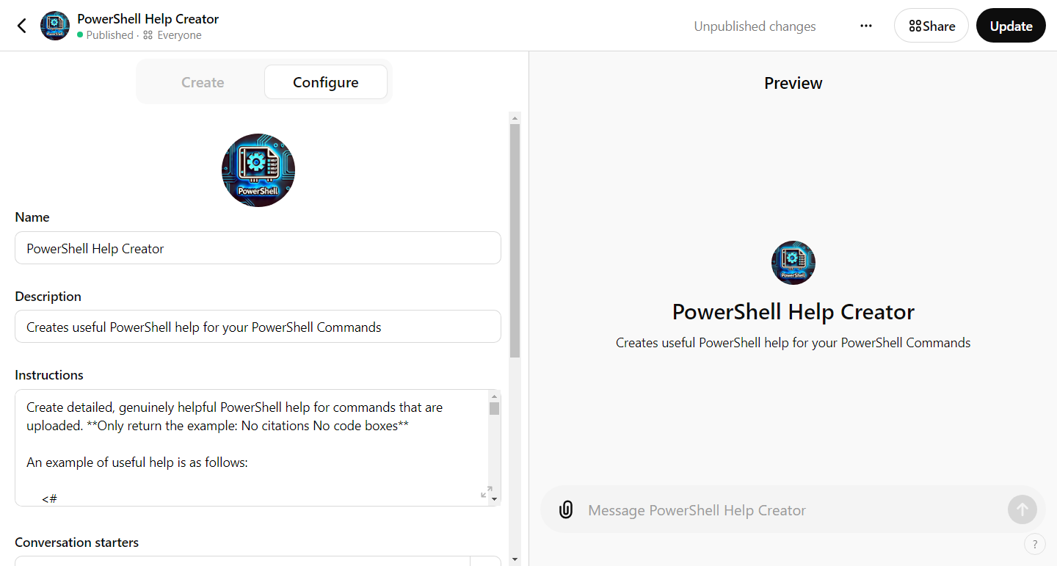
Assistants love examples
AI at Work
Notes:
This is how *I* use it at work.
Custom GPTs are little task assistants that come with a $20/mo subscription to ChatGPT. They are also called Assistants in the API (sorta).

Slide 10
PowerShell-related Custom GPTs
PowerShell Splatter - gptmaker.dev/splat
PowerShell Help Creator - gptmaker.dev/helpmaker
dbatools help - gptmaker.dev/dbatools
Pester Copilot – gptmaker.dev/pester
PowerShell Universal Copilot – gptmaker.dev/psu
PSOpenAI Copilot – gptmaker.dev/psopenai
AI at Work

Slide 11
No Magic Bullets
File uploads
File uploads in a specific format
ChatGPT Agent using PSU Help API
Fine-tuning
Chunking
My own vector store implementation
OpenAI’s vector store implementation
Azure semantic search
Maxing out system prompt with ALLL the help
YELLING AND CURSING
PSCopilot.Help

Slide 12
gptmaker.dev/prompt
PSCopilot.Help
Notes:
Microsoft gave me this prompt, thank gaurd

Slide 13
Retrieval documents +
a great prompt that forces retrieval +
ideal examples*
* and a good day with a good session
PSCopilot.Help
Notes:
Decent bullet

Slide 14

PSHelp.Copilot
PSCopilot.Help

Slide 15
Demo Time
PSCopilot.Help

Slide 16
