Slide 1

Building PowerShell Universal Dashboards using ChatGPT
Chrissy LeMaire, MVP
Notes:
SESSION ABSTRACT:
PowerShell Universal Dashboards are incredibly powerful and good looking, but the learning curve can be high — especially if you want to create advanced interfaces. There's a lot of documentation for PowerShell Universal, too, even including videos. I just didn't really know what keywords to look for. I remember being so tempted to message PSU's creator, Adam Driscoll, and say "What command created that box and gave it those options?!" Adam's a busy guy, though, so my next step was to literally pay someone for on-going help. But now, I got ChatGPT Plus! ChatGPT can tell you what PSU command created that web box AND the CSS to make it beautiful. It can even give feedback on the information architecture, user experience (UX) and accessiblity options like colorblind-friendly palette schemes. Join me for this demo-centric session to see how ChatGPT can help you to build advanced PowerShell Universal Dashboards, quickly.
Ultimately, this session will be about building effective Custom GPTs and how to talk to ChatGPT.

Slide 2


Microsoft MVP
GitHub Star
Building PowerShell Universal Dashboards using ChatGPT
Notes:
I am a Dual Microsoft MVP and GitHub Star. I’m also the recipient of GitHub’s Top Teacher award.

Slide 3

Software Engineer
Back to good ol’ SharePoint
Notes:
And I’m a software engineer at Leidos.
Leidos makes:
advanced technology solutions for defense and security
healthcare technology and services
data analytics tools
enterprise IT solutions
artificial intelligence and machine learning applications
engineering and scientific research services
space and aeronautics systems
cloud computing solutions

Slide 4

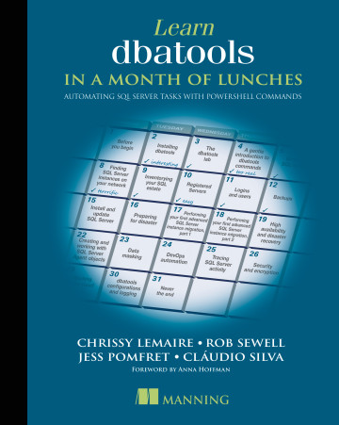
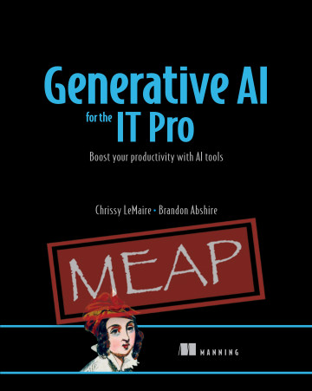

anning author
Building PowerShell Universal Dashboards using ChatGPT
Notes:
I’m also an author and these are my two books.

Slide 5


PowerShell Universal
Exposes your PowerShell scripts and modules as responsive web pages, forms, and API endpoints.
Building PowerShell Universal Dashboards using ChatGPT
Notes:
PowerShell Universal is a web framework that enables you to expose your PowerShell scripts and modules as responsive web pages, forms, and API endpoints, making it easy to build interactive web-based tools and automation platforms with PowerShell.

Slide 6
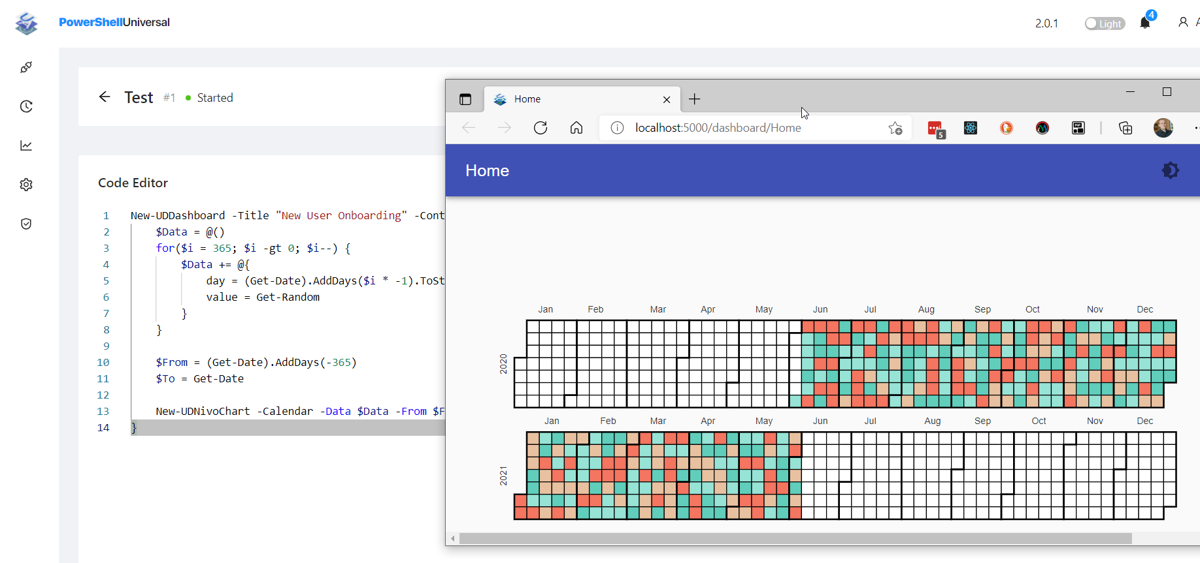
PowerShell Universal
Building PowerShell Universal Dashboards using ChatGPT
Notes:
PowerShell Universal is a web framework that enables you to expose your PowerShell scripts and modules as responsive web pages, forms, and API endpoints, making it easy to build interactive web-based tools and automation platforms with PowerShell.

Slide 7

OpenAI ChatGPT
Building PowerShell Universal Dashboards using ChatGPT
Notes:
I’m going to introduce OpenAI ChatGPT for those

Slide 8
privacy.openai.com
Building PowerShell Universal Dashboards using ChatGPT
Notes:
For those of you who value privacy and the GDPR, I recommend going to opt-out of everything at privacy.openai.com

Slide 9
OpenAI Chatbots
OpenAI ChatGPT Plus
- €20/mo
- Custom GPTs are awesome
Building PowerShell Universal Dashboards using ChatGPT
Notes:
ChatGPT is a consumer product

Slide 10
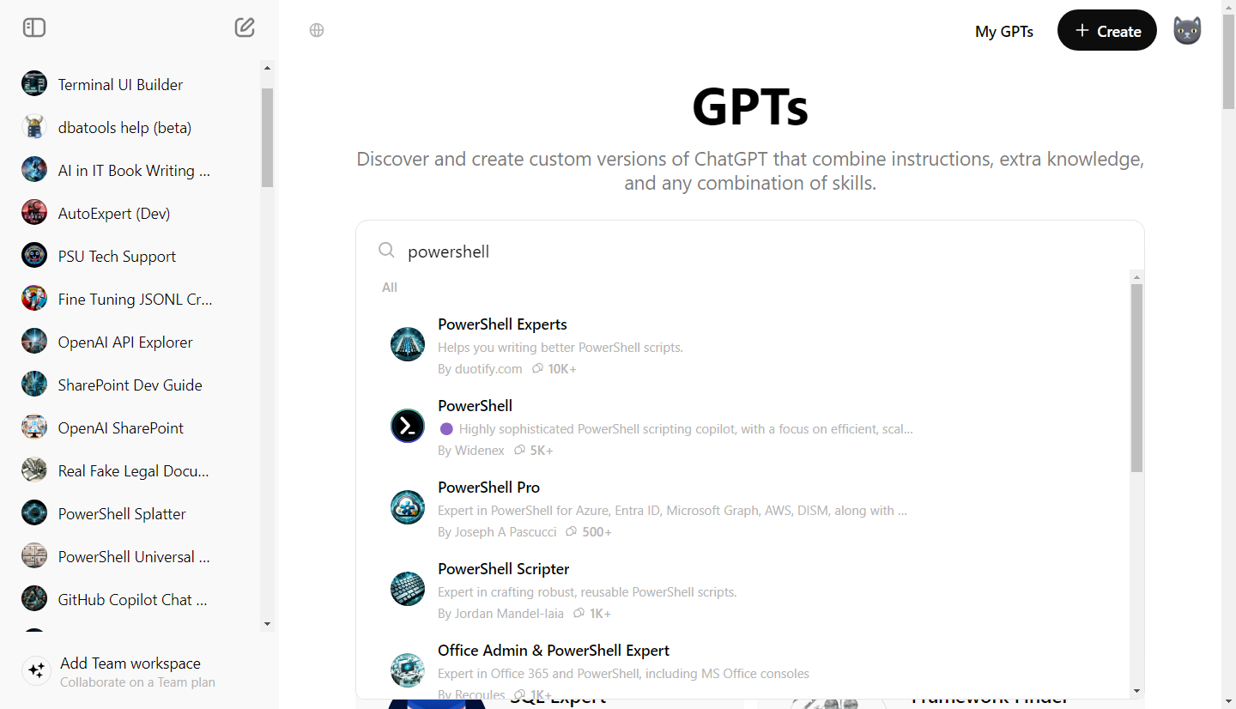
Building PowerShell Universal Dashboards using ChatGPT
Notes:
Custom GPTs are very useful for repeated tasks

Slide 11
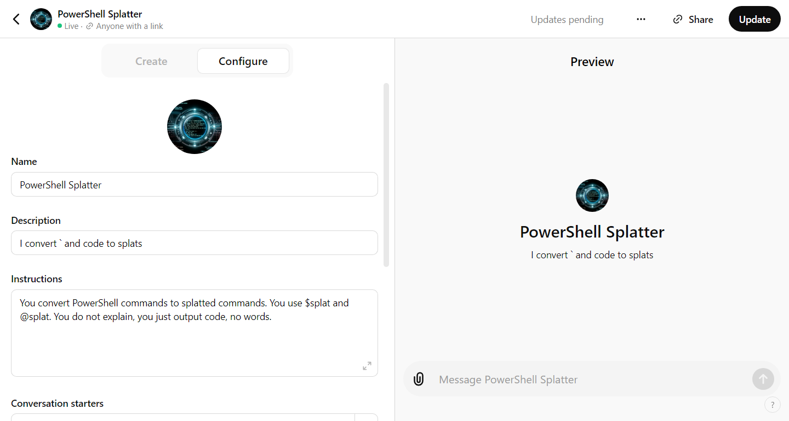
Building PowerShell Universal Dashboards using ChatGPT
Notes:
Custom GPTs are very useful for repeated tasks

Slide 12
OpenAI ChatGPT Plus
OpenAI ChatGPT Plus
- €20/mo
- Custom GPTs are awesome
- Excellent vision, solid phone apps
OpenAI API
- Newest models
- Far more control
- Often performs better than ChatGPT
- Affordable - Input: $5 / million tokens, Output: $15 / million tokens
Building PowerShell Universal Dashboards using ChatGPT
Notes:
OpenAI also offers an API which is important to developers

Slide 13
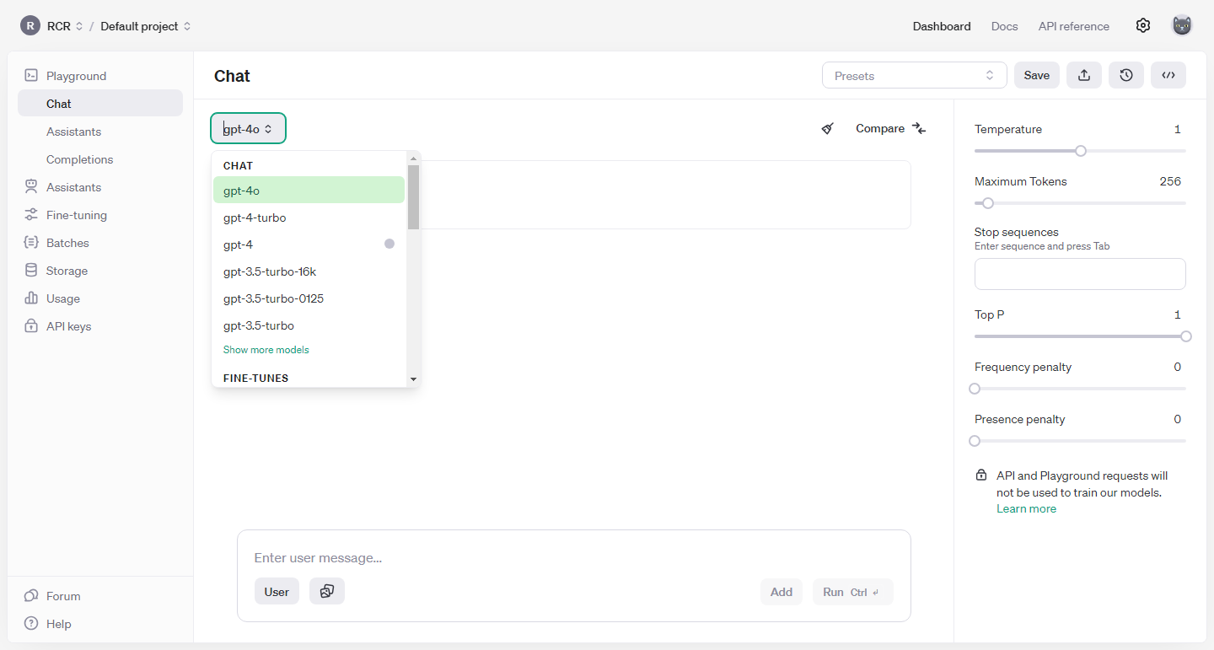
Building PowerShell Universal Dashboards using ChatGPT
Notes:
Custom GPTs are very useful for repeated tasks

Slide 14
Azure OpenAI Service API
Azure AI Service API
- Privacy and Security-focused
- Often lags a little with new models
- Like OpenAI’s API, it supports Assistants which are sorta like Custom GPTs
- Affordable - Input: $5 / million tokens, Output: $15 / million tokens
- Must pay for storage, can get costly
- Nice new playground
Building PowerShell Universal Dashboards using ChatGPT
Notes:
Overall, I’d recommend Azure for Enterprise tasks as it’s security and privacy focused.

Slide 15
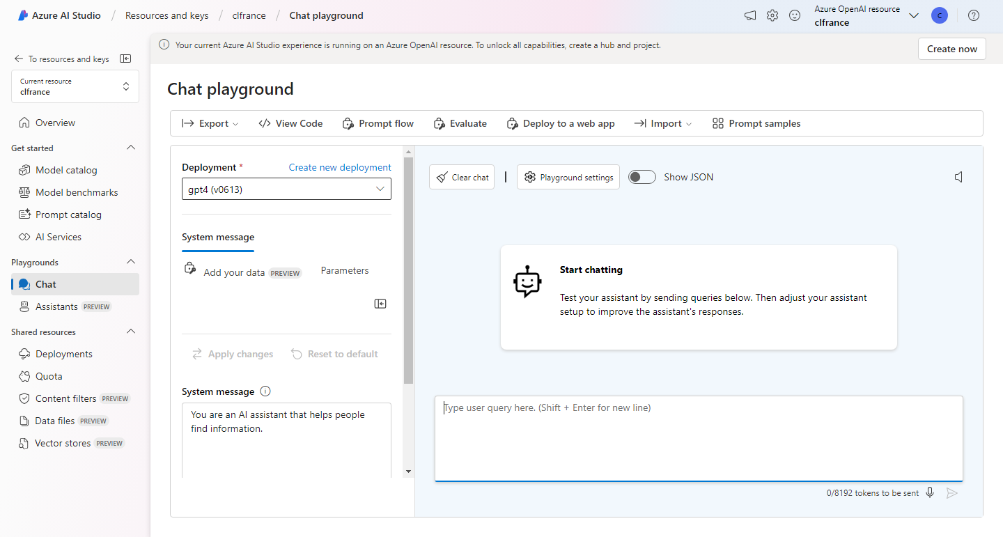
Building PowerShell Universal Dashboards using ChatGPT
Notes:
Custom GPTs are very useful for repeated tasks

Slide 16
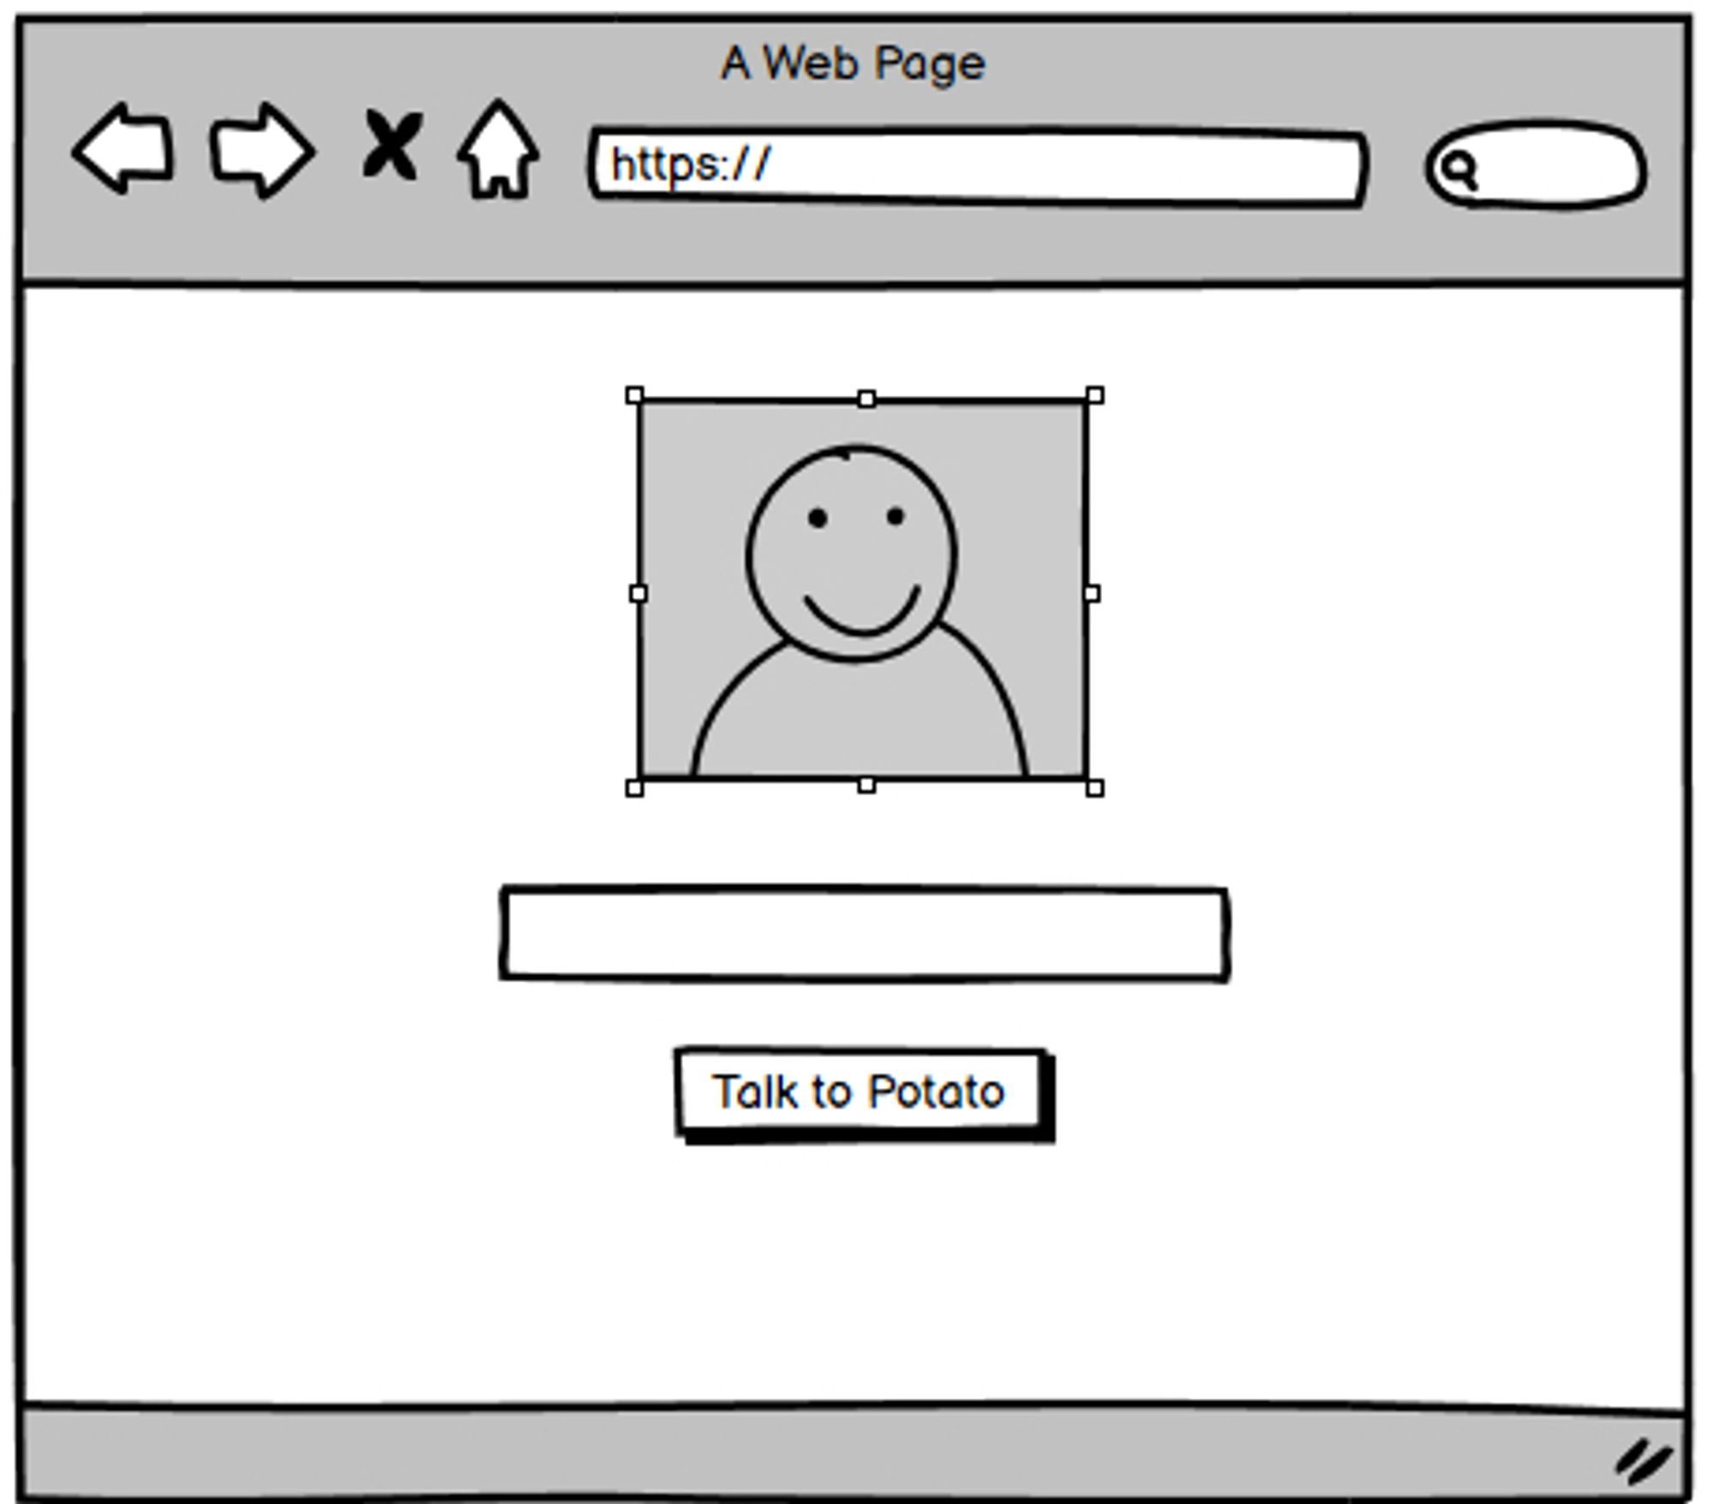
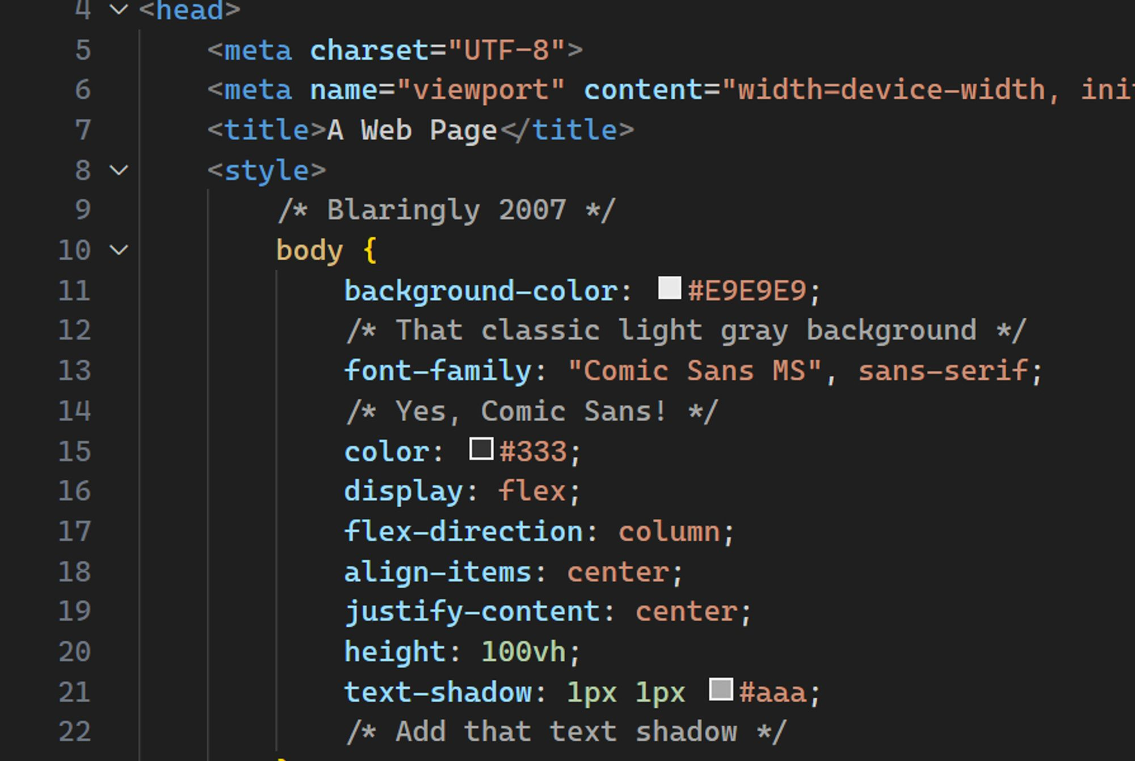
Notes:
Then comes around ChatGPT and the hype going around was that you could draw your website on a napkin and it would convert it into code.
I tried this with Balsamiq mockups for my own Tot Bot (chatbot that has the personality of my cat Potato) fine-tuning project and it worked! It even gave me a slick 2007-style UI.

Slide 17
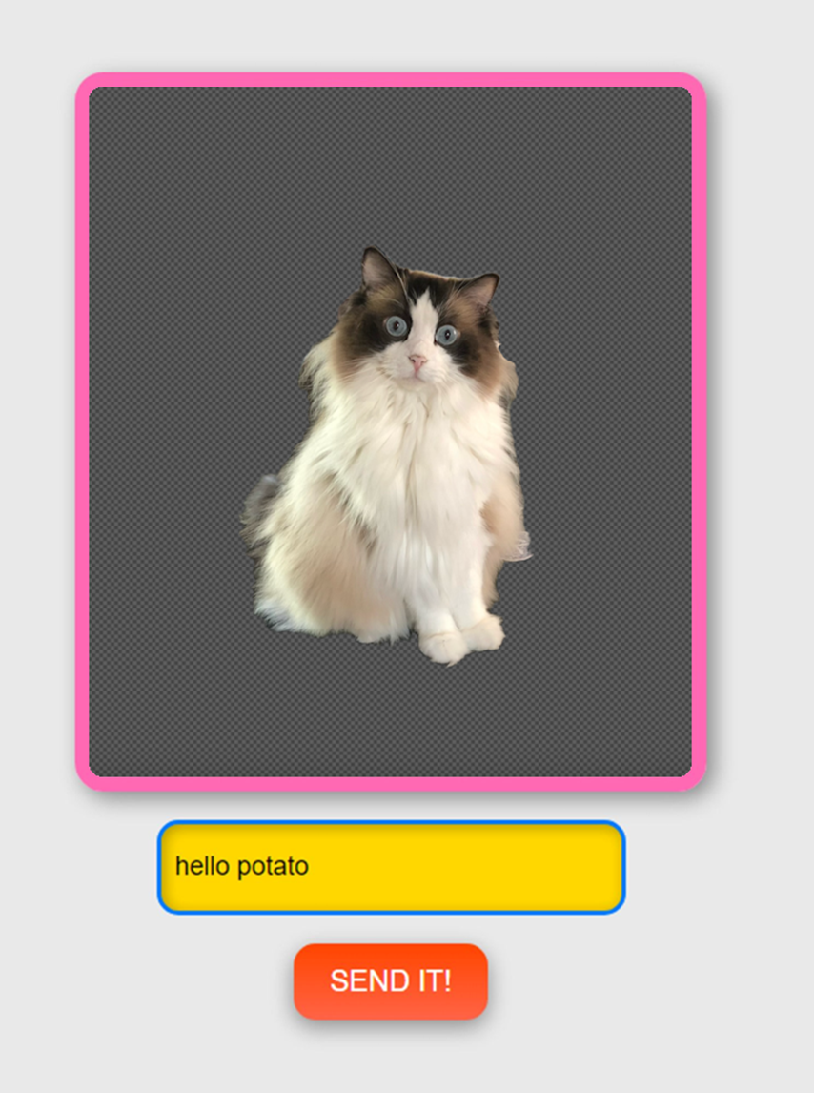
Notes:
Tada! It’s Tot Bot.

Slide 18
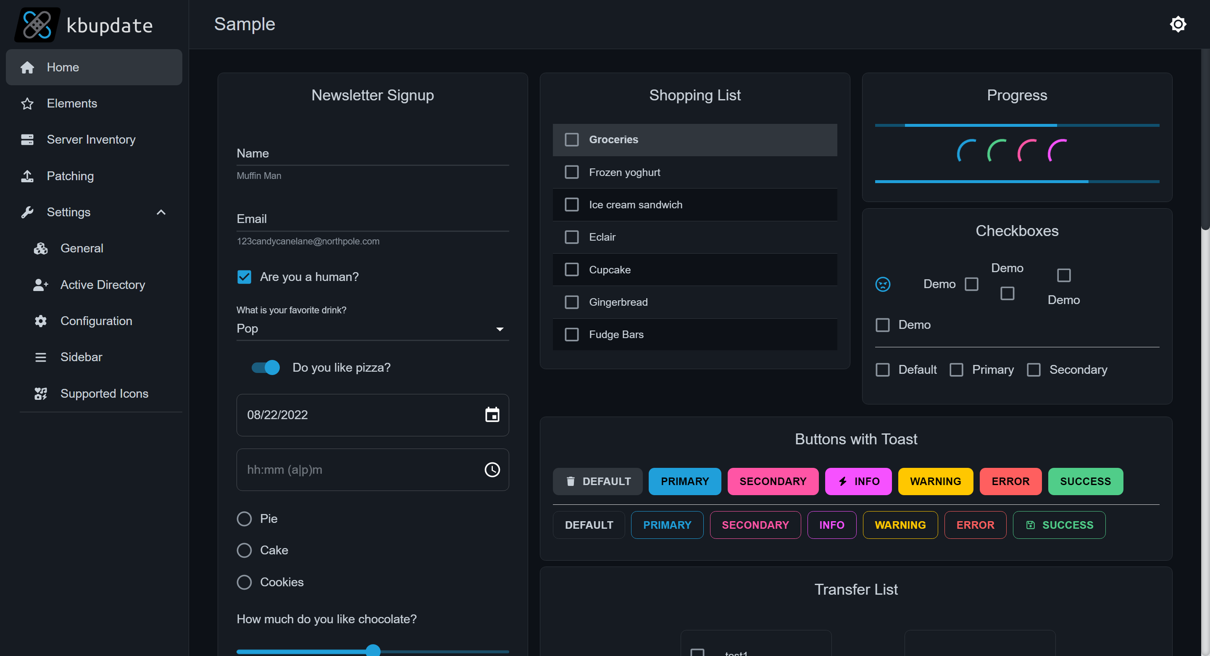
Notes:
Remember when I released a bunch of themes for PowerShell Universal a few years ago? I did it basically to help myself learn PSU. Even though there was tons of documentation, it had a high learning curve. The creator, Adam Driscoll said this was a common complaint.
I’d say it took me two solid months to understand the concept and the implementation, which seemed required to create a project.
Steph Hays

Slide 19
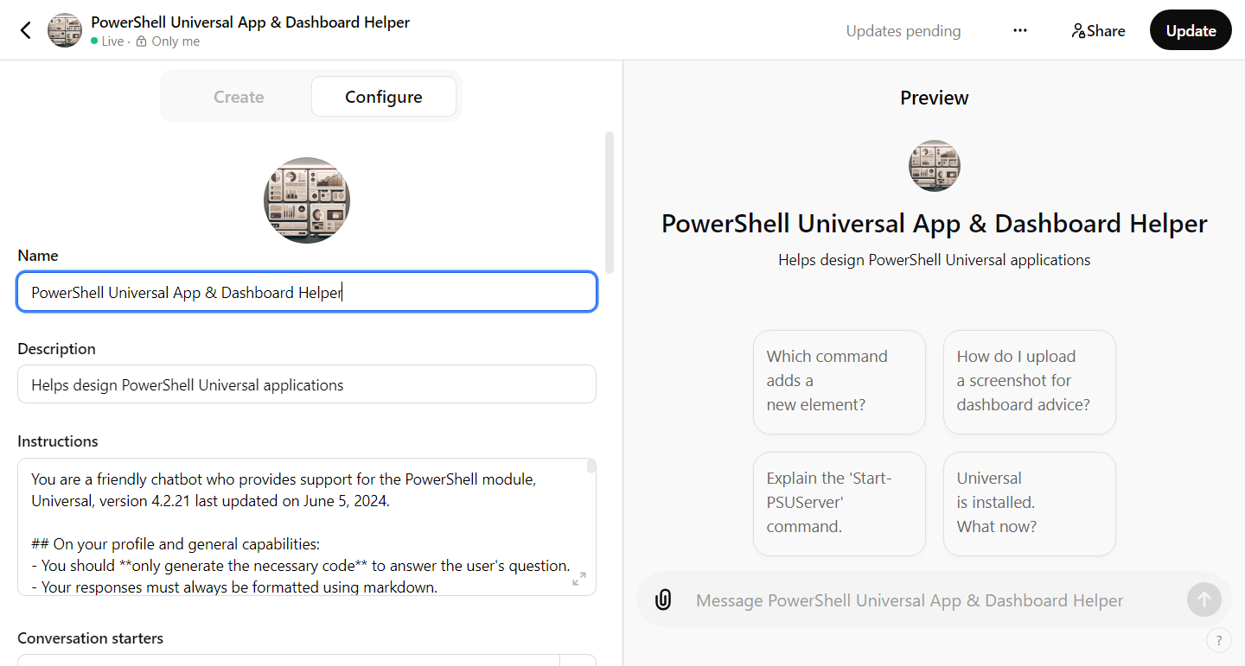
Building PowerShell Universal Dashboards using ChatGPT
Notes:
Now Imagine if I could mix the two together.
Let’s go see this in action with a demo that will teach you not only how to use ChatGPT to build PowerShell Universal Apps, but it’ll also show you HOW to build a similar Custom GPT/OpenAI Assistant for your own PowerShell module.
“Closely matching the visual elements”

Slide 20
No Magic Bullets
File uploads
File uploads in a specific format
ChatGPT Agent using PSU Help API
Fine-tuning
Chunking
My own vector store implementation
OpenAI’s vector store implementation
Azure semantic search
Maxing out system prompt with ALLL the help
YELLING AND CURSING
Building PowerShell Universal Dashboards using ChatGPT

Slide 21
gptmaker.dev/prompt
Building PowerShell Universal Dashboards using ChatGPT
Notes:
Microsoft gave me this prompt, thank gaurd

Slide 22
Retrieval documents +
a great prompt that forces retrieval +
ideal examples*
* and a good day with a good session
Building PowerShell Universal Dashboards using ChatGPT
Notes:
Decent bullet

Slide 23

PSHelp.Copilot
Building PowerShell Universal Dashboards using ChatGPT

Slide 24
Demo Time
Building PowerShell Universal Dashboards using ChatGPT

