Slide 1
Next Up:
David Sass

Slide 2
3
3

Slide 3
2

Slide 4
1

Slide 5
Building SOC Tools on Stage
David Sass
Notes:
Joke about being on stage

Slide 6

Many thanks to our sponsors:

Slide 7
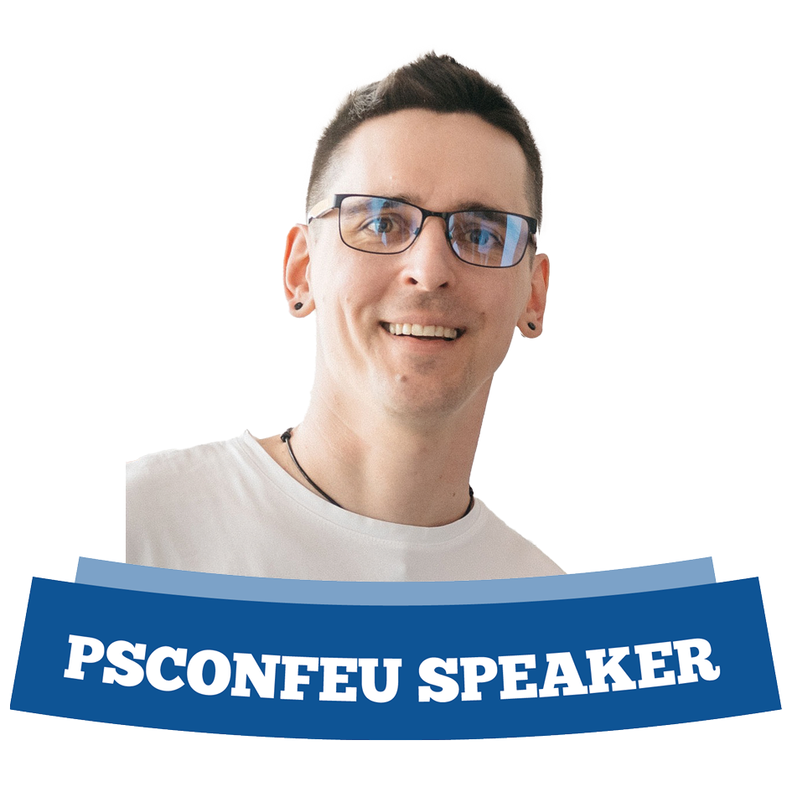
David Sass
Security Domain Architect at Switch
Former SRE
Recovering SharePoint Architect
Still dreams about Kerberos
Screams at the cloud
Relationship with Git is complicated
Will tell you Notebooks are awesome
dah-vEEd Schass
He/him/his/Skills

Slide 8
Goals
Help you
Share best practices
Go open source
Give a tool which isn’t super terrible to use

Slide 9
Context
Switch operates a Security Operations Center (SOC) for the higher education community in Switzerland
The technology stack is Microsoft Defender XDR and Azure Sentinel
Defender is not tuned for the educational space
Defender XDR is slow as a web application
Entra ID is also slow
Notes:
Not tuned is problematic because it is full of BYOD and both VPN and TOR usage counts as legitimate formost students and even for some faculty
Too high amount of false positives

Slide 10
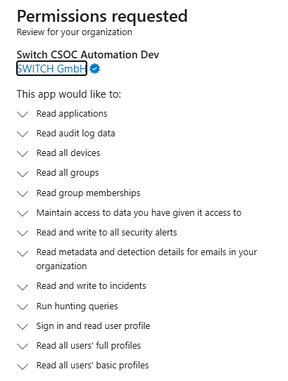
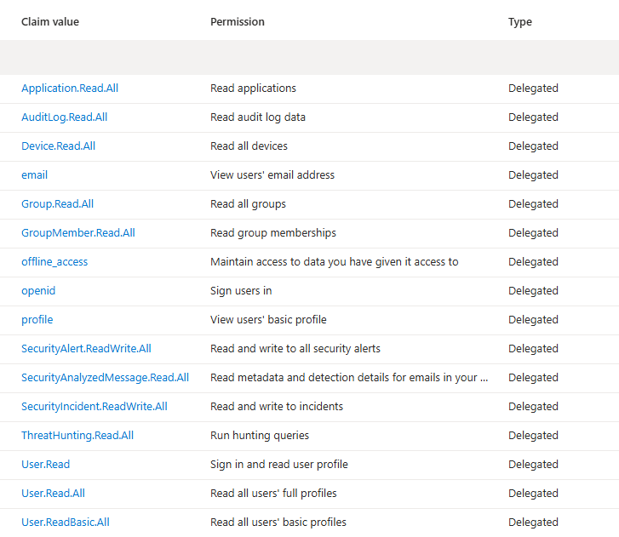
Pre-req: App reg with delegated API perm

Slide 11
Demos
We love Demos!

Slide 12
Recap
Delegated API permissions are perfect No secrets nor certificates are required
Individual accountability is not lost
Cross platform
Notebooks can be nested
Notebooks can be saved for audit purposes

Slide 13
Q&A
15 minutes

Slide 14
Links
https://github.com/psconfeu/2024/tree/main/DavidSass/PowerShellNotebooks_everywhere
https://youtu.be/RNQto14mH9s
https://github.com/switch-ch/SwitchPwshXDRNotebooks ⭐

