Slide 1
Next Up:
David Sass

Slide 2
3
3

Slide 3
2

Slide 4
1

Slide 5
Winget inside Intune remediation scripts
David Sass

Slide 6

Many thanks to our sponsors:

Slide 7

David Sass
Security Domain Architect at Switch
Former SRE
Recovering SharePoint Architect
Still dreams about Kerberos
Screams at the cloud
Relationship with Git is complicated
Will tell you Notebooks are awesome
dah-vEEd Schass
He/him/his/Skills

Slide 8
Session goals
Look at alternatives
Share the journey, so you can skip over some errors
There were LOTS of error

Slide 9
Context
Small fleet of hardened device
Fully centralized management
No local admin rights
User context installation disabled
We need less than 10 apps
Hard to justify a subscription for this
How hard it can be?

Slide 10
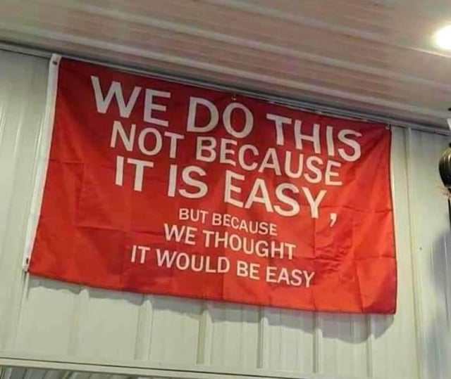
Notes:
It all started with a problem and my lack of understanding of the problem.

Slide 11
Alternatives
Paid subscription
Cost, security, internal bureaucracy
Do it by hand
Package apps for Intune
Platform scripts?
Remediation scripts

Slide 12
Read the Docs!!
As a SysAdmin: I didn’t read it, and now I am telling you that you should read the Intune docs.

Slide 13
Main errors along the day
Didn’t read the docs
Forgot that devices were – while used – never customized
Nuget was missing
Forgot about the SYSTEM context
It matters where things are installed (ie: PowerShell modules)
Exceptions (dotnet)

Slide 14
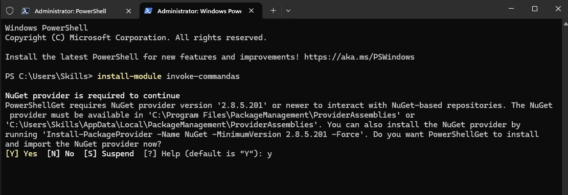
Favorite Nuget error

Slide 15
Demos
We love Demos!

Slide 16
Recap
Must read the Intune docs, ask ChatGPT for examples
Return codes are must, and output should be written to console
Remediation scripts need scheduling!
File based logging won’t scale, hard to get the logs

Slide 17
Q&A
15 minutes

Slide 18
Repository
https://github.com/switch-ch/IntuneWinGetRemediation

