Slide 1
Next Up:
Friedrich “Fred” Weinmann

Slide 2
3
3

Slide 3
2

Slide 4
1

Slide 5
Caching Accelerate your code and Murder your Memory
Fred

Slide 7
"There are only two hard things in Computer Science: cache invalidation, naming things, and off-by-one errors."

Slide 8
Notes on PDD
Have you heard about PSFramework?
https://PSFramework.org
Install-Module PSFramework
Install-PSResource PSFramework
Install-PSFModule PSFramework

Slide 9
Demos
We love Demos!

Slide 10
Q&A
15 minutes

Slide 11
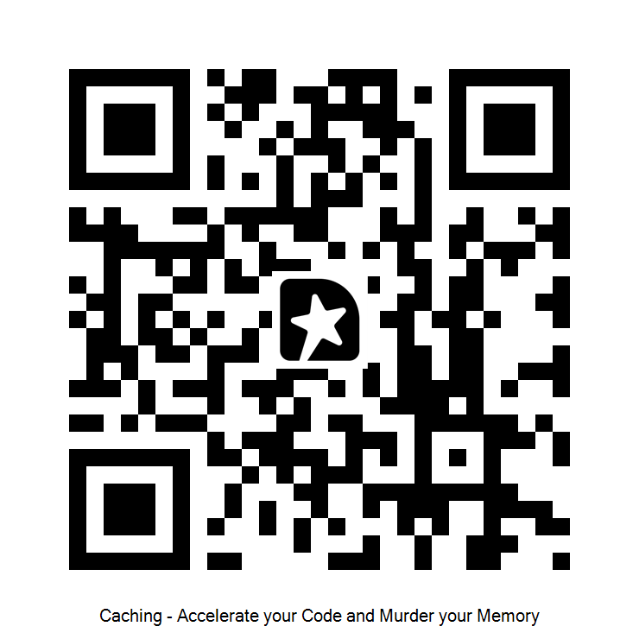
GIVE ME FEEDBACK
INSERT YOUR SESSION QRCODE HERE

