Slide 1
Next Up:
Leo D’Arcy

Slide 2
3
3

Slide 3
2

Slide 4
1

Slide 5
From Scripts to System Calls with PowerShell
Leo D’Arcy

Slide 7


Leo D’Arcy
(He/Him)
Consultant for 10 Years specializing in:
Azure Datacentre Migrations
Automation
Remote Access Solutions
Currently a Cloud Solutions Architect for a global stakeholder advisory firm
Run Remote Access UG Discord Community and Develop DPC for Always On VPN

Slide 8
What is a System Call?

Slide 9
What is a System Call?
Officially known as the Windows API
Written in C
Initial Release in 1985

Slide 10
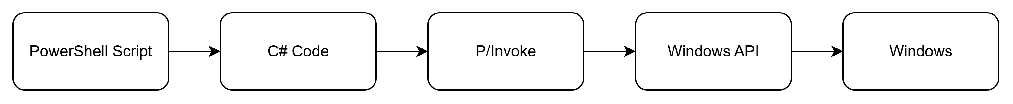
What is a System Call?
Officially known as the Windows API
Written in C
Initial Release in 1985
Accessed via C# P/Invoke

Slide 11
Memory Management

Slide 12
Memory Management
C has no automatic Memory Management

Slide 13
Memory Management
C has no automatic Memory Management
String sizes are defined at compile time

Slide 14
Memory Management
C has no automatic Memory Management
String sizes are defined at compile time
Memory generally provided by requestor

Slide 15

Why?

Slide 16

Disclaimer
Don’t Copy my VPN Setup!

Slide 17
Demos
We love Demos!

Slide 18
Building your own

Slide 19
Building your own
https://learn.microsoft.com/en-us/windows/win32/api/ is mostly accurate
Windows SDK Header Files
https://pinvoke.net/
Github/Google/AI

Slide 20
Considerations

Slide 21
Considerations
Memory Management is Hard

Slide 22
Considerations
Memory Management is Hard
$null <> IntPtr::Zero

Slide 23
Considerations
Memory Management is Hard
$null <> IntPtr::Zero
Add-Type can’t be undone

Slide 24
Considerations
Memory Management is Hard
$null <> IntPtr::Zero
Add-Type can’t be undone
Development takes Trial and Error

Slide 25
Summary

Slide 26
Summary
Super Powerful API

Slide 27
Summary
Super Powerful API
Massive Pain to Use

Slide 28
Summary
Super Powerful API
Massive Pain to Use
Consider if PowerShell is the right tool…

Slide 29
Q&A
15 minutes

Slide 30
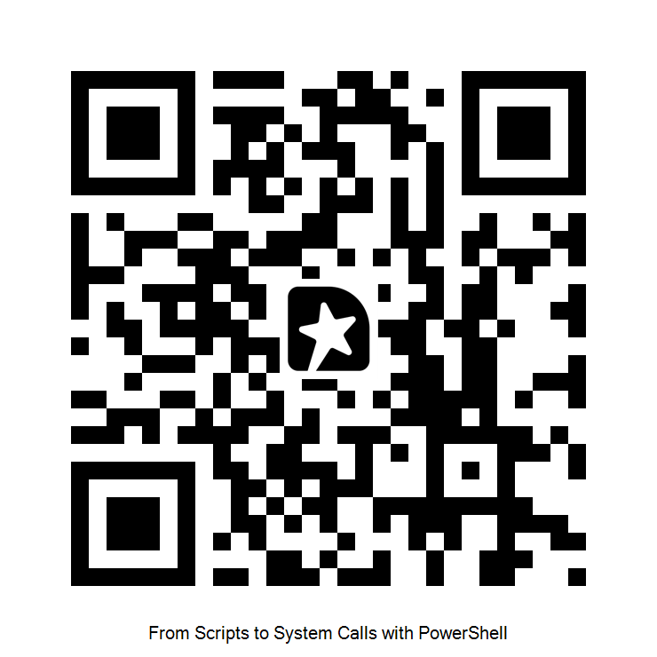
GIVE ME FEEDBACK

