Slide 1
Next Up:
Marc-André Moreau

Slide 2
3
3

Slide 3
2

Slide 4
1

Slide 5
Side-by-Side PowerShell and Module Environments with multi-pwsh
Marc-André Moreau

Slide 6
Many thanks to our sponsors:

Slide 7

Marc-André Moreau
Chief Technology Officer at Devolutions
Microsoft MVP (PowerShell & Windows)
Creator of the FreeRDP open source project
I love PowerShell, .NET, Rust, network protocols and reversing Windows internals ☺
CTO, Devolutions

Slide 8

github.com/Devolutions/multi-pwsh
Side-by-side PowerShell installs (7.4, 7.5, 7.6 incl. previews/RCs)
Per-version aliases (e.g. pwsh-7.4.11), pin or track latest
Virtual environments for PowerShell module isolation
Export / import virtual environments as zip archives
.NET native Rust host – not the regular .NET apphost.exe

Slide 9
Getting Started
Bootstrap, Install, and Verify

Slide 10
Demo Time
Let's see it in action
github.com/Devolutions/multi-pwsh

Slide 11
Installing PowerShell with multi-pwsh
Install and verify side-by-side versions:
$ multi-pwsh install 7.4
$ multi-pwsh install 7.5
$ pwsh-7.4 --version | pwsh-7.5 --version
Flexible version selectors:
7 = latest 7.x | 7.4 = latest 7.4.x | 7.4.11 = exact | 7.4.x = all patches

Slide 12
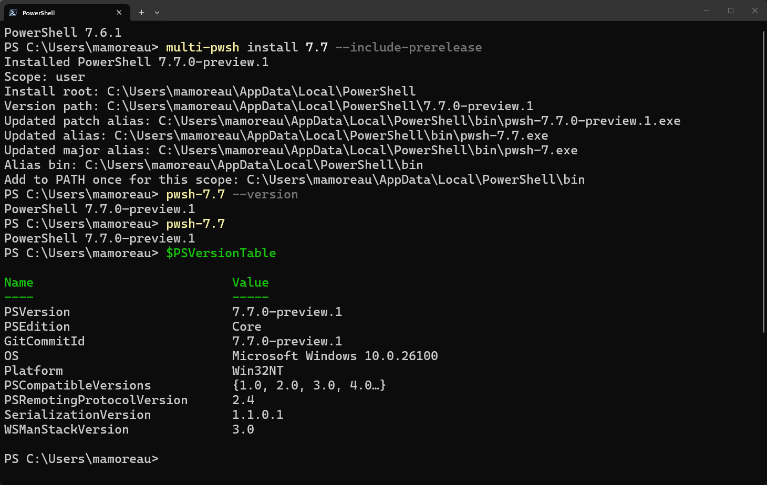

Slide 13
Scoped Installs & Alias Management
User vs. Machine scope (Windows, macOS, Linux):
$ multi-pwsh install 7.5 --scope machine
Versions stay side-by-side under the selected install root
PATH only needs one entry per scope; aliases live in a stable bin dir
Alias pinning and lifecycle:
$ multi-pwsh alias set 7.4 7.4.11 # pin to exact version
$ multi-pwsh alias unset 7.4 # unpin, track latest
Windows integration flags:
--enable-psremoting --add-explorer-context-menu --register-manifest

Slide 14
Virtual Environments & Native Host
Isolated module roots (like Python venvs for PowerShell):
$ multi-pwsh venv create msgraph
$ multi-pwsh host 7.4 -venv msgraph -NoLogo -NoProfile
Save-Module directly into venv root; PSModulePath is scoped per launch
Export and import for reproducible environments:
$ multi-pwsh venv export msgraph msgraph.zip
$ multi-pwsh venv import msgraph-copy msgraph.zip
Native host mode (pwsh-host crate):
Runs PowerShell through native hosting, not a subprocess
Alias shims are hard links to multi-pwsh; auto-repaired by doctor

Slide 15
Q&A
15 minutes

