Slide 1
Your Graph Apps Are Over-Privileged — Let’s Fix That! / Morten Mynster
Notes:
Slide 0: this slide will not automatically turned over. Show this BEFORE the acutal presentation starts.

Slide 2

Who am I?
Name – Morten Mynster
Cybersecurity Consultant @ TDC Erhverv
LeastPrivilegedMSGraph - Creator
MSGraphPermissions - Creator
ActionableMessages – Creator
AndrewPlaClips - Creator
Maester - Contributor
1 / 20

Slide 3
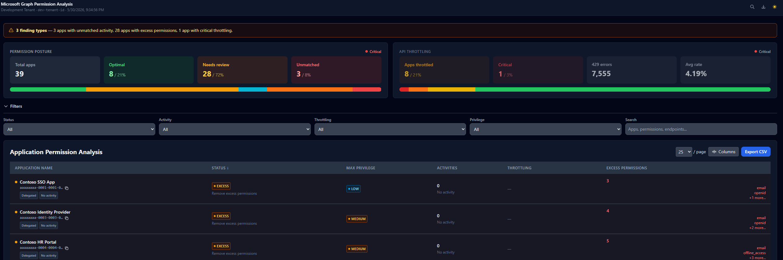
What we are talking about
2 / 20

Slide 4
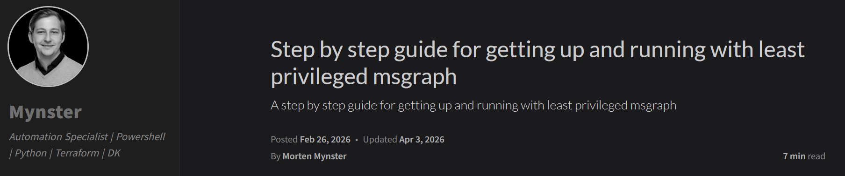
Prerequisite
Step by step guide available here: https://mynster9361.github.io/posts/LeastPrivilegedMSGraphSetup/
3 / 20

Slide 5
Why should you audit sp/mi permissions
Cloud integrations is only getting bigger.
Permission sprawl
Legacy
4 / 20

Slide 6
How would you do audit sp/mi permissions?
5 / 20

Slide 7
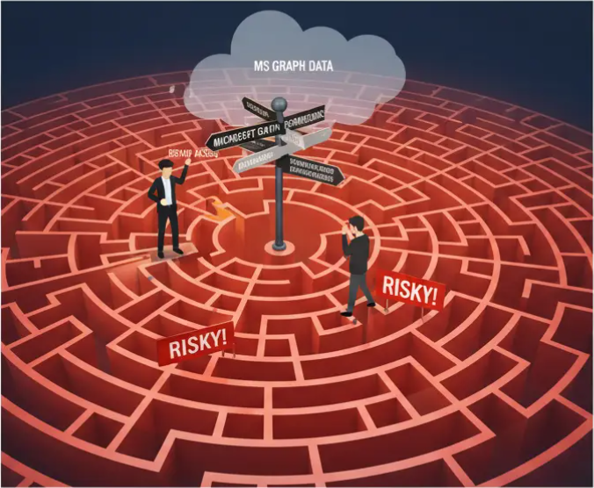
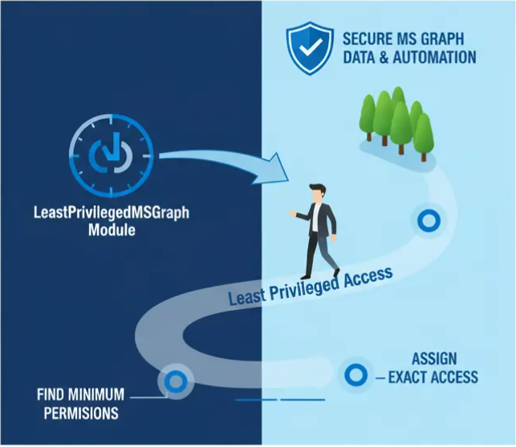
Lets take a look at how my module can assist
6 / 20

Slide 8
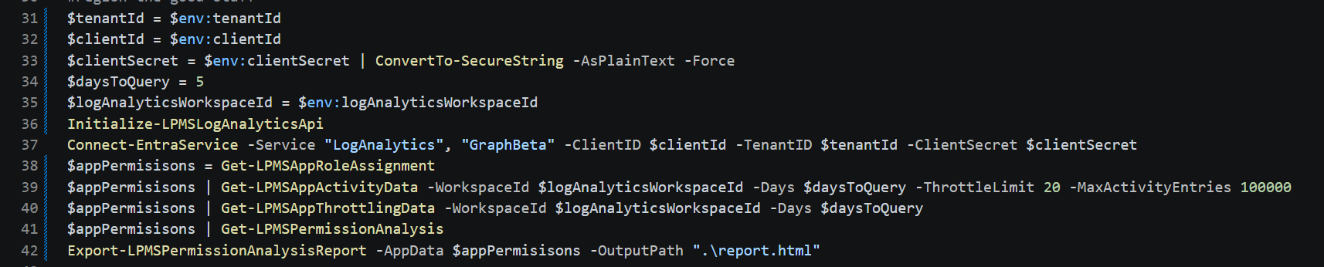
A few commands and you can have your own report
7 / 20

Slide 9
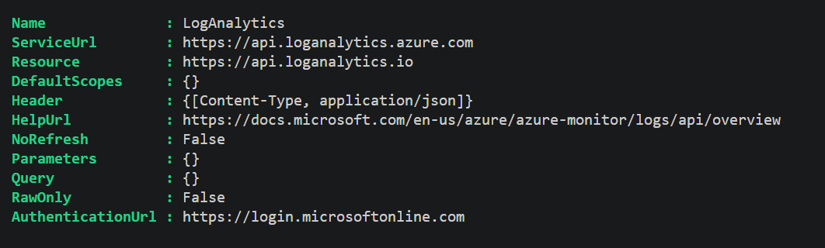
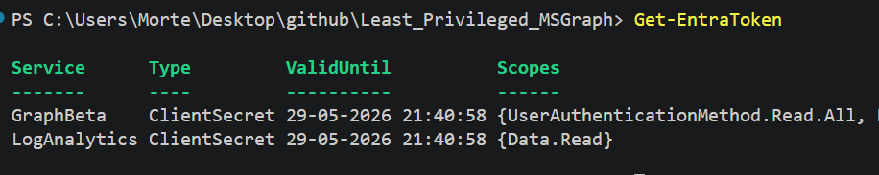
8 / 20

Slide 10
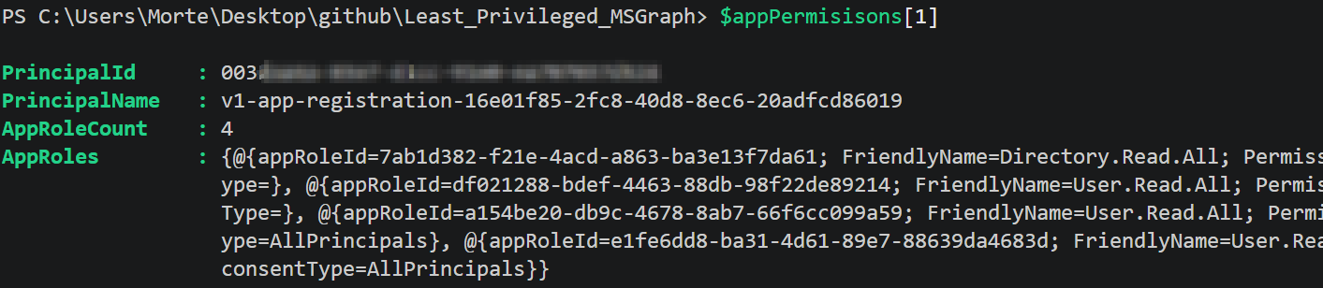
Graph permission assignments
9 / 20

Slide 11
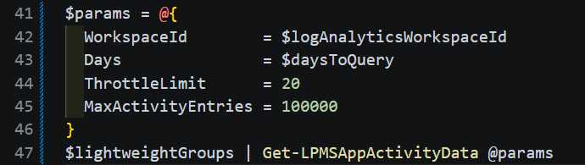
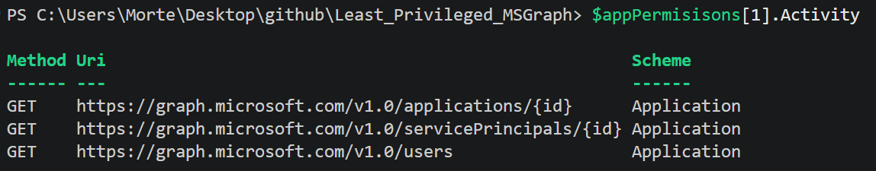
Activity data
10 / 20

Slide 12
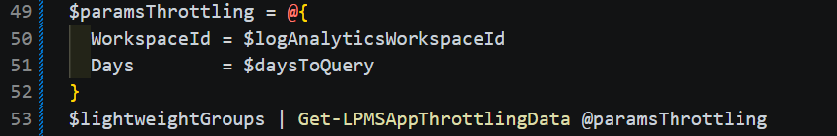
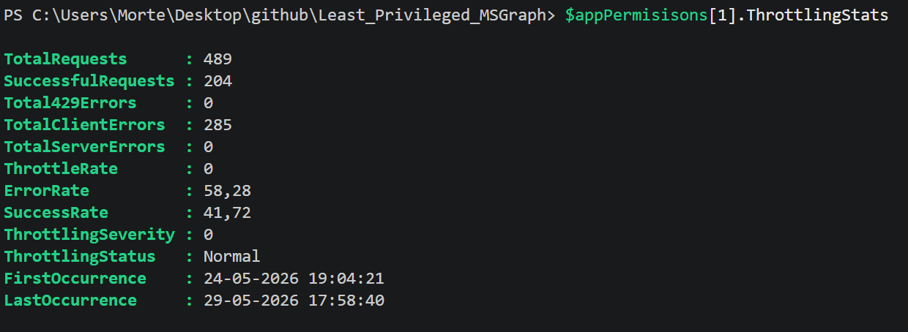
Throttling
11 / 20

Slide 13
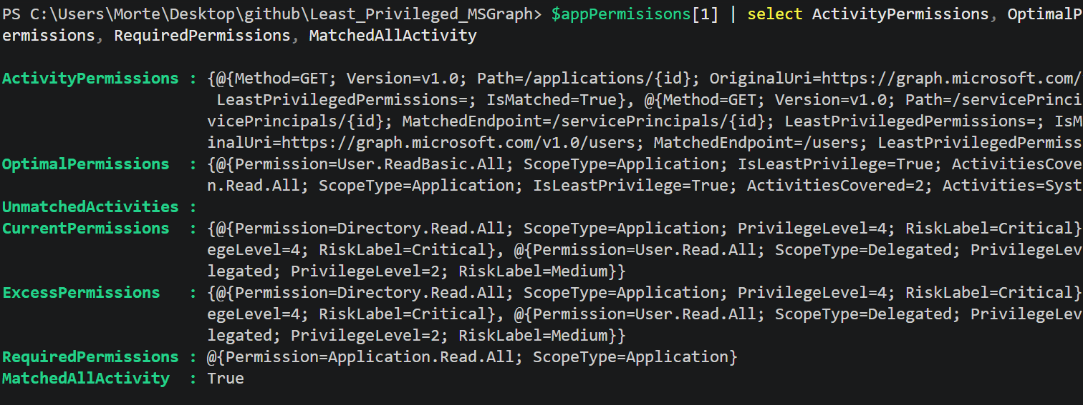
12 / 20

Slide 14
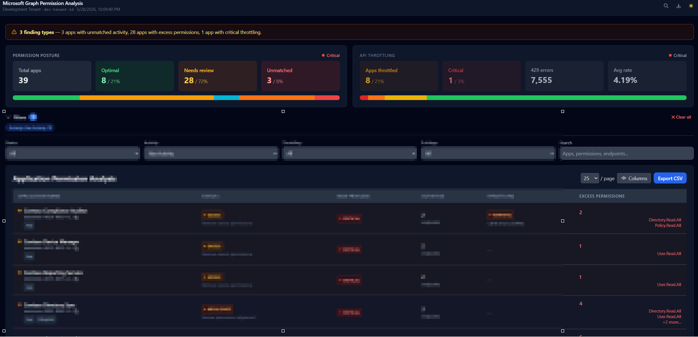
Initial view of the report
13 / 20

Slide 15
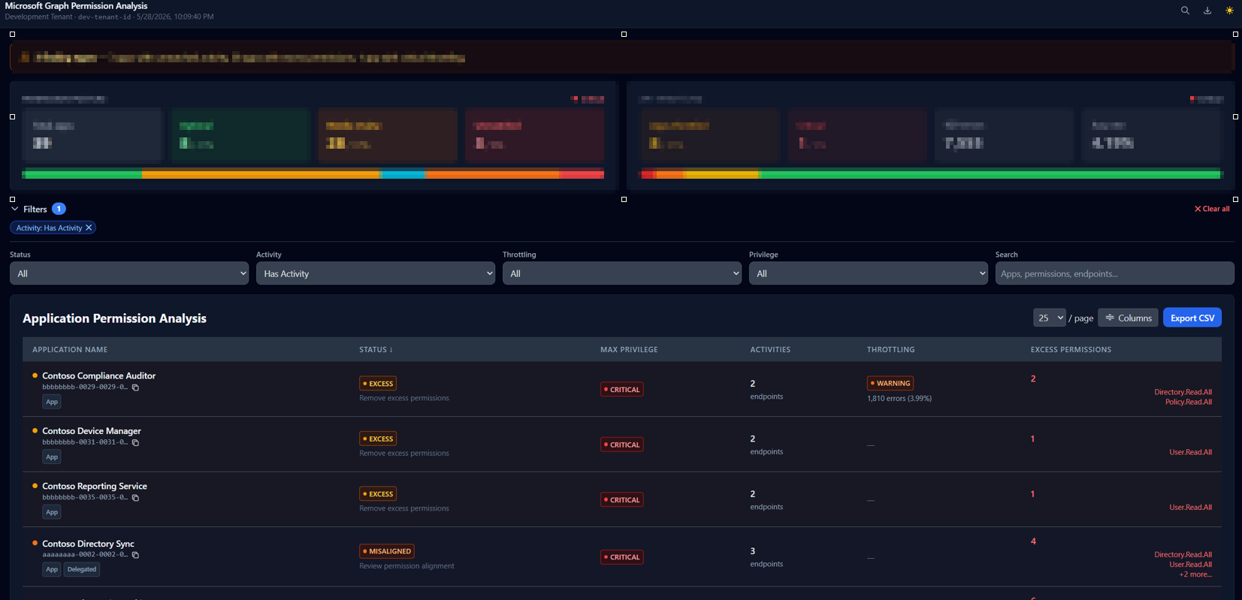
Initial view of the report
14 / 20

Slide 16
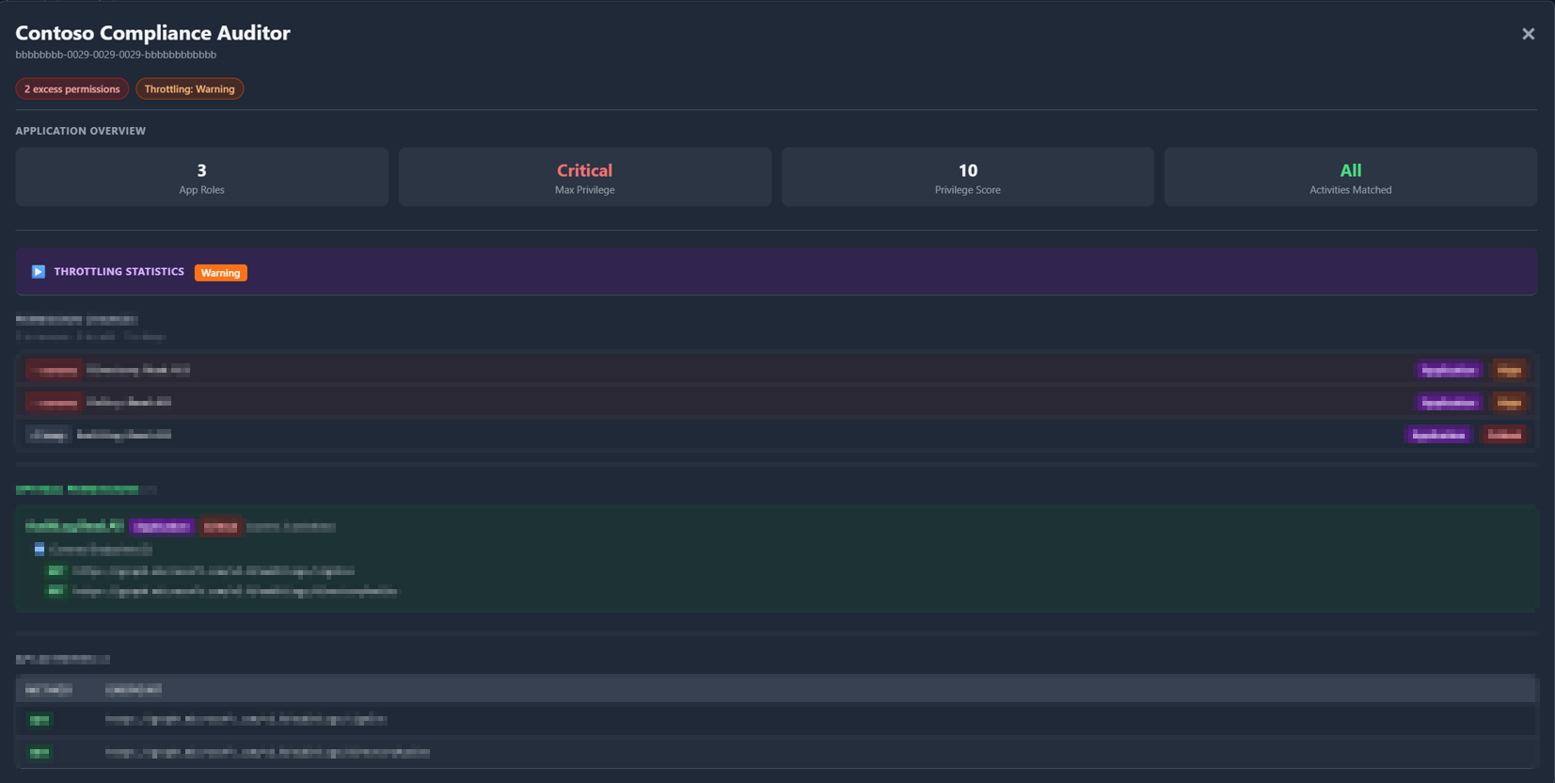
15 / 20

Slide 17
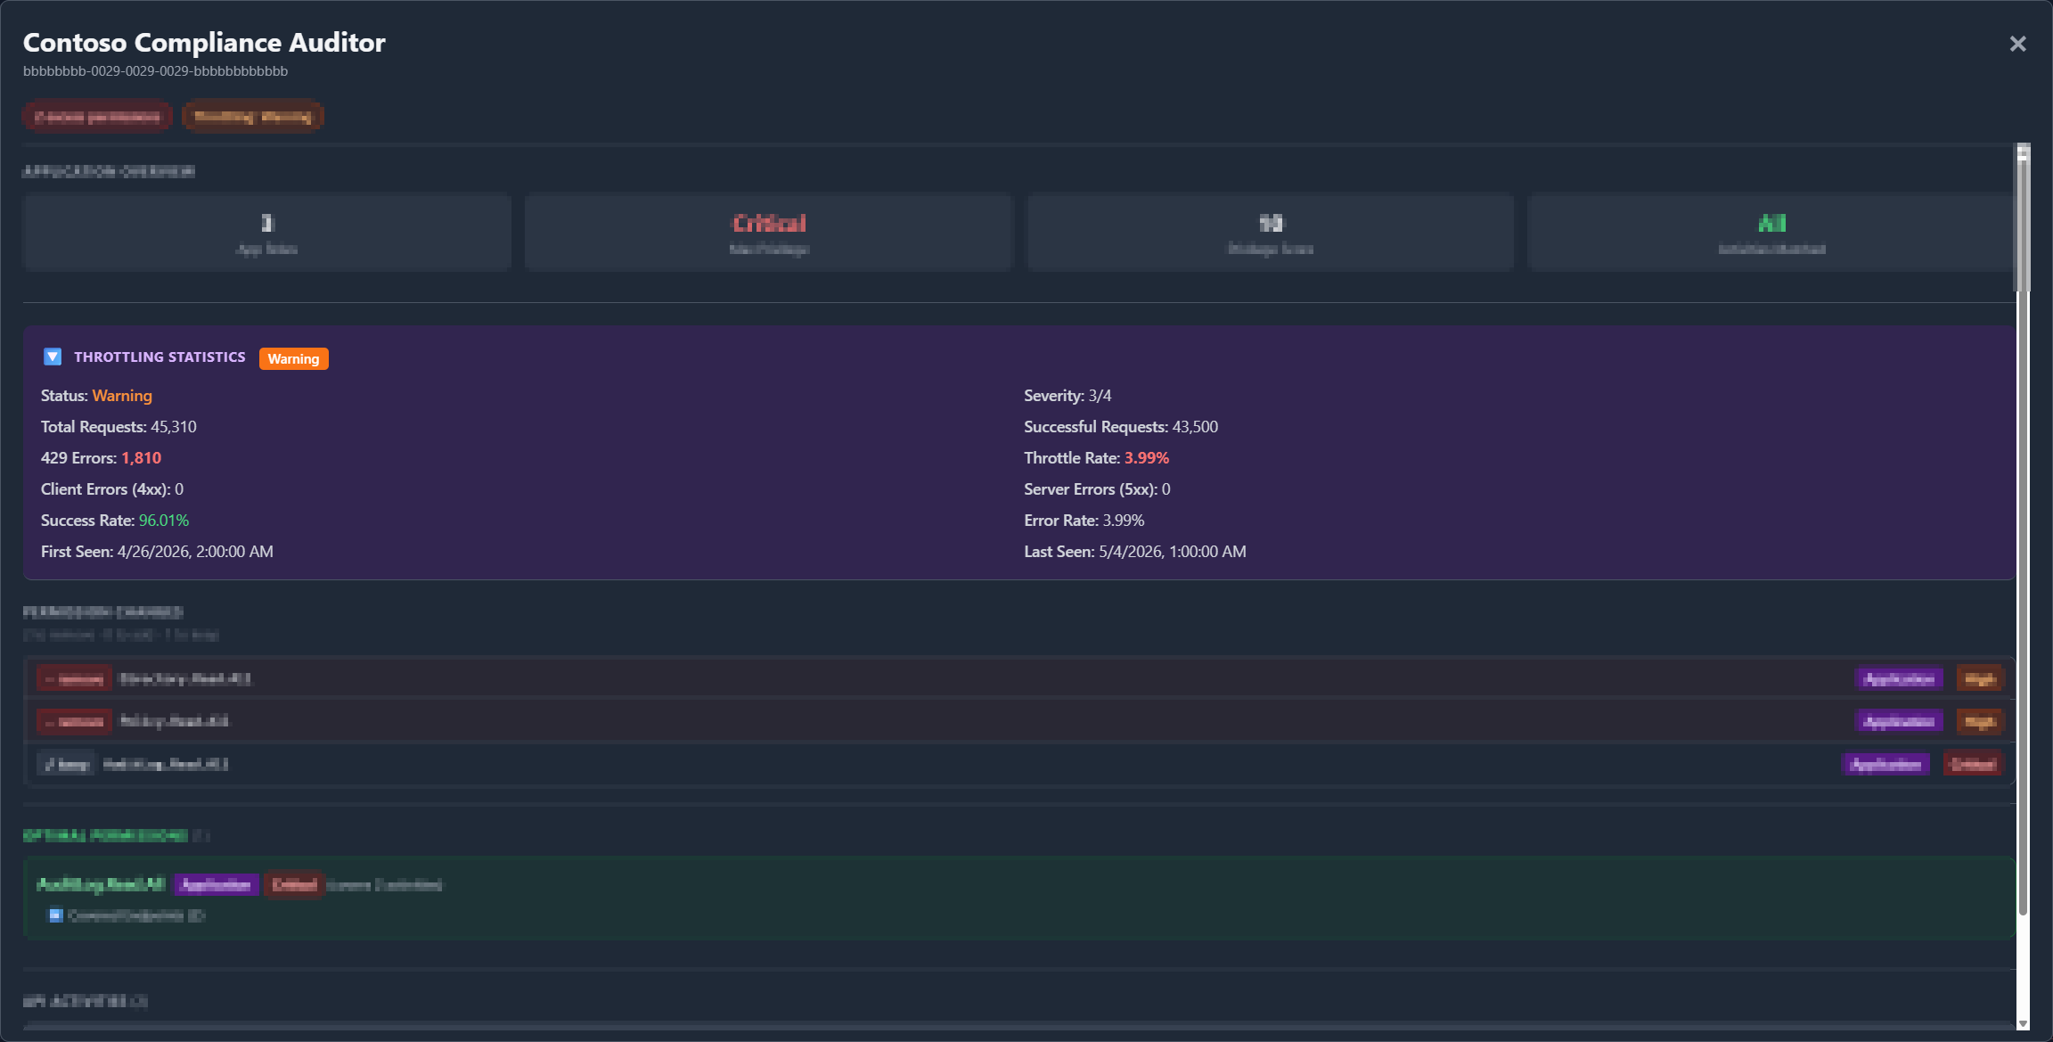
16 / 20

Slide 18
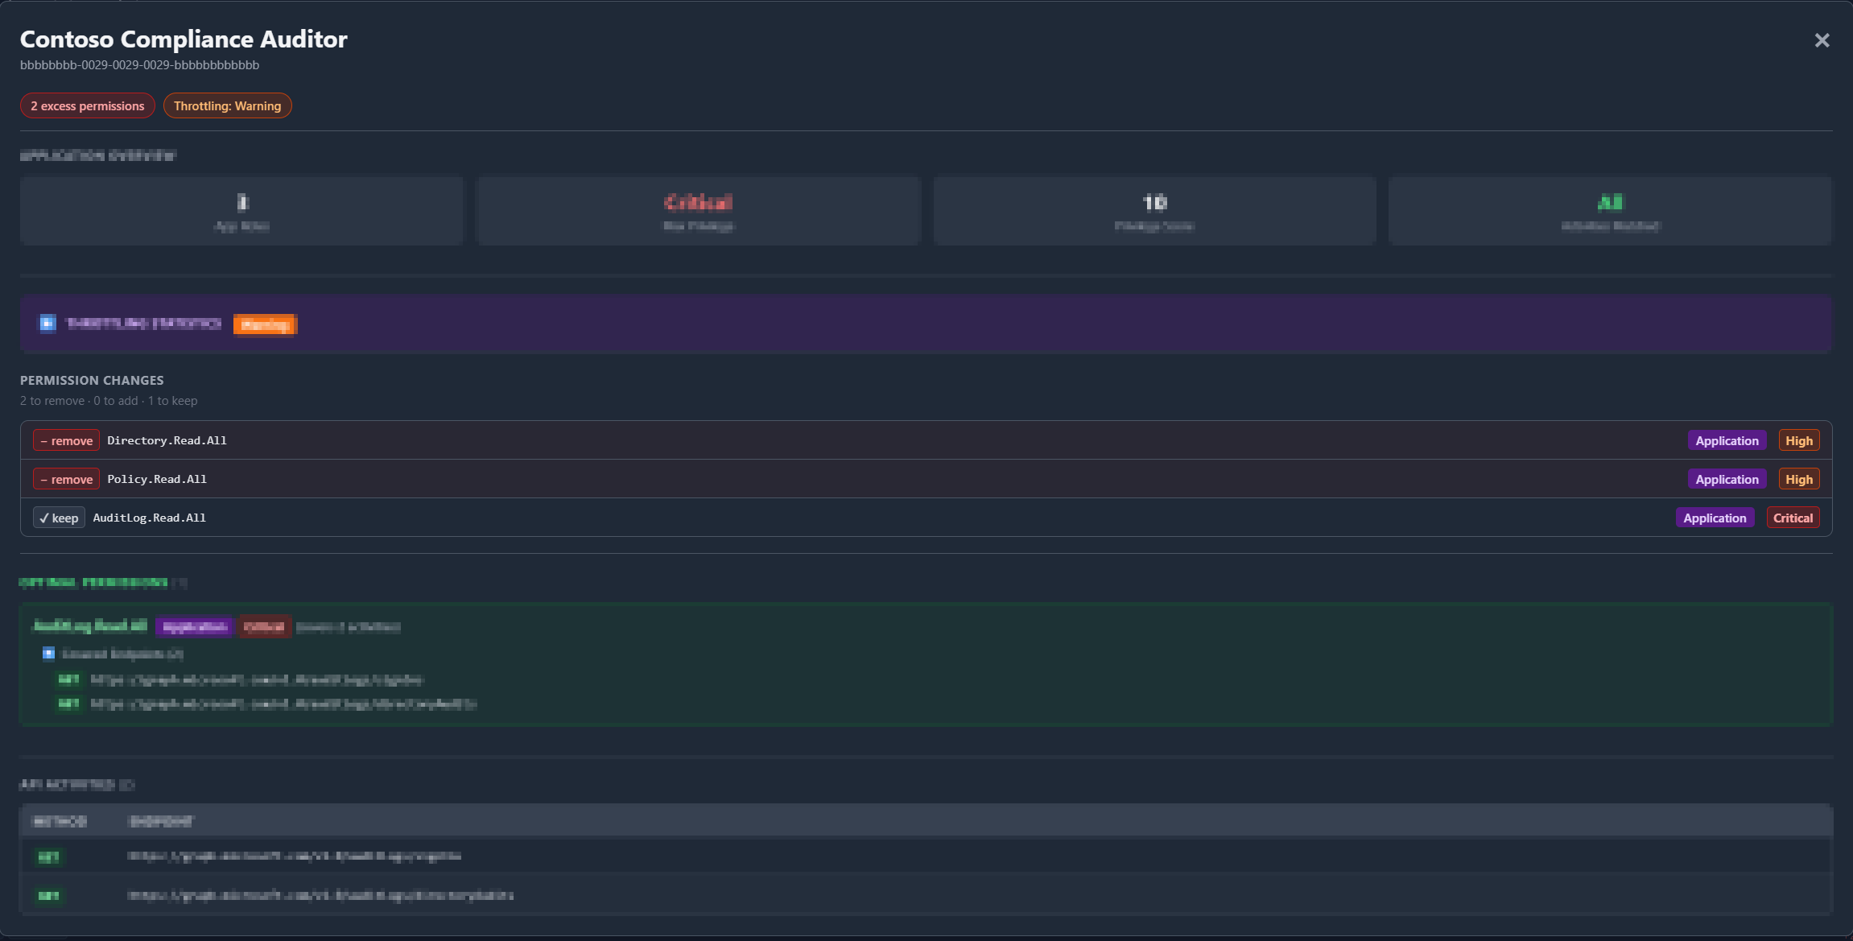
17 / 20

Slide 19

18 / 20

Slide 20
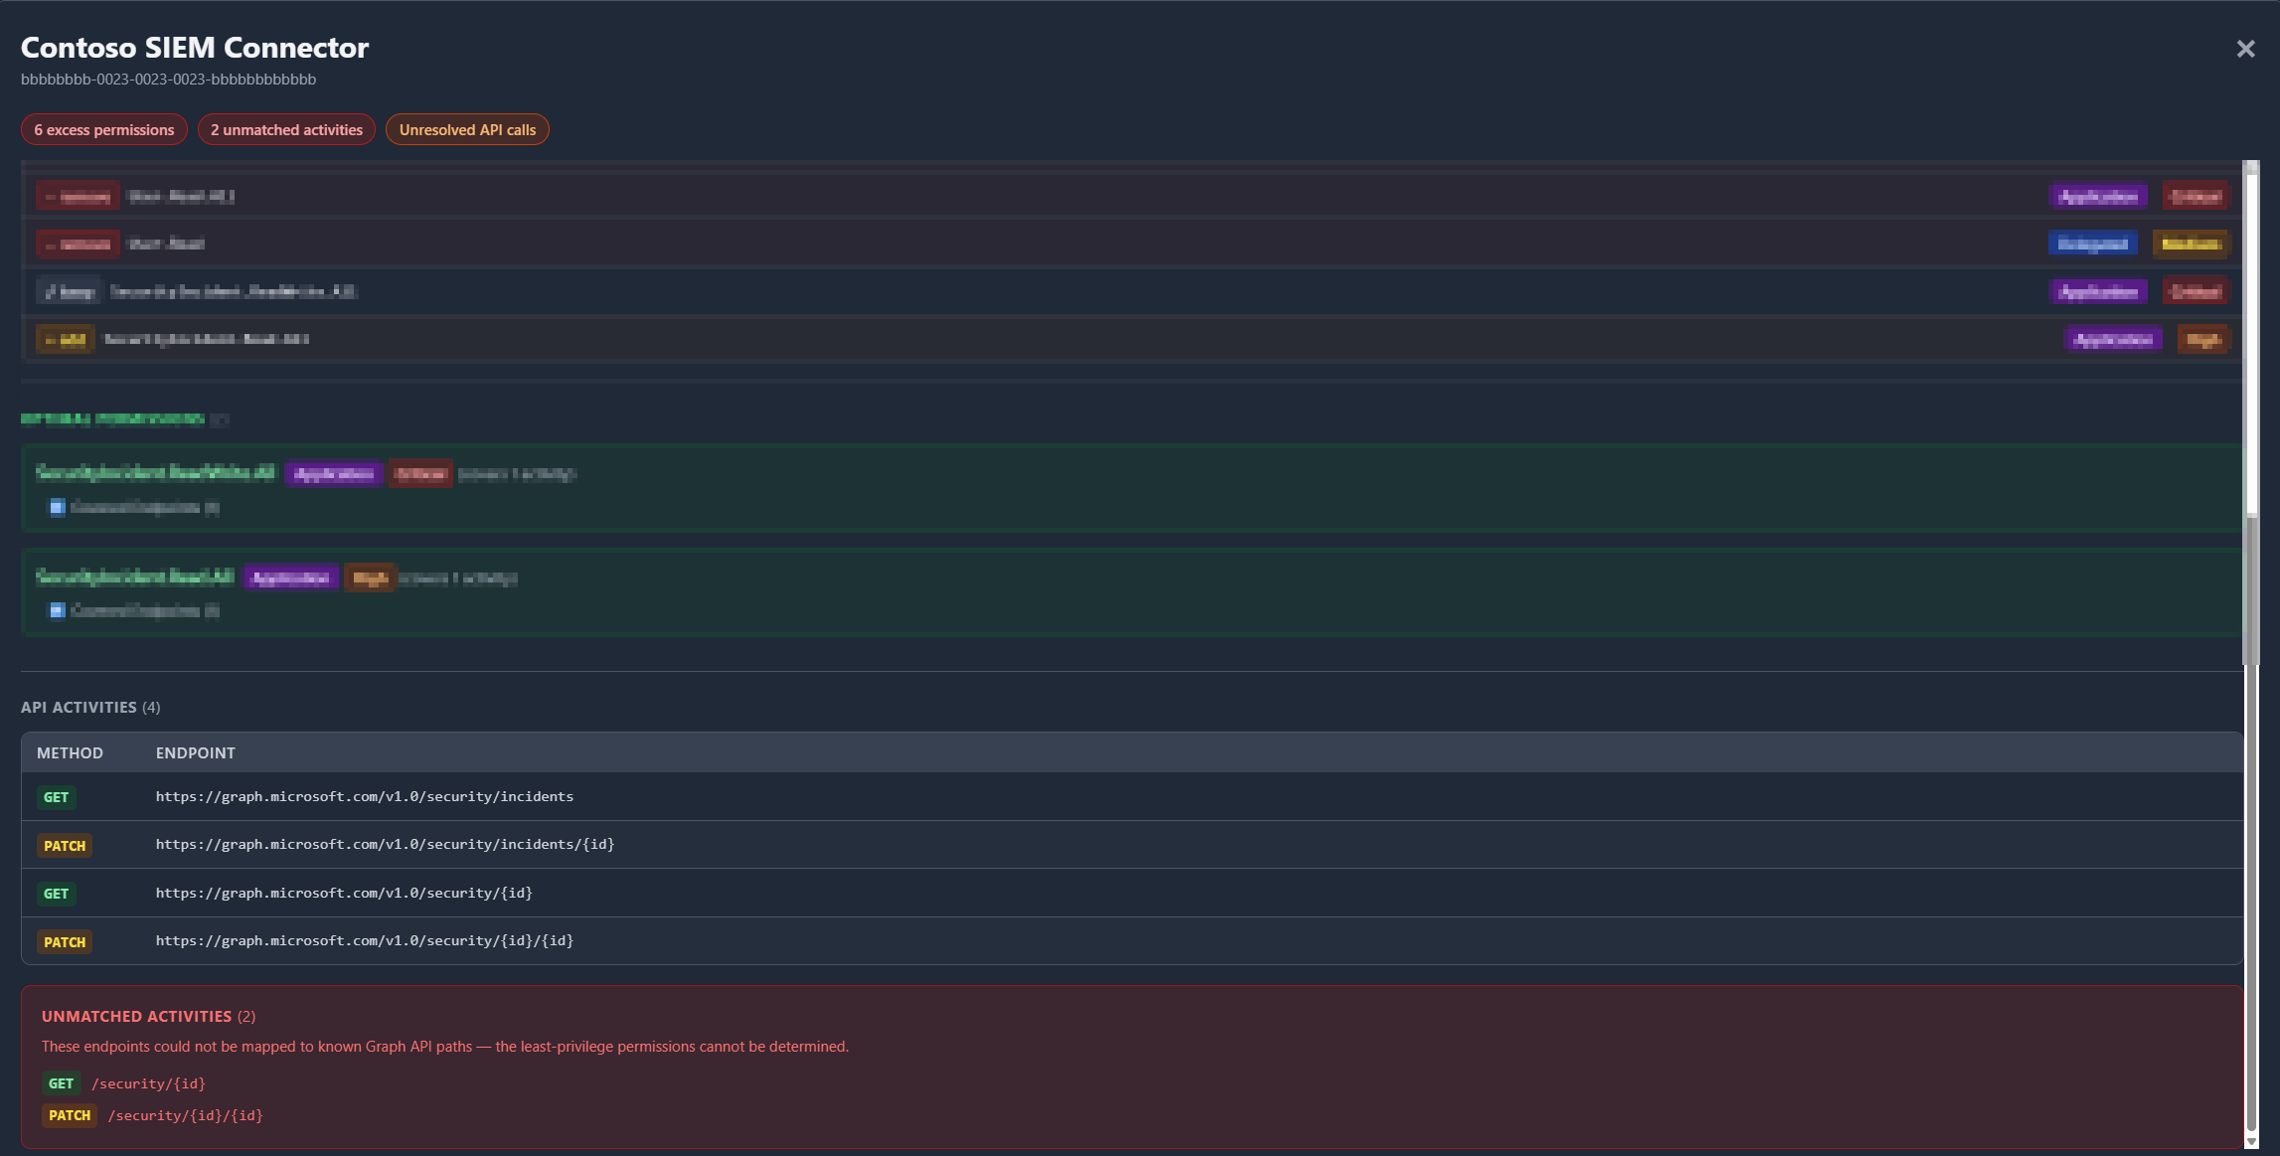
19 / 20

Slide 21
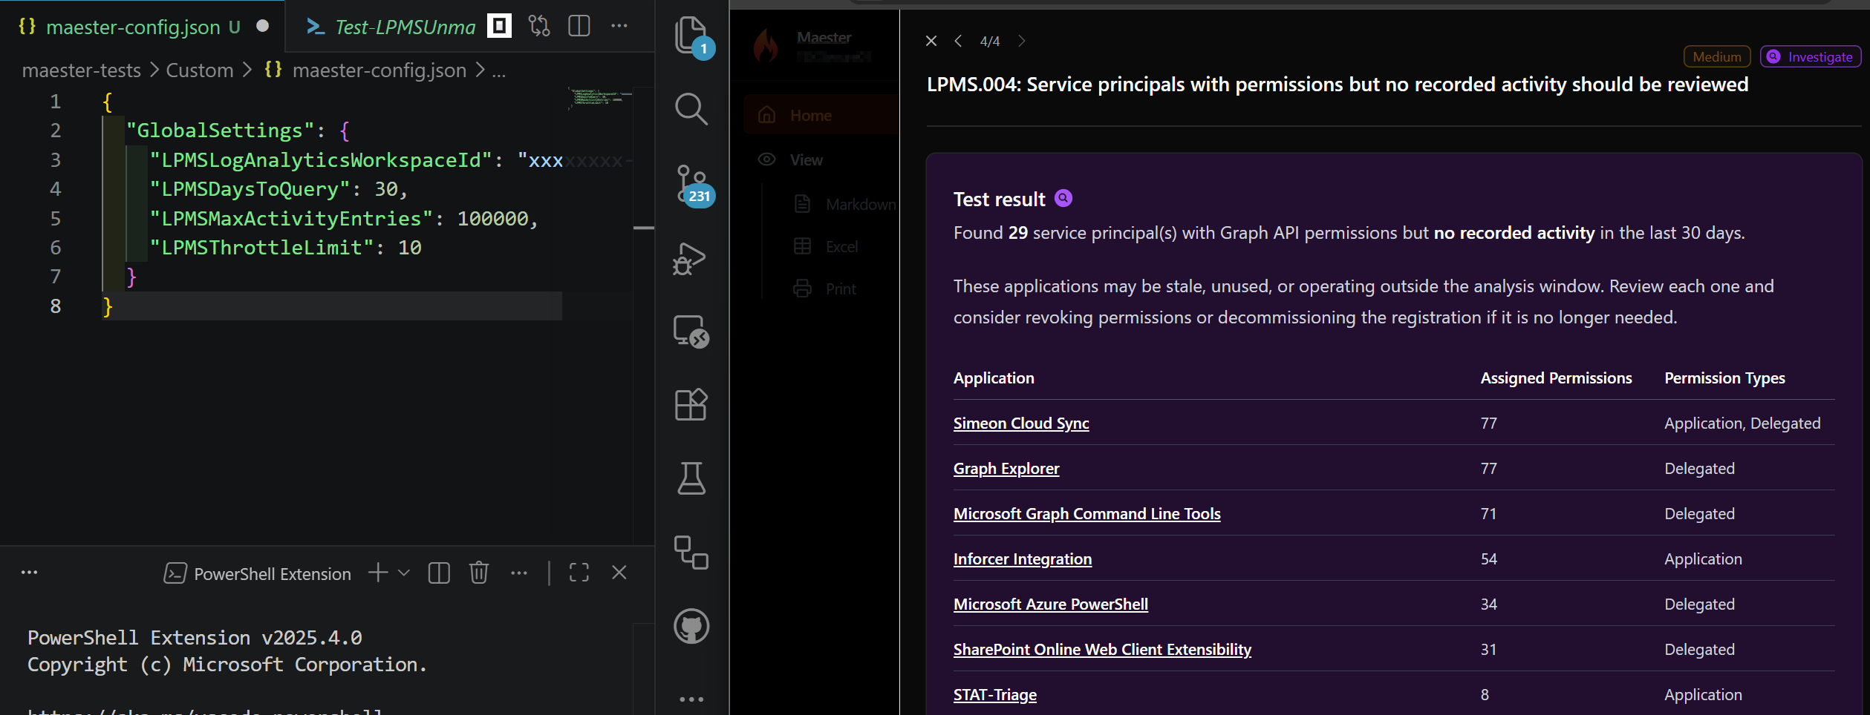
What’s up next?
20 / 20

