Slide 1
Kubernetes
K8s

Slide 2
Kubernetes
Original came from Greek word which means ship governer κυβερνήτης
https://www.google.com/search?q=translate+greek+to+english&rlz=1C1RXQR_en-GBIN1074IN1074&oq=translate+greek+&gs_lcrp=EgZjaHJvbWUqBwgAEAAYgAQyBwgAEAAYgAQyBggBEEUYOTIHCAIQABiABDIHCAMQABiABDIHCAQQABiABDIHCAUQABiABDIHCAYQABiABDIHCAcQABiABDIHCAgQABiABDIHCAkQABiABNIBCDIxNjlqMGo3qAIAsAIA&sourceid=chrome&ie=UTF-8

Slide 3
Course objectives
In this chapter, we will explore why we should use container orchestrators, different implementations of container orchestrators, and where to deploy them
Important key points
Define the concept of container orchestration.
Explain the benefits of using container orchestration.
Discuss different container orchestration options.
Discuss different container orchestration deployment options.

Slide 4
Container images allow us to confine the application code, its runtime, and all of its dependencies in a pre-defined format. The container runtimes like runC, containerd, or cri-o can use pre-packaged images as a source to create and run one or more containers. These runtimes are capable of running containers on a single host, however, in practice, we would like to have a fault-tolerant and scalable solution, achieved by building a single controller/management unit, a collection of multiple hosts connected together. This controller/management unit is generally referred to as a container orchestrator.

Slide 5
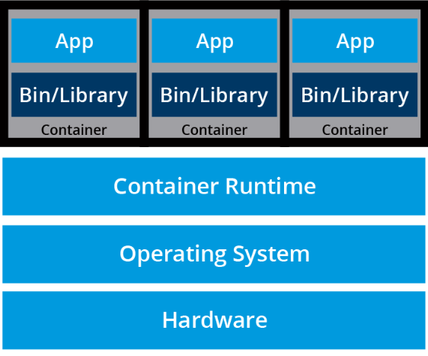
Quick reviews
What Are Containers?
containers are an application-centric method to deliver high-performing, scalable applications on any infrastructure of your choice. Containers are best suited to deliver microservices by providing portable, isolated virtual environments for applications to run without interference from other running applications

Slide 6
Micro services
Microservices are lightweight applications written in various modern programming languages, with specific dependencies, libraries and environmental requirements. To ensure that an application has everything it needs to run successfully it is packaged together with its dependencies.

Slide 7
What Is Container Orchestration?
In Development (Dev) environments, running containers on a single host for development and testing of applications may be a suitable option. However, when migrating to Quality Assurance (QA) and Production (Prod) environments, that is no longer a viable option because the applications and services need to meet specific requirements:
Fault-tolerance
On-demand scalability
Optimal resource usage
Auto-discovery to automatically discover and communicate with each other
Accessibility from the outside world
Seamless updates/rollbacks without any downtime.
Container orchestrators are tools which group systems together to form clusters where containers' deployment and management is automated at scale while meeting the requirements mentioned above.

Slide 8
Container Orchestrators/ Provider
With enterprises containerizing their applications and moving them to the cloud, there is a growing demand for container orchestration solutions. While there are many solutions available, some are mere re-distributions of well-established container orchestration tools, enriched with features and, sometimes, with certain limitations in flexibility.
Amazon Elastic Container Service
Amazon Elastic Container Service (ECS) is a hosted service provided by Amazon Web Services (AWS) to run containers at scale on its infrastructure.
Azure Container Instances
Azure Container Instance (ACI) is a basic container orchestration service provided by Microsoft Azure.
Azure Service Fabric
Azure Service Fabric is an open source container orchestrator provided by Microsoft Azure.

Slide 9
Continued..
Kubernetes
Kubernetes is an open source orchestration tool, originally started by Google, today part of the Cloud Native Computing Foundation (CNCF) project.
Marathon
Marathon is a framework to run containers at scale on Apache Mesos and DC/OS.

Slide 10
Continue…
Nomad Nomad is the container and workload orchestrator provided by HashiCorp.
Docker Swarm

Slide 11
Why Use Container Orchestrators?
Although we can manually maintain a couple of containers or write scripts to manage the lifecycle of dozens of containers, orchestrators make things much easier for users especially when it comes to managing hundreds and thousands of containers running on a global infrastructure.
Most container orchestrators can:
Group hosts together while creating a cluster.
Schedule containers to run on hosts in the cluster based on resources availability.
Enable containers in a cluster to communicate with each other regardless of the host they are deployed to in the cluster.

Slide 12
Bind containers and storage resources.
Group sets of similar containers and bind them to load-balancing constructs to simplify access to containerized applications by creating an interface, a level of abstraction between the containers and the client.
Manage and optimize resource usage.
Allow for implementation of policies to secure access to applications running inside containers.
With all these configurable yet flexible features, container orchestrators are an obvious choice when it comes to managing containerized applications at scale. In this course, we will explore Kubernetes, one of the most in-demand container orchestration tools available today.

Slide 13
Where to deploy
Most container orchestrators can be deployed on the infrastructure of our choice - on bare metal, Virtual Machines, on-premises, on public and hybrid clouds. Kubernetes, for example, can be deployed on a workstation, with or without an isolation layer such as a local hypervisor or container runtime, inside a company's data center, in the cloud on AWS Elastic Compute Cloud (EC2) instances, Google Compute Engine (GCE) VMs, DigitalOcean Droplets, OpenStack, etc.
There are turnkey solutions which allow Kubernetes clusters to be installed, with only a few commands, on top of cloud Infrastructures-as-a-Service, such as GCE, AWS EC2, IBM Cloud, Rancher, VMware Tanzu, and multi-cloud solutions through IBM Cloud Private or StackPointCloud.

Slide 14
What Is Kubernetes?
In this chapter, we describe Kubernetes, its features, and the reasons why you should use it. We will explore the evolution of Kubernetes from Borg, Google's very own distributed workload manager.
We will also learn about the Cloud Native Computing Foundation (CNCF), which currently hosts the Kubernetes project, along with other popular cloud-native projects, such as Prometheus, Fluentd, cri-o, containerd, Helm, Envoy, and Contour, just to name a few.

Slide 15
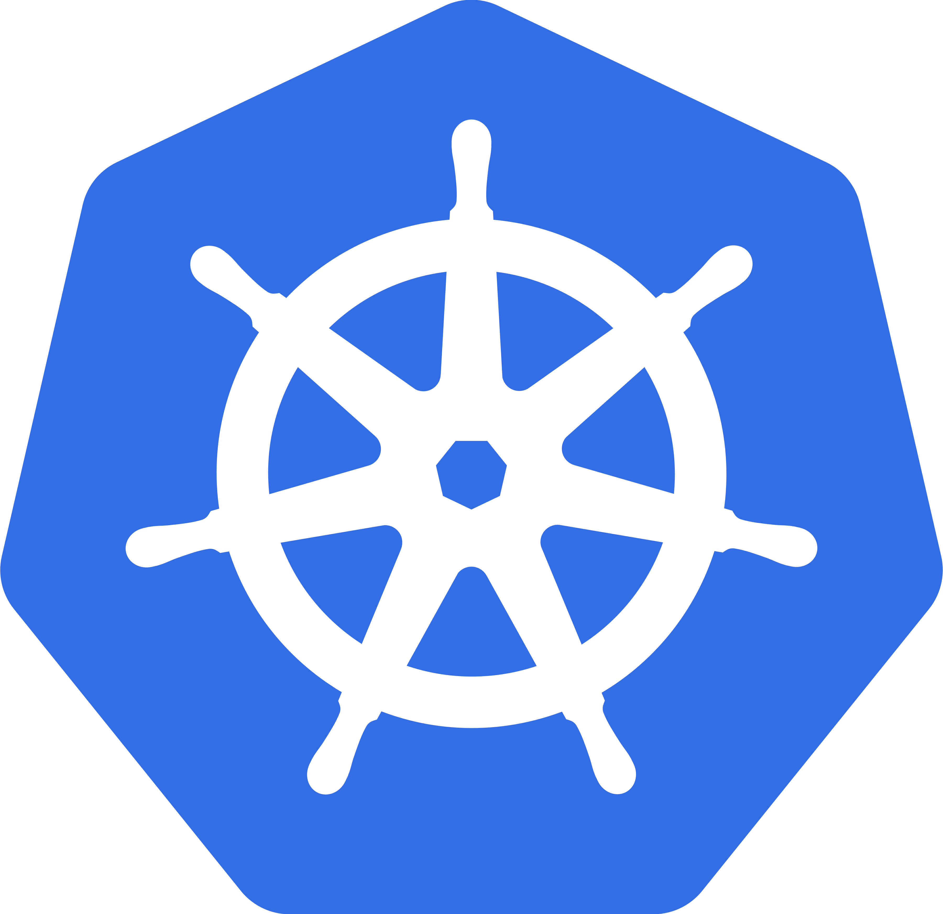
What is kubernetes
Kubernetes comes from the Greek word κυβερνήτης, which means helmsman or shop government

Slide 16
From Borg to Kubernetes
Google's Borg system is a cluster manager that runs hundreds of thousands of jobs, from many thousands of different applications, across a number of clusters each with up to tens of thousands of machines".
For more than a decade, Borg has been Google's secret, running its worldwide containerized workloads in production. Services we use from Google, such as Gmail, Drive, Maps, Docs, etc., are all serviced using Borg.

Slide 17
Key components
API servers
Pods
IP-per-Pod
Services
Labels.

Slide 18
Kubernetes Features
Kubernetes offers a very rich set of features for container orchestration. Some of its fully supported features are:
Automatic bin packing Kubernetes automatically schedules containers based on resource needs and constraints, to maximize utilization without sacrificing availability.
Designed for extensibility A Kubernetes cluster can be extended with new custom features without modifying the upstream source code.
Self-healing Kubernetes automatically replaces and reschedules containers from failed nodes. It terminates and then restarts containers that become unresponsive to health checks, based on existing rules/policy. It also prevents traffic from being routed to unresponsive containers.
Horizontal scaling With Kubernetes applications are scaled manually or automatically based on CPU or custom metrics utilization.

Slide 19
Additional
Service discovery and load balancing Containers receive IP addresses from Kubernetes, while it assigns a single Domain Name System (DNS) name to a set of containers to aid in load-balancing requests across the containers of the set.
Automated rollouts and rollbacks Kubernetes seamlessly rolls out and rolls back application updates and configuration changes, constantly monitoring the application's health to prevent any downtime.
Secret and configuration management Kubernetes manages sensitive data and configuration details for an application separately from the container image, in order to avoid a rebuild of the respective image. Secrets consist of sensitive/confidential information passed to the application without revealing the sensitive content to the stack configuration, like on GitHub.
Storage orchestration Kubernetes automatically mounts software-defined storage (SDS) solutions to containers from local storage, external cloud providers, distributed storage, or network storage systems.
Batch execution Kubernetes supports batch execution, long-running jobs, and replaces failed containers.
IPv4/IPv6 dual-stack Kubernetes supports both IPv4 and IPv6 addresses.

Slide 20
Why Use Kubernetes?
Another one of Kubernetes' strengths is portability. It can be deployed in many environments such as local or remote Virtual Machines, bare metal, or in public/private/hybrid/multi-cloud setups.
For a successful open source project, the community is as important as having great code. Kubernetes is supported by a thriving community across the world. It has more than 3,200 contributors, who, over time, have pushed over 111,000 commits. There are meet-up groups in different cities and countries which meet regularly to discuss Kubernetes and its ecosystem. The community is divided into Special Interest Groups (SIGs), groups which focus on special topics, such as scaling, bare metal, networking, storage, etc. We will learn more about them in our last chapter, Kubernetes Community.

Slide 21
Kubernetes Users
In less than a decade since its debut Kubernetes has become the platform of choice for many enterprises of various sizes to run their workloads. It is a solution for workload management in banking, education, finance and investments, gaming, information technology, media and streaming, online retail, ridesharing, telecommunications, nuclear research, and many other industries.
BlaBlaCar BlackRock Booking.com Box CapitalOne Haufe Group | IBM ING Nokia Pearson Wikimedia

Slide 22
CNCF and Kubernetes
For Kubernetes, the Cloud Native Computing Foundation:
Provides a neutral home for the Kubernetes trademark and enforces proper usage.
Provides license scanning of core and vendor code.
Offers legal guidance on patent and copyright issues.
Creates and maintains open source learning curriculum, training, and certification for Kubernetes and cloud native associates (KCNA), administrators (CKA), application developers (CKAD), and security specialists (CKS).
Manages a software conformance working group.
Actively markets Kubernetes.
Supports ad hoc activities.
Sponsors conferences and meetup events.

Slide 23
Kubernetes architecture
In this chapter, we will explore the Kubernetes architecture, the components of a control plane node, the role of the worker nodes, the cluster state management with etcd and the network setup requirements. We will also learn about the Container Network Interface (CNI), as Kubernetes' network specification.

Slide 24
Learning Objectives
By the end of this chapter, you should be able to:
Discuss the Kubernetes architecture.
Explain the different components of the control plane and worker nodes.
Discuss cluster state management with etcd.
Review the Kubernetes network setup requirements.

Slide 25
Kubernetes Architecture
At a very high level, Kubernetes is a cluster of compute systems categorized by their distinct roles:
One or more control plane nodes
One or more worker nodes (optional, but recommended).

Slide 26
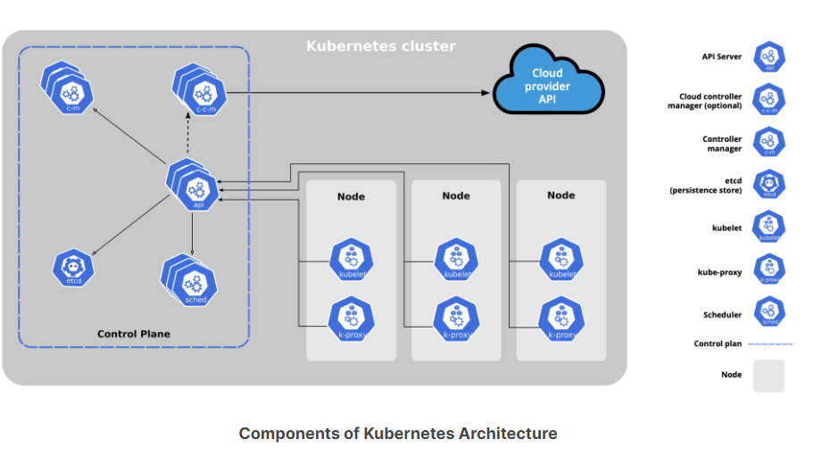

Slide 27
Control Plane Node Overview
The control plane node provides a running environment for the control plane agents responsible for managing the state of a Kubernetes cluster, and it is the brain behind all operations inside the cluster. The control plane components are agents with very distinct roles in the cluster's management. In order to communicate with the Kubernetes cluster, users send requests to the control plane via a Command Line Interface (CLI) tool, a Web User-Interface (Web UI) Dashboard, or an Application Programming Interface (API).

Slide 28
Control Plane Node Components
A control plane node runs the following essential control plane components and agents:
API Server
Scheduler
Controller Managers
Key-Value Data Store.
In addition, the control plane node runs:
Container Runtime
Node Agent
Proxy
Optional add-ons for cluster-level monitoring and logging.

Slide 29
Control Plane Node Components: API Server
All the administrative tasks are coordinated by the kube-apiserver, a central control plane component running on the control plane node. The API Server intercepts RESTful calls from users, administrators, developers, operators and external agents, then validates and processes them. During processing the API Server reads the Kubernetes cluster's current state from the key-value store, and after a call's execution, the resulting state of the Kubernetes cluster is saved in the key-value store for persistence. The API Server is the only control plane component to talk to the key-value store, both to read from and to save Kubernetes cluster state information - acting as a middle interface for any other control plane agent inquiring about the cluster's state.
The API Server is highly configurable and customizable. It can scale horizontally, but it also supports the addition of custom secondary API Servers, a configuration that transforms the primary API Server into a proxy to all secondary, custom API Servers, routing all incoming RESTful calls to them based on custom defined rules.

Slide 30
Control Plane Node Components: Scheduler
he role of the kube-scheduler is to assign new workload objects, such as pods encapsulating containers, to nodes - typically worker nodes. During the scheduling process, decisions are made based on current Kubernetes cluster state and new workload object's requirements.
The scheduler is highly configurable and customizable through scheduling policies, plugins, and profiles. Additional custom schedulers are also supported, then the object's configuration data should include the name of the custom scheduler expected to make the scheduling decision for that particular object; if no such data is included, the default scheduler is selected instead.

Slide 31
Control Plane Node Components: Controller Managers
The controller managers are components of the control plane node running controllers or operator processes to regulate the state of the Kubernetes cluster. Controllers are watch-loop processes continuously running and comparing the cluster's desired state (provided by objects' configuration data) with its current state (obtained from the key-value store via the API Server). In case of a mismatch, corrective action is taken in the cluster until its current state matches the desired state.
The kube-controller-manager runs controllers or operators responsible to act when nodes become unavailable, to ensure container pod counts are as expected, to create endpoints, service accounts, and API access tokens.

Slide 32
Control Plane Node Components: Key-Value Data Store
etcd is an open source project under the Cloud Native Computing Foundation (CNCF). etcd is a strongly consistent, distributed key-value data store used to persist a Kubernetes cluster's state. New data is written to the data store only by appending to it, data is never replaced in the data store. Obsolete data is compacted (or shredded) periodically to minimize the size of the data store.
Out of all the control plane components, only the API Server is able to communicate with the etcd data store.

Slide 33
Worker Node Overview
A worker node provides a running environment for client applications. These applications are microservices running as application containers. In Kubernetes the application containers are encapsulated in Pods, controlled by the cluster control plane agents running on the control plane node. Pods are scheduled on worker nodes, where they find required compute, memory and storage resources to run, and networking to talk to each other and the outside world. A Pod is the smallest scheduling work unit in Kubernetes. It is a logical collection of one or more containers scheduled together, and the collection can be started, stopped, or rescheduled as a single unit of work.
Also, in a multi-worker Kubernetes cluster, the network traffic between client users and the containerized applications deployed in Pods is handled directly by the worker nodes, and is not routed through the control plane node.

Slide 34
Worker Node Components
A worker node has the following components:
Container Runtime
Node Agent - kubelet
Proxy - kube-proxy
Add-ons for DNS, Dashboard user interface, cluster-level monitoring and logging.

Slide 35
Worker Node Components: Container Runtime
Although Kubernetes is described as a "container orchestration engine", it lacks the capability to directly handle and run containers. In order to manage a container's lifecycle, Kubernetes requires a container runtime on the node where a Pod and its containers are to be scheduled. Runtimes are required on all nodes of a Kubernetes cluster, both control plane and worker. Kubernetes supports several container runtimes:
CRI-O A lightweight container runtime for Kubernetes, supporting quay.io and Docker Hub image registries.
containerd A simple, robust, and portable container runtime.
Docker Engine A popular and complex container platform which uses containerd as a container runtime.
Mirantis Container Runtime Formerly known as the Docker Enterprise Edition.

Slide 36
Worker Node Components: Node Agent - kubelet
The kubelet is an agent running on each node, control plane and workers, and communicates with the control plane. It receives Pod definitions, primarily from the API Server, and interacts with the container runtime on the node to run containers associated with the Pod. It also monitors the health and resources of Pods running containers.
The kubelet connects to container runtimes through a plugin based interface - the Container Runtime Interface (CRI). The CRI consists of protocol buffers, gRPC API, libraries, and additional specifications and tools.

Slide 37
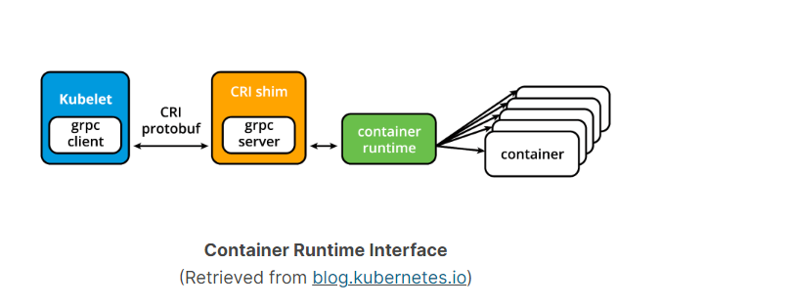
Kublet

Slide 38
Detail
Protocol Buffers (ProtoBuf):
Protocol Buffers, often referred to as ProtoBuf, is a language-agnostic binary serialization format developed by Google. It's used for efficiently serializing structured data, making it suitable for tasks like data storage, data exchange, and communication between systems.
gRPC Server:
gRPC is a high-performance, open-source framework for building remote procedure call (RPC) APIs. It uses Protocol Buffers for defining service contracts and messages.

Slide 39
Container Runtime:
In the context of Kubernetes and container orchestration, a container runtime is the software responsible for running containers. Containers are lightweight, isolated environments that package an application and its dependencies. Kubernetes uses container runtimes to launch and manage containers on worker nodes.

Slide 40
Worker Node Components: kubelet - CRI shims
Originally the kubelet agent supported only a couple of container runtimes, first the Docker Engine followed by rkt, through a unique interface model integrated directly in the kubelet source code. However, this approach was not intended to last forever even though it was especially beneficial for Docker. In time, Kubernetes started migrating towards a standardized approach to container runtime integration by introducing the CRI. Kubernetes adopted a decoupled and flexible method to integrate with various container runtimes without the need to recompile its source code. Any container runtime that implements the CRI could be used by Kubernetes to manage containers.
Shims are Container Runtime Interface (CRI) implementations, interfaces or adapters, specific to each container runtime supported by Kubernetes. Below we present some examples of CRI shims:
cri-containerd cri-containerd allows containers to be directly created and managed with containerd at kubelet's request:

Slide 41
Worker Node Components: Proxy - kube-proxy
The kube-proxy is the network agent which runs on each node, control plane and workers, responsible for dynamic updates and maintenance of all networking rules on the node. It abstracts the details of Pods networking and forwards connection requests to the containers in the Pods.
The kube-proxy is responsible for TCP, UDP, and SCTP stream forwarding or random forwarding across a set of Pod backends of an application, and it implements forwarding rules defined by users through Service API objects.

Slide 42
Worker Node Components: Add-ons
Add-ons are cluster features and functionality not yet available in Kubernetes, therefore implemented through 3rd-party pods and services.
DNS Cluster DNS is a DNS server required to assign DNS records to Kubernetes objects and resources.
Dashboard A general purpose web-based user interface for cluster management.
Monitoring Collects cluster-level container metrics and saves them to a central data store.
Logging Collects cluster-level container logs and saves them to a central log store for analysis.

Slide 43
Networking Challenges
Decoupled microservices based applications rely heavily on networking in order to mimic the tight-coupling once available in the monolithic era. Networking, in general, is not the easiest to understand and implement. Kubernetes is no exception - as a containerized microservices orchestrator it needs to address a few distinct networking challenges:
Container-to-Container communication inside Pods
Pod-to-Pod communication on the same node and across cluster nodes
Service-to-Pod communication within the same namespace and across cluster namespaces
External-to-Service communication for clients to access applications in a cluste

Slide 44
Kubernetes Deployment
Learning Objectives
By the end of this chapter, you should be able to:
Discuss Kubernetes configuration options.
Discuss infrastructure considerations before installing Kubernetes.
Discuss infrastructure choices for a Kubernetes cluster deployment.
Review Kubernetes installation tools and certified solutions.

Slide 45
Kubernetes Configuration
Kubernetes can be installed using different cluster configurations. The major installation types are described below:
All-in-One Single-Node Installation In this setup, all the control plane and worker components are installed and running on a single-node. While it is useful for learning, development, and testing, it is not recommended for production purposes.
Single-Control Plane and Multi-Worker Installation In this setup, we have a single-control plane node running a stacked etcd instance. Multiple worker nodes can be managed by the control plane node.
Single-Control Plane with Single-Node etcd, and Multi-Worker Installation In this setup, we have a single-control plane node with an external etcd instance. Multiple worker nodes can be managed by the control plane node.

Slide 46
Continue..
Multi-Control Plane and Multi-Worker Installation In this setup, we have multiple control plane nodes configured for High-Availability (HA), with each control plane node running a stacked etcd instance. The etcd instances are also configured in an HA etcd cluster and multiple worker nodes can be managed by the HA control plane.
Multi-Control Plane with Multi-Node etcd, and Multi-Worker Installation In this setup, we have multiple control plane nodes configured in HA mode, with each control plane node paired with an external etcd instance. The external etcd instances are also configured in an HA etcd cluster, and multiple worker nodes can be managed by the HA control plane. This is the most advanced cluster configuration recommended for production environments.

Slide 47
Installing Local Learning Clusters
There are a variety of installation tools allowing us to deploy single- or multi-node Kubernetes clusters on our workstations, for learning and development purposes. While not an exhaustive list, below we enumerate a few popular ones:
Minikube Single- and multi-node local Kubernetes cluster, recommended for a learning environment deployed on a single host.
Kind Multi-node Kubernetes cluster deployed in Docker containers acting as Kubernetes nodes, recommended for a learning environment.
Docker Desktop Including a local Kubernetes cluster for Docker users.
MicroK8s Local and cloud Kubernetes cluster for developers and production, from Canonical.
K3S Lightweight Kubernetes cluster for local, cloud, edge, IoT deployments, originally from Rancher, currently a CNCF project.

Slide 48
Continue..
Minikube is an easy and flexible method to create a local Kubernetes setup. We will be using it extensively in this course to manage certain aspects of a Kubernetes cluster, while taking advantage of several automated features designed to simplify the user interaction with the Kubernetes environment and the containerized applications deployed to the cluster.

Slide 49
Installing Production Clusters with Deployment Tools
When it comes to production ready solutions, there are several recommended tools for Kubernetes clusters bootstrapping and a few that are also capable of provisioning the necessary hosts on the underlying infrastructure.
kubeadm kubeadm is a first-class citizen of the Kubernetes ecosystem. It is a secure and recommended method to bootstrap a multi-node production ready Highly Available Kubernetes cluster, on-premises or in the cloud. kubeadm can also bootstrap a single-node cluster for learning. It has a set of building blocks to set up the cluster, but it is easily extendable to add more features. Please note that kubeadm does not support the provisioning of hosts - they should be provisioned separately with a tool of our choice.

Slide 50
Continue..
kubespray kubespray (formerly known as kargo) allows us to install Highly Available production ready Kubernetes clusters on AWS, GCP, Azure, OpenStack, vSphere, or bare metal. kubespray is based on Ansible, and is available on most Linux distributions. It is a Kubernetes Incubator project.
kops kops enables us to create, upgrade, and maintain production-grade, Highly Available Kubernetes clusters from the command line. It can provision the required infrastructure as well. Currently, AWS is officially supported. Support for DigitalOcean and OpenStack is in beta, Azure and GCE is in alpha support, and other platforms are planned for the future. Explore the kops project for more details.

Slide 51
Hosted Solutions
Hosted Solutions providers fully manage the provided software stack, while the user pays hosting and management charges. Popular vendors providing hosted solutions for Kubernetes are (listed in alphabetical order):
Alibaba Cloud Container Service for Kubernetes (ACK)
Amazon Elastic Kubernetes Service (EKS)
Azure Kubernetes Service (AKS)
DigitalOcean Kubernetes
Google Kubernetes Engine (GKE)
IBM Cloud Kubernetes Service
Oracle Container Engine for Kubernetes (OKE)
Platform9 Managed Kubernetes (PMK)
Red Hat OpenShift
VMware Tanzu Kubernetes Grid

Slide 52
Turnkey Cloud Solutions
Turnkey Cloud Solutions install production ready Kubernetes clusters on cloud infrastructure:
Linode Kubernetes Engine
Vultr Kubernetes Engine

Slide 53
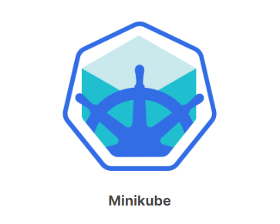

Slide 54
Minikube
Minikube is one of the easiest, most flexible and popular methods to run an all-in-one or a multi-node local Kubernetes cluster, isolated by Virtual Machines (VM) or Containers, run directly on our workstations. Minikube is the tool responsible for the installation of Kubernetes components, cluster bootstrapping, and cluster tear-down when no longer needed. It includes additional features aimed to ease the user interaction with the Kubernetes cluster, but nonetheless, it initializes for us a fully functional, non-production, Kubernetes cluster extremely convenient for learning purposes. Minikube can be installed on native macOS, Windows, and many Linux distributions.

Slide 55
Learning Objectives
Understand Minikube.
Install Minikube on the native OS of your workstation.
Verify the local installation.

Slide 56
What Is Minikube?
Minikube is one of the easiest, most flexible and popular methods to run an all-in-one or a multi-node local Kubernetes cluster directly on our local workstations. It installs and runs on any native OS such as Linux, macOS, or Windows. However, in order to fully take advantage of all the features Minikube has to offer, a Type-2 Hypervisor or a Container Runtime should be installed on the local workstation, to run in conjunction with Minikube. The role of the hypervisor or container runtime is to offer an isolated infrastructure for the Minikube Kubernetes cluster components, that is easily reproducible, easy to use and tear down.

Slide 57
Requirements for Running Minikube
VT-x/AMD-v virtualization must be enabled on the local workstation, and/or verify if it is supported.
kubectl kubectl is a binary used to access and manage any Kubernetes cluster. It is installed through Minikube and accessed through the minikube kubectl command, or it can be installed separately and run as a standalone tool. We will explore kubectl installation and usage in future chapters.
Type-2 Hypervisor or Container Runtime Without a specified driver, Minikube will try to find an installed hypervisor or a runtime, in the following order of preference (on a Linux host): docker, kvm2, podman, vmware, and virtualbox. If multiple isolation software installations are found, such as docker and virtualbox, Minikube will pick docker over virtualbox if no desired driver is specified by the user. Hypervisors and Container Runtimes supported by various native workstation OSes: - On Linux VirtualBox, KVM2, and QEMU hypervisors, or Docker and Podman runtimes - On macOS VirtualBox, HyperKit, VMware Fusion, Parallels, and QEMU hypervisors, or Docker runtime - On Windows VirtualBox, Hyper-V, VMware Workstation, and QEMU hypervisors, or Docker runtime.

Slide 58
Installing Minikube on Linux
Let's learn how to install the latest Minikube release on Ubuntu Linux 20.04 LTS with VirtualBox v7.0 specifically. This installation assumes no other isolation software is installed on our Linux workstation, such as KVM2, QEMU, Docker Engine or Podman, that Minikube can use as a driver.
Verify the virtualization support on your Linux OS in a terminal (a non-empty output indicates supported virtualization):
$ grep -E --color 'vmx|svm' /proc/cpuinfo

Slide 59
Virtulbox
$ sudo bash -c 'echo "deb \ [arch=amd64 signed-by=/usr/share/keyrings/oracle-virtualbox-2016.gpg] \ https://download.virtualbox.org/virtualbox/debian \ eoan contrib" >> /etc/apt/sources.list'
$ wget -O- \ https://www.virtualbox.org/download/oracle_vbox_2016.asc | \ sudo gpg --dearmor --yes \ --output /usr/share/keyrings/oracle-virtualbox-2016.gpg
$ sudo apt update
$ sudo apt install -y virtualbox-7.0

Slide 60
Minikube
$ curl -LO \ https://storage.googleapis.com/minikube/releases/latest/minikube_latest_amd64.deb
$ sudo dpkg -i minikube_latest_amd64.deb
Start Minikube. In a terminal we can start Minikube with the minikube start command, which bootstraps a single-node cluster with the latest stable Kubernetes version release. For a specific Kubernetes version the --kubernetes-version option can be used as such minikube start --kubernetes-version v1.25.1 (where latest is default and acceptable version value, and stable is also acceptable). More advanced start options will be explored later in this chapter:
$ minikube start

Slide 61
minikube status
minikube type: Control Plane host: Running kubelet: Running apiserver: Running kubeconfig: Configured
Stop Minikube. With the minikube stop command, we can stop Minikube:
$ minikube stop

Slide 62
Accessing minikube
We can use a variety of external clients or custom scripts to access our cluster for administration purposes. We will explore kubectl as a CLI tool to access the Minikube Kubernetes cluster, the Kubernetes Dashboard as a web-based user interface to interact with the cluster, and the curl command with proper credentials to access the cluster via APIs.

Slide 63
Learning Objectives
By the end of this chapter, you should be able to:
Compare methods to access a Kubernetes cluster.
Access the Minikube Kubernetes cluster with kubectl.
Access the Minikube Kubernetes cluster from the Dashboard.
Access the Minikube Kubernetes cluster via APIs.

Slide 64
Accessing Minikube: Command Line Interface (CLI)
kubectl is the Kubernetes Command Line Interface (CLI) client to manage cluster resources and applications. It is very flexible and easy to integrate with other systems, therefore it can be used standalone, or part of scripts and automation tools. Once all required credentials and cluster access points have been configured for kubectl, it can be used remotely from anywhere to access a cluster.
We will be using kubectl extensively to deploy applications, manage and configure Kubernetes resources.

Slide 65
Accessing Minikube: Web-based User Interface (Web UI)
The Kubernetes Dashboard provides a Web-based User Interface (Web UI) to interact with a Kubernetes cluster to manage resources and containerized applications. While not as flexible as the kubectl CLI client tool, it is still a preferred tool to users who are not as proficient with the CLI.

Slide 66
Installing kubectl on Linux
To install kubectl on Linux, follow the instructions below extracted from the official installation guide.
Download and install the latest stable kubectl binary:
$ curl -LO "https://dl.k8s.io/release/$(curl -L -s \ https://dl.k8s.io/release/stable.txt)/bin/linux/amd64/kubectl"
$ sudo install -o root -g root -m 0755 kubectl /usr/local/bin/kubectl
$ kubectl version --client

Slide 67
Kubernetes Dashboard
The Kubernetes Dashboard provides a web-based user interface for Kubernetes cluster management. Minikube installs the Dashboard as an addon, but it is disabled by default. Prior to using the Dashboard we are required to enable the Dashboard addon, together with the metrics-server addon, a helper addon designed to collect usage metrics from the Kubernetes cluster. To access the dashboard from Minikube, we can use the minikube dashboard command, which opens a new tab in our web browser displaying the Kubernetes Dashboard, but only after we list, enable required addons, and verify their state:

