Slide 1
TEAM NISHKARSH
SMART KOPARGOAN HACKATHON
CleanKop AI
AI, IoT & GPS-Based Smart Garbage Collection and Monitoring System
PROBLEM STATEMENT ID
PS CATEGORY
SKH21
Software
PROBLEM STATEMENT TITLE
TEAM ID
GPS-Based Smart Garbage Collection and Monitoring System
T4M4VZ
THEME
TEAM NAME
Open Innovation
Team Nishkarsh
Team Members: Parth Desai (Leader) • Divya Pawar • Shreyash Patil • Tanavi Pawar

Slide 2
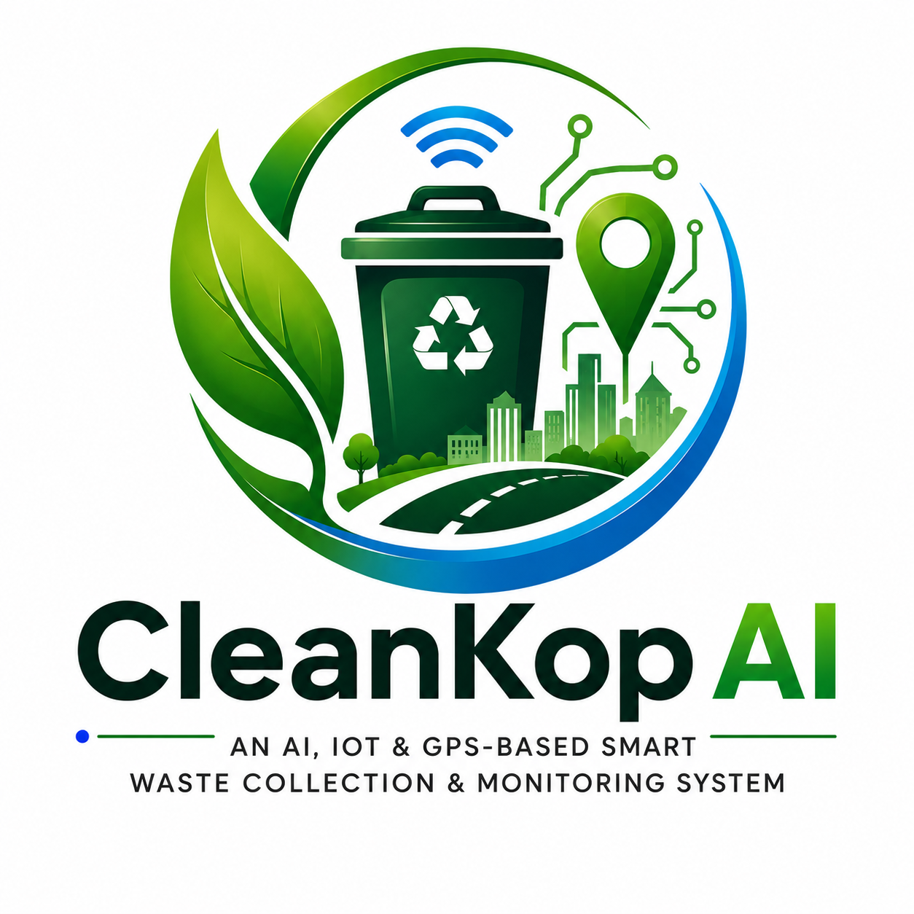









Team Nishkarsh
IDEA TITLE
CleanKop AI — Proposed Solution
A unified IoT + AI platform that gives every bin a digital identity, every collection route a data-driven plan, and every citizen complaint a transparent trail — replacing today's manual, fixed-schedule waste collection.
PROBLEMS WE SOLVE
HOW CLEANKOP AI ADDRESSES IT
No real-time fill data — collections run on fixed schedules, not actual need
Ultrasonic + ESP32 sensors report live bin fill % over Wi-Fi/GSM
No centralized tracking — zero accountability or data synchronization
TSP nearest-neighbor + 2-opt engine plans the shortest priority route
No digital complaints — issues stay informal, untracked, unprioritized
Citizen app + ticketed complaints with Submitted → Resolved workflow
No feedback loop — performance is never measured or improved
Live admin dashboard tracks fuel saved, resolution time & performance
CleanKop AI | Team Nishkarsh | Smart Kopargoan Hackathon
2

Slide 3



Team Nishkarsh
TECHNICAL APPROACH
Technology Stack & Methodology
Frontend
Backend
Database
Maps
Real-time & Alerts
Hosting
React.js + Tailwind CSS
Node.js + Express
MongoDB / PostgreSQL + PostGIS
Leaflet.js + OpenStreetMap
Socket.io, Nodemailer / Twilio
Vercel + Render + Mapbox APIs
IMPLEMENTATION METHODOLOGY
1
→
2
→
3
→
4
→
5
Sensor → Cloud
Store & Alert
Optimize Route
Collect & Update
Resolve Complaints
ESP32 + ultrasonic sensor sends fill-level data to the backend every few minutes (hackathon: simulator script)
Backend stores bin data in the database; bins over 80% trigger an automatic alert
TSP nearest-neighbor + 2-opt algorithm ranks red/yellow/green bins and outputs the shortest route
Driver app tracks GPS live and marks bins collected; status syncs to admin in real time
Citizen reports flow through Submitted → Assigned → In Progress → Resolved, with 48-hr escalation
CleanKop AI | Team Nishkarsh | Smart Kopargoan Hackathon
3

Slide 4
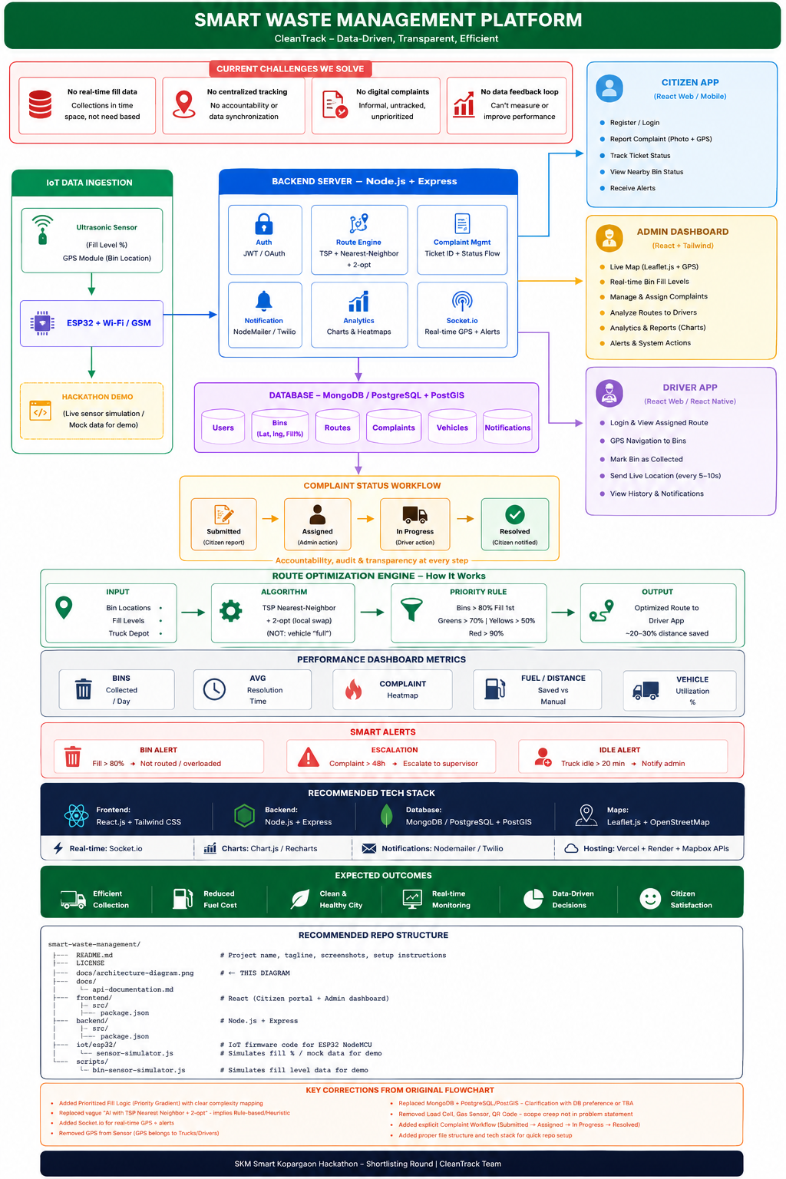



Team Nishkarsh
TECHNICAL APPROACH
System Architecture
HOW TO READ IT
IoT layer
Bin sensors + ESP32 push fill data to the backend
Backend core
Node.js/Express handles auth, routing, complaints, alerts
Data layer
MongoDB/PostgreSQL + PostGIS stores bins, routes, users
Three apps
Citizen, Admin & Driver apps share one live backend
Route engine
TSP + 2-opt turns priority bins into an optimized path
CleanKop AI | Team Nishkarsh | Smart Kopargoan Hackathon
4

Slide 5
Team Nishkarsh
FEASIBILITY AND VIABILITY
Can We Build & Run This?
FEASIBILITY
ESP32 + ultrasonic sensors are low-cost, off-the-shelf, and hackathon-ready
RISKS → MITIGATION STRATEGY
Per-bin hardware cost
Full stack (React, Node.js, MongoDB/PostgreSQL) is mature, documented, and free to prototype on
Phase rollout — pilot in a few high-traffic wards before city-wide scale-up
TSP nearest-neighbor + 2-opt is lightweight enough to run on a standard server in real time
Patchy rural connectivity
GSM fallback alongside Wi-Fi so bins report even without broadband
Firmware-ready architecture: today's simulator script swaps for real sensors with no redesign
Driver / citizen adoption
Simple mobile-first apps + training and incentive program for drivers
Sensor data accuracy
Threshold smoothing + manual override option in the admin dashboard
CleanKop AI | Team Nishkarsh | Smart Kopargoan Hackathon
5

Slide 6





Team Nishkarsh
IMPACT AND BENEFITS
Who Gains, and How
Target audience: Kopargaon municipal corporation, sanitation drivers, and citizens across the city.
Efficient Collection
Reduced Fuel Cost
Clean & Healthy City
Priority routing (red → yellow → green bins) cuts wasted trips
20–30% distance saved vs. fixed manual routes
Bins emptied before overflow — fewer health & odor complaints
Real-time Monitoring
Data-Driven Decisions
Citizen Satisfaction
Admins see live fill levels, trucks, and complaints on one map
Analytics and heatmaps guide staffing and future bin placement
Transparent ticket status builds trust in the system
CleanKop AI | Team Nishkarsh | Smart Kopargoan Hackathon
6

Slide 7


Team Nishkarsh
RESEARCH AND REFERENCES
Grounded in Established Tools & Methods
ESP32 + Ultrasonic Sensing
Route Optimization
Espressif ESP32 technical reference & HC-SR04 ultrasonic sensor documentation for bin fill-level sensing
Traveling Salesman Problem — Nearest-Neighbor construction heuristic refined with 2-opt local search
Geospatial Data
Mapping & Live Tracking
PostgreSQL + PostGIS documentation for storing and querying bin/route geo-coordinates
Leaflet.js and OpenStreetMap documentation for the live map and route rendering
Real-time Communication
Reference Municipal Models
Socket.io documentation for live GPS updates, bin alerts, and dashboard sync
Smart-city solid-waste-management case studies (IoT bin sensors + optimized collection routing)
CleanKop AI | Team Nishkarsh | Smart Kopargoan Hackathon
7

Slide 8
Team Nishkarsh
RESEARCH AND REFRENCES
DETAILS
ESP32 & Ultrasonic Sensor
Espressif Systems. ESP-IDF Programming Guide (Official Documentation).
HC-SR04 Ultrasonic Sensor Datasheet (Components101 / Manufacturer Documentation).
Route Optimization
Traveling Salesman Problem (TSP): Nearest Neighbor + 2-Opt Heuristic.
MDPI, Applied Sciences (2023).
Geospatial Database
PostgreSQL + PostGIS Official Documentation.
Live Mapping
Leaflet.js Official Documentation.
OpenStreetMap Documentation.
Real-Time Communication
Socket.IO v4 Official Documentation
.
Real-World Smart Waste Management Case Studies
Mumbai (Malad), India – IoT Smart Bin Deployment (IIETA Journal): ~20% reduction in garbage truck usage
Team Members: Parth Desai (Leader) • Divya Pawar • Shreyash Patil • Tanavi Pawar
CleanKop AI | Team Nishkarsh | Smart Kopargoan Hackathon
8

