Slide 1

PowerShell & DEVOPS User Group
Scotland 31/01/2019
@ScotPSUG

Slide 2






scottish POWERSHELL & DEVOPS user group
Scottish PowerShell & Devops User Group
Organiser – Paul Broadwith (@pauby)
Co-Organiser – Craig Porteous (@cporteous)
Co-Organiser – Veronique Lengelle (@veronicageek)
psdevopsug.scot
@scotpsug
slack.psdevopsug.scot
video.psdevopsug.scot
git.psdevopsug.scot
meetup.psdevopsug.scot
@ScotPSUG

Slide 3
uk POWERSHELL & DEVOPS user groups
You can find details of all of the groups:
powershell.org.uk
github.com/powershellorguk
@ScotPSUG

Slide 4
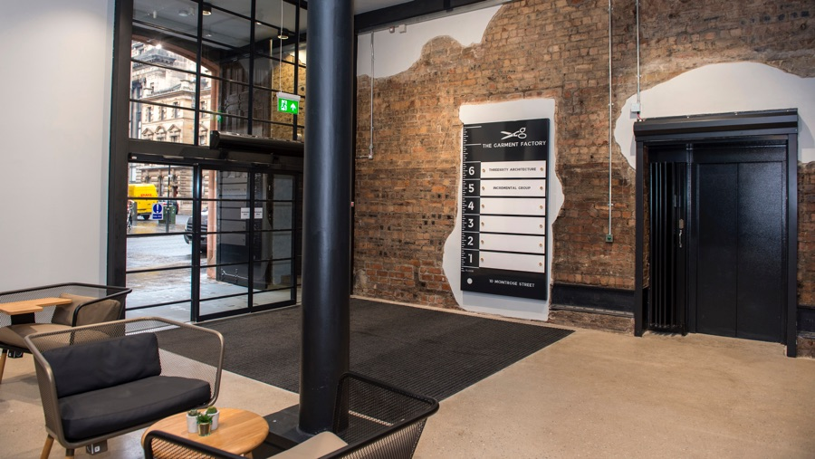


meetup venue
Incremental Group are kindly hosting us
Location - 5th Floor, The Garment Factory, 10-12 Montrose Street, Glasgow, G1 1RE
Website - garment-factory.co.uk
@ScotPSUG

Slide 5


Glasgow Azure User Group
Founded in early 2017 as an independent body GAUG aims to bring the together the IT community to collaborate, network and learn from each other.
www.gaug.co.uk @GlasgowAzureUG

Slide 6




SQL Server
Power BI
Data Analytics
Business Intelligence
Data Warehousing
PowerShell
Azure
@SqlGlasgow
Bit.ly/sqlglasgow
https://SQLGlasgow.co.uk

Slide 7
agenda!
6.00pm – Arrive and mingle
6.10pm - Introduction
6.20pm – How to create a system of Immutable Infrastructure by Gary Ewan Park (@gep13)
7.20pm - Food
7.45pm – Use a platform with a REST API? Make a module for it by Anthony Howell (@ThePoSHWolf)
8.45pm – Thank you’s
@ScotPSUG

Slide 8
Let us know
If you want to present [10 mins/30 mins/1 hour?]
Any topics you are interested in hearing about?
@ScotPSUG

