Slide 1

PowerShell & DEVOPS User Group
Scotland 28/11/2018
@ScotPSUG

Slide 2






scottish POWERSHELL & DEVOPS user group
Scottish PowerShell & Devops User Group
Organiser – Paul Broadwith (@pauby)
Co-Organiser – Craig Porteous (@cporteous)
Co-Organiser – Veronique Lengelle (@veronicageek)
psdevopsug.scot
@scotpsug
slack.psdevopsug.scot
video.psdevopsug.scot
git.psdevopsug.scot
meetup.psdevopsug.scot
@ScotPSUG

Slide 3
uk POWERSHELL & DEVOPS user groups
You can find details of all of the groups:
powershell.org.uk
github.com/powershellorguk
@ScotPSUG

Slide 4
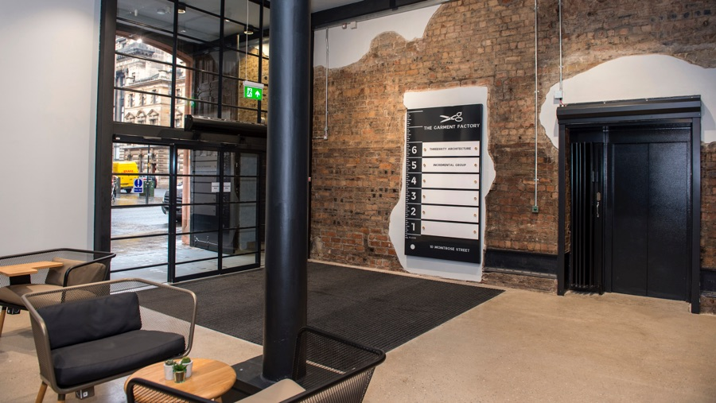


meetup venue
Incremental Group are kindly hosting us
Location - 5th Floor, The Garment Factory, 10-12 Montrose Street, Glasgow, G1 1RE
Website - garment-factory.co.uk
@ScotPSUG

Slide 5

Our SPONSORS
More than just another recruitment business…
MBN Solutions Ingram House, 227 Ingram Street, Glasgow G1 1DA
Website: https://www.mbnsolutions.com
Tel: 0141 225 0130
@ScotPSUG

Slide 6


Glasgow Azure User Group
Founded in early 2017 as an independent body GAUG aims to bring the together the IT community to collaborate, network and learn from each other.
www.gaug.co.uk @GlasgowAzureUG

Slide 7




SQL Server
Power BI
Data Analytics
Business Intelligence
Data Warehousing
PowerShell
Azure
@SqlGlasgow
Bit.ly/sqlglasgow
https://SQLGlasgow.co.uk

Slide 8
agenda!
6.00pm – Arrive and mingle
6.10pm - Introduction
6.20pm – Power BI and PowerShell - A Match Made in Heaven - Craig Porteous (@cporteous)
7.20pm - Pizza, drinks and chat
7.45pm – PowerShell & Microsoft Teams. Slack who?! - Brett Miller (@BrettMiller_IT)
8.45pm – Thank you’s
@ScotPSUG

Slide 9
Let us know
If you want to present [10 mins/30 mins/1 hour?]
Any topics you are interested in hearing about?
@ScotPSUG

Slide 10


