Slide 1




SMART INDIA HACKATHON 2026
Problem Statement ID – SIH26007
Problem Statement Title- Safe and Operations of Mine Vehicles in Fog and Low – Visibility Conditions in Open Cast Iron Ore Mines
Theme- Smart Automation
PS Category- Hardware
Team ID- SIH26-A0H-T237
Team Name- Lowkey
SIH

Slide 2

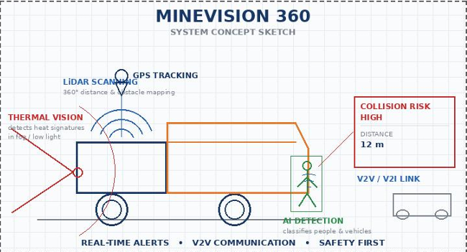
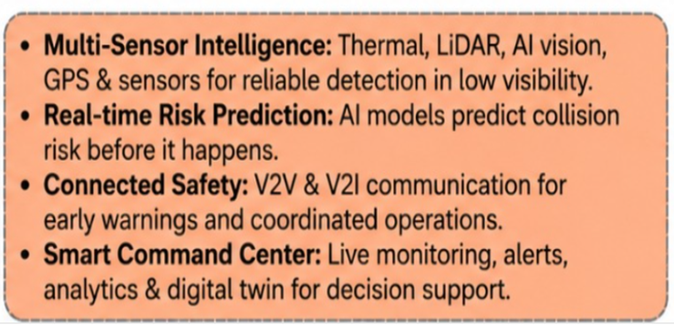
Lowkey
PROPOSED SOLUTION
Problem at Hand
Our Solution
Key Features
Lidar & Radar
Measures distance and detects objects accurately.
Lack of Real-time Awareness:
Drivers cannot detect nearby vehicles , obstacles,or workers in blind zones or sharp turns.
GPS Tracking
Real-time vehicle location & route monitoring.
Low Visibility in Mines:
Fog ,dust ,and smoke reduce diver visibility , leading to high risk of collisions between mine vehicles and with pedestrians.
Thermal & AI vision
.Detects vehicles,pedestrians & obstacles in fog.
High Accident Rate:
Collisions and near-mises cause injuries, equipment damage, production losses ,and operational delays.
V2V & V2I Alerts
Shares data between vehicles and infrastructure
Command Center
Live dashboard,alerts & analytics for control rooms
Inefficient Monitoring:
Manual monitoring and communication delay decisions ,increasing risk in large open-cast mines.
Safety & Efficiency
Reduces collisions,improves productivity &fleet utilization.
2

Slide 3
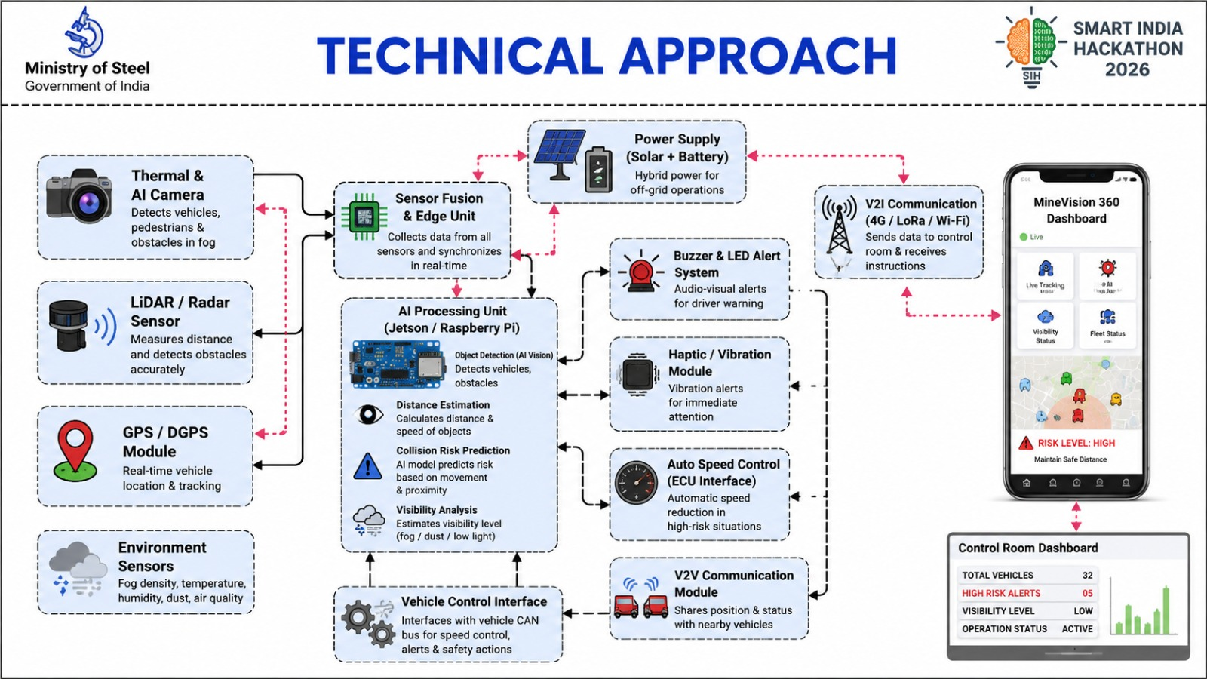
Lockey

Slide 4

LOWKEY
FEASIBILITY AND VIABILITY
Feasibility
Challenge
Solution
Technical Feasibility
Sensor Fusion : 98% fog-penetration accuracy.
Edge Processing : <100ms latency for warnings.
Hardware : IP67-rated for harsh mine conditions.
Sensor Overwhelm
Severe fog, heavy rain, and mist can overwhelm standard LiDAR/optical cameras.
Solution must integrate radar
Al-Powered Sensor Fusion
Use computer vision on fused Thermal Camera (for heat signatures) and Radar (for obstacle detection) data.
• Edge analytics for noise suppression and edge detection
Regulatory & Legal
Compliance: Meets DGMS safety guidelines.
Data Sovereignty: 100% on-premise architecture.
V2X License : Cleared V2V/V2I frequencies.
v2v/v21 Latency Risk
• A delay in V2V communication could mean a missed collision alert.
• Edge computing is critical
Centralized Digital Twin Oversight
• Create a Digital Twin-based control platform for centralized command to monitor fleet positions (GPS/DGPS) and system health.
• Digital twin for simulation
Economic & Business
Cost Savings: 90% reduction in downtime costs.
Continuity: +15% output during low visibility.
Targets: Helps hit the 100 MTPA production goal.
System Reliability & Hardware Degradation
• Mining environments are harsh.
• Sensors must resist vibration and dust.
• Need long-term component durability and maintenance framework.
Predictive Driver-Assistance
Deploy AI/ML models that predict potential collision paths and give proactive, trajectory-based driver warnings.
• User-friendly Human-Machine Interface (HMI)
4

Slide 5
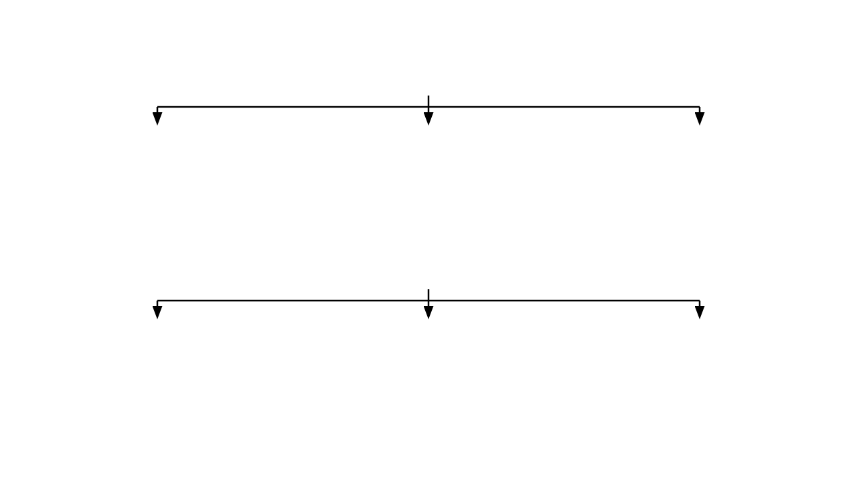







IMPACT AND BENEFITS
NMDC & Ministry of Steel
Dumper Operators
Mining Industry
Secures NMDC's target of 100 MTPA by enabling continuous, safe operations of HEMM in zero-visibility conditions, minimizing massive production losses during the 5-month monsoon season.
Drastically improves personal safety, reduces cognitive load, and aims for zero collisions during high-stress low-visibility hilltop operations through AI driver-assistance.
Creates a scalable, digital-first template for all mechanized open-cast mines across India, revolutionizing haulage efficiency and setting new advanced safety benchmarks.
Operational Transformation
Economic Benefits
•
Yield Increase: Millions saved annually through uninterrupted ore output and extraction.
Digital-First Approach
•
Cycle Time Reduction: Dumpers maintain optimal safe speeds instead of halting during fog.
Real-time Oversight: Live 3D dashboard monitoring of the entire mine environment.
•
•
Fleet Tracking: Total visibility for control rooms via live Digital Twin monitoring.
•
Asset Protection: Prevents multi-crore damages and repair costs from HEMM collisions.
•
Infrastructure V2I: Smart localized hazard broadcasting to all connected vehicles.
•
Autonomous Ready: V2X infrastructure lays the groundwork for future fully autonomous mining.
High ROI: Rapid return on hardware deployment due to retained operational uptime.
•
Collision Resilience: Failsafe edge computing protects vehicles independently of central cloud lag.
•

Slide 6


RESEARCH AND REFERENCES
Lowkey
Kumari et al. (2021/2022) .“Intelligent Driving System at Opencast Mines During Foggy Weather”
https://doi.org/10.1080/17480930.2021.2009724?
Choudhary et al. (2022),“Perceptive Driving Assistant System for Opencast Mines During Foggy Weather”
https://link.springer.com/article/10.1007/s42461-022-00678-x
NIOSH – Collision Warning Systems for Surface Mining Dump Trucks
https://www.cdc.gov/niosh/publications/numbered/2000-120.html?CDC_AA_refVal=https%3A%2F%2Fwww.cdc.gov%2Fniosh%2Fdocs%2Fmining%2Fworks%2Fcoversheet296.html
Guan et al. (2020) Through Fog High-Resolution Imaging Using Millimeter Wave Radar
https://www.microsoft.com/en-us/research/publication/through-fog-high-resolution-imaging-using-millimeter-wave-radar/
6

