Slide 1

Message Passing
Peter Seale
@pseale
Only 1 month of beard growth

Slide 2
Success in life, through message passing
Success
Better programmer
More tools in
toolbox
Message passing

Slide 3
Learning OOP seems simple
C# syntax
Design Patterns
TDD
SOLID

Slide 4
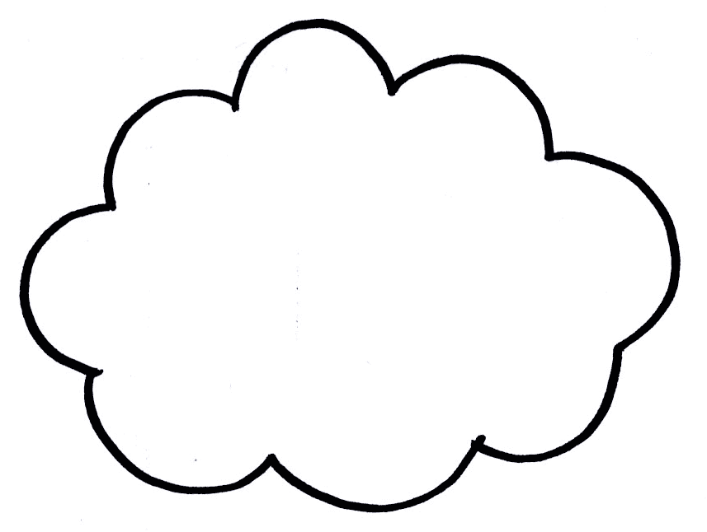
...but learning OOP is messy
C# syntax
Design Patterns
Mocks
Domain model
CQRS
AAA
TDD
SOLID
BDD
Encapsulation
Composition
Cuke it
Message
passing
Stop using
Design Patterns

Slide 5
Alan Kay is the father of OOP, so listen to him
Just a gentle reminder that I took some pains at the last OOPSLA to try to remind everyone that Smalltalk is not only NOT its syntax or the class library, it is not even about classes. I'm sorry that I long ago coined the term "objects" for this topic because it gets many people to focus on the lesser idea.
The big idea is "messaging".

Slide 6
What is message passing?

Slide 7
Wikipedia: “Message passing is the paradigm of communication where messages are sent from a sender to one or more recipients”

Slide 8
What makes message passing different from just calling methods?

Slide 9
Tic Tac Toe demo
(pay attention)

Slide 10
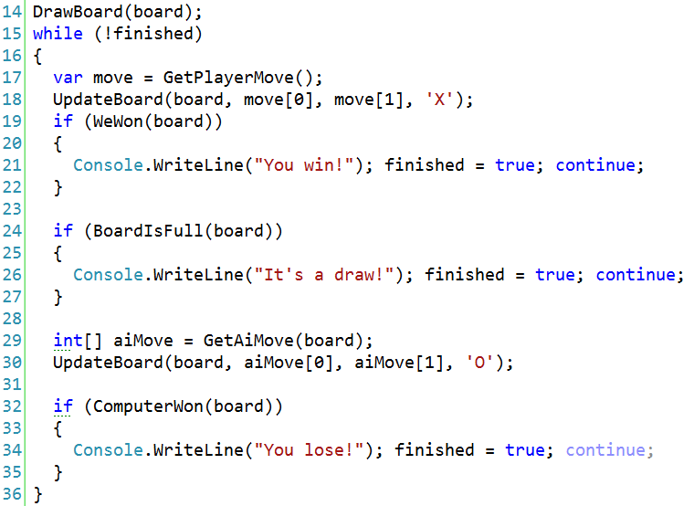

Slide 11
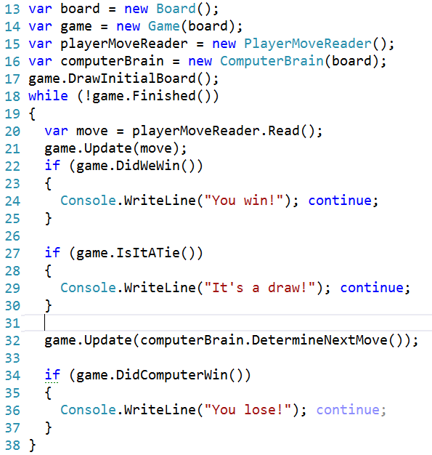

Slide 12
WCF encourages procedural code, but we can choose to do it the message passing way

Slide 13
Takeaway: Reduce chattiness, encourage simplicity by sending messages. Make your messages objects. Stop using Exceptions to send routine messages.

Slide 14
Takeaway: if you're doing distributed computing and are not using durable messages, either start using durable messages or compensate

Slide 15
Takeaway: If you're doing WPF, look into the Event Aggregator pattern and use it (sometimes).

Slide 16
Takeaway: If you're having problems with threading issues or need to scale, look into durable messages and using background workers

Slide 17
Takeaway: If you've tried “classical DDD” from a few years back and don't like all the overhead, read Ayende's blog on architecture and how he builds a simple architecture replacing service methods with messages.
Alternately, CQRS

