Slide 1
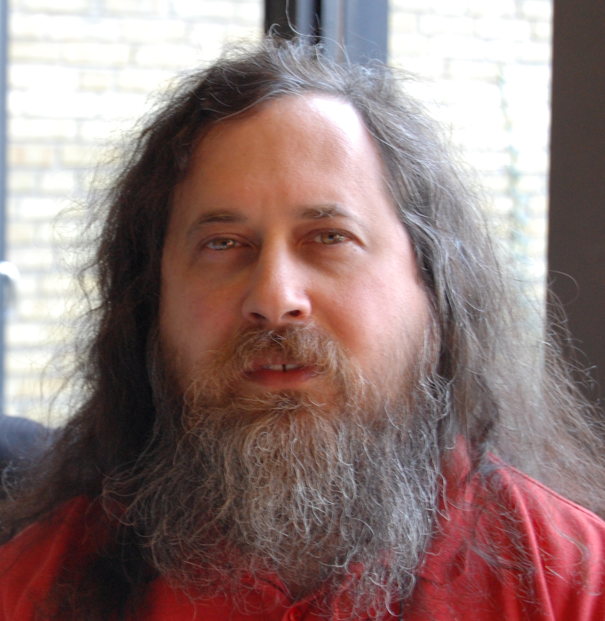
Message Passing
Peter Seale
@pseale
Only 1 month of beard growth

Slide 2
Success in life, through message passing
Success
Better programmer
More tools in
toolbox
Message passing

Slide 3
My goal is for you to have a eureka moment

Slide 4
Learning OOP seems simple
C# syntax
Design Patterns
TDD
SOLID

Slide 5
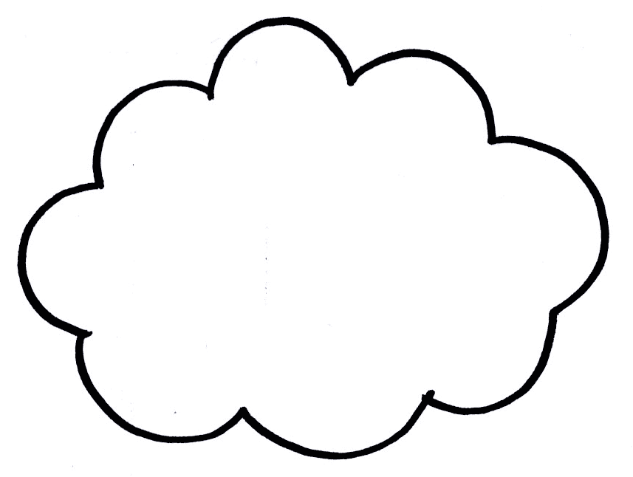
...but learning OOP is messy
C# syntax
Design Patterns
UML
Fowler's PoEAA
Mocks
Domain model
CQRS
AAA
TDD
SOLID
BDD
Encapsulation
Composition
Cuke it
Message
passing
Stop using
Design Patterns
(bad advice)

Slide 6
Alan Kay is the father of OOP, so listen to him
Just a gentle reminder that I took some pains at the last OOPSLA to try to remind everyone that Smalltalk is not only NOT its syntax or the class library, it is not even about classes. I'm sorry that I long ago coined the term "objects" for this topic because it gets many people to focus on the lesser idea.
The big idea is "messaging".

Slide 7
What is message passing?

Slide 8
Wikipedia: “Message passing is the paradigm of communication where messages are sent from a sender to one or more recipients”

Slide 9
What makes message passing different from just calling methods?
What are the benefits?

Slide 10
Tic Tac Toe demo
(pay attention)

Slide 11
Rules:
* 3x3 grid #
* Player goes first as 'X'
* Computer plays as 'O'
* A player wins if they get 3 in a row.
* A tie occurs when the board fills up.

Slide 12
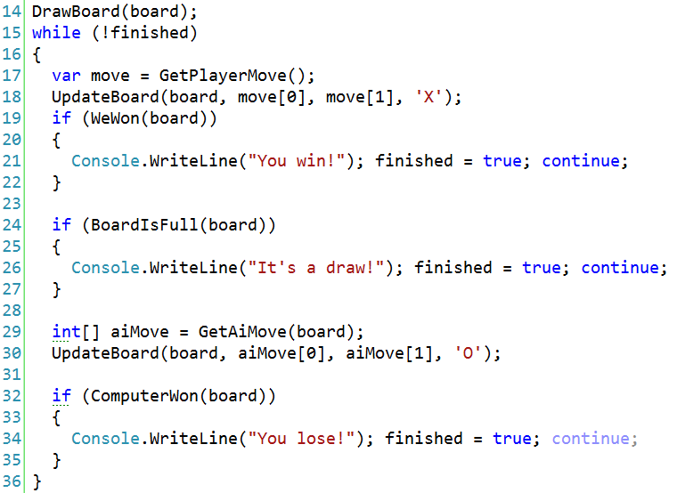

Slide 13
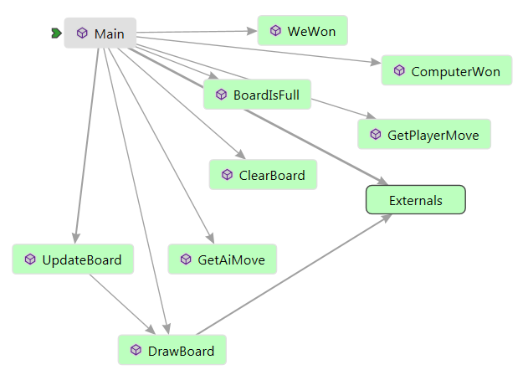

Slide 15
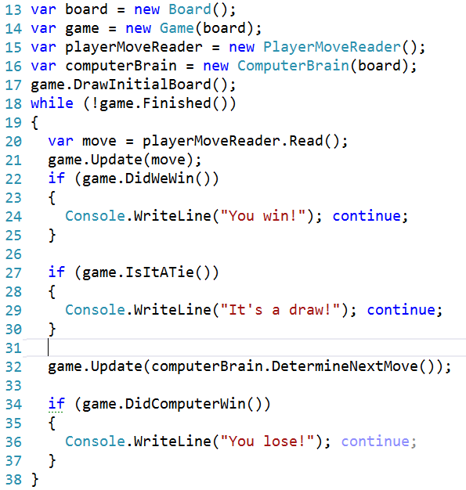

Slide 17
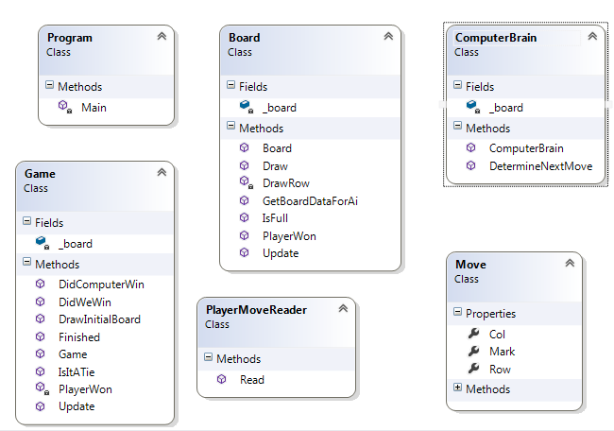

Slide 18
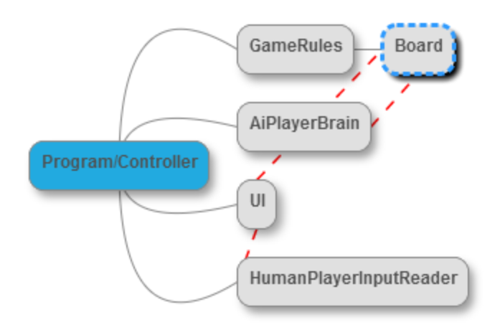

Slide 19
Demo: introducing the “Board was updated” message.

Slide 20
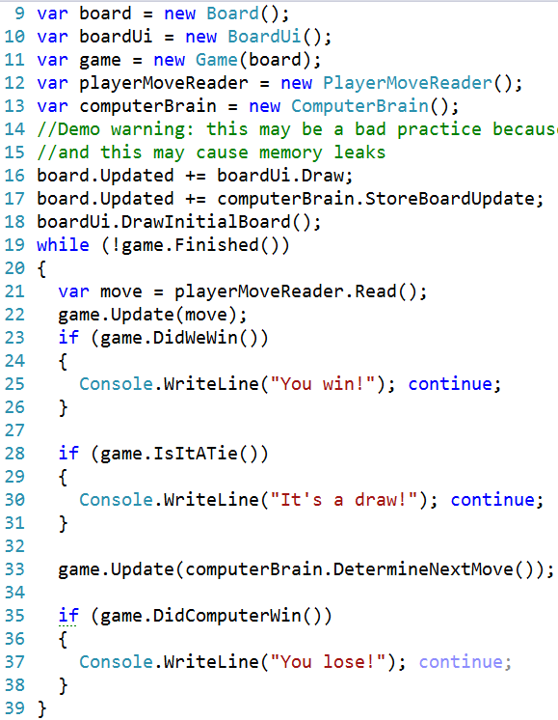

Slide 22
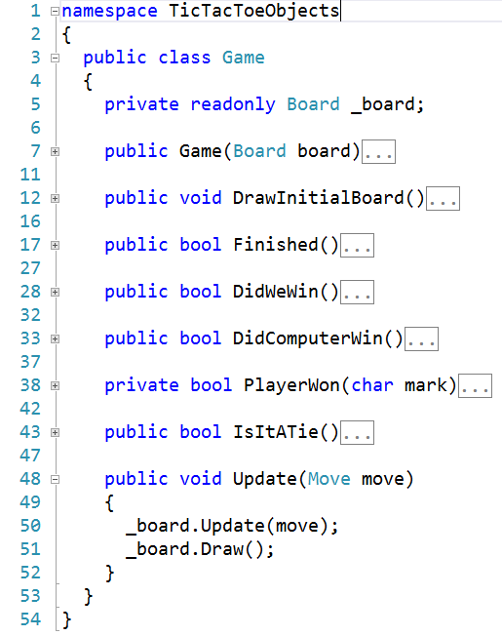
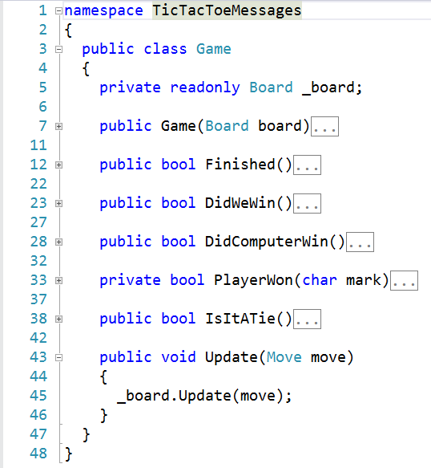

Slide 23
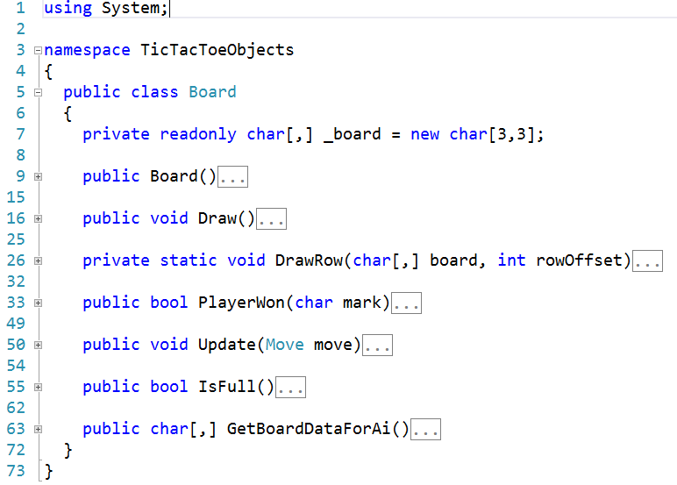
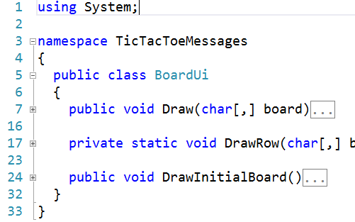

Slide 24
What felt awkward about that?
Was anything better?

Slide 25
Now for the Full message passing Monty – we communicate ONLY with messages

Slide 26
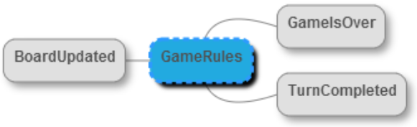
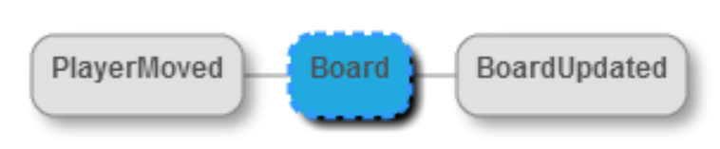
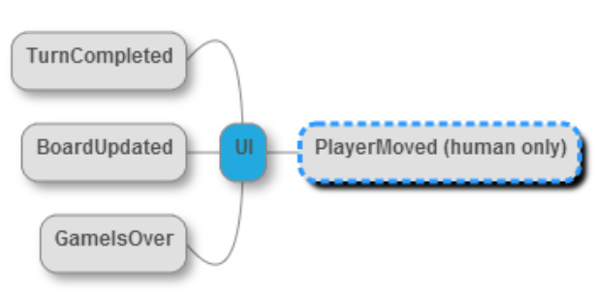
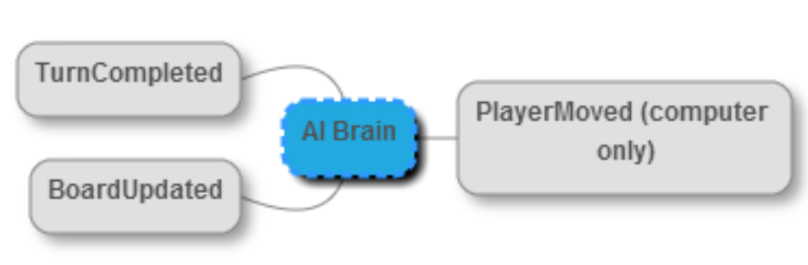

Slide 27
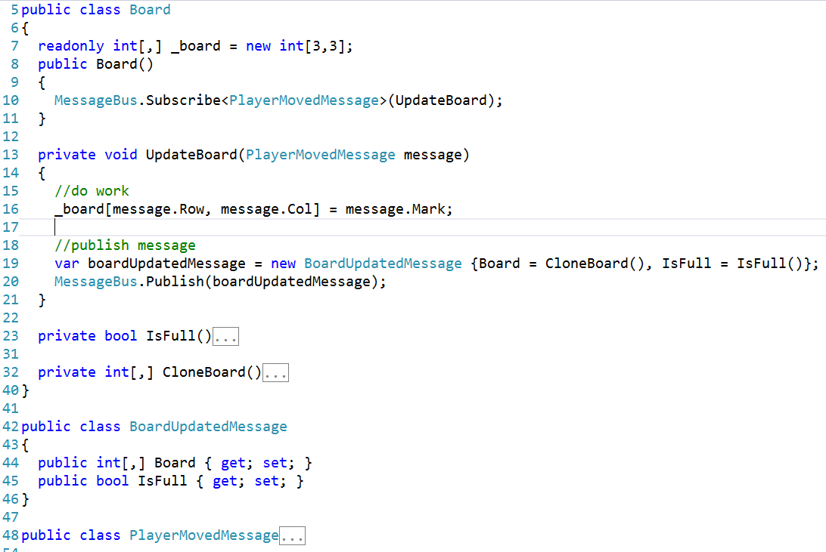

Slide 28
Still awkward? People use IoC containers to wire up events/messages

Slide 29
Moment of reflection

Slide 30
What makes message passing different from just calling methods?
What are the benefits?

Slide 31
Takeaway: Reduce # of collaborators, encourage simplicity by sending messages.

Slide 32
Takeaway: Create and use your own C# events.

Slide 33
Takeaway: When C# events aren't enough, look into “Domain Events”

Slide 34
Takeaway: if you're doing distributed computing and are not using durable messages, either start using durable messages or compensate

Slide 35
Takeaway: If you're doing WPF, look into the Event Aggregator pattern and use it (sometimes).

Slide 36
Takeaway: If you're having problems with threading issues or need to scale, look into durable messages and using background workers

Slide 37
Takeaway: If you've tried “classical DDD” from a few years back and don't like all the overhead, read Ayende's blog on architecture and how he builds a simple architecture replacing service methods with messages.
Alternately, CQRS

