Slide 1
Refactoring
Peter Seale
@pseale

Slide 2
Goal: get you comfy
3 ways:
  Show refactoring demo
  Talk about tools (not Resharper)
  Hint at the greater context

Slide 3
Demo
Focus on
  How we identify CANDIDATES for REFACTORING
  How/why each change begets BETTER CODE
  How to stay SAFE
  How to make LARGE, SWEEPING CHANGES (i.e., don't)

Slide 4
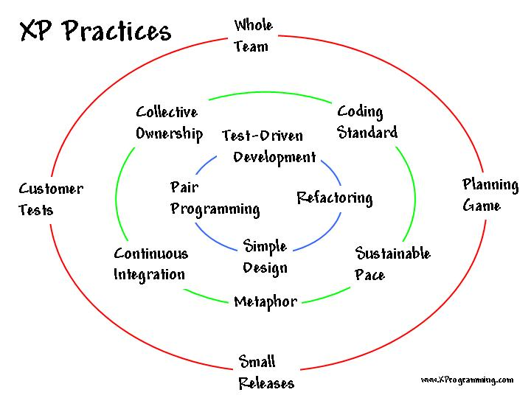

Slide 5
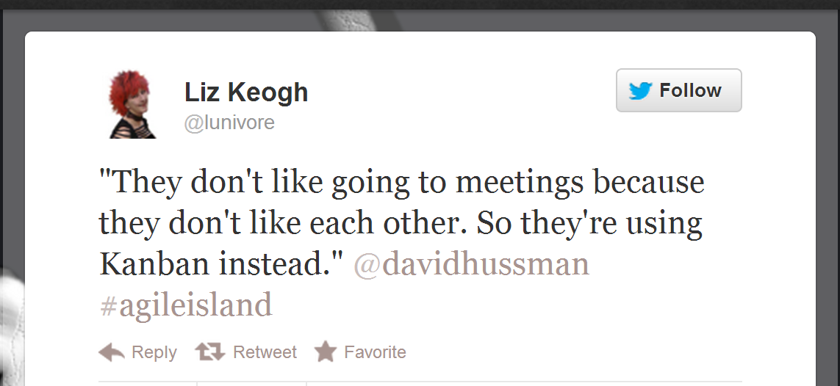
Open discussion time

