Slide 1
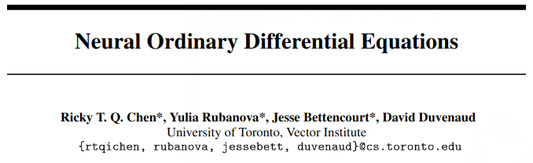
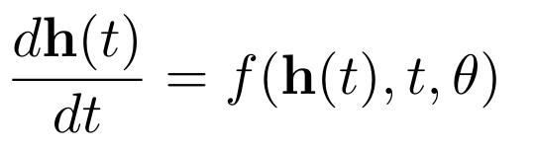

Neural ODEs
Awarded (one of) Best Papers
of NeurIPS 2018
(Chen et al, 2018)
Patrick Eastham
Nov. 13, 2020
Machine Learning Seminar
Florida State University

Slide 2
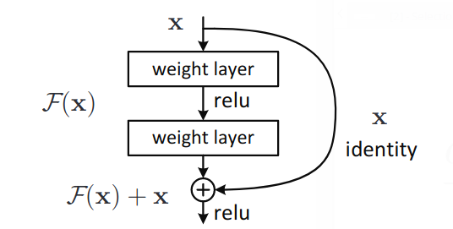

Motivation: Residual Networks
(He et al, 2015)

Slide 3
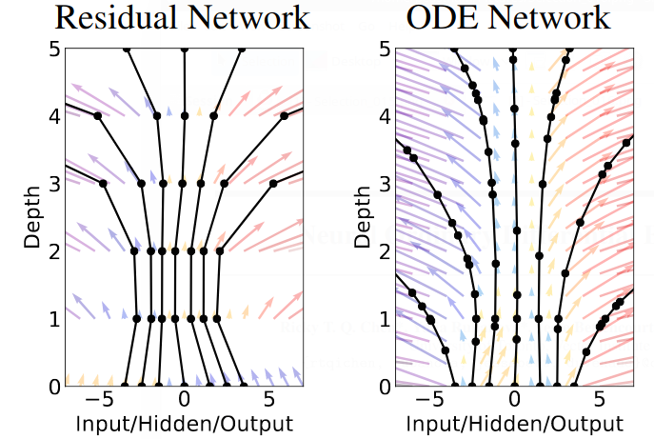
Introduction: Continuum Deep Nets
Advantages:
Natural representation for time-series problems
Uses black-box ODE solvers
Explicit error bounds for speed/accuracy tradeoff
O(1) memory cost for training (does not depend on depth)
(Chen et al, 2018)

Slide 4
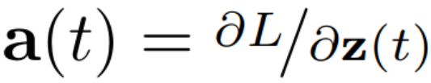
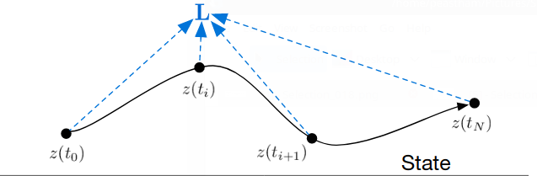
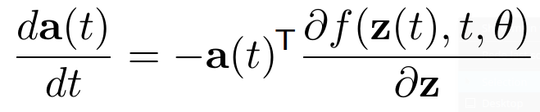
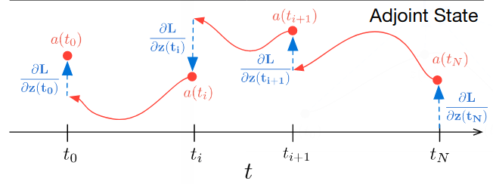
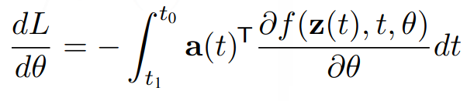
So why weren’t these used before?
See Appendix B of (Chen et al, 2018)
(Chen et al, 2018)

Slide 5
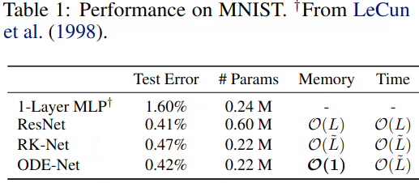
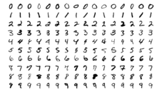
Performance: Supervised Learning
(Chen et al, 2018)

Slide 6
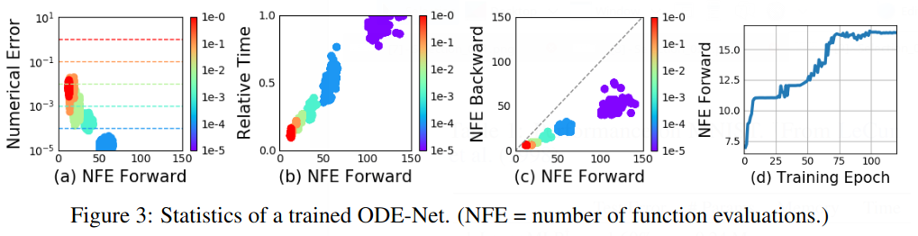
Accuracy/cost tradeoff
(Chen et al, 2018)

Slide 7
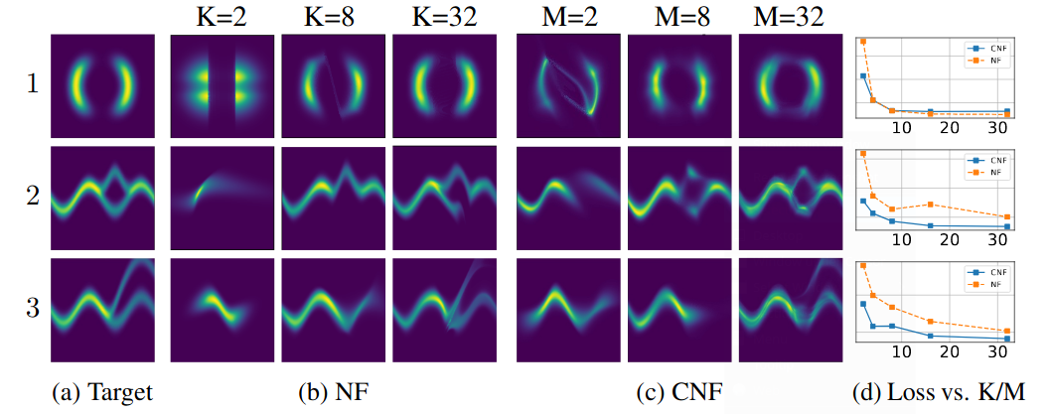
Normalizing Flows
(Chen et al, 2018)

Slide 8
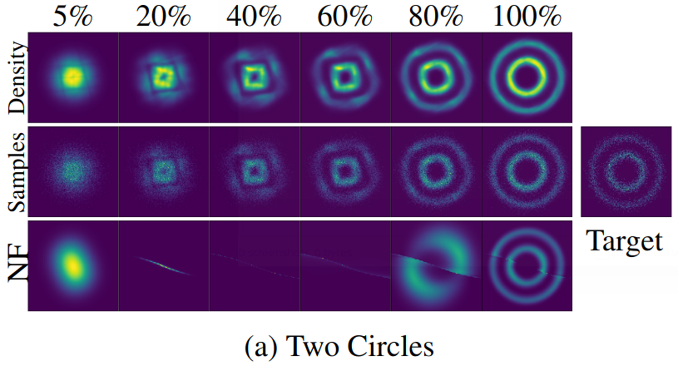
Normalizing Flows
(Chen et al, 2018)

Slide 9
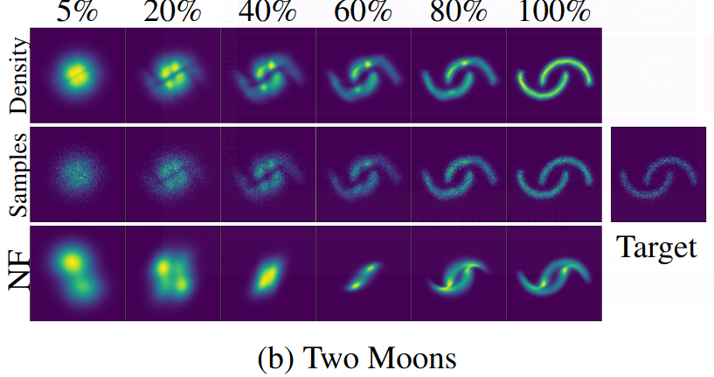
Normalizing Flows
(Chen et al, 2018)

Slide 10
How to implement Neural ODEs
DiffEqFlux.jl
Simple API
Modern ODE solver suite
Stochastic DE
Modern suite of optimization
methods

Slide 11
References
(Chen et al, 2018) Neural Ordinary Differential Equations Ricky T. Q. Chen, Yulia Rubanova, Jesse Bettencourt, David Duvenaud https://arxiv.org/pdf/1806.07366.pdf
(He et al, 2015) Deep Residual Learning for Image Recognition; Kaiming He, Xiangyu Zhang, Shaoqing Ren, Jian Sun https://arxiv.org/pdf/1512.03385.pdf

