Slide 1
Brief Report
Pruthvi S N Swamy

Slide 2
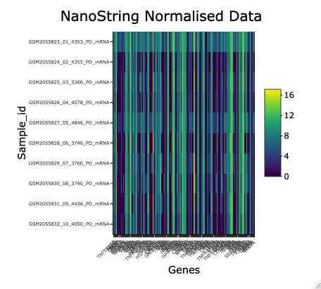
HeatMap

Slide 3
Boxplot
Legend
CXCL1 boxplot: lavender
Green Abline: Min
Red Abline: 25th Percentile
Brown Abline:50th Percentile
Pink Abline:75th Percentile
Maroon Abline:Max
MCL1 boxplot: light blue
Violet Abline: Min
Navy Abline:25th Percentile
Blue Abline:50th Percentile
Yellow Abline:75th Percentile
Orange Abline: Max

Slide 4
Summary Statistics Table
 | min | 25th_percentile | 50th_percentile | 75th_percentile | max
MCL1 | 10.95 | 11.4325 | 12.01 | 12.1075 | 12.74
CXCL1 | 5.24 | 5.48675 | 7.0025 | 7.709 | 9.169

Slide 5
Methodology
R code was used to complete the tasks for quality control, data analysis and reporting
The NanoStringNorm, vsn, heatmaply packages were employed to finish the Data Control and Data Analysis.
The heatmaply throws the output in the interactive plot with positive and negative control genes in columns and samples in row.
The box plot shows the summary statistics(min, 25th percentile, 50th percentile, 75th percentile and max) for each time point by the two genes of interest:MCL1 and CXCL1
The table lists the numeric values of the summary statistics

