Slide 1
GCC plugin for static analyzer support
Lukáš Pšeja
vedoucí: Dr. Ing. Petr Peringer

Slide 2
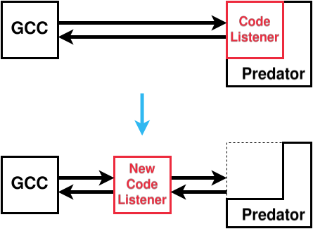
Introduction – Motivation, Technologies
Figure 1: Decoupling Code Listener from Predator
2/7

Slide 3
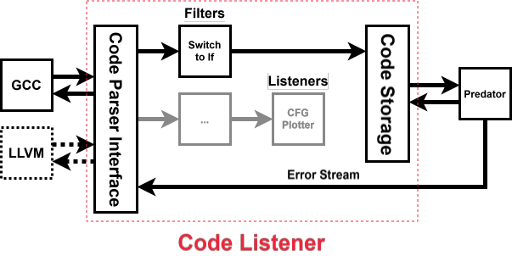
Analysis of the Current Code Listener Architecture
Figure 2: Current Code Listener architecture
3/7

Slide 4
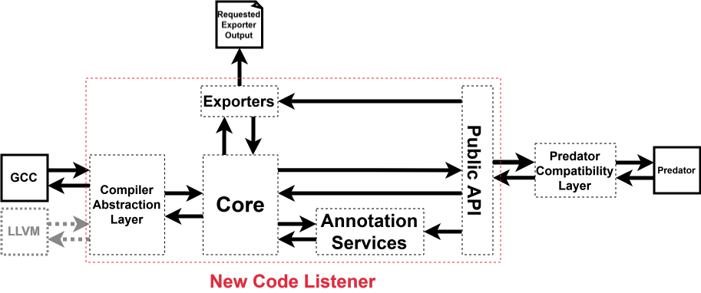
Design of a New Modern Alternative
Figure 3: High level architecture of the new plugin
4/7

Slide 5
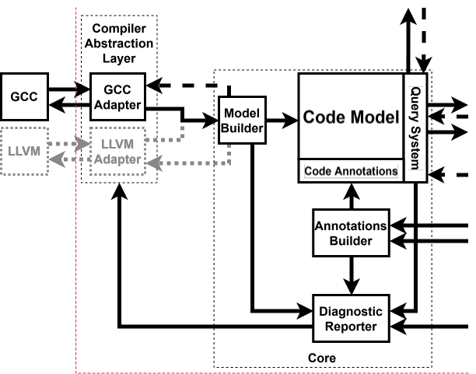
Design of a New Modern Alternative – Detail 1
Figure 4: Detailed view of the CAL and Core
5/7

Slide 6
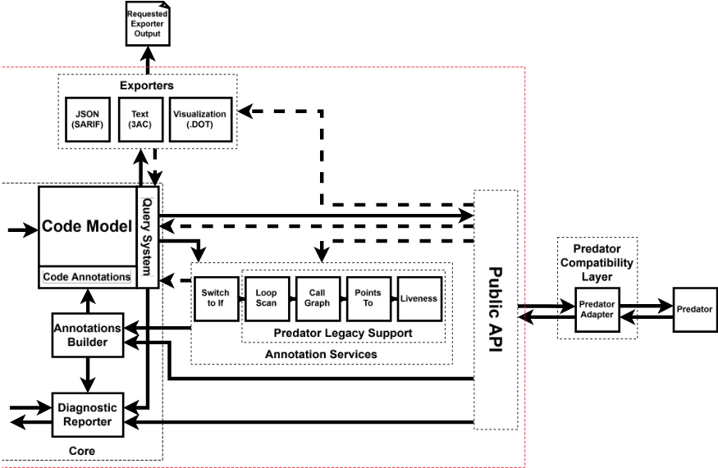
Design of a New Modern Alternative – Detail 2
Figure 5: Detailed view of the Exporters, Annotation Services, Public API and PCL
6/7

Slide 7
Conclusion and Future Work
7/7

