Slide 1
Merchant.App
Paweł Serafin

Slide 2
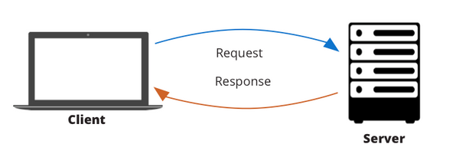


ARCHITECTURE
React JS Client
axios
react-scripts
react-toastify
sass
spinners-react
.Net CORE 3.1 Server
AspNetCore.Identity
Swashbuckle
xunit
AutoFixture
EntityFramework

Slide 3

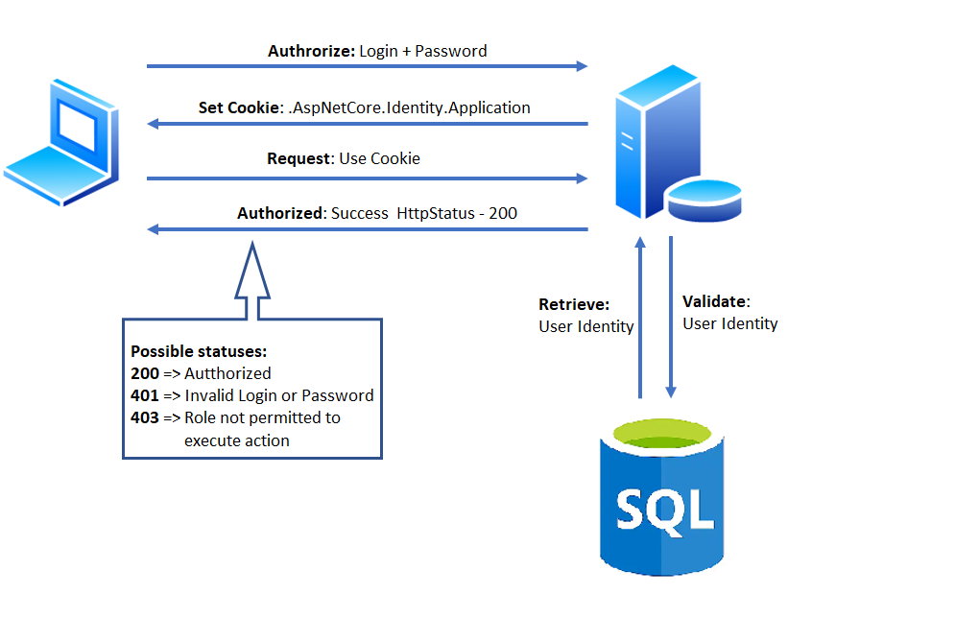


AUTHORIZATION
https://
Admin
User

Slide 4
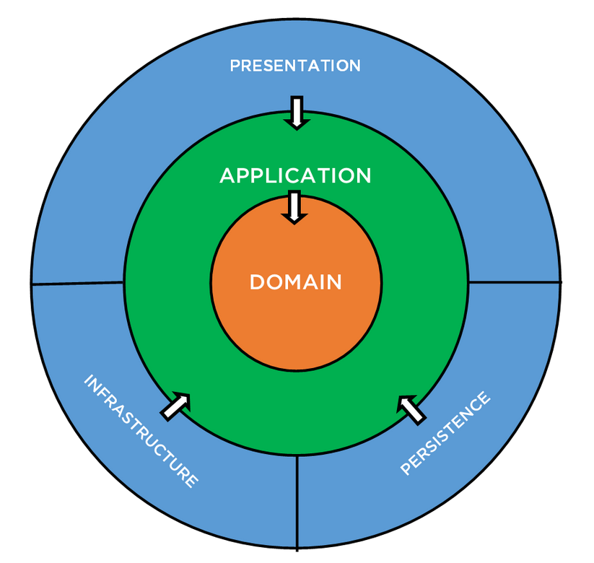
APP Server ARCHITECTURE
API controllers
View Models
Frontend (e.g. MVC views)
„IDEALLY CLEAN”
- Application/Business logic
(interfaces with implementation)
- Dto’s
- Outer layers interfaces
- Domain Entities & Interfaces
- Enterprise types & logic
- e.g. EF Models, extensions, type/model helpers, etc.
- External communication logic implementation)
- e.g. Smtp, Ftp, messaging service,
Data persisting/retrieval
E.g. SQL repositories, Azure storage handlers

Slide 5
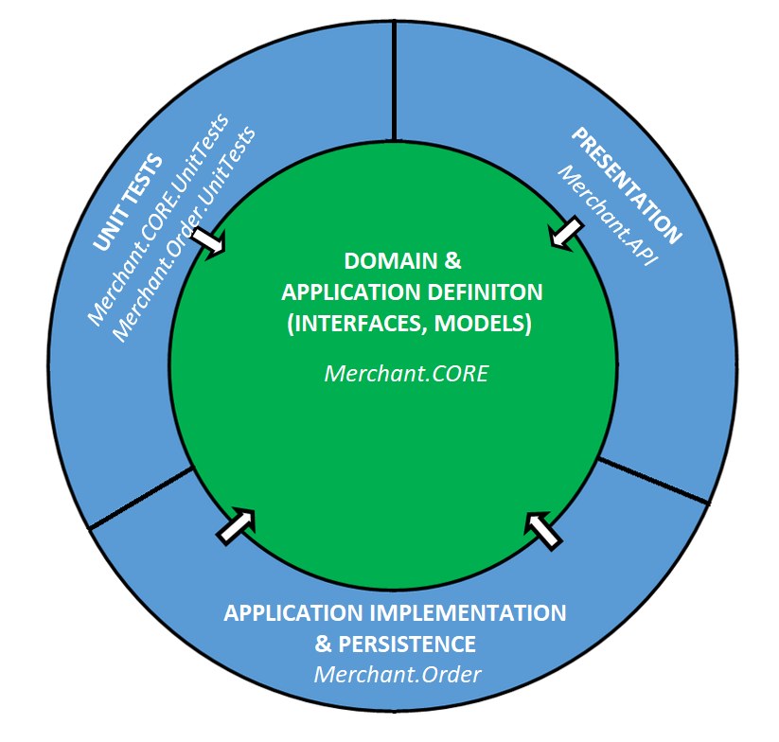
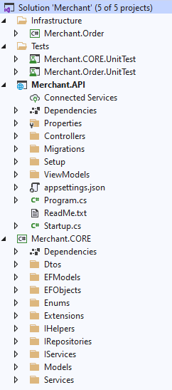
APP Server ARCHITECTURE
„SIMPLIFIED”
Clean
ARCHITECTURE

Slide 6

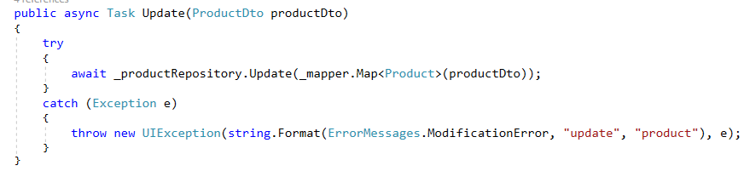
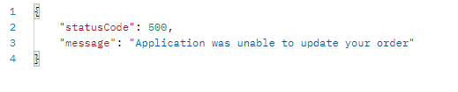
Error HANDLING
Used custom error handling middleware
Why? Identify business value of error and assign it into on of the groups:
„Technical” errors:
- unhandled
- lower priority
- … , in general: errors which message won’t be presented to user or message will be set on UI
„Business” errors:
- critical
- handled in code
- … , in general: errors which message is well formatted and will be presented to user.
- User has to understand the message

Slide 7
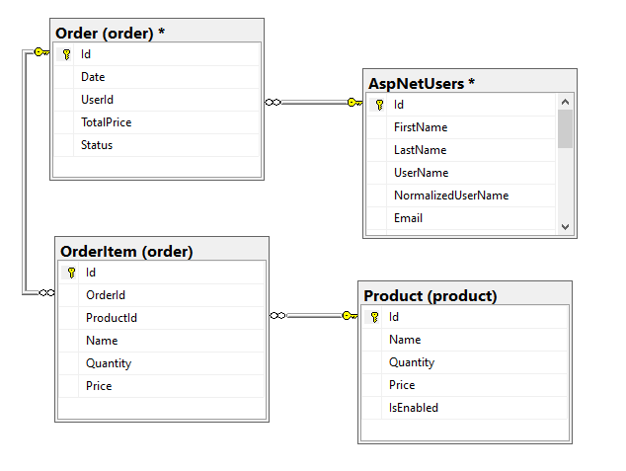
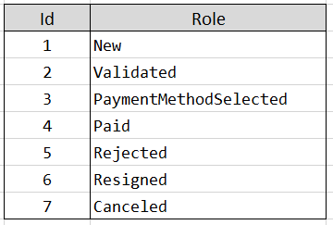

Data Model & ReLATIONS
Order Status:
User Role:

Slide 8

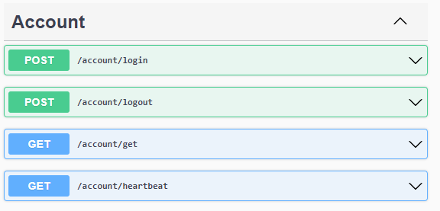
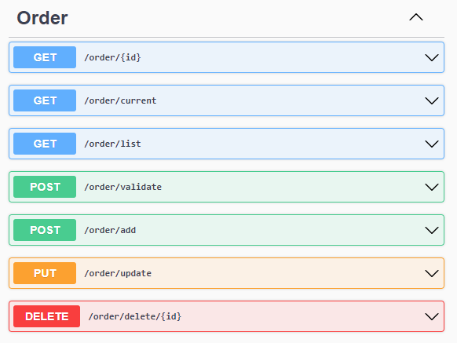
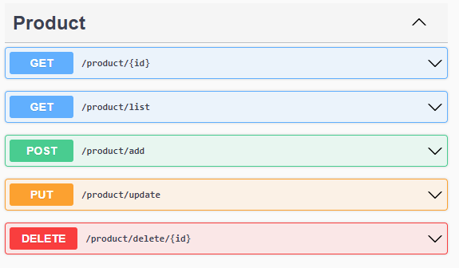
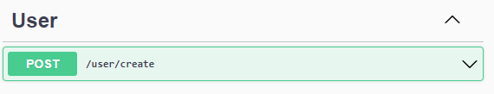
PUBLISHED ENDPOINTS

Slide 9
FRONTEND APP
Its working…. I guess
DEMO

