Slide 1


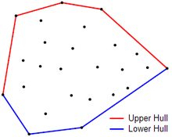
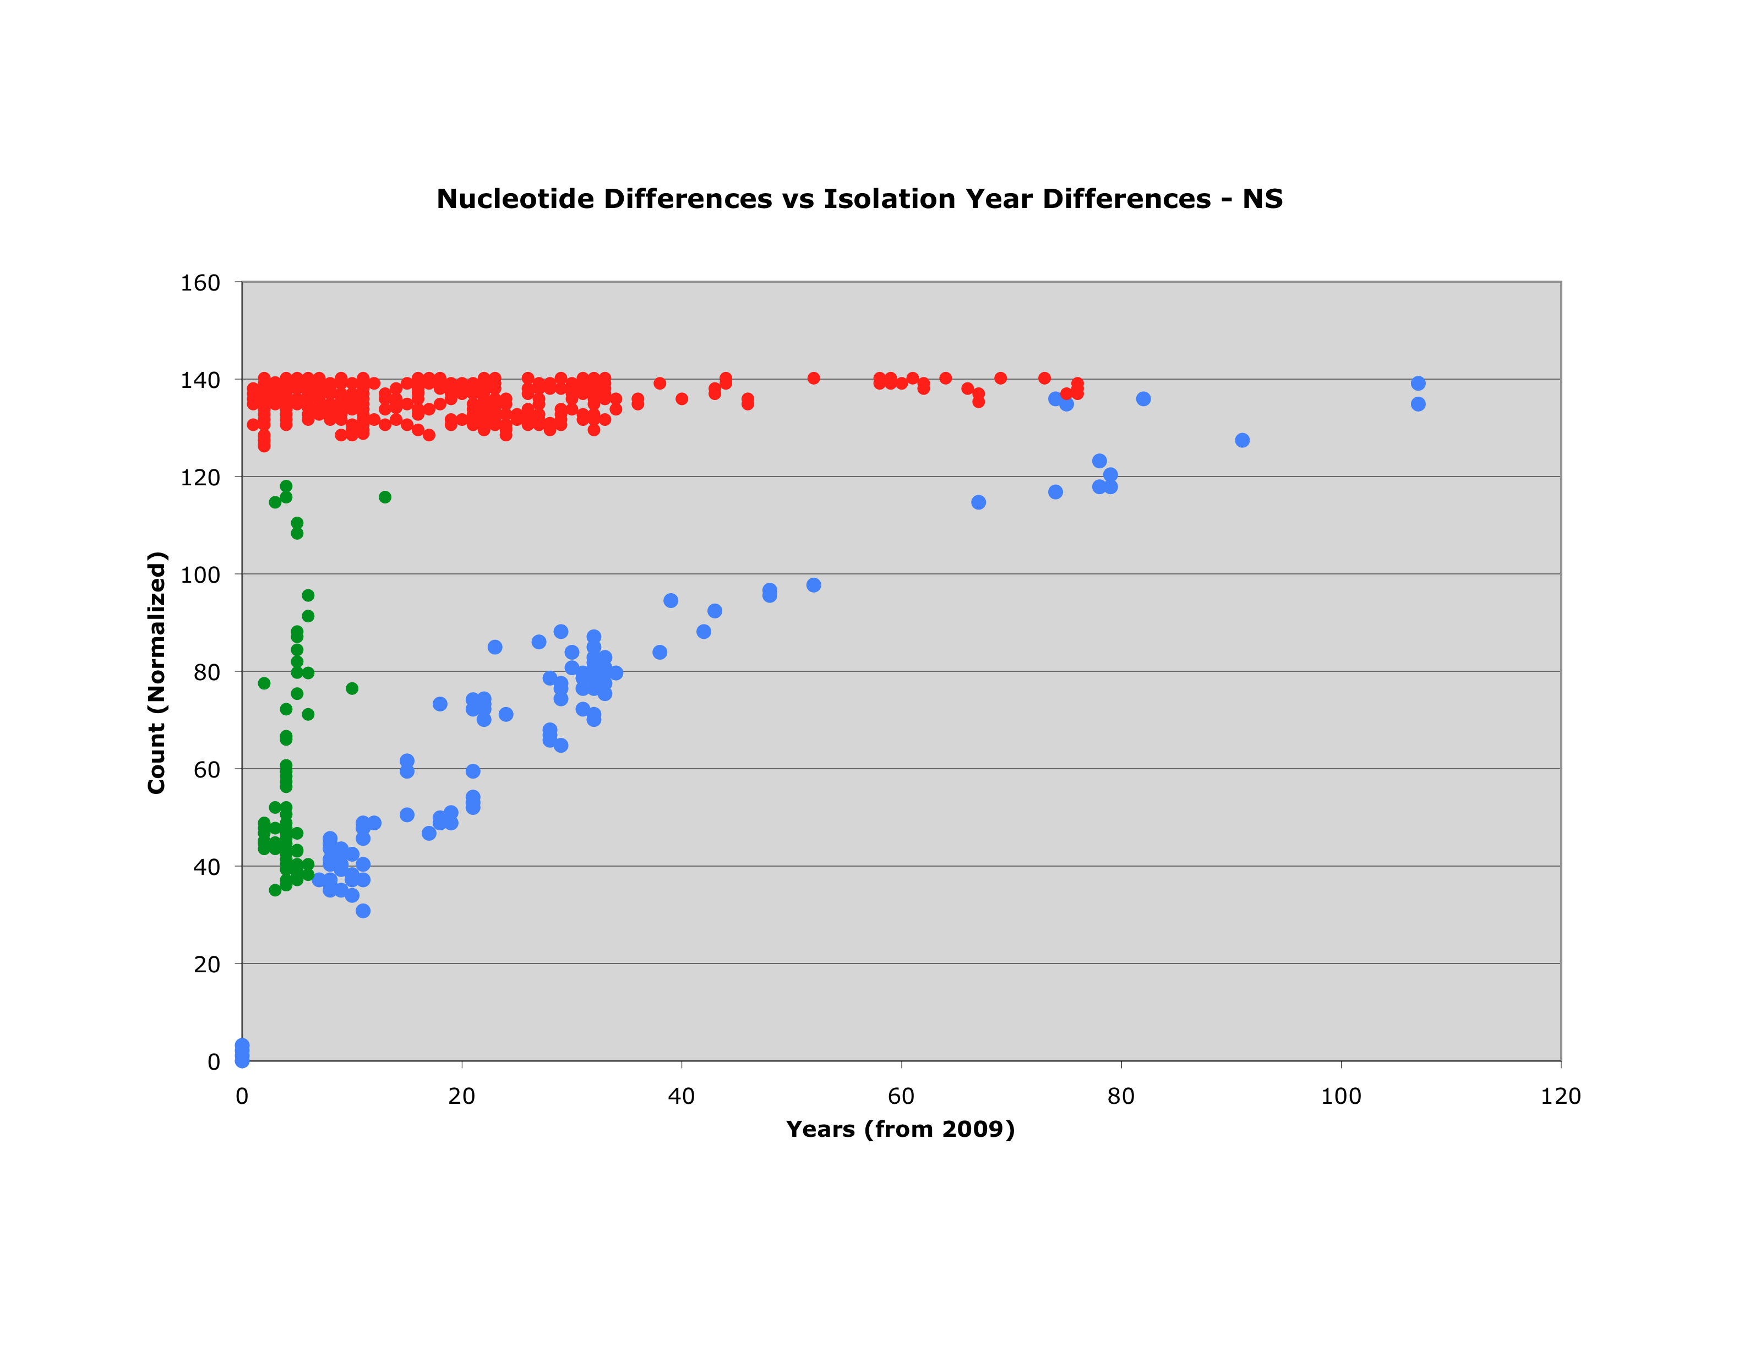
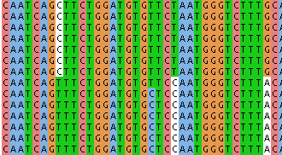
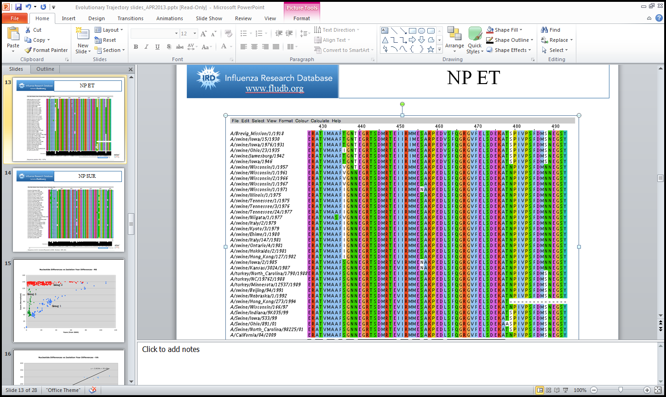
Modeling the Evolutionary Trajectory of Influenza with Scalability to all Viruses
Pietro Sette¹, Douglas S. Greer¹ ,Richard H. Scheuermann^{1,2}
¹J. Craig Venter Institute, La Jolla CA, USA; ²Department of Pathology, University of California, San Diego CA, USA
Abstract
Algorithm 1
Program Summary
Early analysis pointed to evolution from swine for the 2009 H1N1 pandemic. This is an automated method to determine if the evolution trajectory is in fact swine. The approach uses data-driven estimates of mutation rate, per segment, to isolate likely ancestors and then generate multiple sequence alignments. The results suggest that the method can more effectively pinpoint the evolutionary history of viruses, including the host and geographical location of the ancestors, when compared against either BLAST or traditional phylogenetic analysis alone.
Algorithm 1 is the first of two algorithms that does the “ground work” for the second algorithm, in the sense that the second algorithm uses many computations done by the first algorithm. Specifically, it does the following:
Read in a user-specified directory of BLAST results in Fasta format
Read in the header and determines key information
Read the Nucleotide sequence
Calculates the number of mutations and years between each strain and the reference strain
Create an estimated mutation rate by using a re-centering Lower-Bounded Convex hull (illustrated in figure 2)
Create an Ancestral Candidate region , bounded by the mutation rate and the convex hull, improving the mutation rate estimate
Input is the location of a directory of BLAST results, downloaded from IRD in Fasta format with header options being (in any order) Strain Name, Accession Number, Host, Geographic Location, and Date
Estimates a mutation rate using a lower bounded convex hull, created with slope comparison
Creates an ancestral candidate region and updates the mutation rate
Computes a multiple sequence alignment, assigning a penalty to each strain, to determine when it is no longer beneficial to expand the Ancestral Candidate Region
Outputs an estimated mutation rate and a table of each mutation, storing the position, the year, from what nucleotide and to what nucleotide
Writes an out file with all of the ancestral candidates in Fasta format, ready to be uploaded into a Multiple Sequence Alignment program, such as Muscle
Introduction
Evolutionary Trajectory is a chronological group of virus strains mutating each generation, resulting in a particular strain. In this particular instance, it is the progression of mutations to the 2009 H1N1 pandemic (Specifically, A/California/04/2009).
A prior publication^{[1]} indicated that a simple BLAST score was rather one dimensional, in terms of ancestry. A more detailed approach for approximating mutation rate and determining the most probable Evolutionary Trajectory was needed.
Algorithm 1
Algorithm 2
Improved confidence interval & ancestors
Input
FASTA File
Mutation Rate
Improved Mutation Rate
psAlgo4
Confidence Interval
psAlgo
psAlgo2
psAlgo5
Output
Figure 4. An abstract visual representation of the program and the separate, yet connected Algorithms, complete with input and output
Group 3
Upper Hull
Lower Hull
Results
Group 2
The 2009 H1N1 pandemic did evolve from Swine in Mexico
11.94% error, compared to 46.91% error in prior publication^{[1]}
30.67 strains used for mutation rate calculation on average
Successfully isolated group 1 from groups 2 and 3
Fasta format allows for multiple sequence alignment to take place after program has finished running by uploading back to IRD
Multiple sequence alignment shows primarily conservation of nucleotides with varying amounts evolution
Group 1
Figure 2. A lower bounded convex hull was used in the 1st algorithm. It is constructed by computing the slope(or angle) and finding the smallest value.
Algorithm 2
Shows evolution from Cytosine to Thymidine
Figure 1. Graph showing the grouping of Strains based on BLAST score, a line drawn through group 1 was a relatively accurate method of determining mutation rate
Algorithm 2 uses the data read from Algorithm 1. Also, it uses the estimated mutation rate, the number of mutations and years between each strain and the reference. Also, Algorithm 2 does the following:
Create and Initialize an Array of Data Structures of type ETstrain
Compute the distance of a strain from the estimated mutation rate
Sorts all of the strains based on the genetic distance from the mutation rate
Create a multiple sequence alignment that starts with just two sequences then grows by adding one sequence at time in order to create a confidence interval
Strain is added starting with the least distance from mutation rate
Sort these strains by year
Compute a penalty (illustrated in figure 3)
Finds the lowest penalty
The strain with the lowest penalty is the point where it is no longer for the evolutionary trajectory to add more strains
All strains with lower distance from the estimated mutations are used, up to the aforementioned lowest penalty strain
Create a table of each mutation, storing the position, the year, from what nucleotide and to what nucleotide.
Objectives
The approach needed to determine how to isolate the aforementioned group 1 from groups 2 and 3
Find the Evolutionary Trajectory of Influenza, leading to the 2009 H1N1 pandemic, specifically the strain present in the present day vaccine (Inactivated influenza vaccine, quadrivalent (IIV4), standard dose)
Identify probable ancestors of a given virus in any given dataset
Write code to automate this method
Estimate a mutation rate
Identify the most probable ancestral candidates from a given dataset
Estimate a data driven confidence interval and , in doing so, associated tiers of probability
Be able to identify the specific mutations and cites leading to the current nucleotide sequence
Shows evolution from Thymidine to Cytosine
Shows evolution from Guanine to Adenine
Figure 5. Demonstration of Evolutionary Trajectory via Program Output and multiple sequence alignment
Gathering data
References
Use a representative sequence of 2009 H1N1 pandemic through fludb.org (IRD) ^{[2]}
A/California/04/2009
BLAST this sequence, returning the top 1000 non-pandemic sequences, Insuring non-pandemic by using the option in IRD and excluding all results after 2007
Repeat for each of Segment (1-8)
No Penalty
No Penalty
No Penalty
Squires, R. Burke, Brett E. Pickett, Sajal Das, and Richard H. Scheuermann. "Toward a Method for Tracking Virus Evolutionary Trajectory Applied to the Pandemic H1N1 2009 Influenza Virus." Infection, Genetics and Evolution 28 (December, 2014): 351-57.
"Influenza Research Database - Influenza Genome Database with Visualization and Analysis Tools."
1918
Program Performance
2009
Acknowledgements
Written in Java, using Eclipse, a java Integrated Development Environment
Comprised of 2 classes ( along with 2 comparators and 2 data structures)
Classes are called EvolTraj and TrajectoryCost
~1000 lines of code
Runtime is 49 seconds for 8 segments with 1000 strains, of ~1500 nucleotides each , for full analysis
Runtime is under 10 seconds for all 8 segments of just computing the mutation rate
Lower penalty because this shows evolution from Isoleucine to Serine
Higher penalty because the two strains with Asparagine are less likely to be Ancestors
J. Craig Venter Institute
Dr. Richard Scheuermann
Dr. Douglas Greer
Project Funded by National Institute of Allergy and Infectious Diseases (NIH / DHHS) under Contract No. HHSN272201400028C and is a collaboration between Northrop Grumman Health IT, J. Craig Venter Institute, and Vecna Technologies.
Figure 3. Penalty Computation by inserting one strain at a time and sorting by year from the earliest strain to the latest

