Slide 1

Modeling the Evolutionary History of Influenza
ViPR / IRD
31JUL2015
Pietro Sette
Under the Supervision of:
Dr. Greer & Dr. Scheuermann

Slide 2
Objective
Find the Evolutionary Trajectory of Influenza, leading to the 2009 H1N1 pandemic
Evolutionary Trajectory is the ancestral path to the reference strain
Vital in determining the origin of the virus
Identify probable ancestors of a given virus in any given dataset

Slide 3
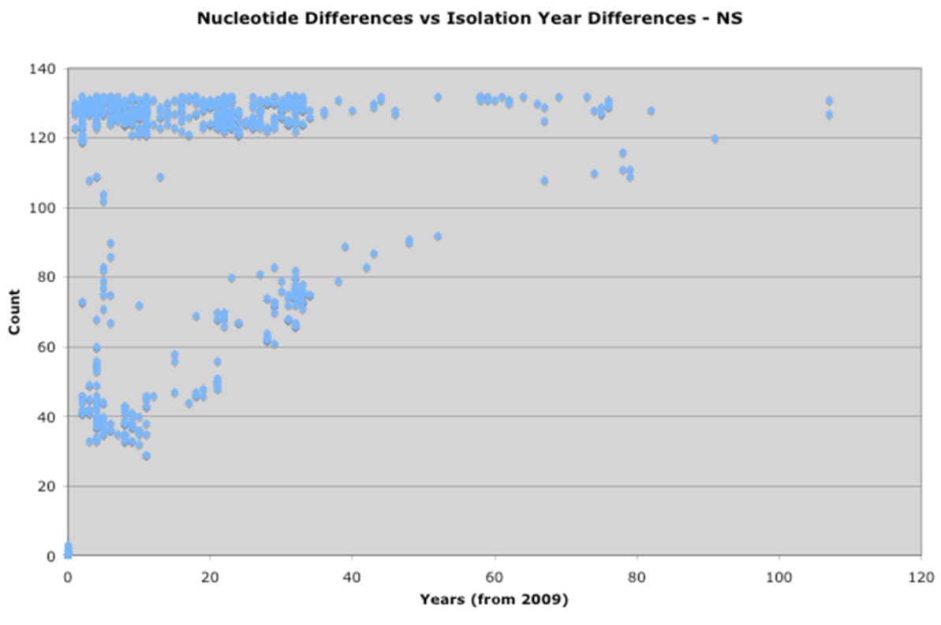
Prior Work
Squires, R. Burke, Brett E. Pickett, Sajal Das, and Richard H. Scheuermann. "Toward a Method for Tracking Virus Evolutionary Trajectory Applied to the Pandemic H1N1 2009 Influenza Virus." Infection, Genetics and Evolution 28 (December, 2014): 351-57.
Nucleotide Differences
Years from 2009

Slide 4
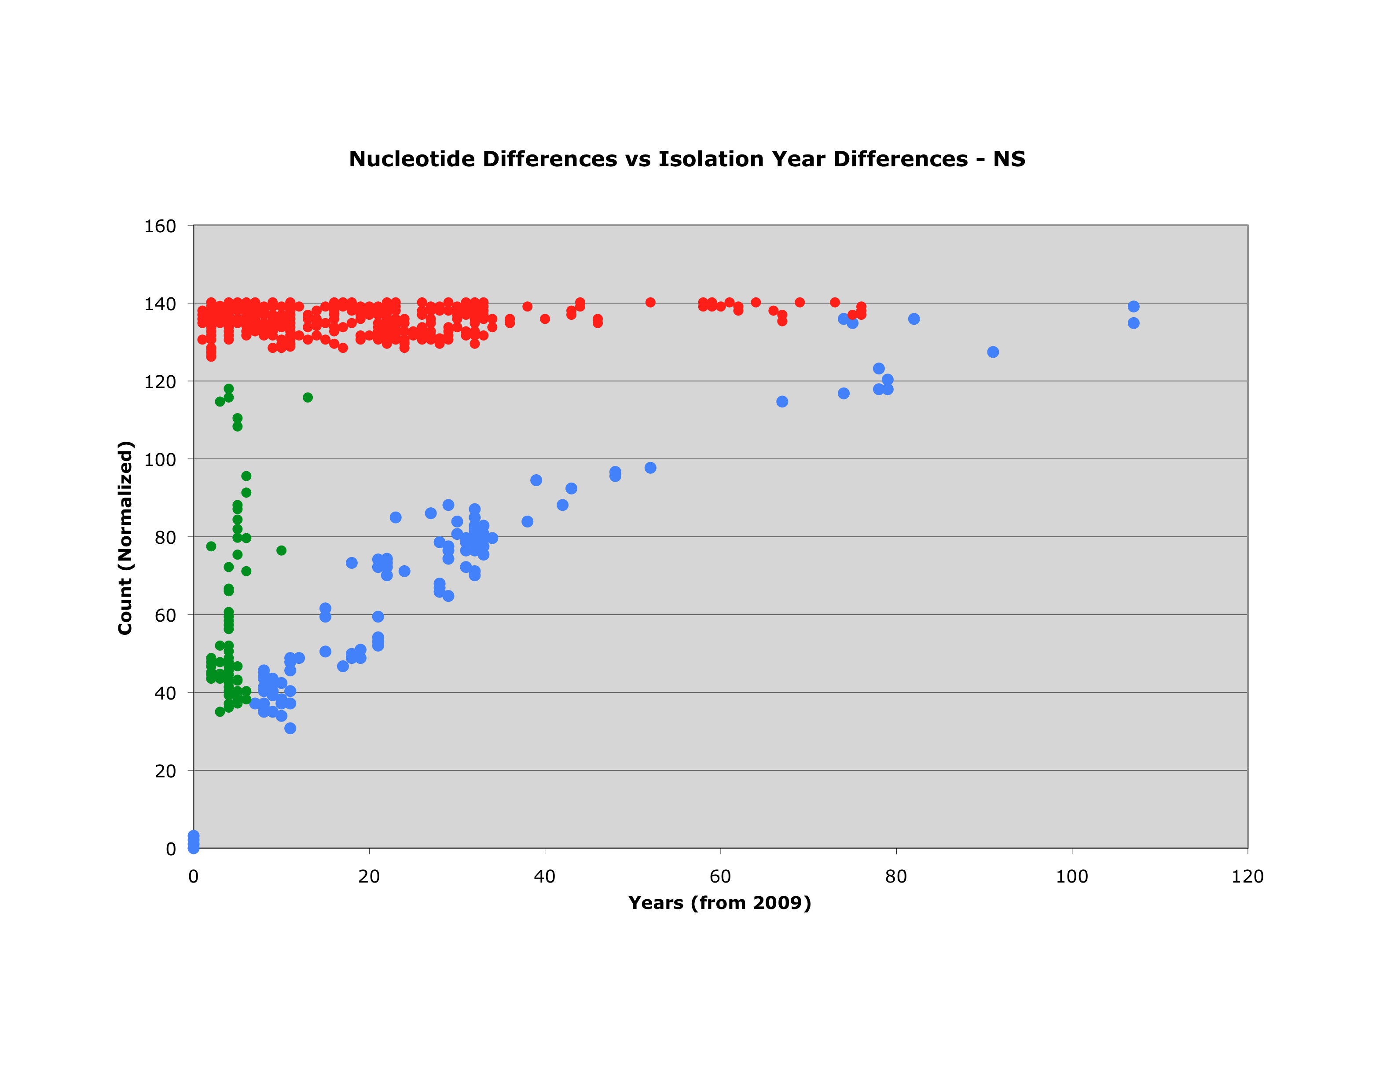
Three Primary Groups of Strains
Group 3
Group 2
Nucleotide Differences
Group 1
2009
1918
Years from 2009

Slide 5
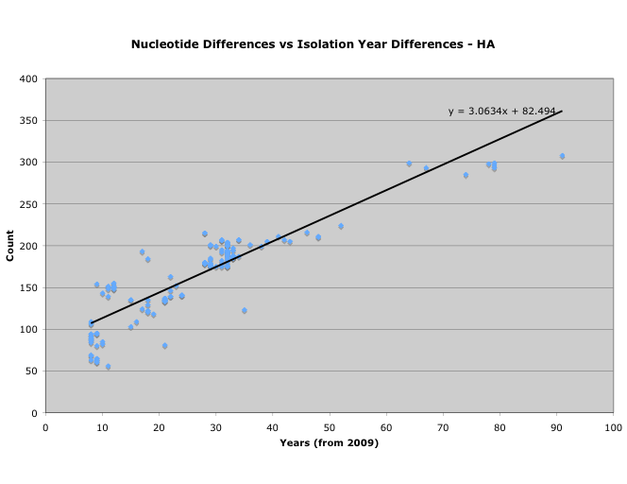
Mutation Rate Computation
Nucleotide Differences
2009
1918
Years from 2009

Slide 6
Algorithms Goals
Write original code to automate this method
Approach:
Estimate a mutation rate
Identify the most probable ancestral candidates from a given dataset
Estimate a data driven confidence interval and associated tiers of probability

Slide 7
Program Outline
Written in Java
Written in Eclipse, a java IDE
IDE stands for Integrated Development Environment
Source code editor, compiler, debugger, etc.
Comprised of 2 classes ( along with 2 comparators and 2 data structures)
Classes are called EvolTraj and TrajectoryCost

Slide 8
Data Acquisition
Gathering data
Use a representative sequence of 2009 H1N1 pandemic through fludb.org (IRD) (A/California/04/2009)
Chosen because it is the strain in the vaccine
BLAST this sequence, returning the top 1000 non-pandemic sequences
Insuring non-pandemic by using the option in IRD and excluding all results after 2007
Repeat for each of Segment (1-8)

Slide 9
Workflow Overview
The EvolTraj Class
INPUT
psAlgo
psAlgo2
FASTA File
Mutation Rate
Improved Mutation Rate
The Trajectory Cost Class
OUTPUT
Improved confidence interval and ancestors
psAlgo5
psAlgo4
Confidence Interval

Slide 10
The EvolTraj Java Class
Includes Algorithm 1 (psAlgo)
Also the successor, Algorithm 2 (psAlgo2)
Reads in a user-specified directory of BLAST results in Fasta format
Reads in the header and determines key information
Reads the Nucleotide sequence

Slide 11
Workflow Overview
The EvolTraj Class
INPUT
psAlgo
psAlgo2
FASTA File
Mutation Rate
Improved Mutation Rate
The Trajectory Cost Class
OUTPUT
Improved confidence interval and ancestors
psAlgo5
psAlgo4
Confidence Interval

Slide 12
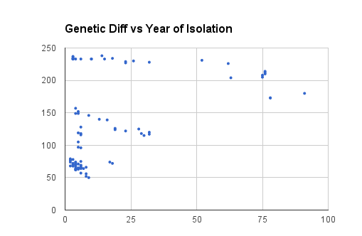
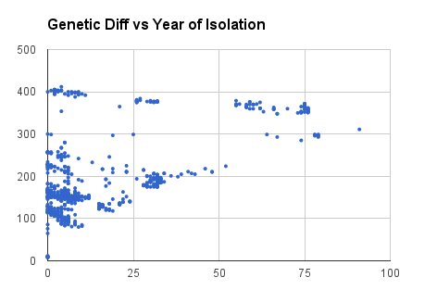
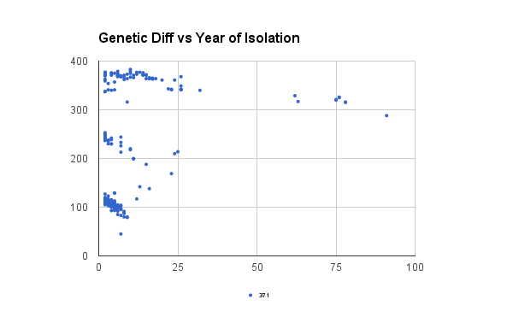
Genetic Difference for Segments 1,4, & 5
Seg 1
Seg 4
# of Genetic Diff
# of Genetic Diff
Years from 2009
Years from 2009
Seg 5
# of Genetic Diff
Years from 2009

Slide 13
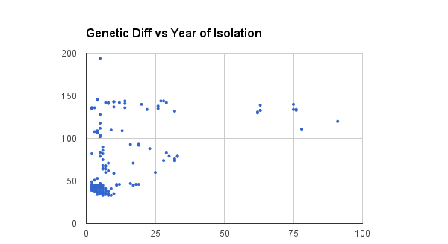
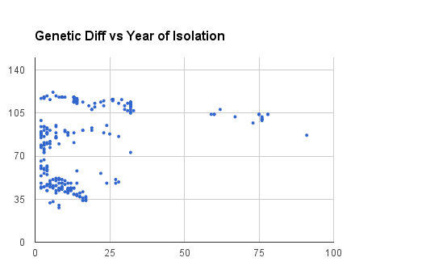
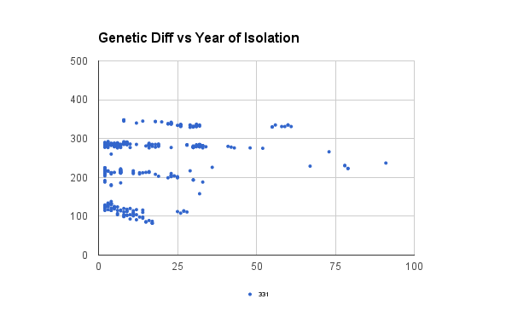
Genetic Difference for Segments 6,7, & 8
Seg 6
# of Genetic Diff
Years from 2009
Seg 7
Seg 8
# of Genetic Diff
# of Genetic Diff
Years from 2009
Years from 2009

Slide 14
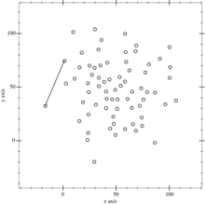
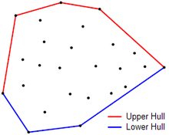
Convex Hull

Slide 15
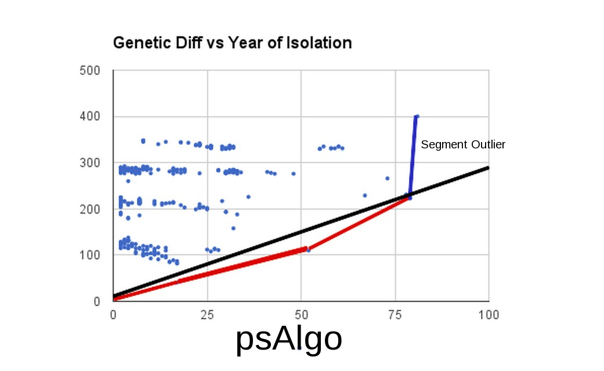
psAlgo function on fabricated dataset
# of Genetic Diff
Years from 2009

Slide 16
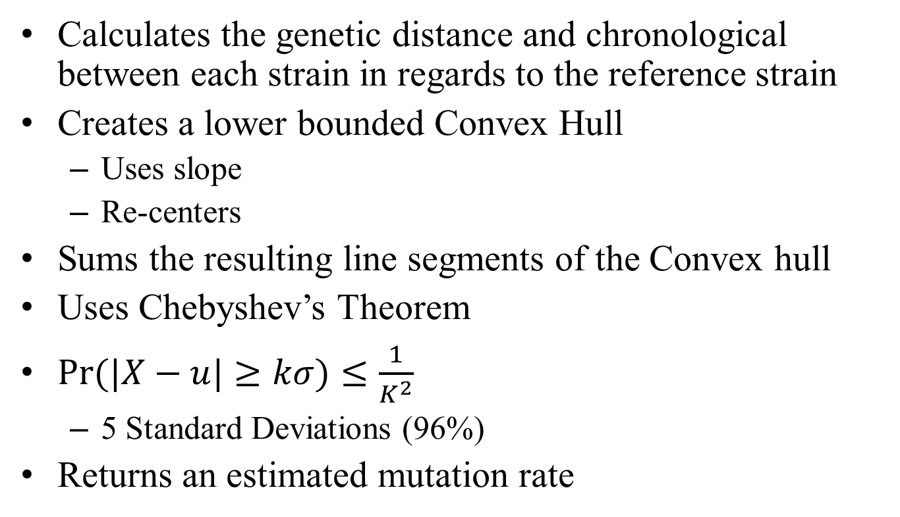
Algorithm 1, psAlgo
Calculates the genetic distance and chronological between each strain in regards to the reference strain
Creates a lower bounded Convex Hull
Uses slope
Re-centers
Sums the resulting line segments of the Convex hull
Uses Chebyshev’s Theorem
$Pr⁡(|X−u|≥kσ)≤\frac{1}{K^{2}}$
5 Standard Deviations (96%)
Returns an estimated mutation rate

Slide 17
Workflow Overview
The EvolTraj Class
INPUT
psAlgo
psAlgo2
FASTA File
Mutation Rate
Improved Mutation Rate
The Trajectory Cost Class
OUTPUT
Improved confidence interval and ancestors
psAlgo5
psAlgo4
Confidence Interval

Slide 18
Re-centering
Re-computes the genetic difference and the change in year at every point in Convex Hull
Re-quantifies the BLAST score of every point to the right of the previous Convex Hull point and re-computes the year
Follows the logic if A evolved from B and B evolved from C, A evolved from C

Slide 19
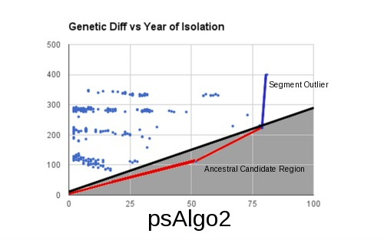
psAlgo2 function on fabricated dataset
# of Genetic Diff
Years from 2009

Slide 20
psAlgo 2
Uses the estimated mutation rate psAlgo
Creates a Ancestral Candidate Region bounded by this mutation rate and the x-axis
Ancestral Candidate Region is a phrase that means a region where all points that lay in it are strains of interest in terms of ancestry
Sums all the X and Y values of all of the points that fall in the region
Computes the average slope, returning another estimation for the mutation rate

Slide 21
Workflow Overview
The EvolTraj Class
INPUT
psAlgo
psAlgo2
FASTA File
Mutation Rate
Improved Mutation Rate
The Trajectory Cost Class
OUTPUT
Improved confidence interval and ancestors
psAlgo5
psAlgo4
Confidence Interval

Slide 22
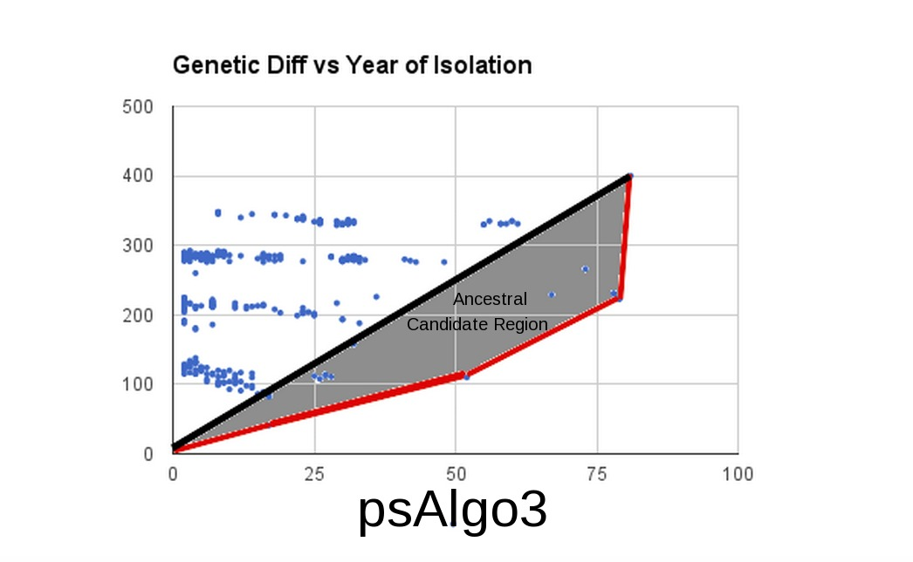
psAlgo3 function on fabricated dataset
# of Genetic Diff
Years from 2009

Slide 23
psAlgo3
Finds the last point in the lower bound Convex Hull (the rightmost point)
Creates another Ancestral Candidate Region, bounded by the line extending to the aforementioned point and the Convex Hull
Sums all the points in this region and computes an average slope
Returns this slope

Slide 24
Representative Results From two of the eight segments
Segment 4 (Accepted= 5.70) % Error # of Points
psAlgo: 5.74 (00.70) 4
psAlgo2: 4.98 (12.63) 111
psAlgo3: 12.79 (124.4) 6
Mean: 5.36 (05.96)
Geometric: 5.35 (06.14)
Segment 7 (Accepted=5.70) _
psAlgo: 2.36 (57.33) 4
psAlgo2: 1.51 (00.66) 30
psAlgo3: 2.64 (76.00) 3
Mean: 1.93 (28.70)
Geometric:1.89 (25.70)

Slide 25
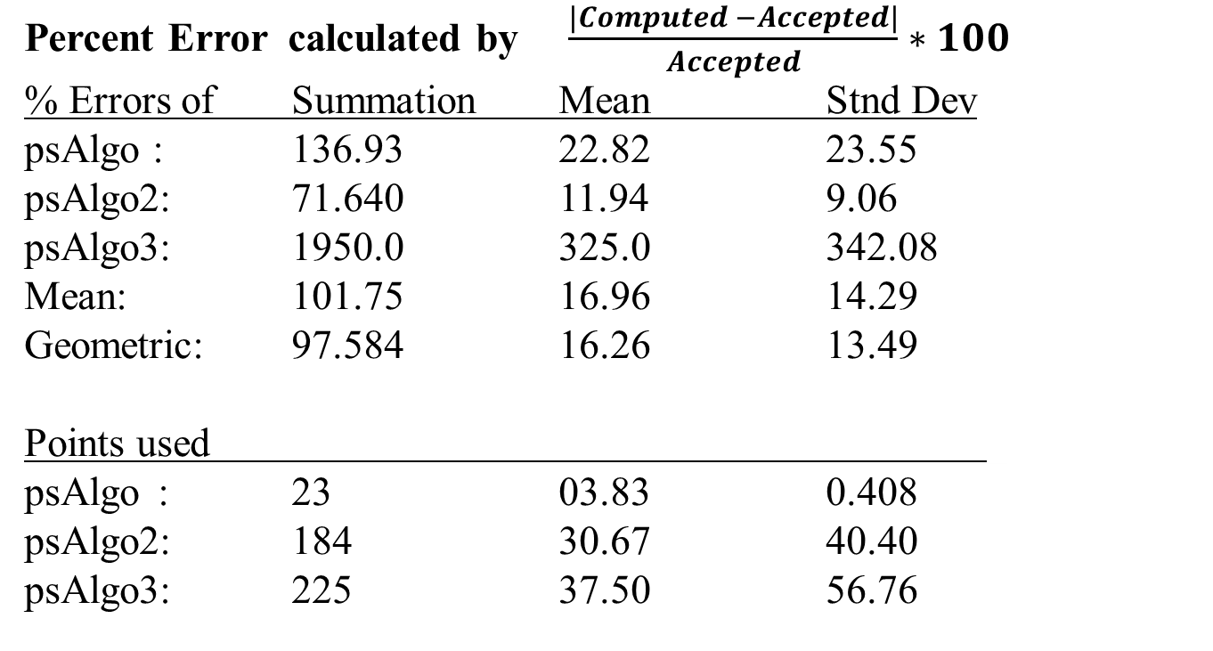
Result Summary
Percent Error calculated by $\frac{|Computed −Accepted|}{Accepted}∗100$
% Errors of Summation Mean Stnd Dev
psAlgo : 136.93 22.82 23.55
psAlgo2: 71.640 11.94 9.06
psAlgo3: 1950.0 325.0 342.08
Mean: 101.75 16.96 14.29
Geometric: 97.584 16.26 13.49
Points used _
psAlgo : 23 03.83 0.408
psAlgo2: 184 30.67 40.40
psAlgo3: 225 37.50 56.76
Recommendation: psAlgo2

Slide 26
The TrajectoryCost Java Class
Creates and Initializes an Array of Data Structures of type ETstrain
Computes the vertical distance of a point from the line generated by psAlgo2
Creates a multiple sequence alignment
Starts with just two sequences then grows by adding one sequence (the next closest to the line)
Computes a penalty
Finds the lowest penalty

Slide 27
Workflow Overview
The EvolTraj Class
INPUT
psAlgo
psAlgo2
FASTA File
Mutation Rate
Improved Mutation Rate
The Trajectory Cost Class
OUTPUT
Improved confidence interval and ancestors
psAlgo5
psAlgo4
Confidence Interval

Slide 28
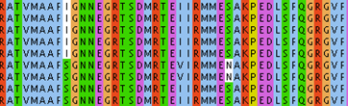
Penalty Computation
No Penalty
No Penalty
No Penalty
1918
2009
Lower penalty because this shows evolution from Isoleucine to Serine
Higher penalty because the two strains with Asparagine are less likely to be Ancestors

Slide 29
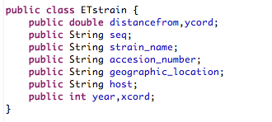
The Strain Data Structure
Strain 1
Strain 2
Strain 3
Strain 4
Strain 5
Date
Strain 6
Country
Strain 7
Host
Etc…
Year
Distance From
Strain Name
Array of Data Structures
Ordering

Slide 30
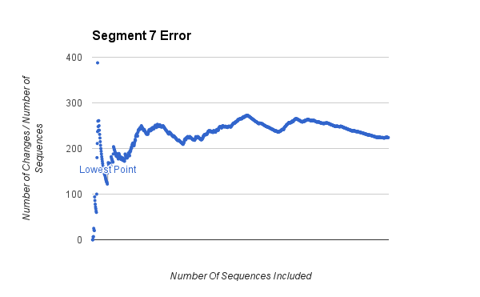
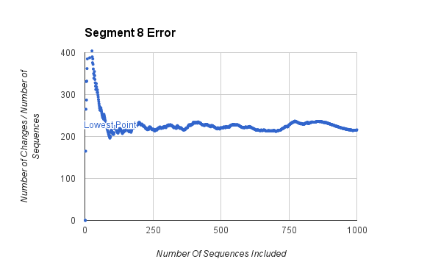
Segments 7/8 Error

Slide 31
Workflow Overview
The EvolTraj Class
INPUT
psAlgo
psAlgo2
FASTA File
Mutation Rate
Improved Mutation Rate
The Trajectory Cost Class
OUTPUT
Improved confidence interval and ancestors
psAlgo5
Basic Confidence Interval and ancestors
psAlgo4

Slide 32
psAlgo5
Takes the earliest strain included before the lowest error point
Creates a line connecting this point and the original reference strain
Computes another multiple sequence alignment with the order of sequence inclusion being a function of the distance from the new line
Diminishes the value of the penalty if there are many years between strains

Slide 33
Workflow Overview
The EvolTraj Class
INPUT
psAlgo
psAlgo2
FASTA File
Mutation Rate
Improved Mutation Rate
The Trajectory Cost Class
OUTPUT
Improved confidence interval and ancestors
psAlgo5
Basic Confidence Interval and ancestors
psAlgo4

Slide 34
Future Plans
Continue improvement and further implementing of psAlgo5
Biologically explain the “random” scattering and “hump” of data in the first few strains of the penalty score calculations or update the algorithm to rid of this problem

Slide 35
Acknowledgements
J. Craig Venter Institute
Dr. Richard Scheuermann
Dr. Douglas Greer
"Influenza Research Database - Influenza Genome Database with Visualization and Analysis Tools."
Squires, R. Burke, Brett E. Pickett, Sajal Das, and Richard H. Scheuermann. "Toward a Method for Tracking Virus Evolutionary Trajectory Applied to the Pandemic H1N1 2009 Influenza Virus." Infection, Genetics and Evolution 28 (December, 2014): 351-57.
The Foo Fighters

