Slide 1
Morgan Stanley Coding Competition
16 Oct 2010

Slide 2
Welcome
Morgan Stanley Technology

Slide 3
What is the competition about?
Programming challenge for a group of three students in 24 hours
Competing with students from other schools
The winning team from each campus would be selected for the final round:
  The winning team would be invited to our Shanghai HQ
Final round is a competition across participating schools, the final winner would entitle to:
  iPads, Macbooks.

Slide 4
The challenge
You are responsible to run a fruit warehouse with ￥100,000 cash for one year
There is only one wholesaler and one distributor you have to interact with
The wholesaler would tell you the lowest price they are willing to sell for each product, and the amount available
The distributor would tell you the highest price they are willing to buy and how much they need
You are competing with other warehouses to make optimal purchase and sales decisions: buy low and sell high
Fruits are perishable: any inventory that is left at the end would be marked down at 10%
Notes:
You've inherited a large, empty warehouse and $100,000 in cash. The cash comes with the stipulation that it must be used to run a fruit distribution business for one year, after which the lease on the warehouse is up.
The business only buys from one wholesaler and sells exclusively to one local retail distributor. Each day those parties will provide the number of units of each type of fruit that they are willing to sell to you/buy from you, and the minimum price they will accept/the maximum price they will pay.
You will compete with other distributors for the business. The service is anonymous, and customers do not have supplier affinity: the wholesaler and distributor will always trade with the person offering the best price. Cash and fruit for successful transactions will arrive the next morning, along with a new list of your customers' needs.
You are contractually obligated to buy your inventory at auction, where you will compete with other distributors for inventory. Every morning you receive a list of products available at the auction, each with a minumum price and how many are available. Bids are filled on best (highest) price. Successful purchaces will be delivered the next morning, along with a new list of available inventory for the next auction.
The aim of the distribution business is, as the old saying goes, "buy low and sell high".

Slide 5
The game rule and format
Create a game client to communicate with the game server
The game is played in rounds, each round represents a business day
There are 200 rounds and 30 products available
In the beginning of the round, you would receive supply and demand message from the game server
Your client needs to send back the amount and price that you wish to purchase and sell
You can not sell more than what you have, and you can not buy if you don’t have enough cash to complete the transaction
Your team have until Sunday 9AM to develop your client, we will hold the final competition in this room
Notes:
There is no available credit of products or cash. Put another way, you can't sell what you don't have and you can't buy more than you have cash on hand for. In the event of a tie, orders will be filled in the order they arrived. Your orders affect the market price of future auctions.
You will be given a message format and a message protocol. Using whatever language you like, you must connect to a TCP server and send and receive game messages to participate in the supply and demand auctions. You will have access to individual test servers, and tools to analyze game play from logfiles.
At the end of 200 rounds, your retirement fund will be valued based on the amount of cash and inventory on hand. Cash will be counted at face value, and inventory will be valued at a 10% discount off the market price. (The "final" market price for each product is the price that would be used in the 201st round.)

Slide 6
Technical details
The message format is in JSON
Clients have to login to the server and all communications are done via TCP
During each round, the following messages would be exchanged:
  Round start message including supply and demand
  Order message sent by your client to perform purchase and sell transaction
  Round end message indicating the successful transactions
We provide some sample clients to get you started
Feel free to utilize any open source libraries available

Slide 7
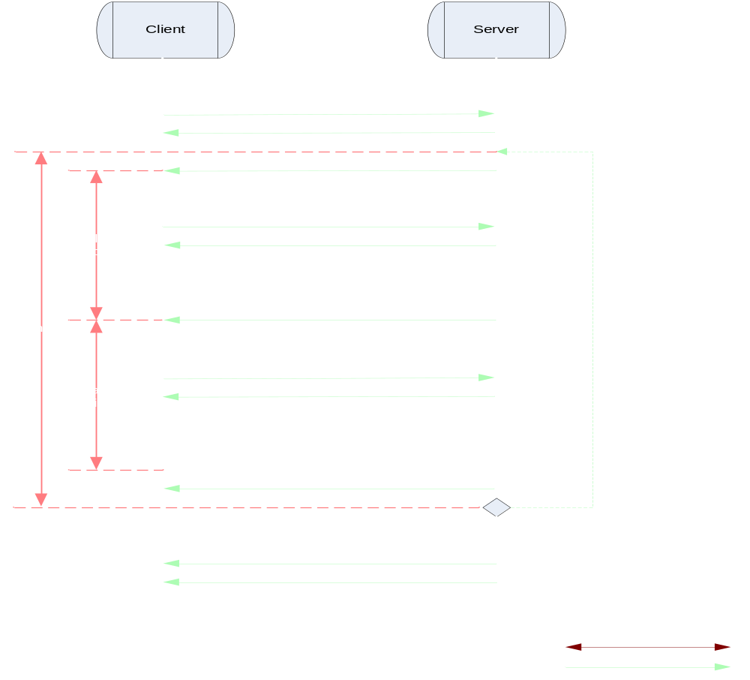
Technical details

Slide 8
Testing and development support
On demand test server available:
  http://114.80.213.55:8080/codestorm/test
  Use your given team name and key to login
  Connect your client to the host port displayed
  Server can generate up to 8 random clients to compete against you
  20 products and 100 rounds
  You can invite other teams to test your strategies!

Slide 9
Offer Matching
The minimum bid price is the same as the maximum offer price, each round
  minimum bid price is the least you can offer to buy from the wholesaler
  maximum offer price is the most you can offer to sell at to the distributor
Order are filled in alphabetical order by product
  you could run out of money for Zucchinis if all your bids for Apples are accepted
Offers are adjusted when the market is short
  i.e. you bid more than is still available
Offers are rejected when the player is short
  i.e. you offer more than you have to sell or have cash to buy
  or if the bid/offer does exceeds the total number of units available to buy/sell

Slide 10
Offer Matching
In a tie situation (two offers at the same price) the client which sent its response first will win
  auction does not consider the number of units bid or offered when resolving a tie
Orders are settled at the end of the round
  For example, you have N units of a fruit at the start of round X. You cannot sell more than N units of that fruit during that round, even if your submission also includes a buy order to buy more of the same fruit.
Market activity affects market prices
  your activity is only a small portion of the global fruit-distribution market

Slide 11
Offer Matching Example
Round starts
Player 1
$10.00 | Cash
10 | Apple
Player 2
$11.00 | Cash
5 | Apple
10 | Pear
Player 3
$20.00 | Cash
5 | Apple

Slide 12
Offer Matching Example
Players receive supply and demand
Player 1
$10.00 | Cash
10 | Apple
Demand
5 Apple @ $2.00
3 Pear @ $3.00
Player 2
$11.00 | Cash
5 | Apple
10 | Pear
Supply
5 Apple @ $2.00
7 Pear @ $3.00 3 Lime @ $5.00
Player 3
$20.00 | Cash
5 | Apple

Slide 13
Offer Matching Example
Players send offers
Player 1
$10.00 | Cash
10 | Apple
Received 1st:
Sell: 2 Pear @ $3.00
Buy: 5 Apple @ $2.00
Buy: 2 Pear @ $3.33
Demand
5 Apple @ $2.00
3 Pear @ $3.00
Player 2
$11.00 | Cash
5 | Apple
10 | Pear
Received 2nd:
Sell: 1 Pear @ $2.00
Buy: 2 Apple @ $2.50
Buy: 3 Pear @ $3.00
Supply
5 Apple @ $2.00
7 Pear @ $3.00 3 Lime @ $5.00
Player 3
$20.00 | Cash
5 | Apple
Received 3rd:
Sell: 5 Apple @ $1.50
Buy: 5 Apple @ $2.00
Buy: 5 Pear @ $4.00

Slide 14
Offer Matching Example
Server acknowledges offers
Player 1
$10.00 | Cash
10 | Apple
Received 1st:
Sell: 2 Pear @ $3.00
Buy: 5 Apple @ $2.00
Buy: 2 Pear @ $3.33
Demand
5 Apple @ $2.00
3 Pear @ $3.00
Player 2
$11.00 | Cash
5 | Apple
10 | Pear
Received 2nd:
Sell: 1 Pear @ $2.00
Buy: 2 Apple @ $2.50
Buy: 3 Pear @ $3.00
Supply
5 Apple @ $2.00
7 Pear @ $3.00 3 Lime @ $5.00
Player 3
$20.00 | Cash
5 | Apple
Received 3rd:
Sell: 5 Apple @ $1.50
Buy: 5 Apple @ $2.00
Buy: 5 Pear @ $4.00

Slide 15
Offer Matching Example
Matching begins
Player 1
$10.00 | Cash
10 | Apple
Received 1st:
Sell: 2 Pear @ $3.00
Buy: 5 Apple @ $2.00
Buy: 2 Pear @ $3.33
Demand
5 Apple @ $2.00
3 Pear @ $3.00
Player 2
$11.00 | Cash
5 | Apple
10 | Pear
Received 2nd:
Sell: 1 Pear @ $2.00
Buy: 2 Apple @ $2.50
Buy: 3 Pear @ $3.00
Supply
5 Apple @ $2.00
7 Pear @ $3.00 3 Lime @ $5.00
Player 3
$20.00 | Cash
5 | Apple
Received 3rd:
Sell: 5 Apple @ $1.50
Buy: 5 Apple @ $2.00
Buy: 5 Pear @ $4.00

Slide 16
Offer Matching Example
Lowest offer is best for matching demand
Player 1
$10.00 | Cash
10 | Apple
Received 1st:
Sell: 2 Pear @ $3.00
Buy: 5 Apple @ $2.00
Buy: 2 Pear @ $3.33
Demand
5 Apple @ $2.00
3 Pear @ $3.00
Player 2
$11.00 | Cash
5 | Apple
10 | Pear
Received 2nd:
Sell: 1 Pear @ $2.00
Buy: 2 Apple @ $2.50
Buy: 3 Pear @ $3.00
Supply
5 Apple @ $2.00
7 Pear @ $3.00 3 Lime @ $5.00
Player 3
$20.00 | Cash
5 | Apple
Received 3rd:
Sell: 5 Apple @ $1.50
Buy: 5 Apple @ $2.00
Buy: 5 Pear @ $4.00

Slide 17
Offer Matching Example
Match best price for Apples
Player 1
$10.00 | Cash
10 | Apple
Received 1st:
Sell: 2 Pear @ $3.00
Buy: 5 Apple @ $2.00
Buy: 2 Pear @ $3.33
Demand
5 Apple @ $2.00
3 Pear @ $3.00
Player 2
$11.00 | Cash
5 | Apple
10 | Pear
Received 2nd:
Sell: 1 Pear @ $2.00
Buy: 2 Apple @ $2.50
Buy: 3 Pear @ $3.00
Supply
5 Apple @ $2.00
7 Pear @ $3.00 3 Lime @ $5.00
Player 3
$20.00 | Cash
5 | Apple
Received 3rd:
Sell: 5 Apple @ $1.50
Buy: 5 Apple @ $2.00
Buy: 5 Pear @ $4.00

Slide 18
Offer Matching Example
Match best price for Pears
Player 1
$10.00 | Cash
10 | Apple
Received 1st:
Sell: 2 Pear @ $3.00
Buy: 5 Apple @ $2.00
Buy: 2 Pear @ $3.33
Demand
0 Apple @ $2.00
3 Pear @ $3.00
Player 2
$11.00 | Cash
5 | Apple
10 | Pear
Received 2nd:
Sell: 1 Pear @ $2.00
Buy: 2 Apple @ $2.50
Buy: 3 Pear @ $3.00
Supply
5 Apple @ $2.00
7 Pear @ $3.00 3 Lime @ $5.00
Received 3rd:
Player 3
$20.00 | Cash
5 | Apple
+$7.50
-5
Sell: 5 Apple @ $1.50
Buy: 5 Apple @ $2.00
Buy: 5 Pear @ $4.00

Slide 19
Offer Matching Example
Next-best price for Pears rejected due to lack of inventory
Player 1
$10.00 | Cash
10 | Apple
Received 1st:
Sell: 2 Pear @ $3.00
Buy: 5 Apple @ $2.00
Buy: 2 Pear @ $3.33
Demand
0 Apple @ $2.00
2 Pear @ $3.00
Player 2
$13.00 | Cash
5 | Apple
10 | Pear
+$2.00
-1
Received 2nd:
Sell: 1 Pear @ $2.00
Buy: 2 Apple @ $2.50
Buy: 3 Pear @ $3.00
Supply
5 Apple @ $2.00
7 Pear @ $3.00 3 Lime @ $5.00
Received 3rd:
Player 3
$20.00 | Cash
5 | Apple
+$7.50
-5
Sell: 5 Apple @ $1.50
Buy: 5 Apple @ $2.00
Buy: 5 Pear @ $4.00

Slide 20
Offer Matching Example
Highest price is best to match supply
Player 1
$10.00 | Cash
10 | Apple
Received 1st:
Sell: 2 Pear @ $3.00
Buy: 5 Apple @ $2.00
Buy: 2 Pear @ $3.33
Demand
0 Apple @ $2.00
2 Pear @ $3.00
Player 2
$13.00 | Cash
5 | Apple
10 | Pear
+$2.00
-1
Received 2nd:
Sell: 1 Pear @ $2.00
Buy: 2 Apple @ $2.50
Buy: 3 Pear @ $3.00
Supply
5 Apple @ $2.00
7 Pear @ $3.00 3 Lime @ $5.00
Received 3rd:
Player 3
$20.00 | Cash
5 | Apple
+$7.50
-5
Sell: 5 Apple @ $1.50
Buy: 5 Apple @ $2.00
Buy: 5 Pear @ $4.00

Slide 21
Offer Matching Example
Best match price for Apples
Player 1
$10.00 | Cash
10 | Apple
Received 1st:
Sell: 2 Pear @ $3.00
Buy: 5 Apple @ $2.00
Buy: 2 Pear @ $3.33
Demand
0 Apple @ $2.00
2 Pear @ $3.00
Player 2
$13.00 | Cash
5 | Apple
10 | Pear
+$2.00
-1
Received 2nd:
Sell: 1 Pear @ $2.00
Buy: 2 Apple @ $2.50
Buy: 3 Pear @ $3.00
Supply
5 Apple @ $2.00
7 Pear @ $3.00 3 Lime @ $5.00
Received 3rd:
Player 3
$20.00 | Cash
5 | Apple
+$7.50
-5
Sell: 5 Apple @ $1.50
Buy: 5 Apple @ $2.00
Buy: 5 Pear @ $4.00

Slide 22
Offer Matching Example
Next-best offers are tied so fill the one received first
Player 1
$10.00 | Cash
10 | Apple
Received 1st:
Sell: 2 Pear @ $3.00
Buy: 5 Apple @ $2.00
Buy: 2 Pear @ $3.33
Demand
0 Apple @ $2.00
2 Pear @ $3.00
Player 2
$13.00 | Cash
5 | Apple
10 | Pear
+$2.00 -$5.00
+2
-1
Received 2nd:
Sell: 1 Pear @ $2.00
Buy: 2 Apple @ $2.50
Buy: 3 Pear @ $3.00
Supply
3 Apple @ $2.00
7 Pear @ $3.00 3 Lime @ $5.00
Received 3rd:
Player 3
$20.00 | Cash
5 | Apple
+$7.50
-5
Sell: 5 Apple @ $1.50
Buy: 5 Apple @ $2.00
Buy: 5 Pear @ $4.00

Slide 23
Offer Matching Example
Offer adjusted to match supply
Player 1
$10.00 | Cash
10 | Apple
Received 1st:
Sell: 2 Pear @ $3.00
Buy: 3 Apple @ $2.00
Buy: 2 Pear @ $3.33
Demand
0 Apple @ $2.00
2 Pear @ $3.00
Player 2
$13.00 | Cash
5 | Apple
10 | Pear
+$2.00 -$5.00
+2
-1
Received 2nd:
Sell: 1 Pear @ $2.00
Buy: 2 Apple @ $2.50
Buy: 3 Pear @ $3.00
Supply
3 Apple @ $2.00
7 Pear @ $3.00 3 Lime @ $5.00
Received 3rd:
Player 3
$20.00 | Cash
5 | Apple
+$7.50
-5
Sell: 5 Apple @ $1.50
Buy: 5 Apple @ $2.00
Buy: 5 Pear @ $4.00

Slide 24
Offer Matching Example
Matched best price for Pears
Player 1
$10.00 | Cash
10 | Apple
Received 1st:
-$6.00
+3
Sell: 2 Pear @ $3.00
Buy: 3 Apple @ $2.00
Buy: 2 Pear @ $3.33
Demand
0 Apple @ $2.00
2 Pear @ $3.00
Player 2
$13.00 | Cash
5 | Apple
10 | Pear
+$2.00 -$5.00
+2
-1
Received 2nd:
Sell: 1 Pear @ $2.00
Buy: 2 Apple @ $2.50
Buy: 3 Pear @ $3.00
Supply
0 Apple @ $2.00
7 Pear @ $3.00 3 Lime @ $5.00
Received 3rd:
Player 3
$20.00 | Cash
5 | Apple
+$7.50
-5
Sell: 5 Apple @ $1.50
Buy: 5 Apple @ $2.00
Buy: 5 Pear @ $4.00

Slide 25
Offer Matching Example
Next-best price rejected due to lack of funds
Player 1
$10.00 | Cash
10 | Apple
Received 1st:
-$6.00
+3
Sell: 2 Pear @ $3.00
Buy: 3 Apple @ $2.00
Buy: 2 Pear @ $3.33
Demand
0 Apple @ $2.00
2 Pear @ $3.00
Player 2
$13.00 | Cash
5 | Apple
10 | Pear
+$2.00 -$5.00
+2
-1
Received 2nd:
Sell: 1 Pear @ $2.00
Buy: 2 Apple @ $2.50
Buy: 3 Pear @ $3.00
Supply
0 Apple @ $2.00
2 Pear @ $3.00 3 Lime @ $5.00
Received 3rd:
Player 3
$20.00 | Cash
5 | Apple
+$7.50 -$20.00
-5 +5
Sell: 5 Apple @ $1.50
Buy: 5 Apple @ $2.00
Buy: 5 Pear @ $4.00

Slide 26
Offer Matching Example
Next-best offer adjusted to match supply
Player 1
$10.00 | Cash
10 | Apple
Received 1st:
-$6.00
+3
Sell: 2 Pear @ $3.00
Buy: 3 Apple @ $2.00
Buy: 2 Pear @ $3.33
Demand
0 Apple @ $2.00
2 Pear @ $3.00
Player 2
$13.00 | Cash
5 | Apple
10 | Pear
+$2.00 -$5.00
+2
-1
Received 2nd:
Sell: 1 Pear @ $2.00
Buy: 2 Apple @ $2.50
Buy: 2 Pear @ $3.00
Supply
0 Apple @ $2.00
2 Pear @ $3.00 3 Lime @ $5.00
Received 3rd:
Player 3
$20.00 | Cash
5 | Apple
+$7.50 -$20.00
-5 +5
Sell: 5 Apple @ $1.50
Buy: 5 Apple @ $2.00
Buy: 5 Pear @ $4.00

Slide 27
Offer Matching Example
All possible matching complete
Player 1
$10.00 | Cash
10 | Apple
Received 1st:
-$6.00
+3
Sell: 2 Pear @ $3.00
Buy: 3 Apple @ $2.00
Buy: 2 Pear @ $3.33
Demand
0 Apple @ $2.00
2 Pear @ $3.00
Player 2
$13.00 | Cash
5 | Apple
10 | Pear
+$2.00 -$5.00 -$6
+2
-1 +2
Received 2nd:
Sell: 1 Pear @ $2.00
Buy: 2 Apple @ $2.50
Buy: 2 Pear @ $3.00
Supply
0 Apple @ $2.00
0 Pear @ $3.00 3 Lime @ $5.00
Received 3rd:
Player 3
$20.00 | Cash
5 | Apple
+$7.50 -$20.00
-5 +5
Sell: 5 Apple @ $1.50
Buy: 5 Apple @ $2.00
Buy: 5 Pear @ $4.00

Slide 28
Offer Matching Example
Player inventories updated
Player 1
$4.00 | Cash
13 | Apple
Received 1st:
Sell: 2 Pear @ $3.00
Buy: 3 Apple @ $2.00
Buy: 2 Pear @ $3.33
Demand
0 Apple @ $2.00
2 Pear @ $3.00
Player 2
$4.00 | Cash
7 | Apple
11 | Pear
Received 2nd:
Sell: 1 Pear @ $2.00
Buy: 2 Apple @ $2.50
Buy: 2 Pear @ $3.00
Supply
0 Apple @ $2.00
0 Pear @ $3.00 3 Lime @ $5.00
Player 3
$7.50 | Cash
0 | Apple
5 | Pear
Received 3rd:
Sell: 5 Apple @ $1.50
Buy: 5 Apple @ $2.00
Buy: 5 Pear @ $4.00

Slide 29
Offer Matching Example
Unmet demand puts upward pressure on price
Player 1
$4.00 | Cash
13 | Apple
Received 1st:
Sell: 2 Pear @ $3.00
Buy: 3 Apple @ $2.00
Buy: 2 Pear @ $3.33
Demand
0 Apple @ $2.00
2 Pear @ $3.00
Player 2
$4.00 | Cash
7 | Apple
11 | Pear
Received 2nd:
Sell: 1 Pear @ $2.00
Buy: 2 Apple @ $2.50
Buy: 2 Pear @ $3.00
Supply
0 Apple @ $2.00
0 Pear @ $3.00 3 Lime @ $5.00
Player 3
$7.50 | Cash
0 | Apple
5 | Pear
Received 3rd:
Sell: 5 Apple @ $1.50
Buy: 5 Apple @ $2.00
Buy: 5 Pear @ $4.00

Slide 30
Offer Matching Example
Unwanted supply puts downward pressure on price
Player 1
$4.00 | Cash
13 | Apple
Received 1st:
Sell: 2 Pear @ $3.00
Buy: 3 Apple @ $2.00
Buy: 2 Pear @ $3.33
Demand
0 Apple @ $2.00
2 Pear @ $3.00
Player 2
$4.00 | Cash
7 | Apple
11 | Pear
Received 2nd:
Sell: 1 Pear @ $2.00
Buy: 2 Apple @ $2.50
Buy: 2 Pear @ $3.00
Supply
0 Apple @ $2.00
0 Pear @ $3.00 3 Lime @ $5.00
Player 3
$7.50 | Cash
0 | Apple
5 | Pear
Received 3rd:
Sell: 5 Apple @ $1.50
Buy: 5 Apple @ $2.00
Buy: 5 Pear @ $4.00

Slide 31
Hints & Tips
Make sure the basic communication parts of your code works before working on your strategy
You don’t have to make bids or offers in every round
  you may want to watch what is happening in the market for a few rounds before conducting any transactions

Slide 32
Schedule
Saturday 9am
  kick-off
Saturday 12pm – 5:00pm
  Morgan Stanley technology team will be available to answer questions
Sunday 9am
  game final
  players in first heat must have your clients running and connected to the game server by 9am exactly

Slide 33
Contact us
Send e-mail to codestorm@morganstanley.com
Any announcements will be sent via email.

