Slide 1

Life link: hospital management database
Apresentação do projeto de Base de Dados, 2023/24
Pedro Lima, 2017276603
Sofia Leitão, 2022214134
João Esteves, 2022230550

Slide 2
Main Objectives
Development of a Hospital Management System
Management of data related to events and users
Simple and robust user/database interaction

Slide 3



General Description: Tools
REST API
SQL Interface
PostgreSQL databse

Slide 4
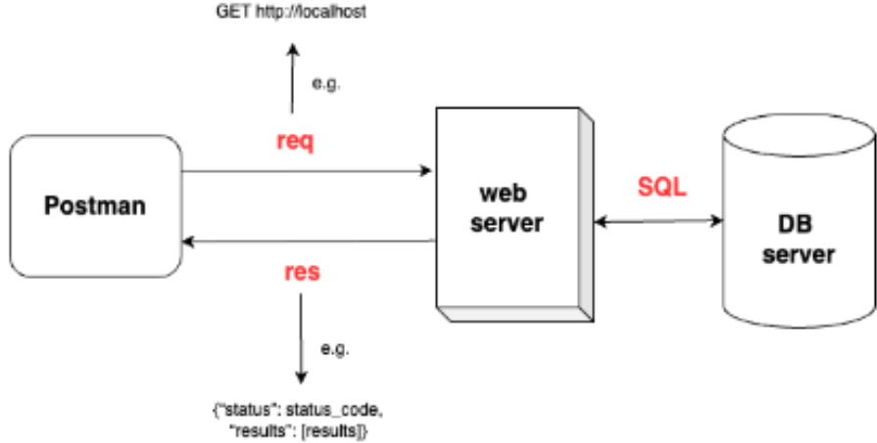
General description: operation
REST API - SQL interface -
Database interaction
Request-response protocol
REST API response structure
200 – success
400 – error: bad request (request error)
500 – error: internal server error (API error)

Slide 5
Functionalities:
Endpoints:
- Add Patient, doctor, Nurse, Assistant
- User Authentication
- Schedule Appointment
- See Appointments
- Schedule Surgery
- Get Prescriptions
- Add Prescriptions
- Execute Payment
- List Top 3 patients
- Daily Summary
- Generate Montlhy Report

Slide 6
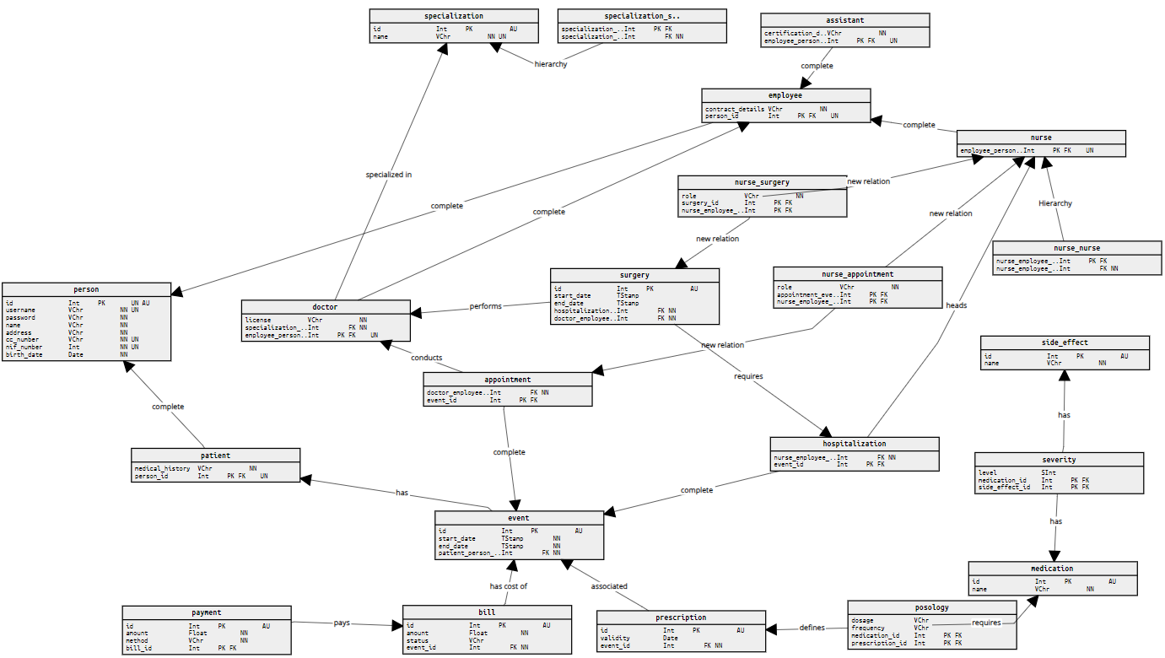
DB Architecture

Slide 7
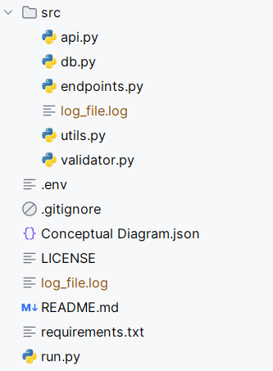
Code Structure
run.py
src:
api.py
db.py
utils.py
validator.py
endpoints.py

Slide 8
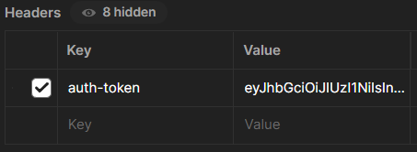
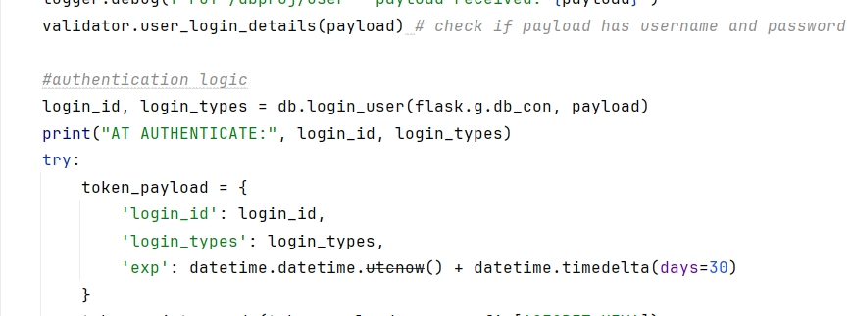
Token handling and login flow
Login process
Token creation
Token handling

Slide 9
Transactions and concurrency handling

Slide 10
Query optimization

