Slide 1
Data Analytics
Session 2: Explore Data

Slide 2
Agenda
Session 1: Setup
Session 2: Explore Data
Session 3: Transform Data
Session 4: Share Insights

Slide 3

Data Structures

Slide 4
Outline
Tuple
List
Dictionary
Set
Class

Slide 5
Tuple

Slide 6
Tuple
A tuple is a fixed-length immutable sequence of Python objects.
Tuple can be created using parentheses or invoking tuple().
That said, the parentheses for creating a tuple is a norm, not a requirement.
Elements of a tuple can be accessed using square brackets
Tuples do not have too many methods. A particularly useful method is count which counts occurrences of a value.

Slide 7
List

Slide 8
List
A list is a data structure that holds an ordered collection of values.
Unlike tuples, lists are mutable and have variable length.
Although a list can contain elements of different types, lists generally have elements of the same type.
We often use the term element to describe an item in a list.
The length of a list is its number of elements.
A list may be instantiated using [ ] or list( ).

Slide 9
Methods
Lists have a number of methods that can be used to mutate or change the list object.
Since lists are mutable, after the method is invoked, the result does not have to be assigned to an object.
Here are a set of common methods for a list called lst:
lst.append(): Add an elements to the end
lst.remove(): Remove a specific element
in: Check if an element is present in the list
not in: Check if an element is not in the list
lst.extend(): add elements to the end of the list
lst.pop(): removes last element in the list
lst.sort(): arrange elements

Slide 10
Slicing
Since a list holds an ordered collection of values, elements can be identified by their position.
Each element is assigned an index position.
Indices are consecutive and begin in 0.
Square brackets are used for extracting an element by index position.
A negative sign before an index means values are extracted relative to the end of the list.
A start:stop notation can be passed to a list to subset or slice multiple elements. In this notation, the first element is inclusive but the last element is not included. So, lst[1:3] includes the second, and third elements in the list but not the fourth.
A missing index on either side of the : in a slicing operation is a shortcut to indicate all elements before or after.

Slide 11
Dictionary

Slide 12
Dictionary
A dictionary is a data structure that stores data as a collection of key-value pairs, where the key and value are Python objects.
The key can be used to identify a value to be retrieved, inserted, modified or deleted. A key is a unique identifier for a value.
A value corresponds to the key.
The values can contain duplicates, the keys should not.
Dictionary is mutable

Slide 13
Dictionary
One way to distinguish a dictionary from a list is to recognize that a dictionary is used to create an association, while a list is defined to place elements in order.
A Python dictionary is similar to the Webster Dictionary where words are associated ot their meaning. One can lookup a word in the dictionary and find its corresponding meaning. There are many real-world situations where data includes a set of key-value pairs such as menu item and price on a restaurant menu, customer and dollars spent in a customer transaction file, etc.
One way to construct a dictionary is using curly braces.

Slide 14
Set

Slide 15
Set
A set is an unordered collection of unique elements.
A set can be created using the set() or curly braces

Slide 16
Class

Slide 17
Class
A class is a blue print for creating objects.
A class defines the methods/functionalities that objects made from it will have
An object is called an instance of the class it is made from
The act of creating an object is called instantiation
Every time we work with an Python object, it has been "instantiated" from a Class.
Syntax options like "" or [] or {} are shortcuts for instantiation
For other classes, we will need to use class() syntax to instantiate an object

Slide 18
Conclusion
In this section, we examined built-in data structures in Python.
Tuple
List
Dictionary
Set
Class

Slide 19

NumPy

Slide 20
NUMPY
NumPy, short for "Numerical Python," is a fundamental package for scientific computing in Python.
It is widely used in data analysis due to its ability to handle large, multi-dimensional arrays and matrices, along with a variety of mathematical functions that can be applied to these arrays efficiently.

Slide 21
NumPy serves as the foundation for many other data science libraries such as Pandas, SciPy, and scikit-learn, making it an essential tool for anyone working with data in Python.
Notes:
Created from Claude

Slide 22
Key Features
N-Dimensional Array Object (ndarray): Efficient handling of arrays (1D, 2D, and multi-dimensional).
Mathematical Functions: Fast mathematical operations on entire arrays of data without having to write loops
Data Simulation: Generate random numbers for simulations and sampling.
Linear Algebra Operations: Includes matrix operations, eigenvalue computation, and more.
Broadcasting: Simplifies operations on arrays of different shapes.
Integration with Other Libraries: Easily integrates with data science libraries like Pandas and SciPy.

Slide 23
Our Focus
We will focus only on features directly related to data analysis
Fast array-based operations for data wrangling such as subsetting, filtering, transformation, and cleaning.
Functions for performing descriptive statistics such as mean, and standard deviation.
Ways to combine and restructure datasets.

Slide 24
Creating an Array
Notes:
Created from Claude

Slide 25
Array
Names for these arrays in Math
1d array = vector
2d array = matrix
3d+ array = tensor

Slide 26
Creating an Array
Numpy arrays can be created by
From a list using np.array()
shortcut functions like np.arange, np.zeros(), np.full()

Slide 27
Dimensions
NumPy is an ndarray, which means it can have one or more dimensions
.shape contains information about dimensionality
An n-dimensional array can be thought of as a set of elements on which a structure is imposed
Shape can be changed
.flatten() converts an n-dimensional array into a 1-d array-
.reshape() can change the structure (if it is possible)

Slide 28
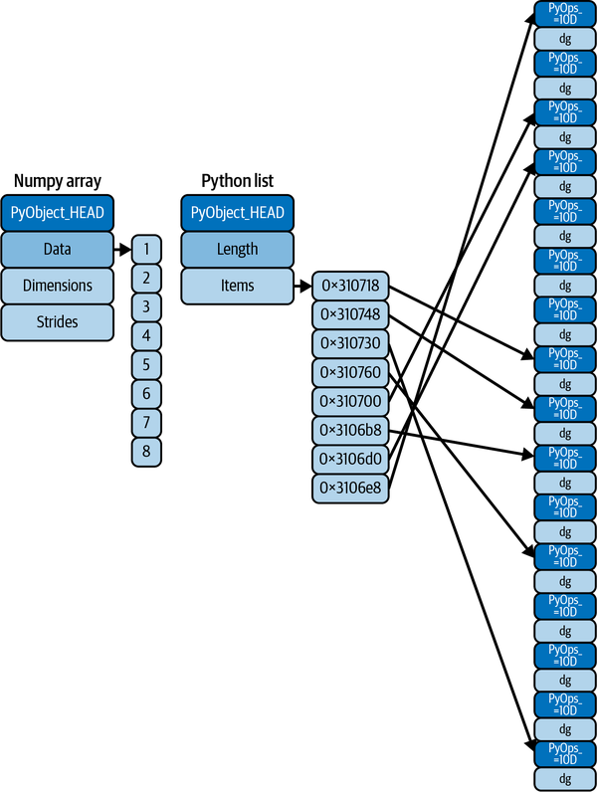
dtype
The computational speed of NumPy arrays is attributable to the type constraints.
A NumPy array can only contain data of a single type.
Unless explicitly specified, the array structure will infer a suitable data type for the array that it creates.
The data type is stored in a special dtype medadata object.
Source: Python Data Science Handbook, Jake VanderPlas

Slide 29
Numpy vs.

Slide 30
Dtype
Here are some of the commonly used data types (dtype).
Numbers: int8, int16, int32, int64, float16, float32, float64, float128. Python as such only allows int and float!
Complex: complex64, complex128, complex256
Boolean: bool
Text: <U6, <U12, etc. This is a unicode str with a length constraint, as opposed to generic str
It is possible to convert one data type to another using astype()
Since NumPy arrays can contain data of only one type, if NumPy encounters elements of differnt types, it will convert them to the same type.
If a dtype argument is not passed, NumPy will examine the data and automatically assign a data type

Slide 31
Element Wise operation
Lists in Python do not do elementwise operation.
On the other hand, for numpy arrays, elementwise operation is the default.
Elementwise operations can be conducted using loops, but loops in Python are slow. Instead numpy conducts vectorized operations where in the operation is carried out in C, a low-level language.

Slide 32
Broadcasting
In math, one can only add two matrices of the same shape. Numpy will allow addition of arrays of different shapes (but not any shape).
Numpy can only add compatible arrays. The arrays should have the same shape except for one dimension. The dimension that does not have the same value must be 1. E.g, (4,4) and (4,1); (4,4) and (1,1); but not (4,4) and (2,2)
Python will not reshape an array under the hood to make the computation work. For instance, if you intend to use a vertical array, then you would need to explicitly reshape a 1-d array with n elements to an array with shape, (n,1).
Broadcasting can be done for all arithmetic operations, not only addition.
Broadcasting is similar to (but less inclusive) than recycling behavior in R.

Slide 33
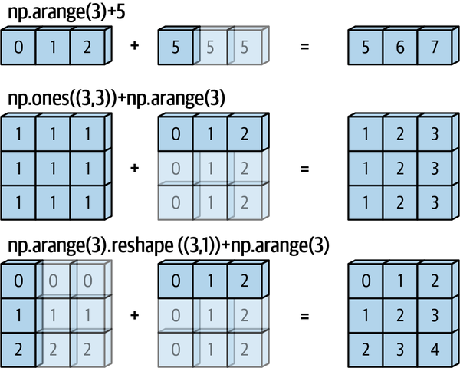
Broadcasting

Slide 34
Indexing 1-d array
Extract a single element by specifying location index in square brackets
numpy array indices begin at 0
Negative indices count from the end of the array

Slide 35
Indexing and Slicing

Slide 36
Indexing 2-d array
Extract a single element by specifying row and column location index in square brackets separated by a comma
numpy array indices begin at 0
Negative indices count from the end of the array

Slide 37
Indexing and Slicing
Notes:
import pandas as pd
pd.DataFrame(np.random.randint(0,9,100).reshape(10,10))

Slide 38
Slicing 1-d array
Extract more than one element
Specify more than one location as a list. [[1,2,3,4]]
Specify a range of locations. First element is included, last is not. [1:5]
Use colon to refer to everything before, or everything after. [:5]
Negative indexes to begin from the end [-9:-5]

Slide 39
Slicing 2-d array
Extract more than one element
Specify a range of locations for rows and columns. First element is included, last is not. [3:7,3:7]
Use colon to refer to everything before, or everything after. [:3,7:]
Negative indexes to begin from the end [-10:-7,-3:]
You can also slice with steps by specifying the start, end and step value separated by colon. [3:7:3,3:7:3]

Slide 40
Boolean Indexing
Arrays are subset based on a condition.

Slide 41
Find and replace
numpy.where() can be used to find an element. It can also be used to find an element and replace it with another

Slide 42
Useful numpy methods
.concatenate(): To combine two or more arrays with compatible shapes. Does not work with 1d arrays.
.delete(): Remove a column or row
.sort(): Sort a ndarray by rows (axis = 0) or columns (axis = 1)
.transpose(): swaps axes, essentially reshaping the data
.flip(): reverses the order of elements along a given axis
.stack(): Combine arrays by adding a new dimension
.split(): Split an array into multiple subarrays

Slide 43
Vectorized operations and ufuncs
Python’s default implementation (known as CPython) does some operations very slowly. This is partly due to the dynamic, interpreted nature of the language; types are flexible, so sequences of operations cannot be compiled down to efficient machine code as in languages like C and Fortran. This relative sluggishness of Python can generally be seen in situations where many small operations are being repeated; for instance, looping over arrays to operate on each element.
For many types of operations, NumPy provides a convenient interface into just this kind of statically typed, compiled routine. This is known as a vectorized operation. For simple operations like the element-wise division here, vectorization is as simple as using Python arithmetic operators directly on the array object. This vectorized approach is designed to push the loop into the compiled layer that underlies NumPy, leading to much faster execution.

Slide 44
ufuncs
Vectorized operations in NumPy are implemented via ufuncs, whose main purpose is to quickly execute repeated operations on values in NumPy arrays. Ufuncs are extremely flexible. Here are a few commonly used Ufuncs. The names are intuitive.
Unary functions: mod, abs, sqrt, square, exp, log, log10, sign, ceil, floor, rint (round to the nearest integer), modf (return fractional and integeral parts of array), isnan (wether each value is NaN), isfinite, isinf, cos, cosh, sin, sinh, tan, tanh, logical_not
Binary functions: add, subtract, multiply, divide, floor_divide, power, maximum, minimum, mod, greater, greater_equal, less, less_equal, equal, not_equal, logical_and, logical_or, logical_xor.
Statistical Methods: sum, mean, std, var, min, max, cumsum, cumprod
Other Methods: sort, unique, intersect1d, union1dalent to ~arr)

Slide 45
Vectorized operations
Elementwise operations can be conducted using loops, but loops in Python are slow.
Instead numpy conducts vectorized operations where in the operation is carried out in C, a low-level language.
Native Python functions can be vectorized by passing them to numpy.vectorize()

Slide 46
Universal Functions
Universal functions perform elementwise operations on ndarrays. Here are a few commonly used functions. The names are intuitive.
Unary functions: abs, sqrt, square, exp, log, log10, sign, ceil, floor, rint (round to the nearest integer), modf (return fractional and integeral parts of array), isnan (wether each value is NaN), isfinite, isinf, cos, cosh, sin, sinh, tan, tanh, logical_not
Binary functions: add, subtract, multiply, divide, floor_divide, power, maximum, minimum, mod, greater, greater_equal, less, less_equal, equal, not_equal, logical_and, logical_or, logical_xor.
Statistical Methods: sum, mean, std, var, min, max, cumsum, cumprod
Other Methods: sort, unique, intersect1d, union1dalent to ~arr

Slide 47
Summary
numpy makes Python a powerful data analysis language
Useful data structures
Efficient vectorized operations
Useful data-analysis functions
Foundation for other data analysis libraries such as pandas and scikit-learn.

Slide 48
References
Python for Data Analysis by Wes McKinney. O’Reilly Media, 2023.
Python Data Science Handbook, 2nd Edition by Jake VanderPlas, O’Reilly Media, 2022.

Slide 49
Groups

Slide 50
Groups
Pair up with another student
Decide on a group name

