Slide 1
Data Analytics
Session 2: Prepare Data

Slide 2
Agenda
Day 1: Setup and Basics
Day 2: Explore and Transform Data
Day 3: Share Insights

Slide 3
Explore Data

Slide 4
Outline
Inspect
Subset
Edit
Summarize
Visualize

Slide 5
Data Exploration
Data exploration is a crucial first step in any machine learning workflow.
Helps data scientists understand the
structure,
quality, and
patterns in the data.

Slide 6
Inspect Data
Examine data format
Plain text (e.g., csv, .txt), spreadsheet (e.g.,.xlsx), columnar/binary (e.g., parquet, feather, pickle), or statistical format (e.g., SPSS, SAS)
Examine data to gain insight on
size
structure
data types
completeness
consistency
encoding

Slide 7
Subset
Machine learning problems often involve
selecting relevant features
using observations that meet analysis requirements
For e.g.: individuals who have visited the website in the last one month, a random sample of 70% of data

Slide 8
Edit Data
This is essential for making datasets cleaner, more interpretable, and analysis-ready.
Change variable names to align with analysis needs.
For instance, names that are too long, uninformative or do not comply with naming rules
Derive new variables from existing variables
Identify missing values and replace them with an identifier or a value
Change data types
If data was parsed incorrectly; accommodate greater precision; reduce memory requirement
Sort
Delete rows or columns

Slide 9
Summarize
Eyeballing even a moderate sized dataset is unlikely to yield useful insights
Numerical summaries can yield insights independent of the actual size of the data
For numeric variables
Measures of central tendency: Mean, Median, Mode
Measures of dispersion: Standard Deviation, Variance, Range
Shape of the distribution: Skewness, Kurtosis
For categorical variables
Frequency or Proportion
Cross-tabulations

Slide 10
Visualize
Early in the analysis pipeline, visualizing data can aid in
forming an understanding of the data,
identifying trends, and
spotting anomalies
Common chart types
Histogram: Distribution of variable
Scatterplot: Relationship between a pair of variables
Line plot: Trend over time
Bar chart: Compare a numeric variable across levels of a categorical variable

Slide 11
Tidy Data

Slide 12
Data Preparation
Data seldom comes in a form that is ready for analysis. This may be because
Variables are not in the correct format
Variables are too raw for analysis
Structure of data is not amenable for analysis
Data is spread across multiple tables
Some of the data is missing

Slide 13
Tidy Data
Parsing: When variables are not the correct format
Feature Extraction: When variables are too raw for analysis
Restructuring: When the structure of data is not amenable for analysis
Joining tables: When data is spread across multiple tables
Imputation and Deletion: When data is missing

Slide 14
Parsing
Data imported must assign the correct class to variables:
Numbers using a type like int32 or float64
Text as string type
Boolean as Boolean type
Dates using a suitable date type
Categorical variables as type category

Slide 15
Parsing
Numbers
Conventions for writing numbers differ across the world. For e.g., in the US, we use a period for a decimal point and a comma for grouping numbers but France does the exact opposite.
Numbers may include characters or words to show context. E.g., $25, 25%, 25% increase in wages

Slide 16
Parsing
Words
As such, words are easy to parse.
But this simple task is complicated by the use of special symbols (e.g., Häagen-Dazs), non-english languages, and emojis(e.g., 💩).
The ASCII system of encoding characters was not designed for such use cases.
This has given way to UTF-8, a more expansive and universal character coding format that extends the lexicon of ASCII.

Slide 17
Parsing
Dates
The conventions for expressing date and time vary across the world.. For e.g., US Independence Day can be written as
July 4, 1776
4/7/1776
7/4/1776
1776/7/4

Slide 18
Feature Engineering
Variables contained in a dataset seldom come in an analysis-ready format.
With suitable transformations, variables can be converted into useful features.
The nature and types of transformation depend on whether the variable is categorical or numeric.
Examining all variable transformations is beyond the scope of this course, but we will examine commonly used transformations.

Slide 19
Feature Engineering For Categorical Variables
Dummy Variables: A categorical variable with k levels is represented using k-1 dummy variables, where one of the levels serves as a reference level. A dummy variable can only take on two values, 0 and 1. An alternative, one-hot encoding represents k levels with k dummy variables.
Remove Low Variance Variables: Remove variables with zero variance or low variance.
Lump categories: Combine sparse categories with a related category
Other Category: Combine rare categories into an Other category
Date and Time: Elements of date and time such as year and hour
Text: Elements of string type

Slide 20
Feature Engineering For Numeric Variables
Scaling: Place all predictors in the same units by methods such as centering, standardizing and range scaling.
Skewness: Fix distribution of skewed variables by applying suitable methods (e.g., Box-Cox, Yeo-Johnson)
Low Variance: Remove variables with zero variance or low variance.
Simple Transformations: Transform variables to make it a more predictive feature (e.g., square, cube, interaction)
Combine Variables: Construct a weighted or unweighted index by combing variables.
Binning: Group a numeric variable into a set of two more discrete bins.

Slide 21
Restructure Data
Sometimes, structure of the data may get in the way of analyses
Hadley Wickham recommends the use of a tidy data structure which is one in which
Each variable has its own column
Each observation has its own row
Each values has its own cell
Choice of structure is often driven by the functions to be used and analytical technique to be conducted.

Slide 22

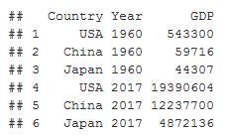
Restructure Data
Wide Data
Tall Data

Slide 23
Joins
Data is generally spread across multiple tables rather than in a single flat file.
These tables share a common variable or field, thus are related (which is why these tables are also known as relations). All the tables or relations together comprise a relational database.
Storing data across relations offers a number of benefits such as reduced redundancy, fewer errors from updates, and greater efficiency in storage and retrieval.
The data required for analysis at hand is retrieved by linking relations through joins. The languages most widely used for this is SQL, however, this can also be accomplished using other languages like Python and R.

Slide 24
Joins
Types of Joins
Inner Join
Outer Joins
Left Outer Join
Right Outer Join
Full Outer Join

Slide 25
Missing Data
Common in real datasets
Critical to address it as many predictive models require complete data
Important to understand reasons for missing data in order to decide what do with it

Slide 26
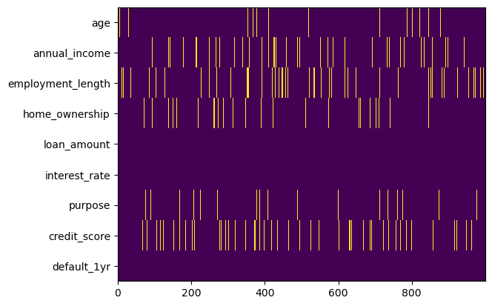
Missing Data
Possible reasons may be
Random
Data deficiency
Specific causes
Pattern in a heatmap may highlight reasons

Slide 27
Missing Data Solutions
Delete
Encode Missing Data
Impute
Simple solution
Delete
Pairwise
Listwise
However,
small number of missing values can lead to losing a large percent of sample.
acquiring new data may be costly
potential of introducing bias

Slide 28
Missing Data Solutions
Delete
Encode Missing Data
Impute
Hard code missingness
In a categorical variable, missing data may be encoded as another level
Missing data in a continuous variable may be represented using a dummy variable.

Slide 29
Missing Data Solutions
Delete
Encode Missing Data
Impute
Information and relationships among non-missing predictors is used to estimate missing values
Univariate techniques: Use a non-biasing estimate like mean or median.
Multivariate techniques: Use data on other variables to estimate missing values. E.g, kNN, MICE.
Impute no more than 20% missing data for any variable
Conducted prior to other steps in data preparation

Slide 30
Project

Slide 31
Project
Group of 3 or 4 with different skill sets
Select Data
Explore and Transform Data
Share Insights

