Slide 1
markdown-pptx
Markdown in. Editable PowerPoint out.

Slide 2
What markdown-pptx is
markdown-pptx converts constrained Markdown slide decks into editable PowerPoint .pptx presentations.
It uses real PowerPoint layouts and placeholders, so the output stays easy to edit in PowerPoint instead of becoming a pile of free-positioned text boxes.

Slide 3
How the format works
An optional markdown-pptx:deck comment sets deck-wide defaults such as aspect ratio, fonts, colors, and background behavior.
Each ATX # H1 or Setext H1 starts a new slide. An optional markdown-pptx:slide comment appears immediately after the heading. Everything until the next H1 belongs to that slide.

Slide 4
Basic CLI usage
Run uvx markdown-pptx deck.md to write deck.pptx next to the source markdown file.
Use uvx markdown-pptx deck.md out.pptx to choose the output path, --template theme.pptx to render against an existing PowerPoint template, and --force to overwrite an existing file.
Run uvx markdown-pptx with no arguments for the quick reference or use --about for project metadata.

Slide 5
Inspection-friendly CLI modes
Use --syntax to print the supported deck format, --list-masters to inspect a template's slide masters, --list-layouts to inspect layouts on a selected master, and --list-color-schemes to see the built-in theme presets.
Add --json for structured results. Master and layout inspection report names, indices, placeholder inventory, and compatibility so people and coding agents can discover valid inputs before generating a deck.

Slide 6
Master and layout selection
This slide uses the template's Showcase Alternate master while the rest of the deck defaults to master 1. Templates keep every embedded master in the output.
Master selection uses slide metadata first, then the CLI default, then master 1. Layout names are resolved within the selected master.

Slide 7
Agent skill support
Run uvx markdown-pptx skill install to install the managed agent skill under ~/.agents/skills, or uvx markdown-pptx skill remove to remove it safely.
The skill teaches agents to inspect syntax, masters, and layouts; prefer structured output; respect overwrite safety; and handle local or remote images predictably.

Slide 8
Color and template control
Markdown can set document-level and slide-level colors with color_scheme, title_color, body_color, and background values such as solid colors, gradients, and images.
When a template already has the colors you want, --ignore-document-colors and --ignore-slide-colors let the template remain the source of truth for those color settings.

Slide 9
Supported color formats
Colors accept short or long hex, RGB, HSL, and PowerPoint theme references such as var(--accent-1).

Slide 10
Every PowerPoint theme color
Notes:
This slide uses every theme color as a hard band in the background.
From top to bottom: Dark 1, Light 1, Dark 2, Light 2, Accent 1 through Accent 6, Hyperlink, and Followed Hyperlink.

Slide 11
Feature examples
Each slide after this one isolates a single markdown-pptx feature.

Slide 12
Title Slide layout
This slide uses the Title Slide layout.

Slide 13
Section Header layout
This slide uses the Section Header layout.

Slide 14
Title and Content layout
This slide explicitly uses master 1 and its Title and Content layout.

Slide 15
Title Only layout

Slide 16
Body text with hyperlinks
markdown-pptx can include links in normal body text, such as the project repository and the python-pptx documentation.

Slide 17
Inline text styling
Normal text can mix strong with nested italic, italic emphasis, inline code, deleted text, H₂O, x², and formatted links in the same editable placeholder.

Slide 18
Line breaks
This source line wraps without forcing a visual break.
This line ends here.
The next line stays in the same paragraph.

Slide 19
H2 through H6 headings
H2 heading
H3 heading
H4 heading
H5 heading
H6 heading
Setext H2 heading

Slide 20
Setext H1 slide
An H1 underline can start a slide without an ATX marker.

Slide 21
Bulleted list
Write a readable Markdown deck
Choose a template if needed
Render an editable PowerPoint file

Slide 22
Nested lists
Inspect the template
  Select a master
    Choose a compatible layout
Write the Markdown
  Keep each slide focused
Render and review the PowerPoint

Slide 23
Numbered list
Write the markdown source
Run the CLI
Open the generated .pptx

Slide 24
Task lists and continuations
☑ Create the editable deck
☐ Review the slides
Begin with a numbered item
Continue its explanation without another number.
Finish the sequence

Slide 25
Pipe table
Markdown input | PowerPoint result
# H1 | New slide
layout | Real slide layout
master | Master-specific layout group
notes | Editable speaker notes
Total | All six native table-style flags

Slide 26
Blockquote
markdown-pptx keeps the source format simple enough to read directly while still producing a real presentation.
Quoted lists keep their bullets.

Slide 27
Code block: PowerShell
uvx markdown-pptx sample/showcase.md sample/showcase.pptx --template sample/showcase-template.pptx --force

Slide 28
Syntax highlighting: Python
# Summarize completed work
def summarize(tasks: list[str]) -> str:
count = len(tasks)
return f"Completed {count} tasks"
tasks = ["Design", "Build", "Review"]
if len(tasks) >= 3:
print(summarize(tasks))
Notes:
Language labels select syntax coloring. The highlighted code remains editable PowerPoint text.

Slide 29
Syntax highlighting: TypeScript
// Calculate the remaining work
type Project = { name: string, completed: number }
const remaining = (project: Project): number => {
return Math.max(0, 10 - project.completed)
}
const launch = { name: "Launch", completed: 7 }
console.log(`Remaining: ${remaining(launch)}`)
Notes:
TypeScript highlights type declarations, keywords, strings, and numeric values.

Slide 30
Syntax highlighting: HTML
<!-- A compact project card -->
<article class="project-card">
<h2 id="title">Launch checklist</h2>
<p>Three steps remain before release.</p>
<ul>
<li>Review the preview</li>
<li>Publish the update</li>
</ul>
<a href="/projects/launch">View project</a>
</article>
Notes:
HTML highlights tags, attribute names, quoted values, and comments.

Slide 31
Syntax highlighting: CSS
/* Style the project card */
.project-card {
display: grid;
gap: 12px;
padding: 24px;
color: #10263f;
background: #eef8ff;
}
.project-card a:hover { color: #1d6fa8; }
Notes:
CSS highlights selectors, property names, color values, and units.

Slide 32
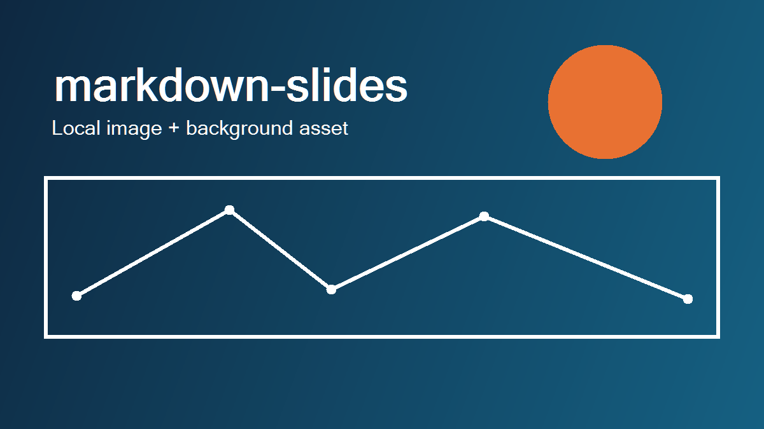
Local image

Slide 33

Remote image
Notes:
This slide demonstrates downloading a remote image during rendering.
[Sources]
- https://raw.githubusercontent.com/github/explore/main/topics/python/python.png (Python logo)

Slide 34

Local video: Big Buck Bunny
Notes:
The local MP4 is embedded in this PowerPoint file. Click Next to start playback.
The slide stays in place when the clip ends.
The preview image is generated from the first video frame.
Clip: (c) copyright 2008, Blender Foundation / www.bigbuckbunny.org
Licensed under Creative Commons Attribution 3.0.

Slide 35

Local video: automatic fullscreen playback
Notes:
The embedded Big Buck Bunny clip starts when this slide appears.
It fills the screen, loops, and plays with sound muted.
Advance the slide manually when you are ready to continue.
Clip and poster: (c) copyright 2008, Blender Foundation / www.bigbuckbunny.org
Licensed under Creative Commons Attribution 3.0.

Slide 36

YouTube video: Big Buck Bunny
Online playback
The video on the right is linked to YouTube.
Click the video to play the full film in PowerPoint.
Notes:
This slide uses an online YouTube media object. Playback needs internet access.
The film is (c) copyright 2008, Blender Foundation / www.bigbuckbunny.org

Slide 37
Background color
This slide uses a solid slide background color.

Slide 38
Transparent background and hidden master graphics
This slide removes its slide-level fill and hides the orange accent graphic inherited from the alternate master.

Slide 39
Notes:
This slide demonstrates a full-slide background image on the Blank layout.

Slide 40
Linear gradient background
This slide uses a three-stop linear gradient background.

Slide 41
Radial gradient background
This slide uses a radial gradient background.

Slide 42
Slide colors override document colors
This slide overrides the document-level title and body colors.

Slide 43
Notes:
This slide intentionally demonstrates the Blank layout.

Slide 44
Two content areas
First option
Small initial scope
Quick feedback
Second option
Broader initial scope
More preparation
Notes:
A single top-level thematic break separates the left and right placeholders.

Slide 45
Text beside a table
Progress
☑ Design agreed
☐ Delivery scheduled
Milestone | Status
Design | Complete
Delivery | Planned

Slide 46
Theme syntax: dark colors
code_highlighting: theme-dark on a white background.
# Colors follow this deck's blue theme
def greet(name: str, count: int = 3):
for index in range(count):
print(f"Hello, {name}: {index}")
greet("PowerPoint")
Notes:
Dark 1 supplies ordinary code. Accents 1, 2, and 3 supply keywords, values, and named tokens. Brightness is adjusted only as needed for 4.5 to 1 contrast.

Slide 47
Theme syntax: light colors
code_highlighting: theme-light on a navy background.
// Editable theme colors on a dark slide
interface Greeting { message: string }
const greet = (name: string): Greeting => ({
message: `Hello, ${name}`
});
console.log(greet("PowerPoint"));
Notes:
Light 1 supplies ordinary code. The same accent slots are used with lighter variants where needed. Comments meet the same contrast target as other code.

Slide 48
Theme syntax: a light gradient
The background range guides the brightness adjustments.
<!-- Theme colors stay editable -->
<article class="greeting">
<h2>Hello, PowerPoint</h2>
<p data-state="ready">Ready to present.</p>
</article>
Notes:
A 16 by 16 grid estimates the background range beneath the content placeholder. HTML tags use Accent 1, values use Accent 2, and attributes use Accent 3.

Slide 49
Theme syntax: a dark gradient
One palette is reused across all code blocks in this area.
/* Presentation colors follow the theme */
.greeting {
color: #1d6fa8;
padding: 24px;
display: grid;
gap: 12px;
}
Notes:
A dark radial gradient demonstrates the light variant. Native theme references retain their slot and use brightness adjustments for the estimated background range.

Slide 50
Shared references
Read the project guide.
The same definition can supply links throughout the deck.
Formatted links retain their ScreenTips.
Notes:
The title and body use a reference defined on a later slide. The optional link title becomes a ScreenTip in PowerPoint. Hover over a link in Slide Show view to see the tip.

Slide 51
Code stays inside its list item
Run the check
status = "Ready"
print(status)
Result
Continue after checking the output.
Present the result
Notes:
The code block and result heading align with the parent list text. The HTML comment is omitted.

Slide 52
Numbering and reusable definitions
0. Prepare the content
Render the presentation
Review in PowerPoint
Return to the project guide for more examples.
Notes:
Zero is preserved with an editable text marker. Native numbering is used where PowerPoint supports it. The reference definition at the bottom is invisible and serves earlier slides.

Slide 53
Markdown in. Editable PowerPoint out.
Run uvx markdown-pptx --help to get started.

