Slide 1
markdown-pptx
Markdown in. Editable PowerPoint out.

Slide 2
What markdown-pptx is
markdown-pptx converts constrained Markdown slide decks into editable PowerPoint .pptx presentations.
It uses real PowerPoint layouts and placeholders, so the output stays easy to edit in PowerPoint instead of becoming a pile of free-positioned text boxes.

Slide 3
How the format works
An optional document front matter block sets deck-wide defaults such as aspect ratio, fonts, colors, and background behavior.
Each # H1 starts a new slide, optional slide front matter appears immediately after the H1, and everything until the next H1 becomes that slide's content.

Slide 4
Basic CLI usage
Run uvx markdown-pptx deck.md to write deck.pptx next to the source markdown file.
Use uvx markdown-pptx deck.md out.pptx to choose the output path, --template theme.pptx to render against an existing PowerPoint template, and --force to overwrite an existing file.
Run uvx markdown-pptx with no arguments for the quick reference or use --about for project metadata.

Slide 5
Inspection-friendly CLI modes
Use --syntax to print the supported deck format, --list-masters to inspect a template's slide masters, --list-layouts to inspect layouts on a selected master, and --list-color-schemes to see the built-in theme presets.
Add --json for structured results. Master and layout inspection report names, indices, placeholder inventory, and compatibility so people and coding agents can discover valid inputs before generating a deck.

Slide 6
Master and layout selection
This slide uses the template's Showcase Alternate master while the rest of the deck defaults to master 1. Templates keep every embedded master in the output.
Master selection uses slide metadata first, then the CLI default, then master 1. Layout names are resolved within the selected master.

Slide 7
Agent skill support
Run uvx markdown-pptx skill install to install the managed agent skill under ~/.agents/skills, or uvx markdown-pptx skill remove to remove it safely.
The skill teaches agents to inspect syntax, masters, and layouts; prefer structured output; respect overwrite safety; and handle local or remote images predictably.

Slide 8
Color and template control
Markdown can set document-level and slide-level colors with color_scheme, title_color, body_color, and background values such as solid colors, gradients, and images.
When a template already has the colors you want, --ignore-document-colors and --ignore-slide-colors let the template remain the source of truth for those color settings.

Slide 9
Supported color formats
Colors accept short or long hex, RGB, HSL, and PowerPoint theme references such as var(--accent-1).

Slide 10
Every PowerPoint theme color
Notes:
This slide uses every theme color as a hard band in the background.
From top to bottom: Dark 1, Light 1, Dark 2, Light 2, Accent 1 through Accent 6, Hyperlink, and Followed Hyperlink.

Slide 11
Feature examples
Each slide after this one isolates a single markdown-pptx feature.

Slide 12
Title Slide layout
This slide uses the Title Slide layout.

Slide 13
Section Header layout
This slide uses the Section Header layout.

Slide 14
Title and Content layout
This slide explicitly uses master 1 and its Title and Content layout.

Slide 15
Title Only layout

Slide 16
Body text with hyperlinks
markdown-pptx can include links in normal body text, such as the project repository and the python-pptx documentation.

Slide 17
Inline text styling
Normal text can mix strong emphasis, italic emphasis, inline code, and hyperlinks in the same editable placeholder.

Slide 18
H2 through H6 headings
H2 heading
H3 heading
H4 heading
H5 heading
H6 heading

Slide 19
Bulleted list
Write a readable Markdown deck
Choose a template if needed
Render an editable PowerPoint file

Slide 20
Nested lists
Inspect the template
Select a master
Choose a compatible layout
Write the Markdown
Keep each slide focused
Render and review the PowerPoint

Slide 21
Numbered list
Write the markdown source
Run the CLI
Open the generated .pptx

Slide 22
Pipe table
Markdown input | PowerPoint result
# H1 | New slide
layout | Real slide layout
master | Master-specific layout group
notes | Editable speaker notes
Total | All six native table-style flags

Slide 23
Blockquote
markdown-pptx keeps the source format simple enough to read directly while still producing a real presentation.

Slide 24
Code block
uvx markdown-pptx sample/showcase.md sample/showcase.pptx --template sample/showcase-template.pptx --force

Slide 25
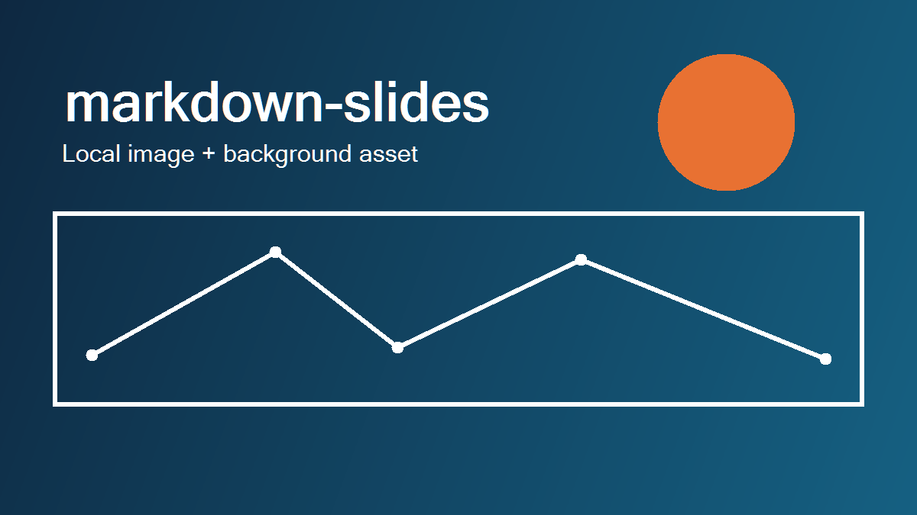
Local image

Slide 26

Remote image
Notes:
This slide demonstrates downloading a remote image during rendering.
[Sources]
- https://raw.githubusercontent.com/github/explore/main/topics/python/python.png (Python logo)

Slide 27
Background color
This slide uses a solid slide background color.

Slide 28
Transparent background and hidden master graphics
This slide removes its slide-level fill and hides the orange accent graphic inherited from the alternate master.

Slide 29
Notes:
This slide demonstrates a full-slide background image on the Blank layout.

Slide 30
Linear gradient background
This slide uses a three-stop linear gradient background.

Slide 31
Radial gradient background
This slide uses a radial gradient background.

Slide 32
Slide colors override document colors
This slide overrides the document-level title and body colors.

Slide 33
Notes:
This slide intentionally demonstrates the Blank layout.

Slide 34
Markdown in. Editable PowerPoint out.
Run uvx markdown-pptx --help to get started.

