Slide 1
Default showcase
Vanilla Markdown becomes editable PowerPoint.

Slide 2
Markdown without metadata
This source has no markdown-pptx metadata. Ordinary content slides use Title and Content.
A title with an optional H2 subtitle infers the title layout first and section layouts later.

Slide 3
Markdown chooses two content areas
Left content
One top-level horizontal rule selects Two Content.
Right content
Each side can contain text, an image, a table, or a video.

Slide 4
What markdown-pptx is
markdown-pptx converts constrained Markdown slide decks into editable PowerPoint .pptx presentations.
It uses real PowerPoint layouts and placeholders, so the output stays easy to edit in PowerPoint instead of becoming a pile of free-positioned text boxes.

Slide 5
Basic CLI usage
Run uvx markdown-pptx deck.md to write deck.pptx next to the source markdown file.
Use uvx markdown-pptx deck.md out.pptx to choose the output path, --template theme.pptx to render against an existing PowerPoint template, and --force to overwrite an existing file.
Run uvx markdown-pptx with no arguments for the quick reference or use --about for project metadata.

Slide 6
Body text with hyperlinks
markdown-pptx can include links in normal body text, such as the project repository and the python-pptx documentation.

Slide 7
Inline text styling
Normal text can mix strong with nested italic, italic emphasis, inline code, deleted text, H₂O, x², and formatted links in the same editable placeholder.

Slide 8
Line breaks
This source line wraps without forcing a visual break.
This line ends here.
The next line stays in the same paragraph.

Slide 9
H2 through H6 headings
H2 heading
H3 heading
H4 heading
H5 heading
H6 heading
Setext H2 heading

Slide 10
Setext H1 slide
An H1 underline can start a slide without an ATX marker.

Slide 11
Bulleted list
Write a readable Markdown deck
Choose a template if needed
Render an editable PowerPoint file

Slide 12
Nested lists
Inspect the template
  Select a master
    Choose a compatible layout
Write the Markdown
  Keep each slide focused
Render and review the PowerPoint

Slide 13
Numbered list
Write the markdown source
Run the CLI
Open the generated .pptx

Slide 14
Task lists and continuations
☑ Create the editable deck
☐ Review the slides
Begin with a numbered item
Continue its explanation without another number.
Finish the sequence

Slide 15
Native table row sizing
Tables fill the content area's width. PowerPoint sizes each row to its content.
Short rows stay compact. Longer text wraps and makes its row taller. Cells are centered vertically and left aligned by default.
Item | Description
Short | A brief entry
Wrapped | This longer entry wraps onto several lines. PowerPoint grows this row to fit the content while keeping the shorter row compact.

Slide 16
Blockquote
markdown-pptx keeps the source format simple enough to read directly while still producing a real presentation.
Quoted lists keep their bullets.

Slide 17
Code block: PowerShell
uvx markdown-pptx sample/default-showcase.md sample/default-showcase.pptx --force

Slide 18
Syntax highlighting: Python
# Summarize completed work
def summarize(tasks: list[str]) -> str:
count = len(tasks)
return f"Completed {count} tasks"
tasks = ["Design", "Build", "Review"]
if len(tasks) >= 3:
print(summarize(tasks))

Slide 19
Syntax highlighting: TypeScript
// Calculate the remaining work
type Project = { name: string, completed: number }
const remaining = (project: Project): number => {
return Math.max(0, 10 - project.completed)
}
const launch = { name: "Launch", completed: 7 }
console.log(`Remaining: ${remaining(launch)}`)

Slide 20
Syntax highlighting: HTML
<!-- A compact project card -->
<article class="project-card">
<h2 id="title">Launch checklist</h2>
<p>Three steps remain before release.</p>
<ul>
<li>Review the preview</li>
<li>Publish the update</li>
</ul>
<a href="/projects/launch">View project</a>
</article>

Slide 21
Syntax highlighting: CSS
/* Style the project card */
.project-card {
display: grid;
gap: 12px;
padding: 24px;
color: #10263f;
background: #eef8ff;
}
.project-card a:hover { color: #1d6fa8; }

Slide 22
Table column alignment
Region | Status | Revenue
North | Complete | $50,000
South | Planned | $40,000

Slide 23
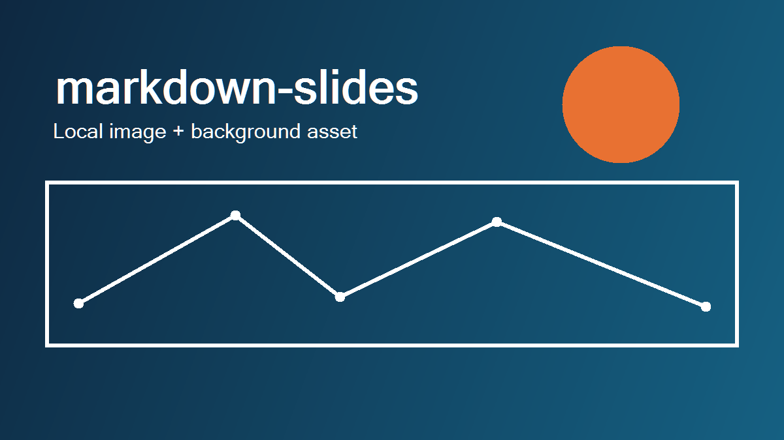
Local image

Slide 24

Remote image
A remote image stays editable. Downloading it requires an internet connection.

Slide 25

YouTube video: Big Buck Bunny
Online playback
The video on the right is linked to YouTube.
Click the video to play the full film in PowerPoint. Playback requires internet access.
Big Buck Bunny is copyright 2008, Blender Foundation. Licensed under Creative Commons Attribution 3.0.

Slide 26
An empty heading
An empty H1 with no body creates a Blank slide. The next slide demonstrates it.

Slide 28
Two content areas
First option
Small initial scope
Quick feedback
Second option
Broader initial scope
More preparation

Slide 29
Text beside a table
Progress
☑ Design agreed
☐ Delivery scheduled
Milestone | Status
Design | Complete
Delivery | Planned

Slide 30
Shared references
Read the project guide.
The same definition can supply links throughout the deck.
Formatted links retain their ScreenTips.

Slide 31
Code stays inside its list item
Run the check
status = "Ready"
print(status)
Result
Continue after checking the output.
Present the result

Slide 32
Numbering and reusable definitions
0. Prepare the content
Render the presentation
Review in PowerPoint
Return to the project guide for more examples.

Slide 33
Pipe table
Markdown input | PowerPoint result
# H1 | New slide
layout | Real slide layout
master | Master-specific layout group
notes | Editable speaker notes
Total | All six native table-style flags

Slide 34

Video without metadata
The local clip uses its first decoded frame as its poster. Playback starts on click.
Big Buck Bunny is copyright 2008, Blender Foundation. Licensed under Creative Commons Attribution 3.0.

Slide 35

A linked image supplies a video poster
A linked image pointing to an MP4 becomes its poster.

Slide 36
Setext H2 heading
A smaller heading
A hyphen underline creates an H2. A blank line before a horizontal rule makes the rule a content separator.

Slide 37
Both hard-break spellings
This line ends with two spaces.
The next line stays in the paragraph.
This line ends with a backslash.
The next line also stays in its paragraph.

Slide 38
Indented code
Code can be indented instead of fenced:
status = 'Ready'
print(status)

Slide 39
Escapes and ordinary HTML
Escaped markers stay literal: *asterisks* and _underscores_.
Inline HTML contributes its text. The tags add no PowerPoint formatting.
The comment above contributes no visible content.

Slide 40
Starting numbers and empty items
Begin at five
Continue at six
A visible item
Another visible item
32768. Values beyond native numbering stay editable text
32769. The sequence continues

Slide 41
Reference image forms

Slide 42
Shortcut image reference

Slide 43
Collapsed and shortcut links
Read the showcase-guide and revisit showcase-guide.
The first definition of a reference wins. Reference labels ignore case.

Slide 44
A table can escape pipes
Expression | Meaning
a|b | Either a or b
a|b | A literal pipe

Slide 45
Linked picture titles

Slide 46
Markdown in. Editable PowerPoint out.
Run uvx markdown-pptx default-showcase.md to render this source with the packaged template.

Slide 47
Other horizontal-rule spellings
A hyphen rule surrounded by blank lines creates two content areas.
An underscore rule works the same way on the next slide.

Slide 48
Two tables without metadata
Choice | Cost
Small | 10
Choice | Cost
Large | 20

Slide 49
Tilde fences and automatic links
# This is literal code, not a new slide
***
An angle-bracket link works too: https://github.com/pseudosavant/markdown-pptx.

Slide 50
Mixed nested lists
Plan the presentation
  Write the source
    Review the main point
Render the slides

Slide 51
A section from H1 alone

Slide 52
A section with a subtitle
Native layout from ordinary headings

Slide 53
Multiple H2s remain content
First content heading
Second content heading

Slide 54
Rich table cells
Kind | Example
Emphasis | Bold and italic
Code | status = 'Ready'
Strike | Removed
Baselines | Water is H₂O, area is x²
Links | Read the guide

