Slide 1
markdown-pptx
Markdown in. Editable PowerPoint out.

Slide 2
What markdown-pptx is
markdown-pptx converts constrained Markdown slide decks into editable PowerPoint .pptx presentations.
It uses real PowerPoint layouts and placeholders, so the output stays easy to edit in PowerPoint instead of becoming a pile of free-positioned text boxes.

Slide 3
How the format works
An optional document front matter block sets deck-wide defaults such as aspect ratio, fonts, colors, and background behavior.
Each # H1 starts a new slide, optional slide front matter appears immediately after the H1, and everything until the next H1 becomes that slide's content.

Slide 4
Basic CLI usage
Run markdown-pptx deck.md to write deck.pptx next to the source markdown file.
Use markdown-pptx deck.md out.pptx to choose the output path, --template theme.pptx to render against an existing PowerPoint template, and --force to overwrite an existing file.

Slide 5
Inspection-friendly CLI modes
Use --syntax to print the supported deck format, --list-layouts to inspect the layouts available in a template, and --list-color-schemes to see the built-in theme presets.
These modes are especially useful when a person or coding agent needs to discover the valid inputs before generating a deck.

Slide 6
Color and template control
Markdown can set document-level and slide-level colors with color_scheme, title_color, body_color, and background values such as solid colors, gradients, and images.
When a template already has the colors you want, --ignore-document-colors and --ignore-slide-colors let the template remain the source of truth for those color settings.

Slide 7
Feature examples
Each slide after this one isolates a single markdown-pptx feature.

Slide 8
Title Slide layout
This slide uses the Title Slide layout.

Slide 9
Section Header layout
This slide uses the Section Header layout.

Slide 10
Title and Content layout
This slide uses the default Title and Content layout.

Slide 11
Title Only layout

Slide 12
Body text with hyperlinks
markdown-pptx can include links in normal body text, such as the project repository and the python-pptx documentation.

Slide 13
H2 through H4 headings
H2 heading
H2 stays inside the current slide body.
H3 heading
H3 also stays inside the same slide body.
H4 heading
H4 is rendered smaller while still using heading styling.

Slide 14
Bulleted list
Write a readable Markdown deck
Choose a template if needed
Render an editable PowerPoint file

Slide 15
Numbered list
Write the markdown source
Run the CLI
Open the generated .pptx

Slide 16
Blockquote
markdown-pptx keeps the source format simple enough to read directly while still producing a real presentation.

Slide 17
Code block
markdown-pptx sample/showcase.md sample/showcase.pptx --force

Slide 18
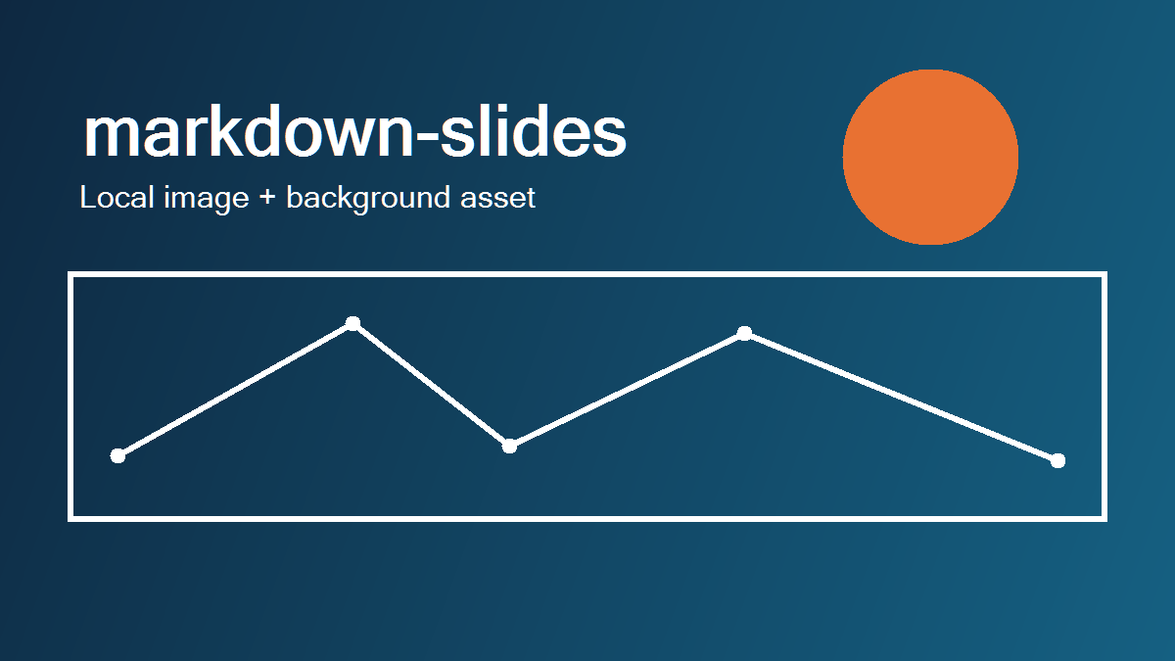
Local image

Slide 19

Remote image

Slide 20
Background color
This slide uses a solid slide background color.

Slide 21
Background image
This slide uses a slide background image.

Slide 22
Linear gradient background
This slide uses a linear gradient background.

Slide 23
Radial gradient background
This slide uses a radial gradient background.

Slide 24
Slide colors override document colors
This slide overrides the document-level title and body colors.

Slide 25
Notes:
This slide intentionally demonstrates the Blank layout.

