Slide 1

Special Topics
Security Engineering CSCE 689/489 Week 6
Prof. Shreyas Kumar

Slide 2
Week 7 - Incident Response
Incident response lifecycle (NIST 800-61)
Digital forensics fundamentals
Security Information and Event Management (SIEM) tools

Slide 3
Announcements
https://www.jstor.org/stable/pdf/3597229.pdf
Event Details
Title: Discuss Translational AI, Cybersecurity, and the Future of CS in India
Date/Time: Oct 9th, 2025; 11:30:–1:00 PM
Location: PETR 118
Host: Prof Shreyas Kumar
Abstract:
The session will be an informal 1–2 hour interaction on AI & Cybersecurity theory/practice, vis-a-vis the new computer science applications that India needs. In addition to the group discussion, the speakers are happy to meet individually over coffee with those interested.
Prof Nitin Saxena, is the Dean, Wadhwani School of AI & Intelligent Systems +N.Rama.Rao.Chair Professor, Computer Science & Engg. at IIT Kanpur
He is known for AKS Primality Test in 2002 in a joint work with Manindra Agrawal and Neeraj Kayal, for which the trio won the 2006 Fulkerson Prize, and the 2006 Gödel Prize.
Please respond to this form if you plan to attend:
https://forms.gle/3zNv3JuXCWw4yLaF7

Slide 4
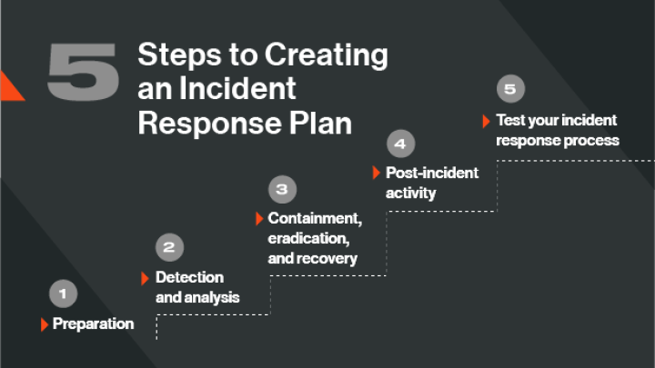
Why Incident Response
Minimizes Damage: Rapid response limits the scope and impact of security incidents (data loss, downtime, reputational harm).
Reduces Recovery Time and Costs: Quick containment and remediation help avoid prolonged disruptions and expensive recovery efforts.
Protects Sensitive Data: Ensures prompt action is taken to prevent data breaches or minimize data exposure.

Slide 5
Engineer for threat detection and response
Design Detection Mechanisms: Build systems to monitor logs, network traffic, endpoints, and cloud services for suspicious activity.
Implement Security Monitoring Tools: Deploy and configure tools like SIEM (e.g., Splunk, ELK, Sentinel) and EDR (e.g., CrowdStrike, SentinelOne).
Develop Detection Rules and Use Cases: Write custom rules (e.g., in Sigma, YARA, or SIEM query language) tailored to organizational risks and threats.
Automate Alerting and Triage: Integrate alerts with SOAR platforms to speed up triage and reduce analyst fatigue.
Build Scalable Logging Infrastructure: Ensure proper log collection, normalization, and storage from all relevant sources (cloud, servers, apps, etc.).

Slide 6
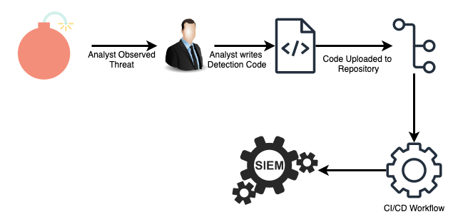
Threat detection as code
Detection Logic Written in Code: Treat detection rules (e.g., for SIEM, EDR) as version-controlled, testable, and auditable code.
Infrastructure-as-Code Principles: Apply DevOps practices (e.g., CI/CD, GitOps) to manage, deploy, and maintain threat detection logic.
Use of Open Formats: Leverage formats like Sigma, YARA, STIX, and OSQuery to write portable, standardized detections.

Slide 7
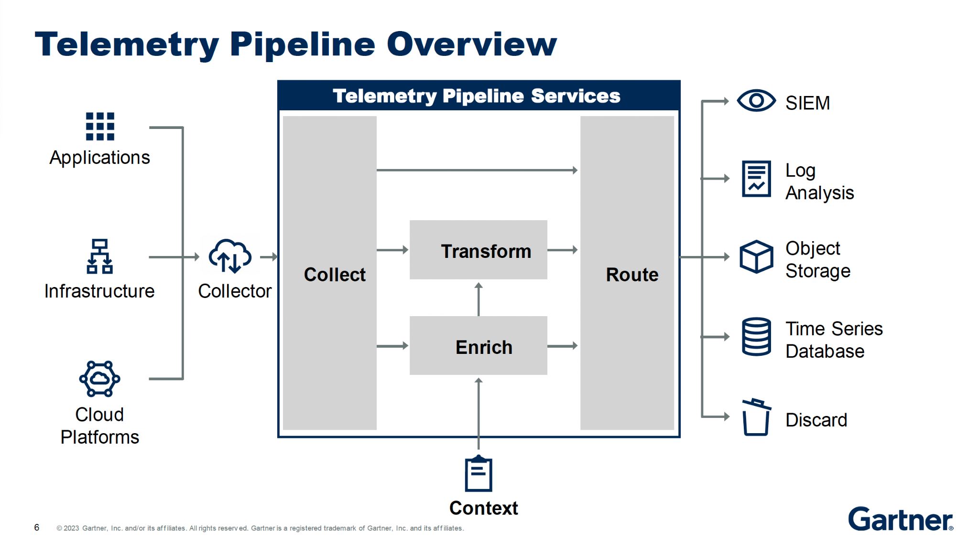
Telemetry Engineering
Ship Minimal Viable Telemetry (MVT): Focus on collecting only the most essential telemetry needed to detect high-priority threats — avoid data overload.
Map Telemetry to MITRE ATT&CK Techniques: Align logs and events with specific ATT&CK TTPs (Tactics, Techniques, and Procedures) to ensure relevance and detection coverage.
Schema Enforcement via Ingest Tests: Validate log structure and field consistency during ingestion to ensure downstream tools can reliably parse and use the data.

Slide 8
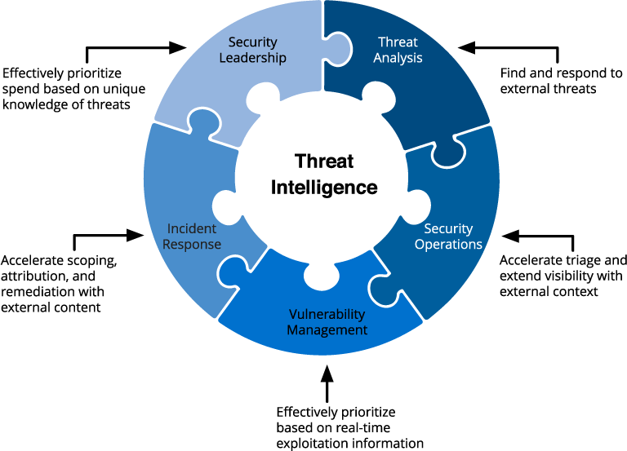
Design for Detection and Triage
Clear Detection Priorities: Design detections based on threat likelihood and impact, aligning with business risk and critical assets.
Layered Detection Approach: Use multiple detection layers (e.g., network, endpoint, cloud, and application) to provide a comprehensive view of threats.
Contextualized Alerts: Ensure alerts provide enough context (e.g., affected assets, severity, and possible attacker tactics) to help triage teams prioritize effectively.

Slide 9
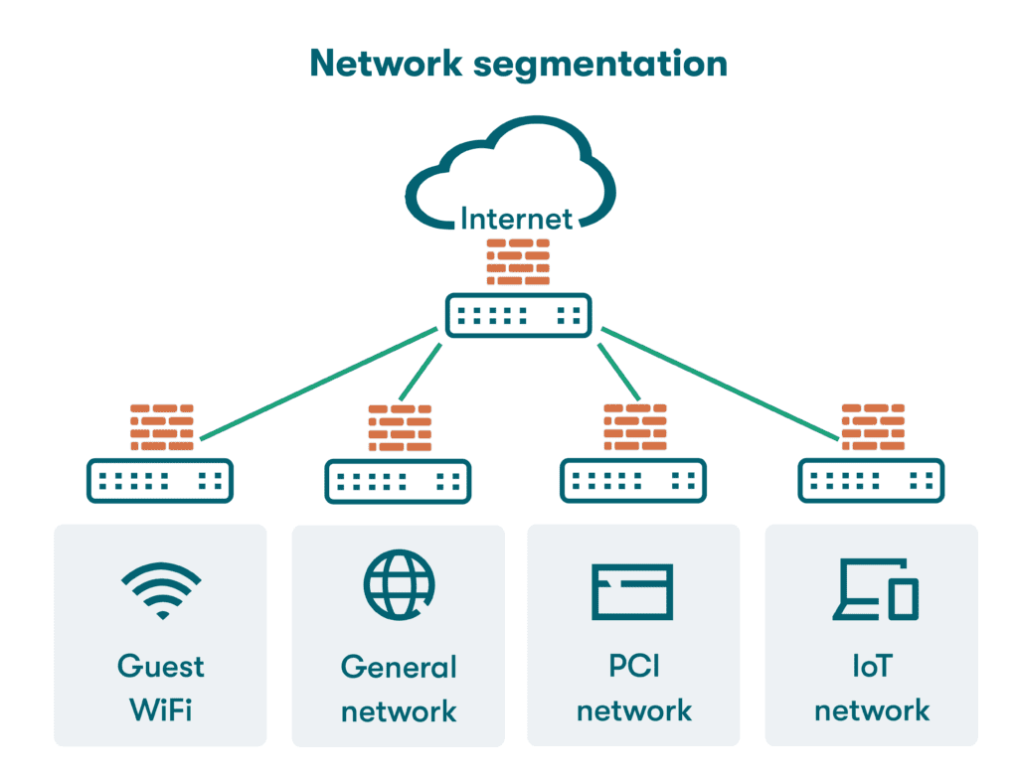
Automated Containment Patterns
Rapid Isolation of Compromised Assets: Automate the process of isolating compromised hosts or accounts to prevent further lateral movement or data exfiltration.
Network Segmentation and Isolation: Automatically segment affected parts of the network (e.g., quarantine VLANs) to contain threats without disrupting unaffected areas.
Automated Endpoint Quarantine: Use EDR tools to automatically quarantine compromised endpoints or isolate suspicious processes based on predefined rules.

Slide 10
Forensics Fundamentals
Purpose of Digital Forensics: Identify, preserve, analyze, and present digital evidence in support of investigations or legal proceedings.
Key Forensic Principles
Preserve Evidence Integrity (no alteration)
Maintain Chain of Custody (document who handled the evidence)
Repeatability and Verifiability (methods must be defensible and reproducible)
Types of Forensic Data
Volatile Data (RAM, processes, network connections — must be captured first)
Non-Volatile Data (disk images, log files, registry, system artifacts)
Common Forensic Artifacts
File system metadata (timestamps, deleted files)
Log files (authentication, system, application)
Browser and email history
Prefetch, registry hives, memory dumps

