Slide 1

Note: The data and information in this document is reflective of a hypothetical situation and client. This document is to be used for KPMG Virtual Internship purposes only.
Sprocket Central Pty Ltd
Data analytics approach
[Division Name] - [Engagement Manager], [Senior Consultant], [Junior Consultant]

Slide 2
Note: The data and information in this document is reflective of a hypothetical situation and client. This document is to be used for KPMG Virtual Internship purposes only.
Agenda
Introduction
Data Exploration
Model Development
Interpretation

Slide 3
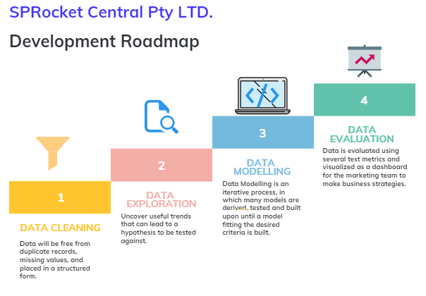
Note: The data and information in this document is reflective of a hypothetical situation and client. This document is to be used for KPMG Virtual Internship purposes only.
Introduction
Analysis for Sprocket Central Pty Ltd(a bikes sales company)
Sprocket Central Pty Ltd, a medium size
bikes & cycling accessories organization, has
approached Tony Smith (Partner) in KPMG's
Lighthouse & Innovation Team. Sprocket
Central Pty Ltd is keen to learn more about
KPMG's expertise in its Analytics,
Information & Modelling team..

Slide 4
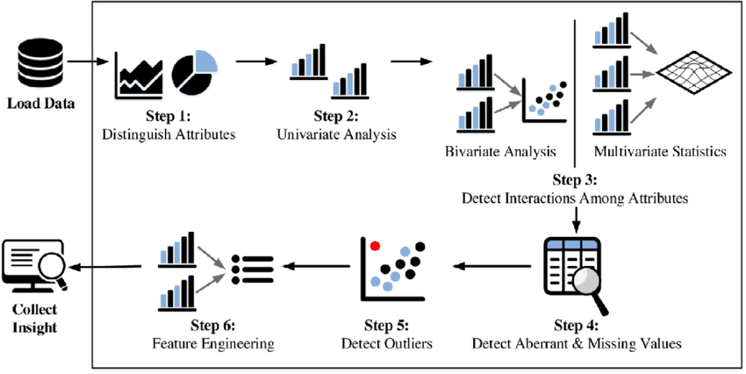
Note: The data and information in this document is reflective of a hypothetical situation and client. This document is to be used for KPMG Virtual Internship purposes only.
Data Exploration
Data Quality Assessment and Data Cleaning.
During module 1, we addressed the data
quality issues present in the given dataset,
specifically focusing on columns that lacked
the following attributes:
Accuracy
Completeness
Relevancy
Consistency

Slide 5
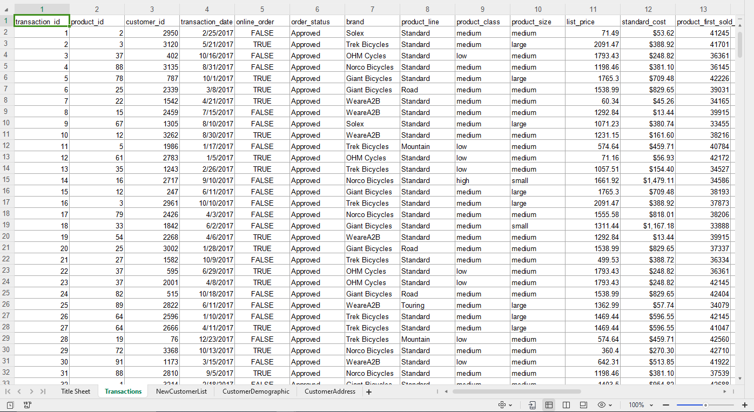
Note: The data and information in this document is reflective of a hypothetical situation and client. This document is to be used for KPMG Virtual Internship purposes only.
Data Exploration
Data Quality Assessment and Data Cleaning.
The Transaction sheet revealed the following
issues:
- A customer_id of 5034 was identified, which
exceeds the range of customer_ids (1-4000) from
the demographic sheet. This entry can be excludeo
from our training model.
From the Demographic sheet, the following
observations were made:
- Customers with IDs 753 and 3790 are deceased.
Since our campaign targets only living customers,
these entries can be removed from our model.

Slide 6
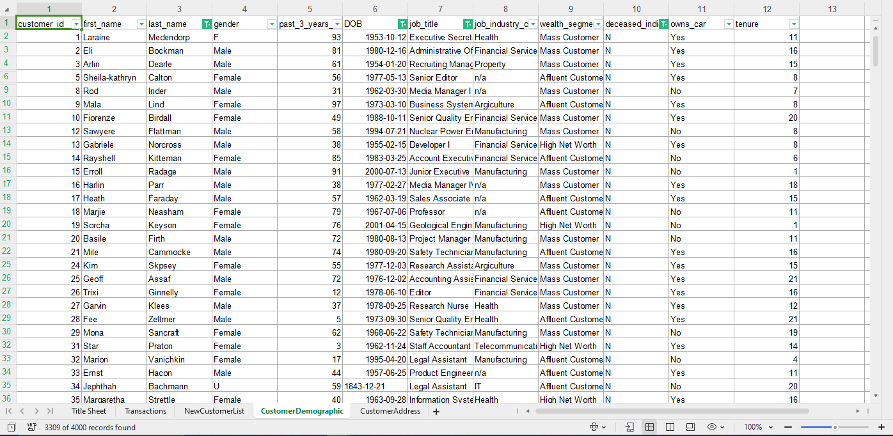
Note: The data and information in this document is reflective of a hypothetical situation and client. This document is to be used for KPMG Virtual Internship purposes only.
Data Exploration
Data Quality Assessment and Data Cleaning.
Based on the Demographic sheet analysis,
two issues have been identified. Customers
with IDs 753 and 3790 are marked as
deceased. Since our campaign targets only
living customers, we recommend excluding
them from our model.

Slide 7
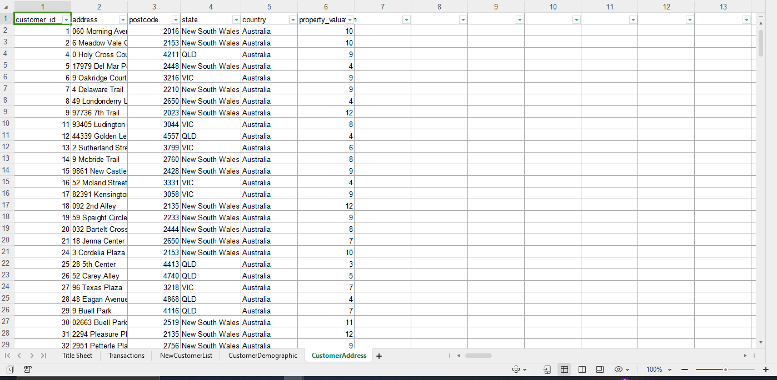
Note: The data and information in this document is reflective of a hypothetical situation and client. This document is to be used for KPMG Virtual Internship purposes only.
Data Exploration
Data Quality Assessment and Data Cleaning.
CustomerAddress sheet
We have identified the following outliers in the dataset:
- Customer_id 34 is recorded as being over 180 years old,
which is highly improbable in contemporary times.
Consequently, it is recommended to remove this entry
from our model.
- Customer _ids 753 and 3790 can be safely excluded from
the dataset since their details indicate that they have
passed away.
- Additionally, the demographic sheet does not provide any
information for customer ids 4001, 4002, and 4003.
Therefore, it is advisable to exclude these entries from the
training model as well.

Slide 8
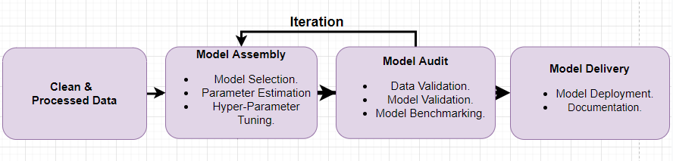
Note: The data and information in this document is reflective of a hypothetical situation and client. This document is to be used for KPMG Virtual Internship purposes only.
Model Development
Iterative Process
The transaction sheet exhibits missing data in various columns. Specifically, there are 197 blank rows in the
"brand," "product line," "product _class," "product _size," "standard _cost," and "product _first sold _date" columns.
Additionally, there are 360 blank rows in the "online _order" column. These blank rows can be safely removed from
the transaction sheet.

Slide 9
Note: The data and information in this document is reflective of a hypothetical situation and client. This document is to be used for KPMG Virtual Internship purposes only.
Model Development
Iterative Process
The data quality issues in the "state" column of the Customer_ Address sheet have been resolved by addressing the
inconsistencies.
In the CustomerDemographic dataset, the 125 blank rows in the "last name" column, 87 blank rows in the "DOB"
column, 506 blank rows in the "job title" column, and 87 blank rows in the "tenure" column have all been
removed.
Furthermore, the inconsistencies in the gender and deceased indicator columns have been addressed and
rectified.

Slide 10
Note: The data and information in this document is reflective of a hypothetical situation and client. This document is to be used for KPMG Virtual Internship purposes only.
Model Development
Iterative Process
The data quality issues in the "state" column of the Customer_ Address sheet have been resolved by addressing the
inconsistencies.
In the CustomerDemographic dataset, the 125 blank rows in the "last name" column, 87 blank rows in the "DOB"
column, 506 blank rows in the "job title" column, and 87 blank rows in the "tenure" column have all been
removed.
Furthermore, the inconsistencies in the gender and deceased indicator columns have been addressed and
rectified.

Slide 11
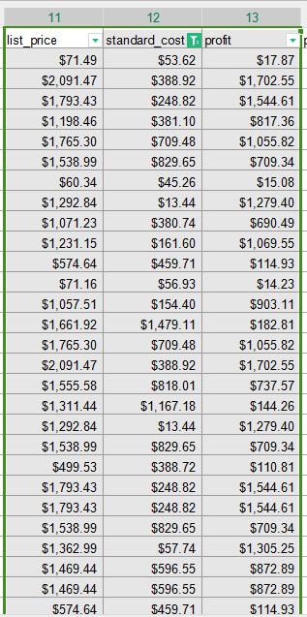
Note: The data and information in this document is reflective of a hypothetical situation and client. This document is to be used for KPMG Virtual Internship purposes only.
Model Development
In the Transaction sheet, I derive the profit by subtracting the Standard_cost from the list _price.

Slide 12
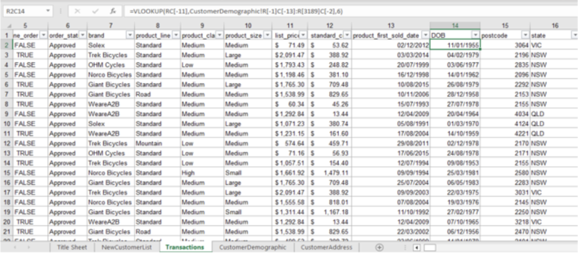
Note: The data and information in this document is reflective of a hypothetical situation and client. This document is to be used for KPMG Virtual Internship purposes only.
Model Development
By utilizing VLOOKUP, the fields for DOB, state, and postcode were extracted and merged into the
transaction dataset

Slide 13
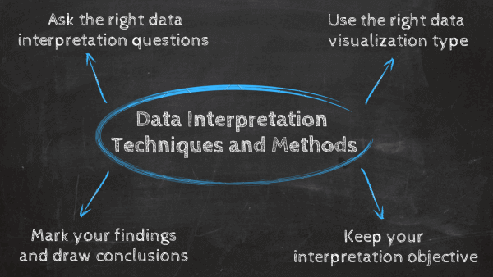
Note: The data and information in this document is reflective of a hypothetical situation and client. This document is to be used for KPMG Virtual Internship purposes only.
Interpretation
Data interpretation is the final step of data analysis where we turn results into a presentable format to gain clear and useful insights for business strategies.
Quantitative and qualitative methods are distinct types of data analyses both offering different type of data interpretation & decision making abilities.
Data dashboards decentralize data without compromising on the necessary speed of thought while blending both quantitative and qualitative data.
We will be reporting the insightful findings in the form of a dashboard which will demonstrate the Customer Demographic , Target Customers, Top Selling Goods etc. to help the team to make appropriate business decisions.

