Slide 1

Controlling a car with Python code
Figure-8 challenge!

Slide 2

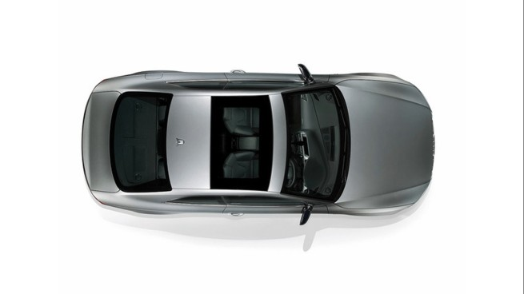
This is a figure-8.

Slide 3
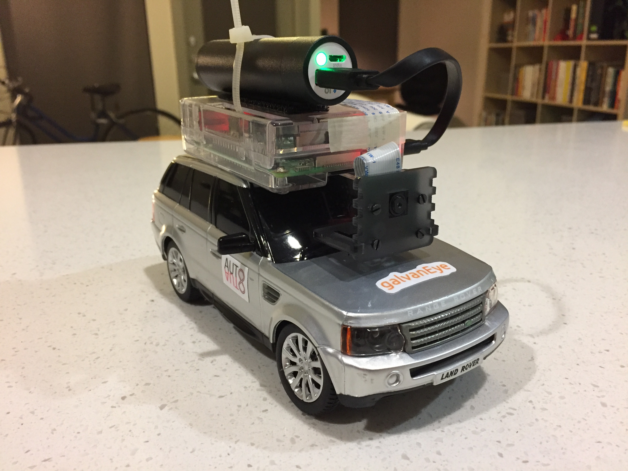
Can you write code to make this car to perform a figure-8?

Slide 4
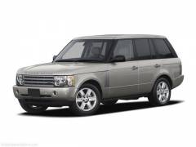
Here are some basic moves for the car.
import car
Left turn
car.left()
Right turn
car.right()
Try out these moves and see what happens.

Slide 5
This is a figure-8.
import car
car.right()
car.right()
car.left()
Try this out and see what happens.
car.left()

Slide 6
This is a figure-8.

Slide 7
This is a simpler figure-8.
car.right()
car.left()

Slide 8
This is a figure-8.
import car
car.right()
car.left()

Slide 9

Congratulations! You have passed the
Figure-8 challenge!

