Slide 1
EE201A Course Project: Automated Inter-Chip Pin Assignment
Junhao Hua and Silei Ma
University of California, Los Angeles
UID: 304734647 & 604741646
Email:{neilair, pseuuuuu}@g.ucla.edu

Slide 2
Outline
Introduction
Port Algorithm
Dealing with Constraints
Data Structure
Evaluation Results

Slide 3
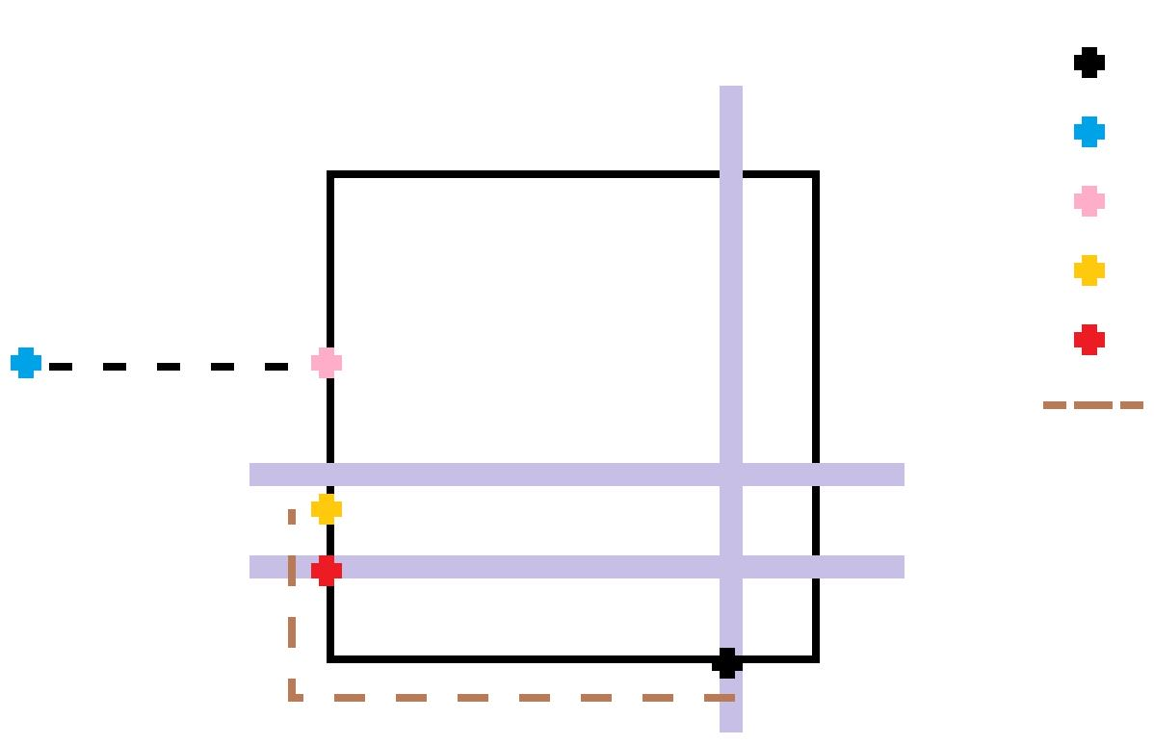
Port Algorithm
Initial
Buoy
Port
Aim
Legal Aim
Perturbation

Slide 4
Outline
Introduction
Port Algorithm
Dealing with Constraints
Data Structure
Evaluation Results

Slide 5
Dealing with Constraints (1)
System Pin Placement
Get Reference Points
Aim ---> Legal Aim
Macro Pin Pitch
Not Occupied: list.find()
Check Neighbor (±range)
Macro Pin Perturbation
Check at ALL time

Slide 6
Dealing with Constraints (2)
Legal Aim Movement
Swap

Slide 7
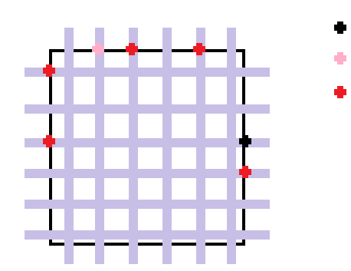
Dealing with Constraints (2)
Legal Aim Movement
Swap
Initial
Proposed Legal Aim
Occupied

Slide 8
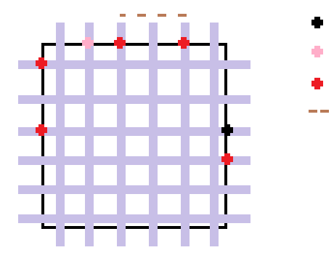
Dealing with Constraints (2)
Legal Aim Movement
Swap
Initial
Proposed Legal Aim
Occupied
Pitch

Slide 9
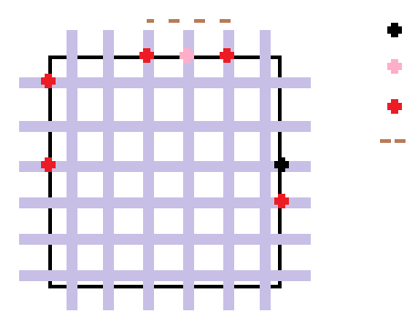
Dealing with Constraints (2)
Legal Aim Movement
Swap
Initial
Proposed Legal Aim
Occupied
Pitch

Slide 10
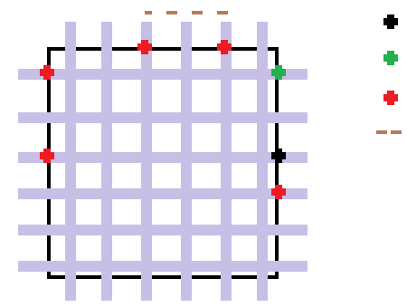
Dealing with Constraints (2)
Legal Aim Movement
Swap
Initial
Final Legal Aim
Occupied
Pitch

Slide 11
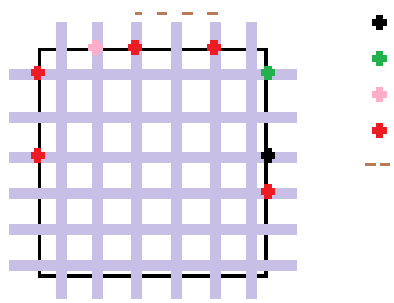
Dealing with Constraints (2)
Legal Aim Movement
Swap
Initial
Final Legal Aim
Proposed Legal Aim
Occupied
Pitch

Slide 12
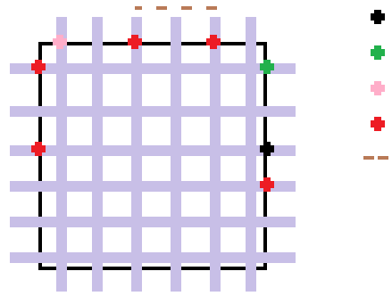
Dealing with Constraints (2)
Legal Aim Movement
Swap
Initial
Final Legal Aim
Proposed Legal Aim
Occupied
Pitch

Slide 13
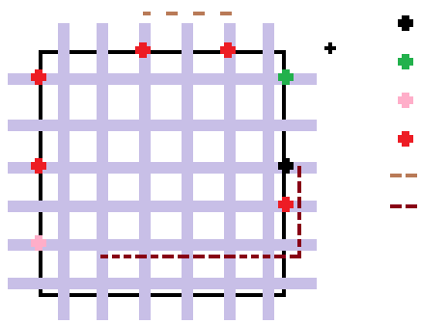
Dealing with Constraints (2)
Legal Aim Movement
Swap
Initial
Final Legal Aim
Proposed Legal Aim
Occupied
Pitch
Perturbation

Slide 14
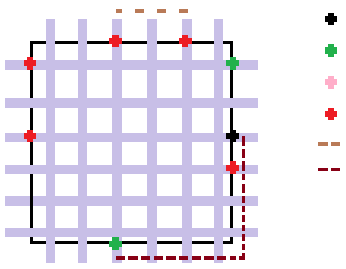
Dealing with Constraints (2)
Legal Aim Movement
Swap
Initial
Final Legal Aim
Proposed Legal Aim
Occupied
Pitch
Perturbation

Slide 15
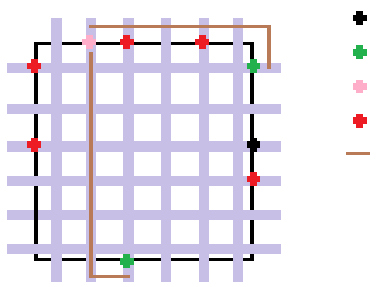
Dealing with Constraints (2)
Legal Aim Movement
Swap
Initial
Final Legal Aim
Proposed Legal Aim
Occupied
Manhattan Distance

Slide 16
Dealing with Constraints (3)
Legal Aim Movement
Swap
1 time swap
2 times swap

Slide 17
Outline
Introduction
Port Algorithm
Dealing with Constraints
Data Structure
Evaluation Results

Slide 18
Data Structure
Net
Pointer to each oaInst and oaTerm connected with this Net
Number of oaInstTerm
Number of oaInst
Pointer Reset Functions
Macro
4 Sides (Left, Right, Top, Bottom)
4 boundary coord (xmin, xmax, ymin, ymax)
4 Legal point along each side
Sides
C++ STL Set

Slide 19
Final Results
Final Scores: 116.522/210
Benchmarks | Connectivity | Micro Placement | System Pin Placement | Pitch | Perturbation
SBOX_X2 | Clear | Clear | Clear | Clear | Clear
SBOX_X2_VERT | Clear | Clear | Clear | Clear | Clear
AES_TOP | Clear | Clear | Clear | Clear | Clear
DES3_PERF_OPT | Clear | Clear | Clear | Clear | Clear
ROCKETTILE_X2 | Clear | Clear | Clear | Clear | Clear
SBOX_X4 | Clear | Clear | Clear | Clear | MAX violated
MIPS_ALU | Clear | Clear | Clear | Clear | MAX violated

