Slide 1
The next generation
Python Software Foundation
What is the PSF ?
Vision
How you can help
Marc-André Lemburg
Director, PSF

Slide 2
What is the PSF ?
People
People from many countries
People with diverse backgrounds
People with diverse skills
People who want to bring
Python forward

Slide 3
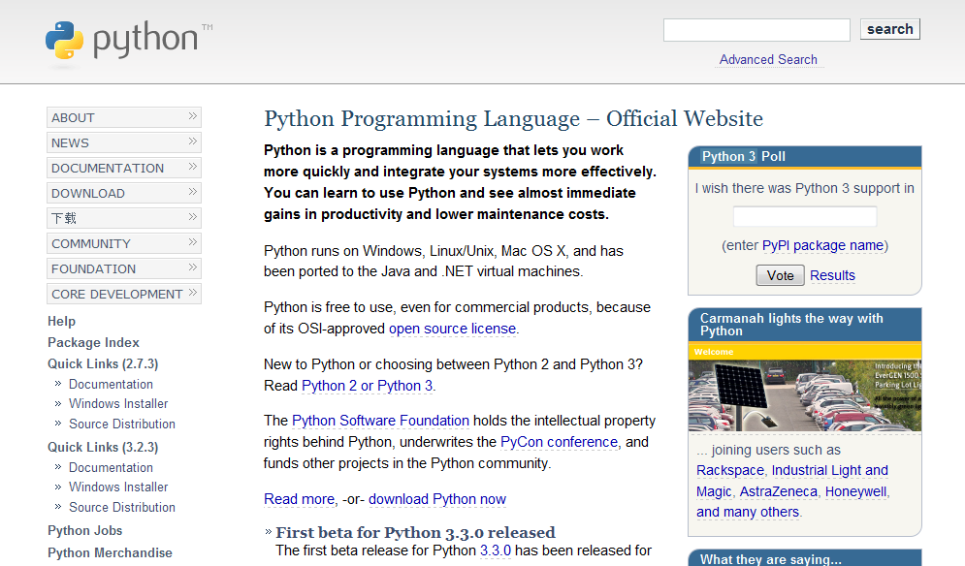
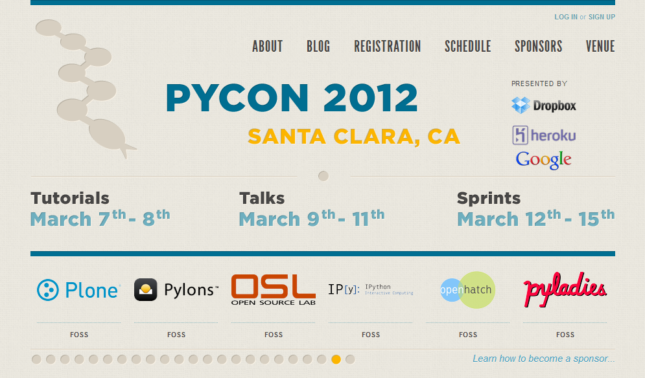
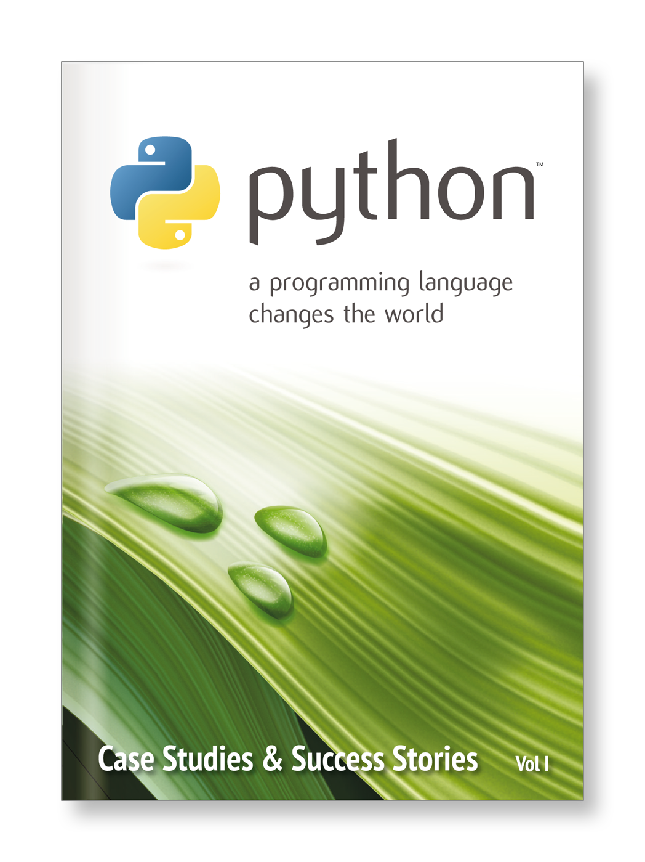
What does the PSF do ?
Protects the IP in Python
Funds conferences & sprints
Funds Python related projects
Runs PSF projects
Helps spread the word about Python

Slide 4
Looks good...
...so where's the problem ?

Slide 5
Need for change
PSF is regarded as closed organization
PSF has problems reaching out to the community
Identity problem:
PSF membership status is difficult to define; lack of interest from the members
(c) 2014 Python Software Foundation, psf@python.org FOSDEM 2014
(c) 2014 Python Software Foundation, psf@python.org FOSDEM 2014
(c) 2014 Python Software Foundation, psf@python.org FOSDEM 2014

Slide 6
Membership size
PSF was founded in 2001:
16 members, 2 sponsor members
June 2012:
204 members, 26 sponsor members
(c) 2014 Python Software Foundation, psf@python.org FOSDEM 2014
(c) 2014 Python Software Foundation, psf@python.org FOSDEM 2014
(c) 2014 Python Software Foundation, psf@python.org FOSDEM 2014

Slide 7
Membership model
2001 – 2014:
Members have to be nominated by other PSF members and then get voted in by the membership (once or twice a year)
Sponsor members can sign up for membership, but also need to be voted in by the membership (once or twice a year)
Result: Very slow membership growth
(c) 2014 Python Software Foundation, psf@python.org FOSDEM 2014
(c) 2014 Python Software Foundation, psf@python.org FOSDEM 2014
(c) 2014 Python Software Foundation, psf@python.org FOSDEM 2014

Slide 8

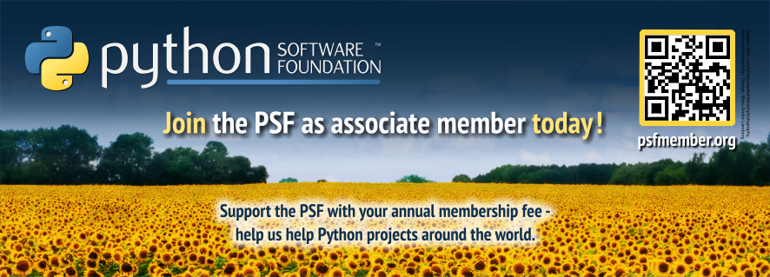

Help us grow !
EuroPython 2012
New PSF Associate Membership
Only USD 99 (EUR 79) per year,
which the PSF will use for funding and running projects
Our Goal:
200 new signups at EuroPython
Visit https://psfmember.org/ or
the PSF booth here at EuroPython

Slide 9
Membership size
PSF was founded in 2001:
16 members, 2 sponsor members
June 2012:
204 members, 26 sponsor members
March 2013:
283 members, 28 sponsor members
Proposal for new membership model
(c) 2014 Python Software Foundation, psf@python.org FOSDEM 2014
(c) 2014 Python Software Foundation, psf@python.org FOSDEM 2014
(c) 2014 Python Software Foundation, psf@python.org FOSDEM 2014

Slide 10
Vision
Extend the reach of the PSF to all Python users
Allow all Python users to call themselves members of the PSF
Turn the PSF into a community organization
Allow members to easily run work groups with access to PSF resources
(c) 2014 Python Software Foundation, psf@python.org FOSDEM 2014
(c) 2014 Python Software Foundation, psf@python.org FOSDEM 2014
(c) 2014 Python Software Foundation, psf@python.org FOSDEM 2014

Slide 11
Vision: Part 1
Extend the reach of the PSF to all Python users
Allow all Python users to call themselves members of the PSF
(c) 2014 Python Software Foundation, psf@python.org FOSDEM 2014
(c) 2014 Python Software Foundation, psf@python.org FOSDEM 2014
(c) 2014 Python Software Foundation, psf@python.org FOSDEM 2014

Slide 12
New membership model
Basic members
Supporting members
Sponsor members
Managing members
Contributing members
Fellows
(c) 2014 Python Software Foundation, psf@python.org FOSDEM 2014
(c) 2014 Python Software Foundation, psf@python.org FOSDEM 2014
(c) 2014 Python Software Foundation, psf@python.org FOSDEM 2014

Slide 13
Basic members
Sign-up via webform
no voting rights
no fees to pay
may attend members meetings
open to anyone, anywhere
(c) 2014 Python Software Foundation, psf@python.org FOSDEM 2014
(c) 2014 Python Software Foundation, psf@python.org FOSDEM 2014
(c) 2014 Python Software Foundation, psf@python.org FOSDEM 2014

Slide 14
Supporting members
Basic membership +
voting rights
yearly fee or lifetime fee
(c) 2014 Python Software Foundation, psf@python.org FOSDEM 2014
(c) 2014 Python Software Foundation, psf@python.org FOSDEM 2014
(c) 2014 Python Software Foundation, psf@python.org FOSDEM 2014

Slide 15
Sponsor members
legal persons only
yearly fee
voting rights via delegates
various sponsor levels
  each with different benefits and number of delegates
voted in by voting members
(c) 2014 Python Software Foundation, psf@python.org FOSDEM 2014
(c) 2014 Python Software Foundation, psf@python.org FOSDEM 2014
(c) 2014 Python Software Foundation, psf@python.org FOSDEM 2014

Slide 16
Managing members
Basic membership +
voting rights
need to sign up to at least one working group and invest at least 5 hours work per month
requirements revisited on a yearly basis; conversion to basic membership in case requirements are no longer met
(c) 2014 Python Software Foundation, psf@python.org FOSDEM 2014
(c) 2014 Python Software Foundation, psf@python.org FOSDEM 2014
(c) 2014 Python Software Foundation, psf@python.org FOSDEM 2014

Slide 17
Contributing members
Basic membership +
voting rights
need to invest at least 5 hours work per month contributing to (Python related) open-source projects
requirements revisited on a yearly basis; conversion to basic membership in case requirements are no longer met
(c) 2014 Python Software Foundation, psf@python.org FOSDEM 2014
(c) 2014 Python Software Foundation, psf@python.org FOSDEM 2014
(c) 2014 Python Software Foundation, psf@python.org FOSDEM 2014

Slide 18
Fellows
Basic membership +
voting rights
need to be nominated by other Fellows
need to be voted in as Fellow by 2/3 of the voting members
stay Fellow for life
nominated members as-of June 2013 are eligable as Fellows and were given the choice to become Fellows or convert to other membership forms
(c) 2014 Python Software Foundation, psf@python.org FOSDEM 2014
(c) 2014 Python Software Foundation, psf@python.org FOSDEM 2014
(c) 2014 Python Software Foundation, psf@python.org FOSDEM 2014

Slide 19
Voting members
Special group of members:
All members with voting rights,
who have indicated that they want to use this right
Voting rights must be reestablished
each year (via checkbox)
Members lose voting rights for a the remainder of a year in case more than 4 votes are not cast
(c) 2014 Python Software Foundation, psf@python.org FOSDEM 2014
(c) 2014 Python Software Foundation, psf@python.org FOSDEM 2014
(c) 2014 Python Software Foundation, psf@python.org FOSDEM 2014

Slide 20
Voting made easy
Special online voting software
Based on the OSS eVote system developed by Massimo di Pierro and David Mertz:https://github.com/mdipierro/evote
Already used by OSI at
https://elections.opensource.org/
(c) 2014 Python Software Foundation, psf@python.org FOSDEM 2014
(c) 2014 Python Software Foundation, psf@python.org FOSDEM 2014
(c) 2014 Python Software Foundation, psf@python.org FOSDEM 2014

Slide 21
Membership size
PSF was founded in 2002:
16 members, 2 sponsor members
March 2013:
283 members, 28 sponsor members
Proposal for new membership model
June 2013:
Only 157 members signed up as
voting members
(c) 2014 Python Software Foundation, psf@python.org FOSDEM 2014
(c) 2014 Python Software Foundation, psf@python.org FOSDEM 2014
(c) 2014 Python Software Foundation, psf@python.org FOSDEM 2014

Slide 22
Vision: Part 2
Turn the PSF into a community organization
Allow members to easily run work groups with access to PSF resources
(c) 2014 Python Software Foundation, psf@python.org FOSDEM 2014
(c) 2014 Python Software Foundation, psf@python.org FOSDEM 2014
(c) 2014 Python Software Foundation, psf@python.org FOSDEM 2014

Slide 23
Work Groups
Can be proposed by any member
Voted in by voting members or
PSF board
Integration into the PSF defined by work group charta
Can get their own budget
(c) 2014 Python Software Foundation, psf@python.org FOSDEM 2014
(c) 2014 Python Software Foundation, psf@python.org FOSDEM 2014
(c) 2014 Python Software Foundation, psf@python.org FOSDEM 2014

Slide 24
Timeline
June 2013/ Feb 2014:
Bylaws WG working out the membership change details
(https://bitbucket.org/vanl/psf-bylaws/src)
Feb/March 2014:
PSF Board adopts the new bylaws
April 2014:
Start opening up the flood gates :-)
(c) 2014 Python Software Foundation, psf@python.org FOSDEM 2014
(c) 2014 Python Software Foundation, psf@python.org FOSDEM 2014
(c) 2014 Python Software Foundation, psf@python.org FOSDEM 2014

Slide 25
How you can help
Talk to people and provide contacts
Participate in PSF projects
Bring Python forward in your professional setting
Organize local user groups or meetings
… and join the PSF

Slide 26
Contact us
Talk to PSF members
Tell us your ideas
Write an email to
psf@python.org
Visit our website at http://python.org/psf/

Slide 27
Thanks to ...
… all of you for coming to this conference
… the FOSDEM Python DevRoom organizers

