Slide 1
The next generation
Python Software Foundation
What is the PSF ?
Vision
How you can help
Nick Coghlan
Director, PSF

Slide 2
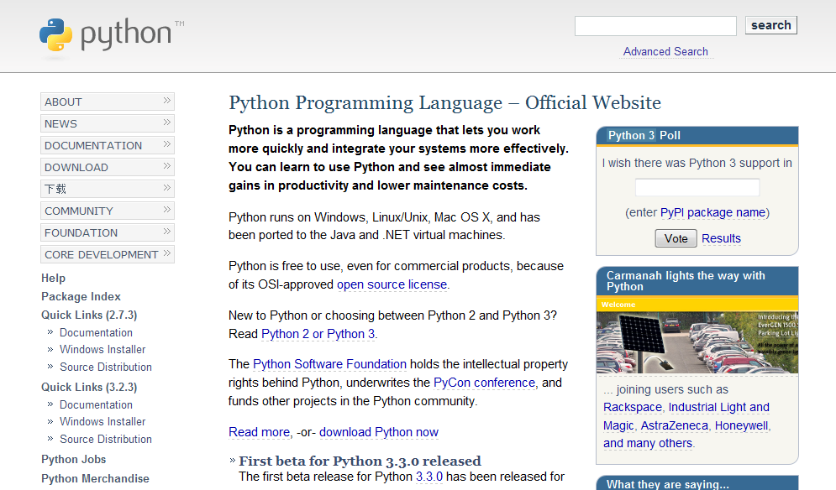
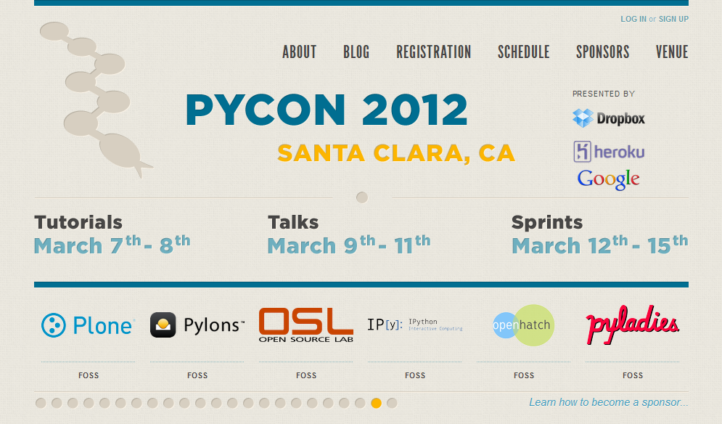
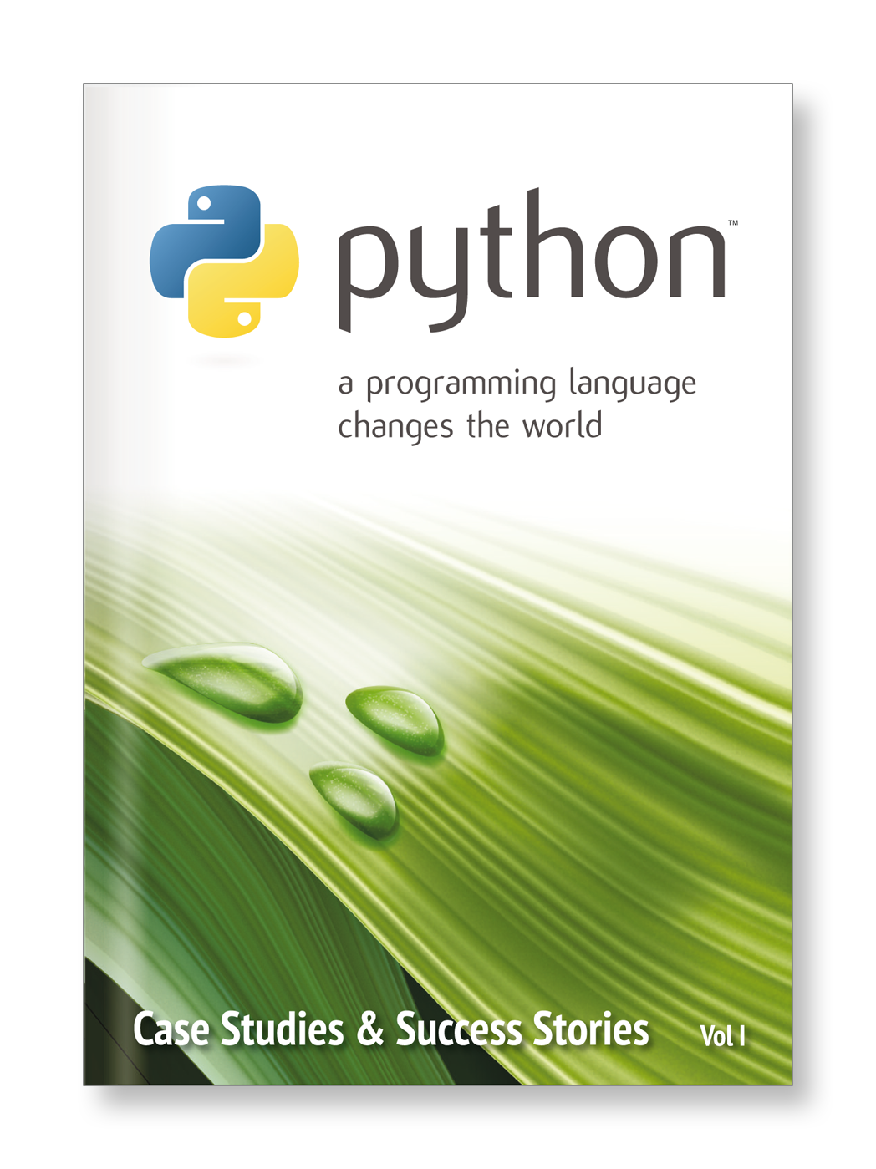
What does the PSF do ?
Protects the IP in Python
Funds conferences & sprints
Funds Python related projects
Runs PSF projects
Helps spread the word about Python

Slide 3
What is the PSF ?
People
People from many countries
People with diverse backgrounds
People with diverse skills
People who want to bring
Python forward

Slide 4
Membership size
PSF was founded in 2001:
16 members, 2 sponsor members
June 2012:
204 members, 26 sponsor members
March 2013:
283 members, 28 sponsor members
Proposal for new membership model
(c) 2014 Python Software Foundation, psf@python.org FOSDEM 2014
(c) 2014 Python Software Foundation, psf@python.org FOSDEM 2014
(c) 2014 Python Software Foundation, psf@python.org FOSDEM 2014

Slide 5
Vision
Extend the reach of the PSF to all Python users
Allow all Python users to call themselves members of the PSF
Turn the PSF into a community organization
Allow members to easily run work groups with access to PSF resources
(c) 2014 Python Software Foundation, psf@python.org FOSDEM 2014
(c) 2014 Python Software Foundation, psf@python.org FOSDEM 2014
(c) 2014 Python Software Foundation, psf@python.org FOSDEM 2014

Slide 6
Vision: Part 1
Extend the reach of the PSF to all Python users
Allow all Python users to call themselves members of the PSF
(c) 2014 Python Software Foundation, psf@python.org FOSDEM 2014
(c) 2014 Python Software Foundation, psf@python.org FOSDEM 2014
(c) 2014 Python Software Foundation, psf@python.org FOSDEM 2014

Slide 7
New membership model
Basic members
Supporting members
Sponsor members
Managing members
Contributing members
Fellows
(c) 2014 Python Software Foundation, psf@python.org FOSDEM 2014
(c) 2014 Python Software Foundation, psf@python.org FOSDEM 2014
(c) 2014 Python Software Foundation, psf@python.org FOSDEM 2014

Slide 8
Basic members
Sign-up via webform
no voting rights
no fees to pay
may attend members meetings
open to anyone, anywhere
(c) 2014 Python Software Foundation, psf@python.org FOSDEM 2014
(c) 2014 Python Software Foundation, psf@python.org FOSDEM 2014
(c) 2014 Python Software Foundation, psf@python.org FOSDEM 2014

Slide 9
Voting members
Special group of members:
All members with voting rights,
who have indicated that they want to use this right
Voting rights must be reestablished
each year (via checkbox)
Members lose voting rights for a the remainder of a year in case more than 4 votes are not cast
(c) 2014 Python Software Foundation, psf@python.org FOSDEM 2014
(c) 2014 Python Software Foundation, psf@python.org FOSDEM 2014
(c) 2014 Python Software Foundation, psf@python.org FOSDEM 2014

Slide 10
Vision: Part 2
Turn the PSF into a community organization
Allow members to easily run work groups with access to PSF resources
(c) 2014 Python Software Foundation, psf@python.org FOSDEM 2014
(c) 2014 Python Software Foundation, psf@python.org FOSDEM 2014
(c) 2014 Python Software Foundation, psf@python.org FOSDEM 2014

Slide 11
Work Groups
Can be proposed by any member
Voted in by voting members or
PSF board
Integration into the PSF defined by work group charta
Can get their own budget
(c) 2014 Python Software Foundation, psf@python.org FOSDEM 2014
(c) 2014 Python Software Foundation, psf@python.org FOSDEM 2014
(c) 2014 Python Software Foundation, psf@python.org FOSDEM 2014

Slide 12
How you can help
Talk to people and provide contacts
Participate in PSF projects
Bring Python forward in your professional setting
Organize local user groups or meetings
… and join the PSF

Slide 13
Contact us
Talk to PSF members
Tell us your ideas
Write an email to
psf@python.org
Visit our website at http://python.org/psf/

Slide 14
Thanks to ...
… all of you for coming to this conference
… the PyCon AU organizers
... Red Hat, for donating their sponsor talk slot

