Slide 1
Python is faster then assembler
HaraldArminMassa@gmail.com
a BLITZ talk @ europython 2006

Slide 2
really.

Slide 3

how can you say this,
when Python comes out
second more often
then not in
http://shootout.alioth.debian.org/

Slide 4
fast = speed()

Slide 5
speed = v
v= s/t
s = distance
t = time

Slide 6
which „distance“?
between
more then one,
typically two points
in time

Slide 7
so, which points in time?

Slide 8
t1: knowing 0 prime numbers
t2: knowing a zillion prime numbers

Slide 9
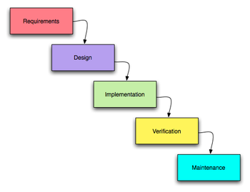

Slide 10
completely
specified
system
unlimited
bandwith
unlimeted
I/O

Slide 11
1. you are dreaming
2. it's a test
3. you are within The Matrix(tm)

Slide 12
t1: a business idea
t2: process is implemented,
revenue is generated

Slide 13

Python shines here

Slide 14
start early
maintain with ease
learn the language
quick

Slide 15
throw-away coding
organic-growth
software

Slide 16
t1: a business idea
t2: process is implemented,
revenue is generated

