Slide 1
publications.cta.int
Arthur de Jong
West Consulting B.V.

Slide 2
West Consulting
Customised solutions
Web enabling business-critical IT systems
On time and within budget
25 years experience
Large customers
Using Django since 2006
Notes:
Using Django for few years.
Platform of choice.

Slide 3
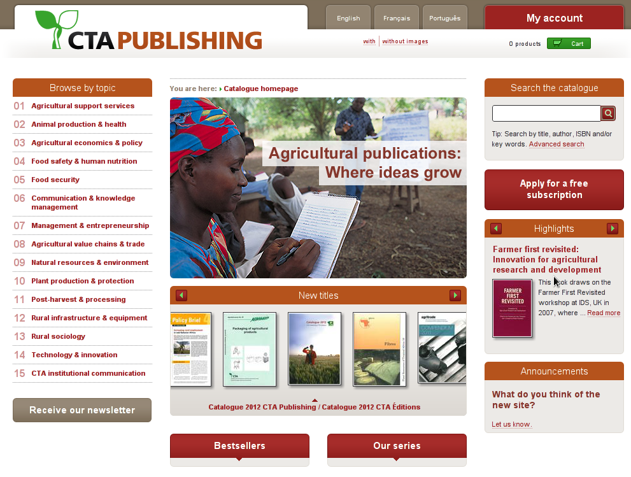

Slide 4
Challenges
Multi-lingual
Migrating from MS Access
CSV exports
Complex business logic
Unit tests
54,706 subscribers
8,474 publications ordered per month
2.7 M objects in the DB
Notes:
Django 1.4 would have been nice.
Keep database consistent.

Slide 5
publications.cta.int
Debian 6.0 squeeze i386
Python 2.6
MySQL 5.1
Django 1.3
Apache Solr 1.4.1
pysolr-2.0.15
django-haystack 1.2.7
django-ajax-selects 1.1.4
django-modeltranslation 0.3.2
python-stdnum 0.5
django-sharer
WebTest 1.2.3
django-webtest 1.4.1
django-tinymce 1.5.1a2
pisa 3.0.32
xlrd 0.6.1
session-cart
a few djangosnippets

Slide 6
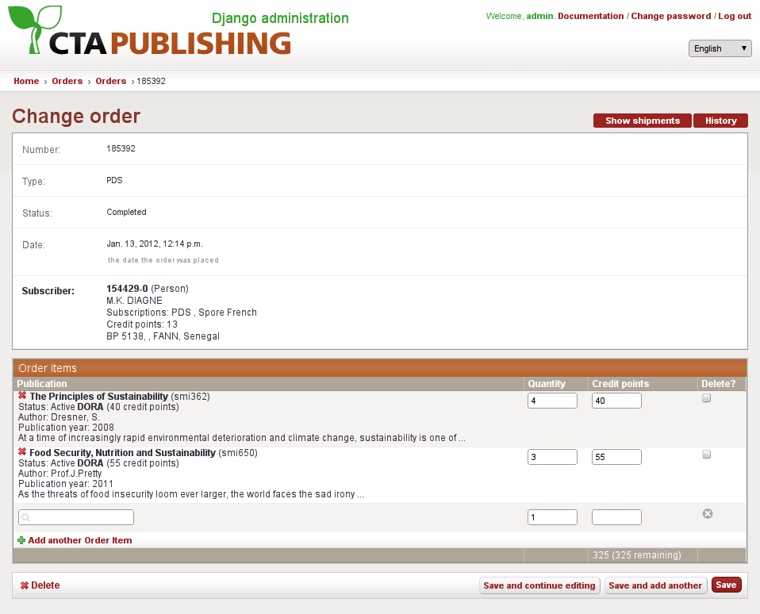

Slide 7
Admin interface
Restyling is not difficult
Added functionality:
  Selecting complex entities (find a subscriber, select address)
  Pseudo fuzzy search
  Mangling auto-generated forms

Slide 8
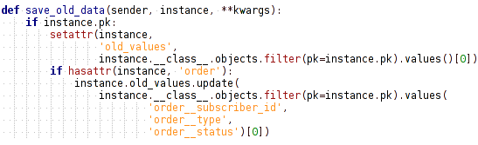
Signal handling trick

Slide 9
Lessons learnt
Generic relations don’t perform
Custom SQL is not hard (but don’t do it too early)
django-ajax-select has limitations
Solr is cool
Customising the admin interface can be tricky

