Slide 1
Introduction to SQL
Construct and Execute Powerful Queries

Slide 2
What is SQL?
Pronounced SQL or sequel
Stands for Structured Query Language
Manage data in a Relational Database Management System (RDBMS)
Developed by IBM (System R) in the 1970s
Standard language: SQL-86, SQL-89, SQL-92, SQL-99, SQL:2003, SQL:2006, SQL:2008, SQL:2011
Many RDBMSs:
PostgresSQL
SQLite
Microsoft SQL Sever
Oracle 12g
IBM DB2
MySQL
Amazon Redshift
… and many many more

Slide 3
Why SQL?
Why RDBMSs?
DATA
A LOT OF DATA
WE WANT A LOT FROM DATA

Slide 4


Example // Researchers
Present Results
90%
50%
0%
SQL
Results
Run analysis
Interesting Datasets
and Analysis Results
SQL
Results

Slide 5
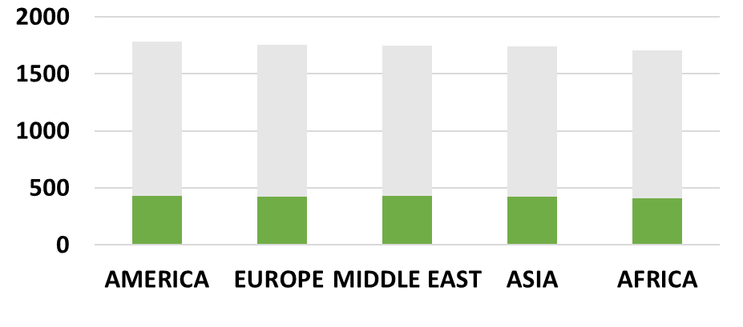
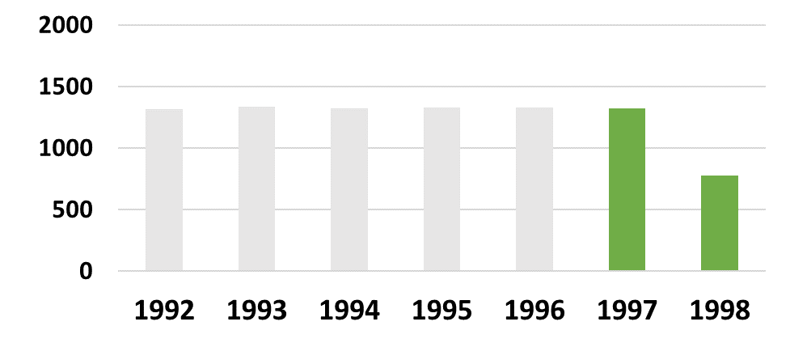


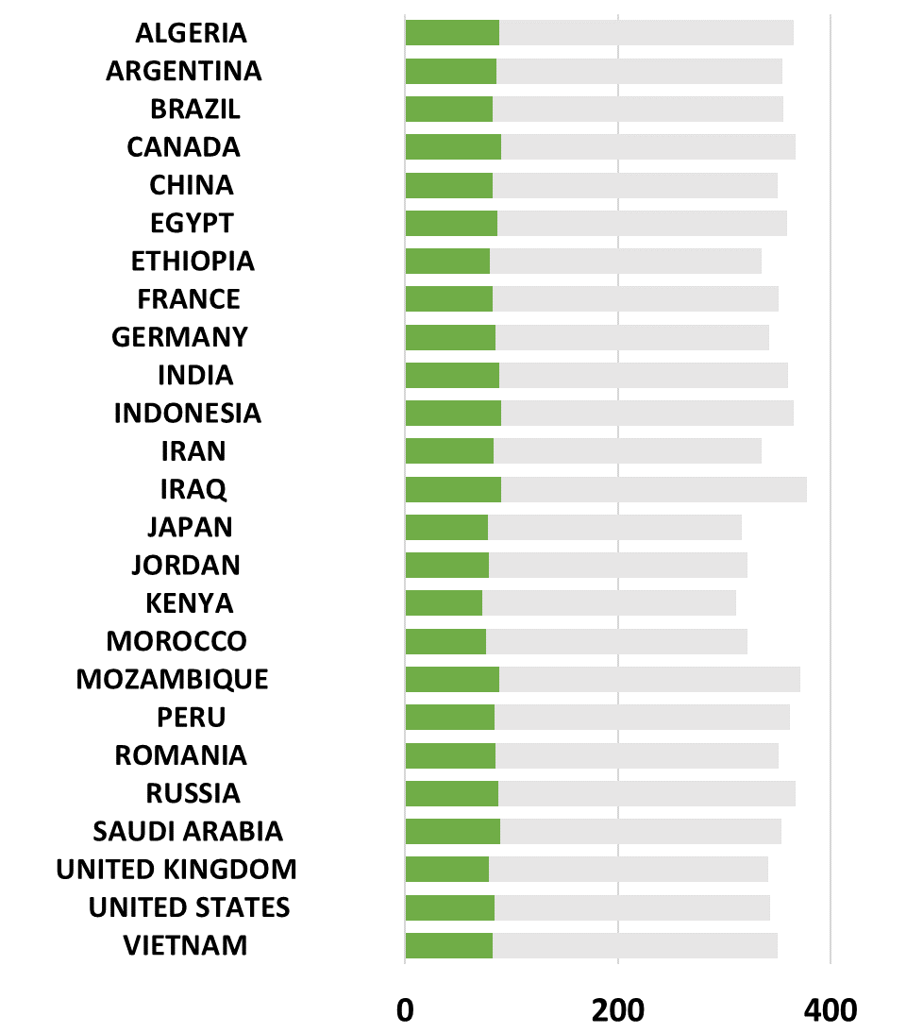
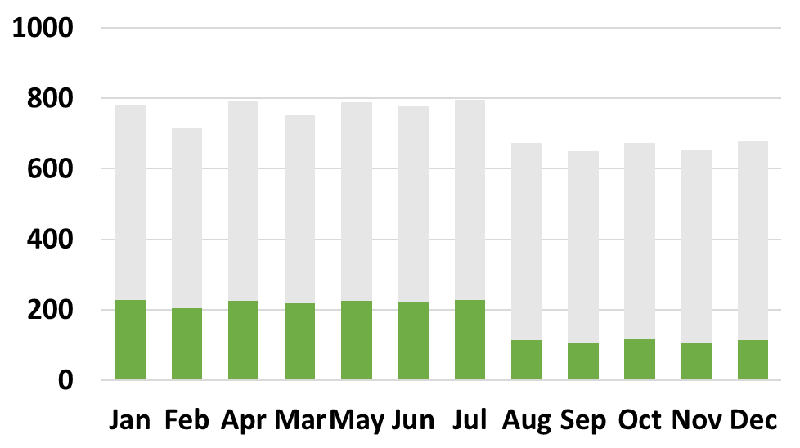
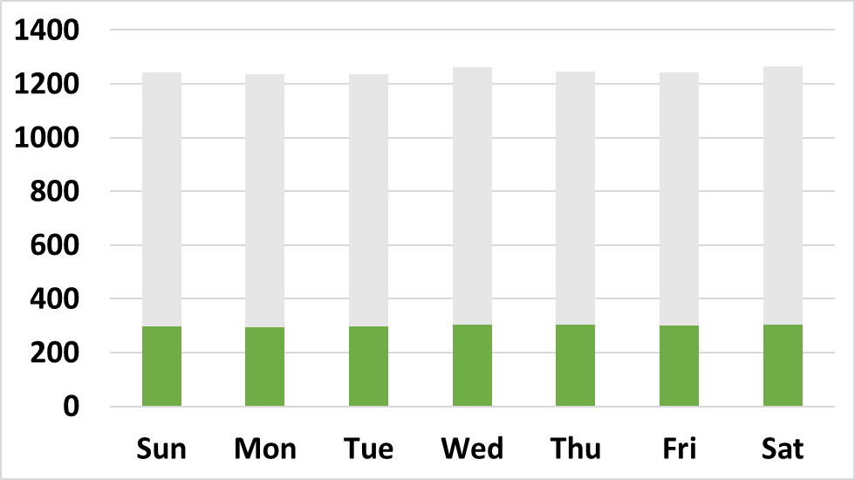
Example // Customers and Analysts
Analysts observe the revenue
breakdown on interactive dashboards
Customers Buy
Products Online
2011 2012 2013 2014 2015 2016 2017
SQL
Results
Sales
SQL
Results

Slide 6
… and many many more examples
Database Applications:
Social networks: posts, comments, likes, videos, and images
Experiments: interesting datasets, complicated analysis, and results
Universities: registration, and grades
Human resources: employee records, salaries, and tax deductions
Airlines: reservations and schedules
Sales: customers, products, and purchases
Online retailers: order tracking and customized recommendations
Manufacturing: production, inventory, orders, supply chain
Databases can be very large
Databases touch all aspects of our lives

Slide 7


If not RDBMS and SQL, then what?
Data Management
&
Analysis Programs
Interesting Dataset
Analysis Results
Folder: A
Folder: A/B
Folder: A/C

Slide 8

If not RDBMS and SQL, then what?
Section 6. Experiments
We conducted our experiments using ? YouTube videos from the Youtube-8M dataset published between ? and ?. For our classification task we used ? classification algorithms: ?. As shown in Figure 1., the accuracy of ? was ? …
90%
50%
0%
? ? ?
Folder: A
Folder: A/B
Folder: A/C

Slide 9
If not RDBMS and SQL, then what?
Data Management
&
Analysis Programs
Interesting Dataset
Analysis Results
Increase the dataset size
Analysis Collapses
Change the dataset format
or task
Waste time writing
new programs
NO ACTUAL RESULTS
What if multiple people want
to access/update the same
dataset?
Waste time trying to
support concurrent access
(or making phone calls to your
teammates)

Slide 10
Instead…
Section 6. Experiments
We conducted our experiments using ? YouTube videos from the Youtube-8M dataset published between ? and ?. For our classification task we used ? classification algorithms: ?. As shown in Figure 1., the accuracy of ? was ? …
90%
50%
0%
SQL
RESULTS
Interesting Datasets
and Analysis Results
SQL
Actual Analysis
Programs
RESULTS

Slide 11
Key Concepts
A DBMS lets you store and manage your data
An RDBMS lets you
store your data under the relational data model and
manage your data with SQL
Key idea behind RDBMSs and SQL
you don’t say how to do something (e.g., as with Java, Python, R, or…)
you say what you want
it’s up to the RDBMS to find how to do what you want

Slide 12
RELATIONAL MODEL

Slide 13
RELATIONS
SCHEMA
INSTANCE

Slide 14
Example of a Relation Schema
domains
(or types)
students(uni int, name string, surname string, GPA real)
relation name
(or table name)
attributes
(or columns or fields)

Slide 15
Example of a Relation Instance
students(uni int, name string, surname string, GPA real)
uni | name | surname | GPA
13578 | Albert | Euler | 4.2
38990 | Leonhard | Einstein | 3.9
34095 | Blaise | Gauss | 4.1
15400 | Carl | Pascal | 3.2
23843 | Alan | Hilbert | 3.6
72323 | David | Turing | 3.8

Slide 16
KEYS AND CONSTRAINTS
Key: attributes whose value uniquely identify each record in a relation
There may be multiple keys
students(uni, name, surname, GPA)
students(uni, name, surname, GPA)
Primary Key: one of the keys that we designate as primary for the relation
Typically used by the RDBMS to store or index the relation
Foreign Key: attribute of a relation that refers to a primary key of a relation
students(uni, name, surname, GPA)
enrolled(uni, course_id, grade)

Slide 17
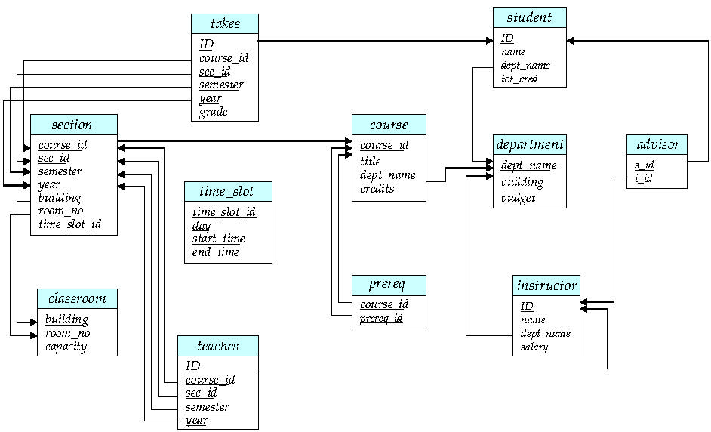
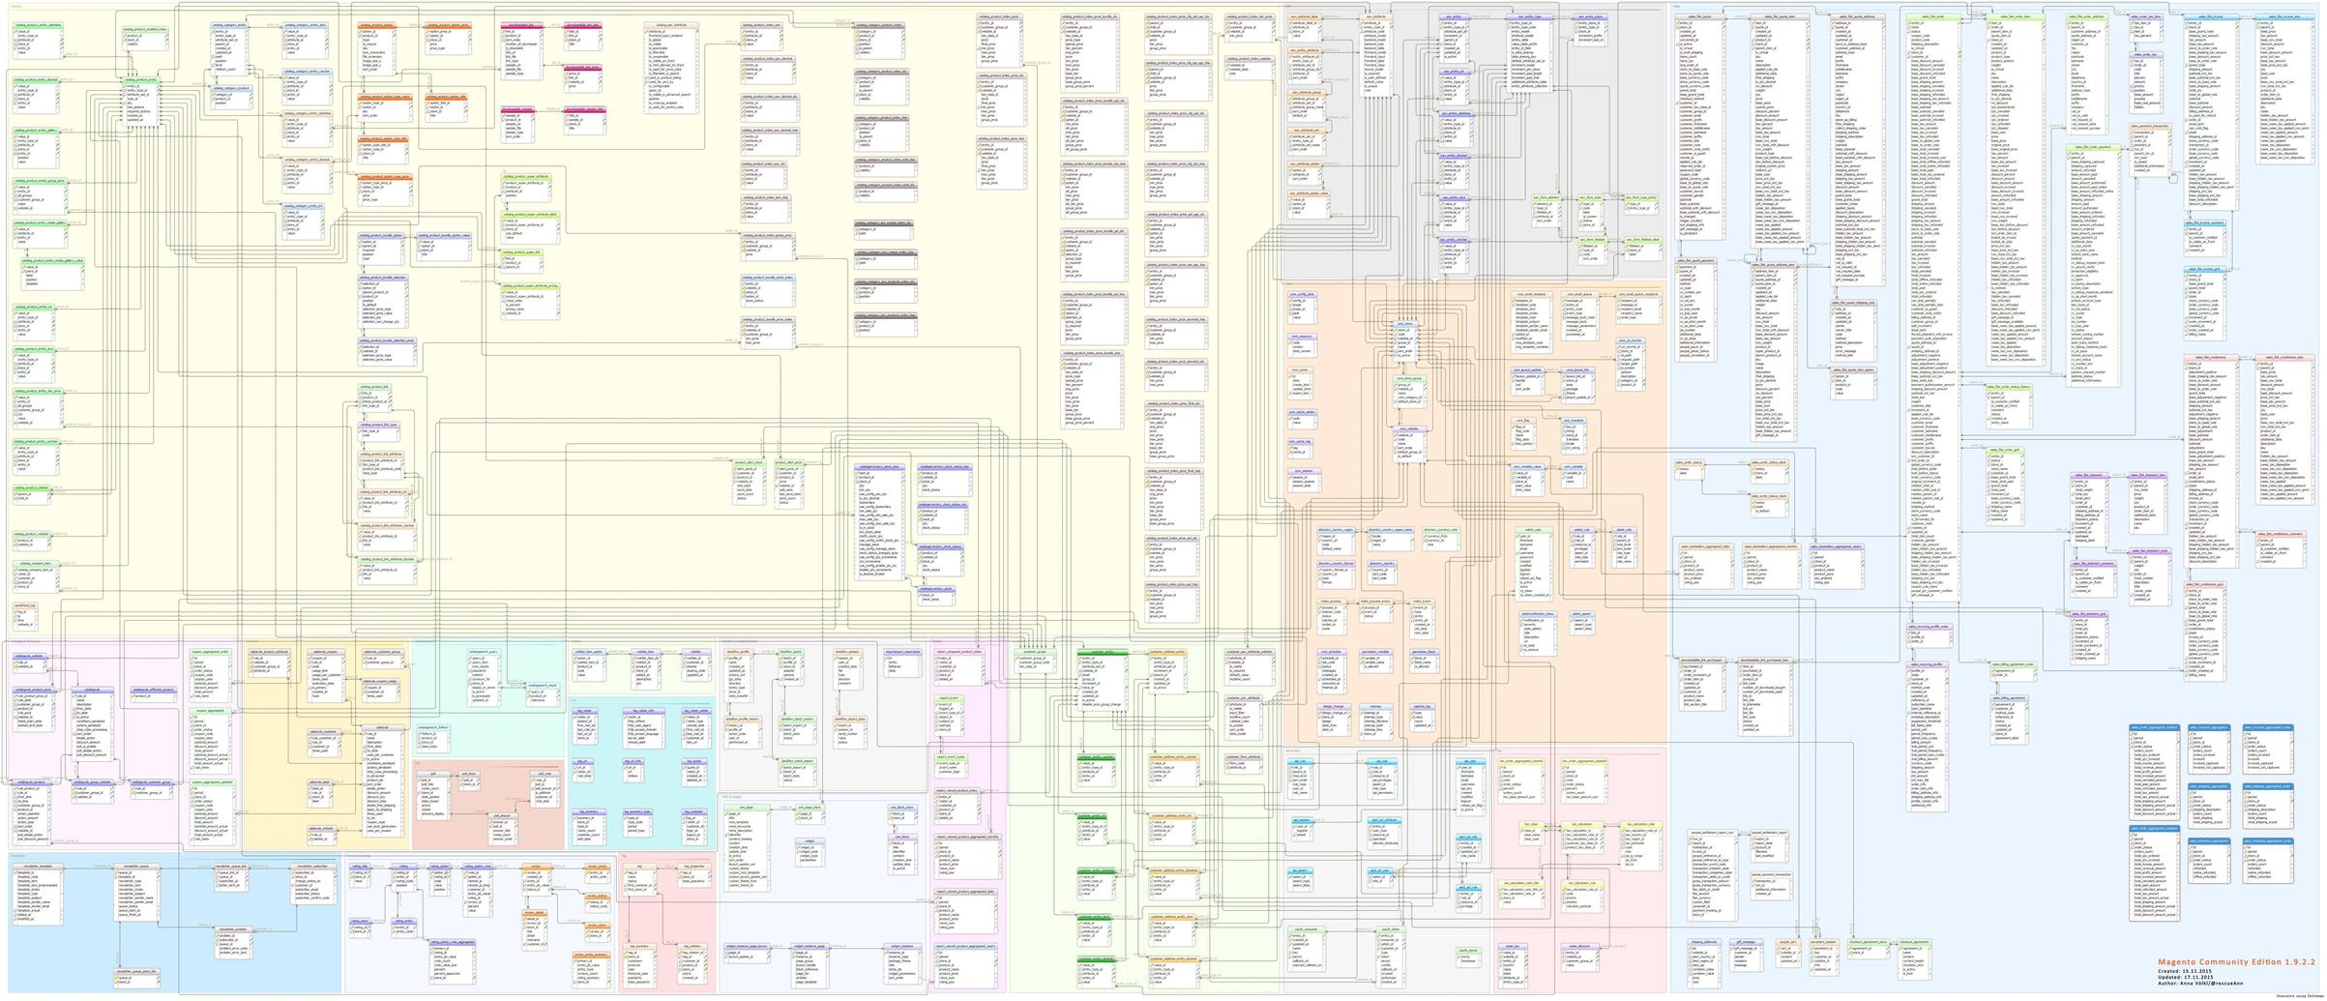
Database Schema – Database Instance
Database schema: The collection of all relation schemas
Database instance: The collection of relation instances
Moderate complexity
High complexity

Slide 18
Introduction to
SQL

Slide 19
CREATE TABLES IN SQL
CREATE TABLE students(
uni INTEGER,
name CHAR(20),
surname CHAR(40),
GPA REAL,
PRIMARY KEY uni);
CREATE TABLE course(
course_id INTEGER,
title CHAR(20),
description CHAR(40),
PRIMARY KEY course_id);
.
CREATE TABLE enrolled(
uni INTEGER REFERENCES students(uni),
course_id INTEGER REFERENCES course(course_id),
grade REAL,
PRIMARY KEY (uni, course_id)
);

Slide 20
POPULATE TABLES USING SQL
INSERT INTO students(uni, name, surname, GPA)
VALUES (13578, ‘Albert’, ‘Euler’, 4.2)
uni | name | surname | GPA
13578 | Albert | Euler | 4.2
uni | name | surname | GPA
13578 | Albert | Euler | 4.2
38990 | Leonhard | Einstein | 4.3
Notes:
ADD 38990 Leonhard Einstein 4.3

Slide 21
UPDATE AND DELETE
UPDATE students set GPA= 4.1
WHERE uni = 13758
uni | name | surname | GPA
13578 | Albert | Euler | 4.2 4.1
DELETE FROM students
WHERE uni = 13758
uni | name | surname | GPA
13578 | Albert | Euler | 4.1
Notes:
ADD 38990 Leonhard Einstein 4.3

Slide 22
BASIC SQL QUERY STRUCTURE
columns we want, or
constants or expressions we want
SELECT [DISTINCT] a1, …, aN
FROM r1, …, rM
WHERE qualification
tables we want
computes cross product of tables
rows we want
qualification: AND, OR, and NOT of conditions
conditions: (a1 OP a2) or (a1 OP constant)
operators:
=, !=, >, <, <=, >=
LIKE
… and many more

Slide 23
EVALUATION MNEMONIC
Compute cross product of relations in the FROM clause
Keep only rows that qualify based on the WHERE clause
Keep only columns necessary in the SELECT clause
If there is a DISTINCT, remove duplicate rows
SELECT [DISTINCT] a1, …, aN
FROM r1, …, rM
WHERE qualification

Slide 24
Find the uni, name, and surname of all students.
Find the uni, name, surname, and GPA of all students.
SELECT uni,name,surname FROM students
,GPA
uni | name | surname | GPA
13578 | Albert | Euler | 4.2
38990 | Leonhard | Einstein | 4.3
34095 | Blaise | Gauss | 4.1
15400 | Carl | Pascal | 3.2
23843 | Alan | Hilbert | 3.6
72323 | David | Turing | 3.8
uni | name | surname
13578 | Albert | Euler
38990 | Leonhard | Einstein
34095 | Blaise | Gauss
15400 | Carl | Pascal
23843 | Alan | Hilbert
72323 | David | Turing

Slide 25
Find the uni, name, surname, and GPA of all students.
SELECT * -- project all columns
FROM students
uni | name | surname | GPA
13578 | Albert | Euler | 4.2
38990 | Leonhard | Einstein | 4.3
34095 | Blaise | Gauss | 4.1
15400 | Carl | Pascal | 3.2
23843 | Alan | Hilbert | 3.6
72323 | David | Turing | 3.8
uni | name | surname
13578 | Albert | Euler
38990 | Leonhard | Einstein
34095 | Blaise | Gauss
15400 | Carl | Pascal
23843 | Alan | Hilbert
72323 | David | Turing

Slide 26
Find students with GPA greater than 4.1
SELECT *
FROM students
WHERE GPA > 4.1
uni | name | surname | GPA
13578 | Albert | Euler | 4.2
38990 | Leonhard | Einstein | 4.3
34095 | Blaise | Gauss | 4.1
15400 | Carl | Pascal | 3.2
23843 | Alan | Hilbert | 3.6
72323 | David | Turing | 3.8

Slide 27
Find students with GPA greater than 4.1 and name Leonhard.
SELECT *
FROM students
WHERE GPA > 4.1 AND
name = ‘Leonhard’
uni | name | surname | GPA
13578 | Albert | Euler | 4.2
38990 | Leonhard | Einstein | 4.3
34095 | Blaise | Gauss | 4.1
15400 | Carl | Pascal | 3.2
23843 | Alan | Hilbert | 3.6
72323 | David | Turing | 3.8

Slide 28
Find students with GPA greater than 3. Account only for students with name Leonhard or surname Hilbert.
SELECT *
FROM students
WHERE GPA > 3. AND
(
name = ‘Leonhard’
OR
surname = ‘Hilbert’
)
uni | name | surname | GPA
13578 | Albert | Euler | 4.2
38990 | Leonhard | Einstein | 4.3
34095 | Blaise | Gauss | 4.1
15400 | Carl | Pascal | 3.2
23843 | Alan | Hilbert | 3.6
72323 | David | Turing | 3.8

Slide 29
Find students whose name starts with ‘Al’.
SELECT *
FROM students
WHERE name LIKE ‘Al%’
uni | name | surname | GPA
13578 | Albert | Euler | 4.2
38990 | Leonhard | Einstein | 4.3
34095 | Blaise | Gauss | 4.1
15400 | Carl | Pascal | 3.2
23843 | Alan | Hilbert | 3.6
72323 | David | Turing | 3.8
Other examples:
name LIKE ‘%hard’
surname LIKE ‘%a_’

Slide 30
EXPRESSIONS AND FUNCTIONS
SELECT CONCAT(name, surname) AS fname, -- STRING FUNCS
0.8*GPA AS CGPA, -- MATH EXPRS
CEIL(0.8*GPA) AS CCGPA, -- MATH FUNCS
0.8 AS correction -- NO COLUMN
FROM students
fname | CGPA | CCGPA | correction_factor
Albert Euler | 3.36 | 4 | 0.8
Leonhard Einstein | 3.44 | 4 | 0.8
Blaise Gauss | 3.28 | 4 | 0.8
Carl Pascal | 2.56 | 3 | 0.8
Alan Hilbert | 2.88 | 3 | 0.8
David Turing | 3.04 | 4 | 0.8

Slide 31
CROSS PRODUCT
SELECT * FROM students AS S, enrolled AS E
uni | course_id | grade
13578 | 4111 | A+
38990 | 4111 | B
13578 | 6112 | B-
13578 | 4512 | A
38990 | 4512 | B-
uni | name | surname | GPA
13578 | Albert | Euler | 4.2
38990 | Leonhard | Einstein | 4.3
S.uni | name | surname | GPA | E.uni | course_id | grade
13578 | Albert | Euler | 4.2 | 13578 | 4111 | A+
13578 | Albert | Euler | 4.2 | 38990 | 4111 | B
13578 | Albert | Euler | 4.2 | 13578 | 6112 | B-
13578 | Albert | Euler | 4.2 | 13578 | 4512 | A
13578 | Albert | Euler | 4.2 | 38990 | 4512 | B-
38990 | Leonhard | Einstein | 4.3 | 13578 | 4111 | A+
38990 | Leonhard | Einstein | 4.3 | 38990 | 4111 | B
38990 | Leonhard | Einstein | 4.3 | 13578 | 6112 | B-
38990 | Leonhard | Einstein | 4.3 | 13578 | 4512 | A
38990 | Leonhard | Einstein | 4.3 | 38990 | 4512 | B-

Slide 32
JOIN
Find the courses that each student has enrolled in.
SELECT S.uni, name, surname, course_id
FROM students AS S, enrolled AS E
WHERE S.uni = E.uni -- JOIN CONDITION
S.uni | name | surname | course_id
13578 | Albert | Euler | 4111
13578 | Albert | Euler | 6112
13578 | Albert | Euler | 4512
38990 | Leonhard | Einstein | 4111
38990 | Leonhard | Einstein | 4512
S.uni | name | surname | GPA | E.uni | course_id | grade
13578 | Albert | Euler | 4.2 | 13578 | 4111 | A+
13578 | Albert | Euler | 4.2 | 38990 | 4111 | B
13578 | Albert | Euler | 4.2 | 13578 | 6112 | B-
13578 | Albert | Euler | 4.2 | 13578 | 4512 | A
13578 | Albert | Euler | 4.2 | 38990 | 4512 | B-
38990 | Leonhard | Einstein | 4.3 | 13578 | 4111 | A+
38990 | Leonhard | Einstein | 4.3 | 38990 | 4111 | B
38990 | Leonhard | Einstein | 4.3 | 13578 | 6112 | B-
38990 | Leonhard | Einstein | 4.3 | 13578 | 4512 | A
38990 | Leonhard | Einstein | 4.3 | 38990 | 4512 | B-
S.uni | name | surname | GPA | E.uni | course_id | grade
13578 | Albert | Euler | 4.2 | 13578 | 4111 | A+
13578 | Albert | Euler | 4.2 | 13578 | 6112 | B-
13578 | Albert | Euler | 4.2 | 13578 | 4512 | A
38990 | Leonhard | Einstein | 4.3 | 38990 | 4111 | B
38990 | Leonhard | Einstein | 4.3 | 13578 | 4512 | A

Slide 33
JOIN
Find the students that have enrolled to course 4111.
SELECT S.uni, name, surname, course_id
FROM students AS S, enrolled AS E
WHERE S.uni = E.uni AND course_id = 4111
S.uni | name | surname | course_id
13578 | Albert | Euler | 4111
13578 | Albert | Euler | 6112
13578 | Albert | Euler | 4512
38990 | Leonhard | Einstein | 4111
38990 | Leonhard | Einstein | 4512

Slide 34
JOIN
Compare the GPA of user 13578 to every other student.
SELECT S1.uni, S2.uni, S1.GPA, S2.GPA, S1.GPA > S2.GPA
FROM students AS S1, students AS S2
WHERE S1.uni = 13758 AND S1.uni != S2.uni
S1.uni | S2.uni | S1.GPA | S2.GPA | S1.GPA > S2.GPA
13578 | 38990 | 4.2 | 4.3 | FALSE
13578 | 34095 | 4.2 | 4.1 | TRUE
13578 | 15400 | 4.2 | 3.2 | TRUE
13758 | 23843 | 4.2 | 3.6 | TRUE
13758 | 72323 | 4.2 | 3.8 | TRUE

Slide 35
UNION, EXCEPT, and INTERSECT
Find students who have enrolled to 4111 or 6112
SELECT S.uni
FROM students AS S, enrolled AS E
WHERE S.uni = E.uni AND course_id = 4111
UNION
SELECT S.uni
FROM students AS S, enrolled AS E
WHERE S.uni = E.uni AND course_id = 6112

Slide 36
UNION, EXCEPT, and INTERSECT
Find students who have enrolled to 4111 and 6112
SELECT S.uni
FROM students AS S, enrolled AS E
WHERE S.uni = E.uni AND course_id = 4111
INTERSECT
SELECT S.uni
FROM students AS S, enrolled AS E
WHERE S.uni = E.uni AND course_id = 6112

Slide 37
UNION, EXCEPT, and INTERSECT
Find students who have enrolled to 4111 but not 6112
SELECT S.uni
FROM students AS S, enrolled AS E
WHERE S.uni = E.uni AND course_id = 4111
EXCEPT
SELECT S.uni
FROM students AS S, enrolled AS E
WHERE S.uni = E.uni AND course_id = 6112

Slide 38
NESTED QUERIES
A powerful feature of SQL:
a WHERE clause can contain a query
so does the FROM clause
so does the HAVING clause (as we will see)

Slide 39
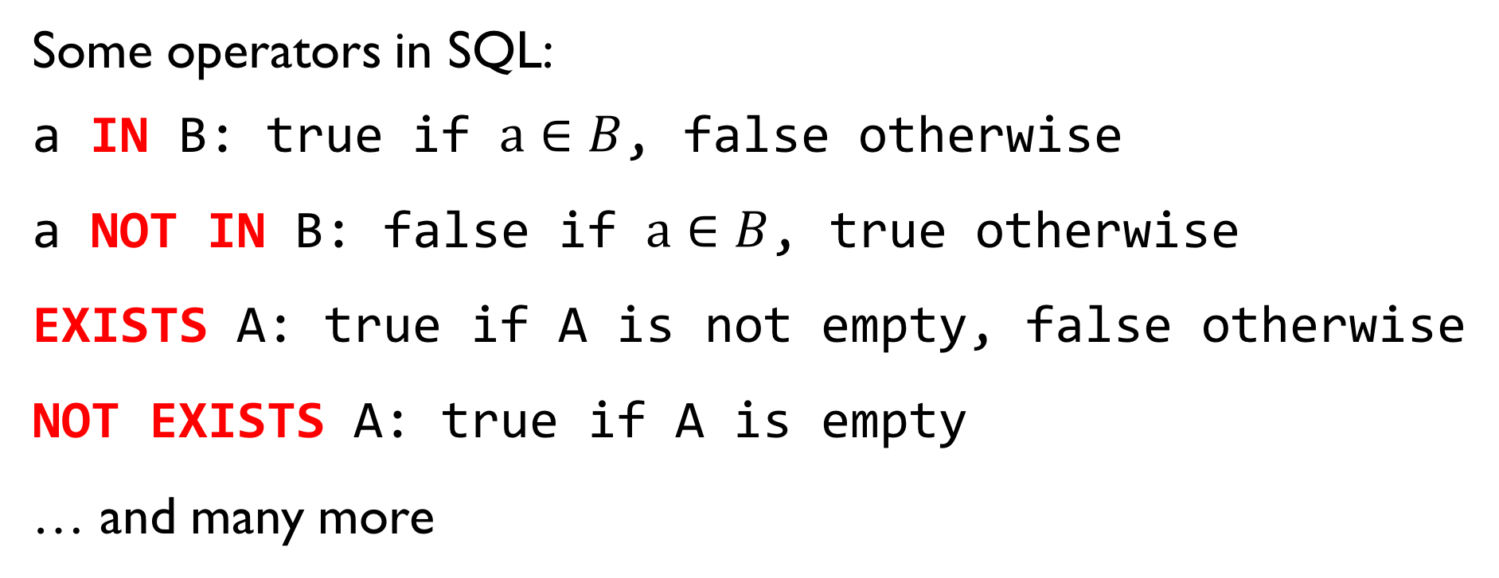
NESTED QUERIES
Some operators in SQL:
a IN B: true if $a∈B$, false otherwise
a NOT IN B: false if $a∈B$, true otherwise
EXISTS A: true if A is not empty, false otherwise
NOT EXISTS A: true if A is empty
… and many more

Slide 40
NESTED QUERIES
Find students that have not enrolled to course 4111.
SELECT *
FROM students AS S
WHERE S.uni NOT IN (
SELECT E.uni
FROM enrolled
WHERE course_id = 4111
)

Slide 41
NESTED QUERIES
Find students that have enrolled to course 4111.
SELECT *
FROM students AS S
WHERE EXISTS (
SELECT *
FROM enrolled AS E
WHERE course_id = 4111 AND
S.uni = E.uni
)

Slide 42
ORDER BY and LIMIT
Order students by descending GPA.
SELECT *
FROM students
ORDER BY GPA DESC
uni | name | surname | GPA
13578 | Albert | Euler | 4.2
38990 | Leonhard | Einstein | 4.3
34095 | Blaise | Gauss | 4.1
15400 | Carl | Pascal | 3.2
23843 | Alan | Hilbert | 3.6
72323 | David | Turing | 3.8
uni | name | surname | GPA
38990 | Leonhard | Einstein | 4.3
13578 | Albert | Euler | 4.2
34095 | Blaise | Gauss | 4.1
72323 | David | Turing | 3.8
23843 | Alan | Hilbert | 3.6
15400 | Carl | Pascal | 3.2

Slide 43
ORDER BY and LIMIT
Order students by ascending GPA.
SELECT *
FROM students
ORDER BY GPA ASC
uni | name | surname | GPA
13578 | Albert | Euler | 4.2
38990 | Leonhard | Einstein | 4.3
34095 | Blaise | Gauss | 4.1
15400 | Carl | Pascal | 3.2
23843 | Alan | Hilbert | 3.6
72323 | David | Turing | 3.8
uni | name | surname | GPA
15400 | Carl | Pascal | 3.2
23843 | Alan | Hilbert | 3.6
72323 | David | Turing | 3.8
34095 | Blaise | Gauss | 4.1
13578 | Albert | Euler | 4.2
38990 | Leonhard | Einstein | 4.3

Slide 44
ORDER BY and LIMIT
Return only the first 2 students.
SELECT *
FROM students
LIMIT 2
uni | name | surname | GPA
13578 | Albert | Euler | 4.2
38990 | Leonhard | Einstein | 4.3
34095 | Blaise | Gauss | 4.1
15400 | Carl | Pascal | 3.2
23843 | Alan | Hilbert | 3.6
72323 | David | Turing | 3.8

Slide 45
ORDER BY and LIMIT
Order students on descending GPA and return only the first student.
SELECT *
FROM students
ORDER BY GPA DESC
LIMIT 1
uni | name | surname | GPA
38990 | Leonhard | Einstein | 4.3
13578 | Albert | Euler | 4.2
34095 | Blaise | Gauss | 4.1
72323 | David | Turing | 3.8
23843 | Alan | Hilbert | 3.6
15400 | Carl | Pascal | 3.2

Slide 46
AGGREGATE OPERATORS
SELECT COUNT(*)
FROM students
SELECT MIN(GPA)
FROM students
COUNT(*)
COUNT([DISTINCT] A)
SUM([DISTINCT] A)
AVG([DISTINCT] A)
MAX(A)
MIN(A)
SELECT MAX(GPA)
FROM students AS S, enrolled AS E
WHERE S.uni = E.uni AND
course_id = 4111
SELECT *
FROM students
WHERE GPA = (SELECT MAX(GPA)
FROM students)

Slide 47
GROUP BY AGGREGATIONS
Find the number of students per grade in course 4111.
SELECT grade, COUNT(*)
FROM enrolled
WHERE course_id = ‘4111’
GROUP BY grade
uni | course_id | grade
13578 | 4111 | A+
38990 | 4111 | B-
63456 | 4111 | B-
64435 | 4111 | A+
54325 | 4111 | C
grade | COUNT(*)
A+ | 2
B- | 2
C | 1

Slide 48
HAVING
Find the grades for course 4111 that have at least 2 students.
SELECT grade, COUNT(*)
FROM enrolled
WHERE course_id = ‘4111’
GROUP BY grade
HAVING COUNT(*) >= 2
uni | course_id | grade
13578 | 4111 | A+
38990 | 4111 | B-
63456 | 4111 | B-
64435 | 4111 | A+
54325 | 4111 | C
grade | COUNT(*)
A+ | 2
B- | 2

Slide 49
NULL VALUES
Sometimes we know the values for some but not all attributes
A NULL value in SQL means “unknown” or “inapplicable”
Check for NULL:
SELECT uni, surname
FROM students
WHERE surname is NULL
Arithmetic expressions with NULL:
SELECT uni, GPA – 1.0
FROM students
uni | name | surname | GPA
38990 | Leonhard | NULL | 4.3
13578 | Albert | NULL | 4.2
34095 | Blaise | Gauss | NULL
uni | GPA
38990 | 3.3
13578 | 3.2
34095 | NULL

Slide 50
COMPLICATED QUERIES
Find the courses whose number of enrolled students is above the average number of enrolled students across courses. Sort the courses by the number of enrolled students.
SELECT course_id
FROM enrolled AS E, students AS S
WHERE E.uni = S.uni
GROUP BY course_id
HAVING COUNT(*) >= ( SELECT AVG(C.cnt)
FROM (
SELECT COUNT(*) AS cnt
FROM enrolled AS E2, students AS S2
WHERE E2.uni = S2.uni
GROUP BY course_id
) AS C
)
ORDER BY COUNT(*) DESC;

Slide 51
HANDS-ON
SESSION

Slide 52
PLAN A. POSTGRESQL + DBEAVER
Difficult to install but you will be able to execute all queries
PLAN B. SQLITE + DBEAVER
Easy to setup but you will not be able to execute 2/28 queries
PLAN C. NO DATABASE + TEXT EDITOR
You will not be able to run your queries against a database
PLAN D. PEN AND PAPER
If you have no pen and paper let the facilitator know

Slide 53
PLAN A CHECKLIST.
YOU NEED TO HAVE POSTGRES ALREADY INSTALLED AND RUNNING
YOU NEED TO REMEMBER THE USER AND THE PASSWORD THAT YOU CREATED DURING THE INSTALLATION
YOU NEED TO HAVE psql INSTALLED
OPEN TERMINAL AND TYPE
> which psql
if not found then type
> locate psql | grep /bin
If nothing is returned then go to PLAN B.

Slide 54
Download BOTH:
the PostgresSQL dump and
the SQLITE DB
https://psfotis.github.io/sqlseminar/createdb/
SELECT * FROM AIRLINES;
Open the exercises:
https://psfotis.github.io/sqlseminar/exercises/

