Slide 1
Introduction to Mathematical Programming through Python open source tools
Dr. George Dikas Lead Data Scientist, Data Science
07 August 2018

Slide 2
What to expect after today’s training?
What to expect
Read and understand >90% of mathematical programming models you will come across
Be able to code and solve >90% mathematical programming models using python
Have the tools to model >90% of problems that can be modelled as mixed integer linear programs (it takes some practice to actually model the problems ☺)
Have a contact to ask related questions: george.dikas@tesco.com
What NOT to expect
Learn python
Learn all the maths and theory behind mathematical programming
Learn everything about the solver

Slide 3

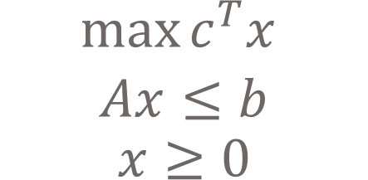
Fundamentals of mathematical programming (1/2)
Basic entities
Combinatorial optimization: consists of finding an optimal solution from a finite set of feasible solution
Objective function: What we are trying to optimize:
Minimize, maximize
Minmax
Lexicographically ordered objectives
Weighted objective function, goal programming
Constraints: Limits or requirements of the systems that must be adhered to absolutely. Comprise a function (left hand side) and a constant value (right hand side)
Decision variables: The unknown variables, which we try to determine based on the objective function and subject to the constraint set
Feasible Solution: A set of values for the decision variables, such that all constraints are met
Optimal/ Best Solution: A feasible solution for which we know that no other feasible solution exists with a better value of the objective function. Note that we may end up with more than one best solutions
Obj. function coefficients
Decision Variables
$$\max{c^{T}x }$$
$$Ax≤b$$
$$x≥0$$
$max$ $c_{1}x_{1}+c_{2}x_{2}+c_{3}x_{3}$
Subject to:
Constraints

Slide 4
Fundamentals of mathematical programming (2/2)
Optimization categories based on the availability and nature of information
Static optimization
All information (i.e. entities, parameter values) are know before solving the problem, and the values of the parameters are deterministic
Dynamic optimization
Information might change during the solution problem or after a solution is produced, e.g. new orders are expected to arrive during the day
Stochastic optimization
The model should address uncertainty in the data. Assumes that (part of) the input is specified in terms of a probability distribution. Data uncertainty examples: stochastic travel times, stochastic demand
Robust optimization
The uncertainty model is not stochastic, but rather deterministic and set-based
The goal is to compute solutions with a priori ensured feasibility when the problem parameters vary within the prescribed uncertainty set

Slide 5
Solution method categories: an overview
Exact methods: Maths, e.g. MILP
Heuristics: A set of rules (usually based on common sense) to create or improve a solution
Constructive, e.g. Best insertion
Local improvement, e.g. 1-Opt, 2-Opt
Metaheuristics: Strategies to utilize heuristic methods to explore the feasibility space. The strategy usually involves:
Ways to create, modify or improve a solution
Ways to jump out of a local minimum
Ways to adapt the procedures to the problem. This is usually called “memory”
Hybrid methods: Combination of exact and metaheuristics methods

Slide 6
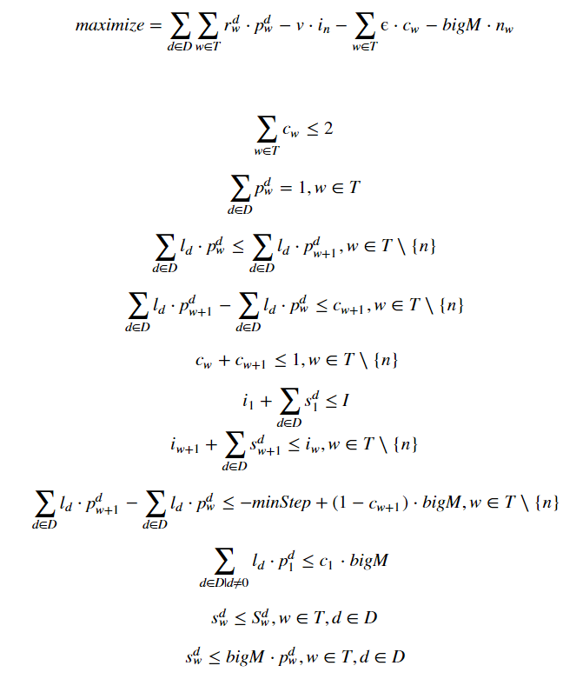
Mathematical Programming applications in Tesco created by the Data Science team
Spacey:
Optimally recommend space for all stores, CFC's and depots across all countries. Trade-off sales and profit to provide maximum business value.
Automated floor planning:
Optimally assign product groups on shelves in stores to improve customer experience
Product placement in CFC picking zones:
Optimally allocate products on shelves in CFC to minimise the distance cover by the pickers
Markdown pricing:
Optimally set the markdown prices for a given period of time to minimise inventory while maximising revenue
Fuel pricing
Fulfilment network optimisation
Subject to:

Slide 7
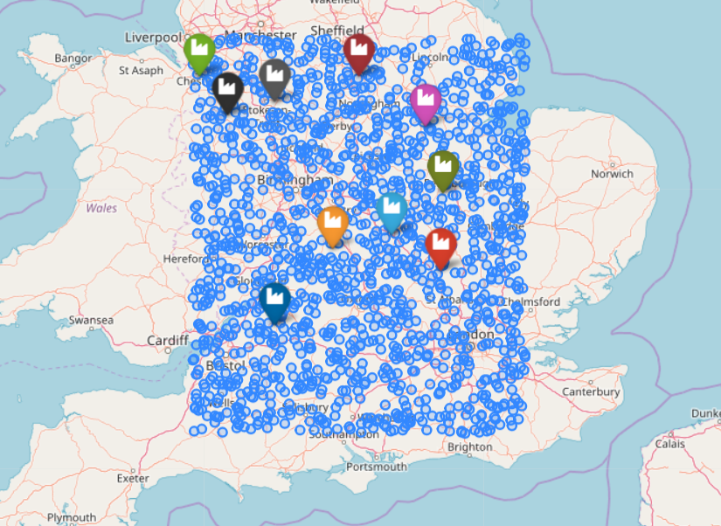
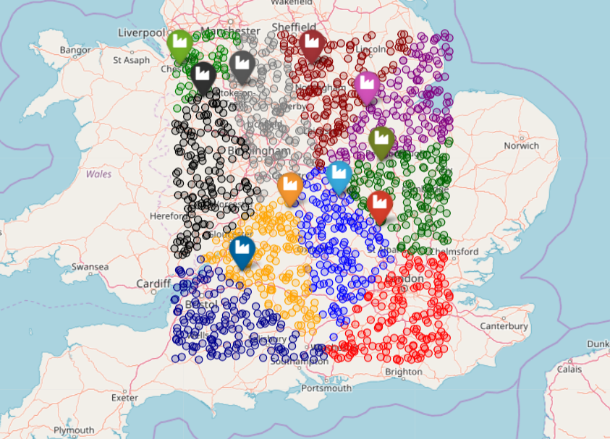
Today’s case study
Assign stores to depots

Slide 8


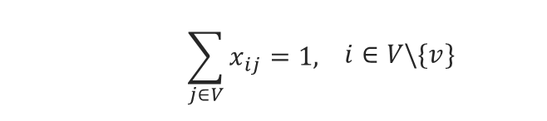


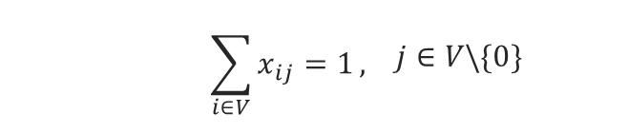
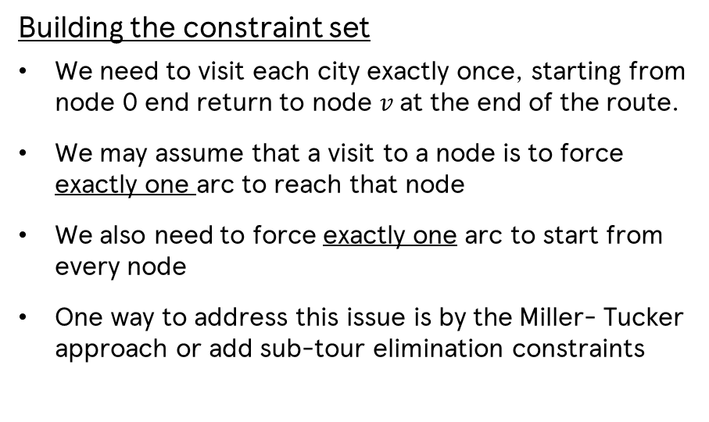

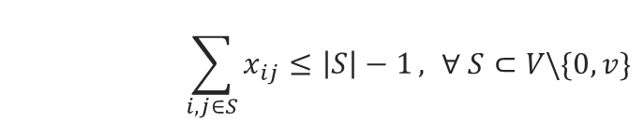

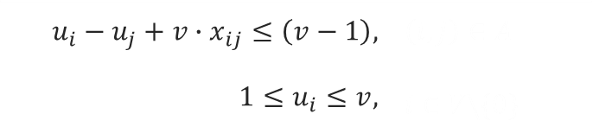
Solving the travelling salesman problem by a MILP – The objective function is a thief
Building the constraint set
We need to visit each city exactly once, starting from node 0 end return to node $v$ at the end of the route.
We may assume that a visit to a node is to force exactly one arc to reach that node
We also need to force exactly one arc to start from every node
One way to address this issue is by the Miller- Tucker approach or add sub-tour elimination constraints
$$min\sum_{\left(i,j\right)∈ A}{d_{ij}x_{ij}}$$
$$x_{ij}∈\left\{0,1\right\},$$ | $\left(i,j\right)∈A$
$$\sum_{i∈V}{x_{ij}=1},$$ | $$j∈V\backslash \{0\}$$
$$\sum_{j∈V}{x_{ij}}=1,$$ | $$i∈V\backslash \{v\}$$
$$u_{i}−u_{j}+v∙x_{ij}≤\left(v−1\right),$$ | $$\left(i,j\right)∈A$$
$$1≤u_{i}≤v,$$ | $$i∈V\backslash \{0\}$$
Miller-Tucker
$$1$$
$$d_{01}$$
$$\sum_{i,j∈S}{x_{ij}≤\left|S\right|−1},$$ | $$∀ S⊂V\backslash \{0,v\}$$
Sub-tour elimination
$$2$$
0
$$v$$

Slide 10












s1
$$c_{s1,d1}$$
$$c_{s1,d2}$$
d1
$$c_{s1,d3}$$
$$c_{s2,d1}$$
s2
$$c_{s2,d2}$$
$$c_{s2,d3}$$
d2
$$c_{s3,d1}$$
s3
$$c_{s3,d2}$$
$$c_{s3,d3}$$
$$c_{s4,d1}$$
d3
s4
$$c_{s4,d2}$$
$$c_{s4,d3}$$

Slide 11


s1
d1
$$c_{s1,d3}$$
i1
$$c_{s1,d4}$$
s2
d2
i2
d3
s3
s4
d4

Slide 12
s1
d1
$$c_{s1,d3}$$
i1
$$c_{s1,d4}$$
s2
d2
i2
d3
s3
s4
d4

