Slide 1
IMDb Movie Recommendations
A project to scrape and analyze movie storylines for recommendations.
Presented By
SAKTHI GANESAN

Slide 2

Introduction
Scraped IMDb (2024) movie names and storylines using Selenium.
Preprocessed storylines with NLP techniques like TF-IDF and CountVectorizer.
Calculated Cosine Similarity to find storyline-based movie similarities. Provided top 5 movie recommendations based on user-inputted storyline.
Built an interactive Streamlit web app for real-time recommendations.

Slide 3
Data Scraping
IMDb website scraped using Python Selenium with a WebDriver.
Extracted Movie Name and Storyline for each 2024 movie.
Stored extracted data in Python lists.
Converted lists into a Pandas DataFrame.
Saved the DataFrame as a CSV file for further analysis and modeling.

Slide 4
Collecting movie names and storylines
The objective is to extract movie names and associated storylines listed on IMDb for 2024.
The scraped data will be comprehensive, ensuring the collection of relevant information for further analysis.
Once obtained, the data will be structured and stored in a CSV file for efficient processing.

Slide 5
Data storage in CSV format
After scraping, the obtained movie names and storylines will be saved into a CSV file. This storage format facilitates easy manipulation and access to data for analysis.
CSV files are widely compatible with various data processing tools and libraries, ensuring that the data can be efficiently loaded and processed in subsequent steps.

Slide 6
NLP techniques for cleaning and tokenizing
Natural Language Processing (NLP) techniques will be utilized to clean the storylines by removing stop words, punctuation, and any irrelevant content.
Tokenization will break the text into individual words or phrases, making it easier to analyze the data.
This preprocessing is crucial for effective vectorization and subsequent analysis.

Slide 7
Vectorization methods: TF-IDF and Count Vectorizer
To convert text data into a numerical format suitable for analysis, two main vectorization methods will be used: TF-IDF (Term Frequency-Inverse Document Frequency) and Count Vectorizer.
TF-IDF helps in quantifying the importance of words within the storylines, while Count Vectorizer simply counts the occurrences of each word.
These methods transform textual data into matrices that can be used for further calculations.

Slide 8
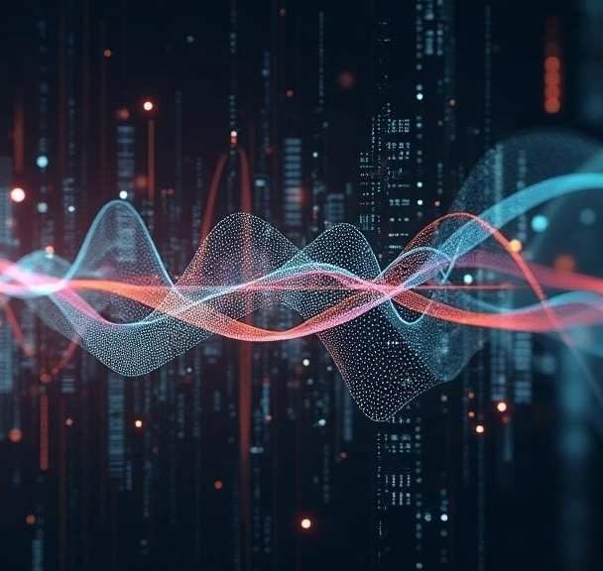
Calculating Cosine Similarity for recommendations
Cosine Similarity will be employed to measure the similarity between different movie storylines.
By calculating the cosine of the angle between the vector representations of each storyline, the project will determine how closely related different movies are based on their narratives.
This information can then be used to rank movies and provide personalized recommendations to users.

Slide 9

Conclusions
This project outlines a systematic approach to extract, process, and analyze movie data from IMDb using advanced techniques.
By utilizing Selenium for data scraping, followed by NLP for data processing and similarity calculations, the project aims to deliver a powerful movie recommendation system that enhances user experience and engagement.

Slide 10
Thank you!
CODE REVIEW

